Slide 1

Hampshire Assessment Model
November 2016
Session 5

Slide 2
Programme
8:45 | Welcome
9:00 | Revisiting the principles of mastery teaching and learning: what have we learned? | Eric Halton
9:40 | Exemplification in Mathematics | Jacqui Clifft
10:30 | Break | Opportunities to network
10:45 | Exemplification in English | Emma Scribbans
11:30 | Development of new materials to support HAM | Eric Halton
12:00 | Close

Slide 3
Some idea to help us think (differently)
Re-modelling of National curriculum predicated on “mastery” for all pupils (not all the same but all gain secure learning)
“Extension” (more things on the same topic) not “acceleration” (rapidly moving on to new content)
Secure fit not best fit
HAM is ONE model but hard thinking required to interpret in school and classroom context: variation inevitable
Implications of Life without Levels are philosophical, cultural and practical

Slide 4
Revisiting the principles of mastery teaching and learning: what have we learned?
Eric Halton, County Education Manager, Professional Learning

Slide 5
Uptake and influence?
Introductory conferences (Hants and IOW)
8 Primary HAM project groups: 200+ schools
Phase materials used by many more schools
Assessment networks
Standardisation meetings
Threaded through core subject meetings/networks and courses
Thematic action research groups
Tracking solutions
Governor training
Secondary Model in all subject areas
Impact on outcomes?

Slide 6
KS1 attainment
2015 RWM 2C+ | 2015 RWM 2B+ | 2016 RWM EXP
89.8% | 74.9% | 65.8% | No comparison with either previous or predicted expectations
2015 RWM 3+ | 2016 RWM GDS
15.2% | 9.4% | Little correlation
EXP | Reading | Writing | Mathematics | Science
Hampshire | 80% | 70% | 77% | 88%
National | 74% | 65% | 73% | 82%
Difference | +6 | +5 | +4 | +6
GDS | Reading | Writing | Mathematics
Hampshire | 29% | 14% | 18%
National | 24% | 14% | 18%
Difference | +5 | = | =
Notes:
Overall strong Hampshire performance at EXP and reading GDS
Combined EXP below previous 4B+ due to secure fit requirement.
Combined GDS lower than 5+ previously

Slide 7
KS2 attainment (provisional)
Expected | 2015 RWM 4C+ | 2015 RWM 4B+ | 2016 RWM EXP
National Hampshire | 80% 83% (+3) | 69 73 (+4) | 52% 57% (+5) | No comparison with either previous or predicted expectations
Deeper | 2015 RWM 5+ | 2016 RWM GDS
National Hampshire | 24 27 (+3) | 5% 7% (+2) | Little correlation
EXP | Reading | Writing | Mathematics | GPS
Hampshire | 71% | 78% | 71% | 74% (23% GDS)
National | 66% | 73% | 70% | 72% (22% GDS)
Difference | +5 | +5 | +1 | +2 +1
GDS | Reading | Writing | Mathematics
Hampshire | 23% | 20% | 17%
National | 19% | 14% | 17%
Difference | +4 | +6 | =
Notes:
Overall strong Hampshire performance at EXP and reading/writing GDS (But something uncomfortable about celebrating an achievement where 43% left KS2 with “failed”?)
Combined EXP below previous 2B+ due to secure fit requirement.
Combined GDS lower than L3+ previously
Maths in line/above but lower than reading: sufficient curriculum time for maths compared to English?

Slide 8
Impact of assessment work?
Ofsted- very positive reviews in inspections, especially when “owned” by leaders and teachers
KS2 Statistical neighbours…
  RWM 1/11 (59% vs group average 50%)
  R 1/11 (71% vs 66%)
  W 1/11 (78% vs 69%)
  Ma 3/11 (71% vs 68%)
A correlation rather than causation:
  Up to three meetings: 2.4% above national average
  Four to six: 3.4%
  Seven plus: 6.6%
However, spread of performance is much wider
Notes:
Three strands to developing assessment understanding that impacts on standards:
Knowing all the curriculum standards to ensure that pitch is heading in right direction (e.g. Y2/Y6 standardisation meetings and HAM sessions)
Understanding the detail of specific statutory requirements (Assessment networks)
Responding to 1 and 2 with development of assessment, curriculum and teaching pedagogy (HAM sessions)
Highest performance reported in schools where there was involvement in all three aspects
Except where
A small number of schools already had effective responses in place
Attendance at courses was not reflected in changes to practices back in school at all levels
There was insufficient curriculum time for higher standards to be realised by pupils (THIS year but not future years?)

Slide 9
Mastery and the link to tests
What stops a pupil from achieving ARE in a test or moderated teacher assessment?
  Not sufficiently fluent?
  Not sufficiently independent?
  Not sufficiently resourceful and resilient?
  ….in all the subject curriculum as experienced by each child
Task design is key – children that were capable of demonstrating the skill required, had not been able to because the classroom tasks they had been undertaking did not require them to.
Implication about changes to the role of a teacher as the year progresses
  Instructor
  Coach
  Facilitator?

Slide 10
Ten Hampshire Assessment Model principles to challenge & refine
Equity & Enrichment
Mastery Matters
A.C.T. Together
Formative First
Responsive Teaching
Secure Learning Pathways
Agile Feedback
Summative Tracking
Pace not Race
Moderated Expectations
Notes:
7 mins
Mastery learning’ is a specific approach in which learning is broken down into discrete units and presented in logical order.
After undertaking these corrective activities (or alternative enrichment or extension activities for those who have already achieved mastery), pupils retake a parallel assessment.
The new national Curriculum is premised on this idea of mastery..
Deep, secure learning for all
Extension of “able” students (more things on the same topic) rather than acceleration (rapidly moving on to new content)

Slide 11
Guiding principles of an assessment model
Uses assessment to focus teachers on the content which must be secured before moving on
Content is introduced in an order which, once secured, supports achievement of the more challenging expectations of the national curriculum
Promotes a ‘recursive curriculum’ approach, enabling objectives to be returned to thus securing and deepening children’s understanding
Opportunities to develop links across subject domains are built into the content progression

Slide 12
Mastery learning
The curriculum expects that children will deepen their grasp of key ideas, over time, rather than move on and leave gaps behind. Progress is neither linear nor skinny
Through being well taught and given curriculum opportunities they will develop and demonstrate their resourcefulness and versatility, (in an age appropriate way)
This does not mean that all pupils achieve the same degree of mastery… but it is at least sufficient, so that they can make successful progress through the fundamental ideas. No one left behind

Slide 13
Mastery Learning for “all” over a year…
This will be evident in pupils’ capacity to apply their knowledge, skills and understanding with (sufficient):
  Fluency over time
  Independence
  Resilience to deal with complexity and new contexts
What might this
mean in different subjects?
Notes:
2 min

Slide 14
Leaners are dependent
Teacher instructs
Leaners are responsible
Teacher guides
Level of Support
Learners are resourceful
Teacher facilitates
Precise learning objectives are used to ensure focus is clear
Learners are creative
Teacher consults
Academic year
‘A MODEL’ – The journey to Mastering EOY expectations
Building independence and resilience, by removing the scaffolding over time
Apprentice
Competent
Expert

Slide 15

Implications for…?
What questions does this raise?

Slide 16
Hampshire Assessment Model
Exemplification to Support Standardisation
Notes:
1 hour
Share exemplification and carry out standardisation milestone 1.

Slide 17
‘A MODEL’ – The journey to Mastering EOY expectations
Building independence and resilience, by removing the scaffolding over time
Level of Support
Precise learning objectives are used to ensure focus is clear
Time
Apprentice
Competent
Expert
EOY Mastery

Slide 18
Apprentice- Fundamental ideas that build on previous year’s work
Competent- builds on ideas initially developed at the Apprentice stage
Expert- builds on Competence and achieves sufficient mastery for next year’s work
Fluency over time?
Independence?
Resilience to deal with complexity and new contexts?

Slide 19
Mathematics NC Aims
The national curriculum for mathematics aims to ensure that all pupils:
become fluent in the fundamentals of mathematics, including through varied and frequent practice with increasingly complex problems over time, so that pupils develop conceptual understanding and the ability to recall and apply knowledge rapidly and accurately.
reason mathematically by following a line of enquiry, conjecturing relationships and generalisations, and developing an argument, justification or proof using mathematical language
can solve problems by applying their mathematics to a variety of routine and non-routine problems with increasing sophistication, including breaking down problems into a series of simpler steps and persevering in seeking solutions.

Slide 20
How can we support children in becoming fluent?
As with much of mathematics, the key to fluency is in making connections, and making them at the right time in a child’s learning.
Manipulatives
concrete to the abstract including structured apparatus such as Dienes can be helpful for learning about meaning
isn’t in the manipulatives themselves – it has to be constructed by children over a period of time,
through playing around with them and connecting them directly to mental and recorded calculation.
Talking about their work
the quality of the talk is important - not simply children sharing how they did a particular calculation,
describing why and how it worked, and how their method is the same or different to those of others.
gives children opportunities to use those higher-level skills of comparing, explaining and justifying. Russell says
  ‘The reason that one problem can be solved in multiple ways is that mathematics does not consist of isolated rules, but connected ideas. Being able to solve a problem in more than one way, therefore, reveals the ability and the predilection to make connections between and among mathematical areas and topics'.
Consolidation in meaningful contexts
By offering children practice in context we help them to make links between the types of situations that a particular strategy might suit.
Russell calls this mathematical memory, which is different from just memorising. She says that important mathematical procedures cannot be "forgotten over the summer" because they are based in a web of connected ideas about fundamental mathematical relationships.
References: Dowker, A (1992); Heibert, J (1999); National Council of Teachers of Mathematics (2000); Russell, Susan Jo. (2000)
Notes:
Manipulatives
We learn by moving from the concrete to the abstract and structured apparatus such as Dienes can be helpful for learning about place value or number bonds. However the meaning isn’t in the manipulatives themselves – it has to be constructed by children over a period of time, through playing around with them and connecting them directly to mental and recorded calculation.
Talking about their work
the quality of the talk is important. It is not simply children sharing how they did a particular calculation, but describing why and how it worked, and how their method is the same or different to those of others. In other words, giving children opportunities to use those higher-level skills of comparing, explaining and justifying. Russell says
‘The reason that one problem can be solved in multiple ways is that mathematics does not consist of isolated rules, but connected ideas. Being able to solve a problem in more than one way, therefore, reveals the ability and the predilection to make connections between and among mathematical areas and topics'.
Consolidation in meaningful contexts
By offering children practice in context we help them to make links between the types of situations that a particular strategy might suit. Russell calls this mathematical memory, which is different from just memorising. She says that important mathematical procedures cannot be "forgotten over the summer" because they are based in a web of connected ideas about fundamental mathematical relationships.
References
Dowker, A. (1992). Computational strategies of professional mathematicians. Journal for Research in Mathematics Education, 23 (1), 45-55.
Hiebert, J. (1999). Relationships between research and the NCTM Standards.Journal for Research in Mathematics Education, 30 (1), 3-19.
National Council of Teachers of Mathematics. (2000). Principles and Standards for School Mathematics. Reston, VA: NCTM.
Russell, Susan Jo. (May, 2000). Developing Computational Fluency with Whole Numbers in the Elementary Grades. In Ferrucci, Beverly J. and Heid, M. Kathleen (eds). Millenium Focus Issue: Perspectives on Principles and Standards. The New England Math Journal. Volume XXXII, Number 2. Keene, NH: Association of Teachers of Mathematics in New England. Pages 40-54.

Slide 21
Reasoning
… is about asking how or why an answer is correct and not focusing on just getting the answer right.
More reasoning can be brought into maths lessons through problem solving.

Slide 22
Problem solving
Real problem solving comes about when the learner is initially stumped and then has to think deeply about what to do.
2 different ways of thinking about problem solving in maths:
1)Teaching for problem solving and
2)Teaching through problem solving

Slide 23
Teaching for problem solving
… this is the most common approach in classrooms as treated as the application of ideas.
Eg: pupils taught addition and subtraction and then given problems that require addition and subtraction.
Therefore, problem solving becomes exercises that practice what has been taught.

Slide 24
Teaching through problem solving …
… assumes that mathematics is a problem solving discipline that helps us understand maths and that children come to school already as skilled problem solvers.
… helps to enable the learners to engage with new mathematical ideas and allow maths learning to come about through refining learners informal solutions.
Problem solving tasks allow learners to learn more about maths and the nature of maths (eg: looking at patterns, seeking generalisations) as well as helping learners to master a concept.

Slide 25
End of phase 1
Which pupils have begun the journey in the chronologically appropriate curriculum and have sufficient conceptual and procedural understanding after approximately 40 lessons?
Some domains will have rightly had more lesson time
End of year statements used to support planning- pupils have all year to develop fluency with the concepts and skills.

Slide 26
Structure of the national curriculum
Key stage 1: year 1 and year 2
Lower key stage 2: year 3 and year 4
Upper key stage 2: year 5 and year 6
3x 6 term journeys…

Slide 27
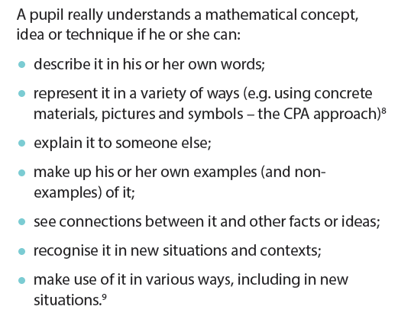
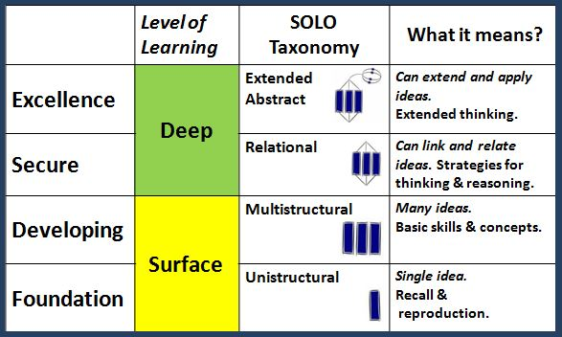
NCETM Teaching for Mastery…
‘Apprentice’ level for November…

Slide 28
APPRENTICE mathematician (November)
Relies heavily on the teachers’ modelling to solve calculations and problems tending to repeat exactly what the teacher/ adult has said to describe process used
Works ‘mentally’ or with pencil and paper recording as directed by the teacher
Uses concrete resources and models and images as shown by the teacher or adult. May still be building understanding of the connections between concrete modelling and informal/ formal recording
Uses success criteria as a checklist
Relies upon adult guidance and reminders when ‘stuck’ particularly when remembering meanings of technical vocabulary or language
Unlikely to suggest ‘what if…’ variations. Needs peer or adult discussion to support ‘intelligent practice’
Some solutions are based on counting in 1s rather than making using appropriate use of number bonds (10, 100, 1000, 1) or other known facts
Makes choices based heavily on previous successes
Draft Oct 2015
Notes:
Based on the Dreyfus model A Five-Stage Model of the Mental Activities Involved in Directed Skill Acquisition’

Slide 29
Apprentice + COMPETENT mathematician (February)
Can anticipate and independently suggest an appropriate mathematical model which has been used in previous work so far in the year when solving a problem or a calculation.
Can make some suggestions for success criteria to clarify their thinking
Beginning to independently explain their reasoning with peers and adults using some new vocabulary accurately
Developing resilience to ‘being stuck’ by using more than one approach independently before asking for adult help
Can accurately identify and record the number sentence involved when working mentally using a missing box to show the unidentified part.
Able to draw on more than one different representation of the same concept, skill or solution to a routine problem including using concrete resources, models and images and informal recording based on these models
Beginning to notice, talk about, demonstrate and use inverse relationships in calculation
Some use of known facts and related facts made to check reasonableness of answer and or to identify a calculation that could be solved easily mentally
Draft Oct 2015
Notes:
Based on the Dreyfus model A Five-Stage Model of the Mental Activities Involved in Directed Skill Acquisition’

Slide 30
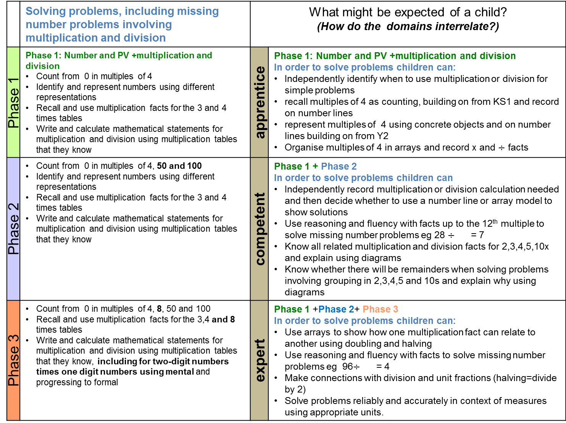
 | Solving problems, including missing number problems involving multiplication and division | What might be expected of a child? (How do the domains interrelate?)
Phase 1 | Phase 1: Number and PV +multiplication and division Count from 0 in multiples of 4 Identify and represent numbers using different representations Recall and use multiplication facts for the 3 and 4 times tables Write and calculate mathematical statements for multiplication and division using multiplication tables that they know | apprentice | Phase 1: Number and PV +multiplication and division In order to solve problems children can: Independently identify when to use multiplication or division for simple problems recall multiples of 4 as counting, building on from KS1 and record on number lines represent multiples of 4 using concrete objects and on number lines building on from Y2 Organise multiples of 4 in arrays and record x and $÷$ facts
Phase 2 | Count from 0 in multiples of 4, 50 and 100 Identify and represent numbers using different representations Recall and use multiplication facts for the 3 and 4 times tables Write and calculate mathematical statements for multiplication and division using multiplication tables that they know | competent | Phase 1 + Phase 2 In order to solve problems children can Independently record multiplication or division calculation needed and then decide whether to use a number line or array model to show solutions Use reasoning and fluency with facts up to the 12th multiple to solve missing number problems eg 28 $÷$ = 7 Know all related multiplication and division facts for 2,3,4,5,10x and explain using diagrams Know whether there will be remainders when solving problems involving grouping in 2,3,4,5 and 10s and explain why using diagrams
Phase 3 | Count from 0 in multiples of 4, 8, 50 and 100 Recall and use multiplication facts for the 3,4 and 8 times tables Write and calculate mathematical statements for multiplication and division using multiplication tables that they know, including for two-digit numbers times one digit numbers using mental and progressing to formal | expert | Phase 1 +Phase 2+ Phase 3 In order to solve problems children can: Use arrays to show how one multiplication fact can relate to another using doubling and halving Use reasoning and fluency with facts to solve missing number problems eg 96$÷$ = 4 Make connections with division and unit fractions (halving=divide by 2) Solve problems reliably and accurately in context of measures using appropriate units.
Notes:
Consider the journey for key aspects of maths e.g. place value, four operations through the year, fractions …

Slide 31
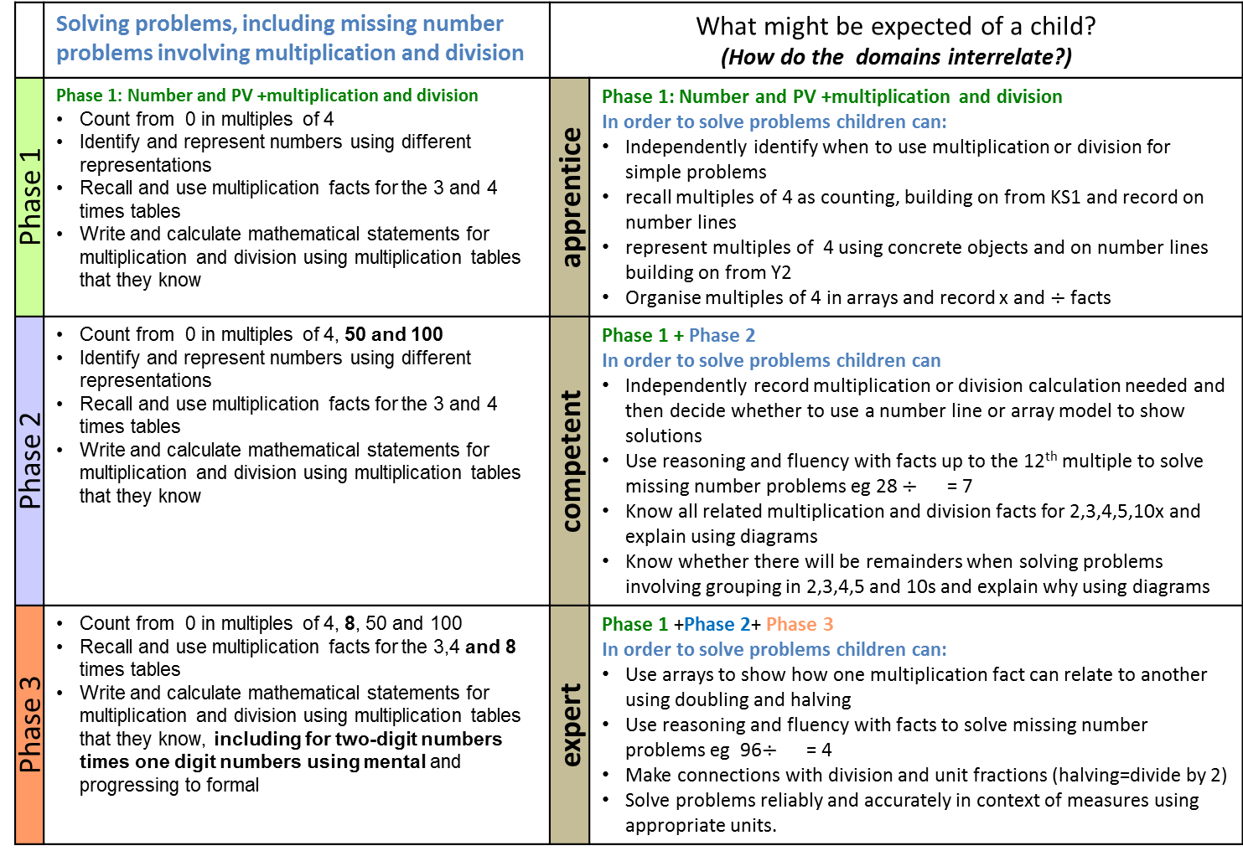
Year 3 Mathematics: Fluency, reasoning, problem solving
 | Solving problems, including missing number problems involving multiplication and division | What might be expected of a child? (How do the domains interrelate?)
Phase 1 | Phase 1: Number and PV +multiplication and division Count from 0 in multiples of 4 Identify and represent numbers using different representations Recall and use multiplication facts for the 3 and 4 times tables Write and calculate mathematical statements for multiplication and division using multiplication tables that they know | apprentice | Phase 1: Number and PV +multiplication and division In order to solve problems children can: Independently identify when to use multiplication or division for simple problems recall multiples of 4 as counting, building on from KS1 and record on number lines represent multiples of 4 using concrete objects and on number lines building on from Y2 Organise multiples of 4 in arrays and record x and $÷$ facts
Phase 2 | Count from 0 in multiples of 4, 50 and 100 Identify and represent numbers using different representations Recall and use multiplication facts for the 3 and 4 times tables Write and calculate mathematical statements for multiplication and division using multiplication tables that they know | competent | Phase 1 + Phase 2 In order to solve problems children can Independently record multiplication or division calculation needed and then decide whether to use a number line or array model to show solutions Use reasoning and fluency with facts up to the 12th multiple to solve missing number problems eg 28 $÷$ = 7 Know all related multiplication and division facts for 2,3,4,5,10x and explain using diagrams Know whether there will be remainders when solving problems involving grouping in 2,3,4,5 and 10s and explain why using diagrams
Phase 3 | Count from 0 in multiples of 4, 8, 50 and 100 Recall and use multiplication facts for the 3,4 and 8 times tables Write and calculate mathematical statements for multiplication and division using multiplication tables that they know, including for two-digit numbers times one digit numbers using mental and progressing to formal | expert | Phase 1 +Phase 2+ Phase 3 In order to solve problems children can: Use arrays to show how one multiplication fact can relate to another using doubling and halving Use reasoning and fluency with facts to solve missing number problems eg 96$÷$ = 4 Make connections with division and unit fractions (halving=divide by 2) Solve problems reliably and accurately in context of measures using appropriate units.
`
`
`
`
`
`
Notes:
Needs apprentice, competent, expert labels…

Slide 32
Over a sequence of lessons:
Is there sufficient problem solving at an appropriate pitch?
Does the range of recording support both conceptual and procedural understanding?
Might see longer sequences of lessons around key concepts e.g. NPV etc. using multiple representations and rich and varied recording/ presentation
Is there sufficient depth of challenge through a range of linked tasks: routine for new learning and some non-routine problem solving for more secure aspects to deepen understanding and reasoning

Slide 33
Over a sequence of lessons:
Are there opportunities for pupils to review their solutions using appropriate vocabulary and language?
Are there adult annotations which illuminate pupils’ reasoning/ strategies
Is there a good range of pupil recording in their books? i.e. work on whiteboards not lost and not available as important assessment information

Slide 34
MATHS exemplification
Year 1, 3, 4, 5

Slide 35
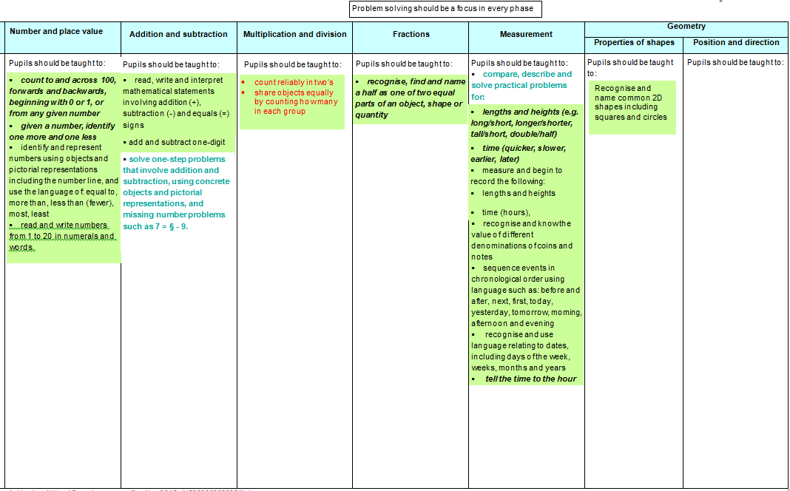
Year 1 Phase 1
YR transition information needs shared discussion relating to year 1 curriculum
Fluency: counting to 20+
Fluency: Count reliably with numbers from one to 20, place them in order and say which number is one more or one less than a given number. ( familiarity with concrete structured resources?)
Fluency: Using quantities and objects, they add and subtract two single-digit numbers and count on or back to find the answer.
Fluency: They solve problems, including doubling, halving and sharing.

Slide 36
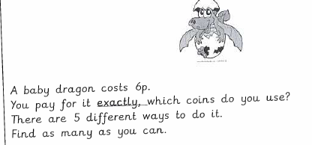
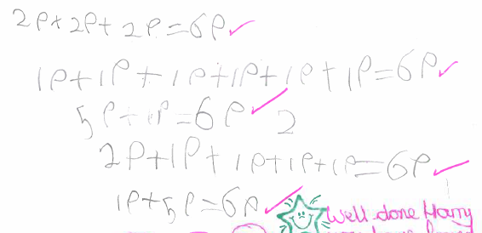
Year 1
Read, write and interpret mathematical statements involving addition (+), subtraction (-) and equals (=) signs
Recognise and know the value of different denominations of coins and notes
Notes:
Making links across the topics/domains

Slide 37
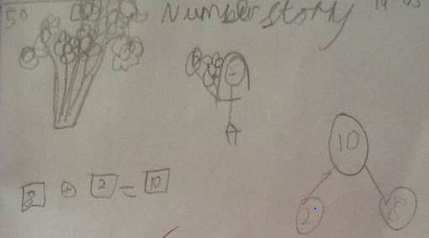
read, write and interpret mathematical statements involving addition (+), subtraction (-) and equals (=) signs
add and subtract one digit
Notes:
Range of recording to show partition of 10 as 8 and 2

Slide 38
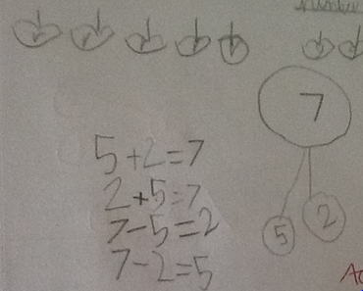
read, write and interpret mathematical statements involving addition (+), subtraction (-) and equals (=) signs
add and subtract one digit
Notes:
Facts and related facts

Slide 39
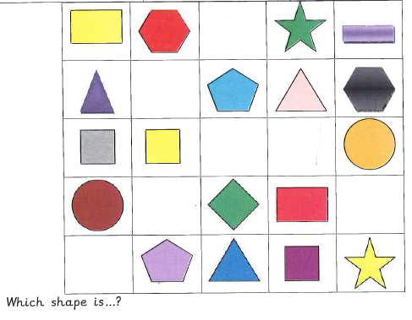
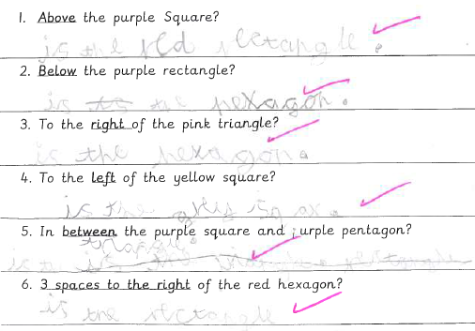
Recognise and name common 2-D shapes including squares and circles
Language of position:
from non-statutory
notes and guidance
Notes:
Note - the non-statutory notes and guidance in the National Curriculum can be useful unpack what is being asked of the pupils

Slide 40
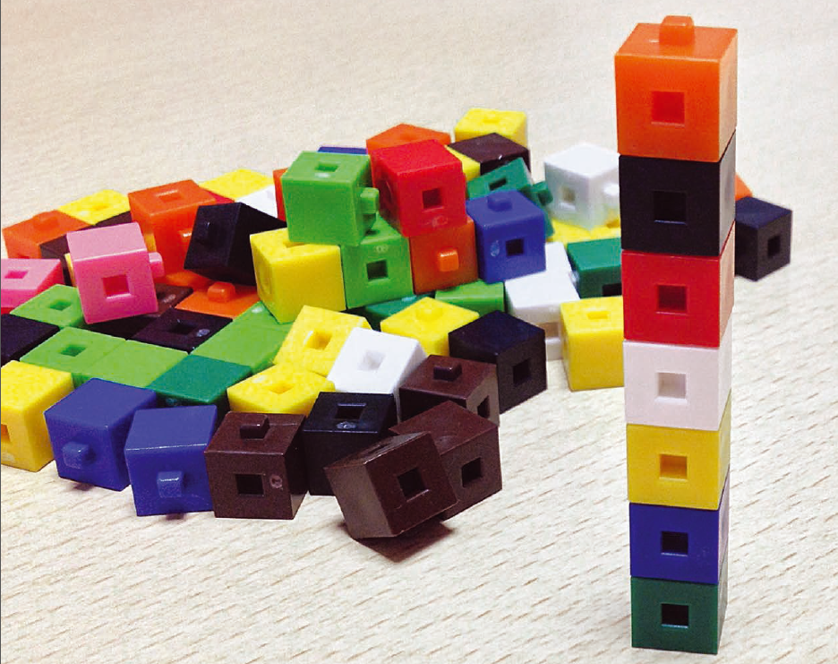
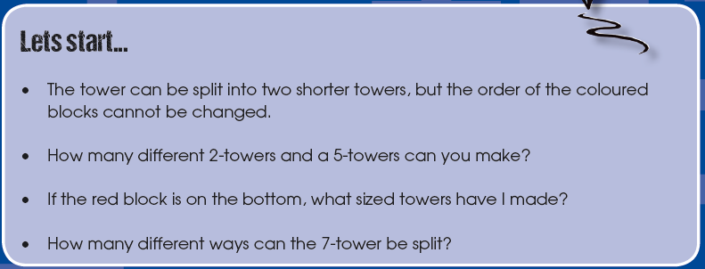

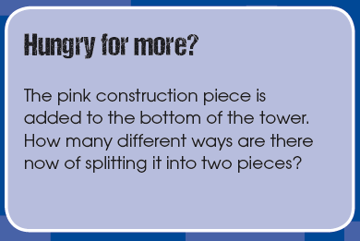
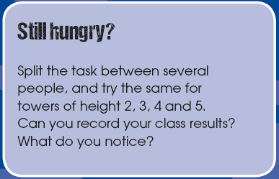
By end of phase 2
Real World Maths TTS

Slide 41
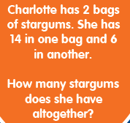

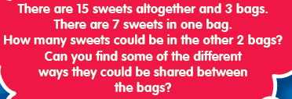
By end of phase 2
Dip and Pick Problem Solving Year 1, TTS

Slide 42











End of KS1: SATs Arithmetic Paper 2016
Q: 1,2,3,4,5, 6, 7, 8,9,10,11,13, 15,16,19,23

Slide 43
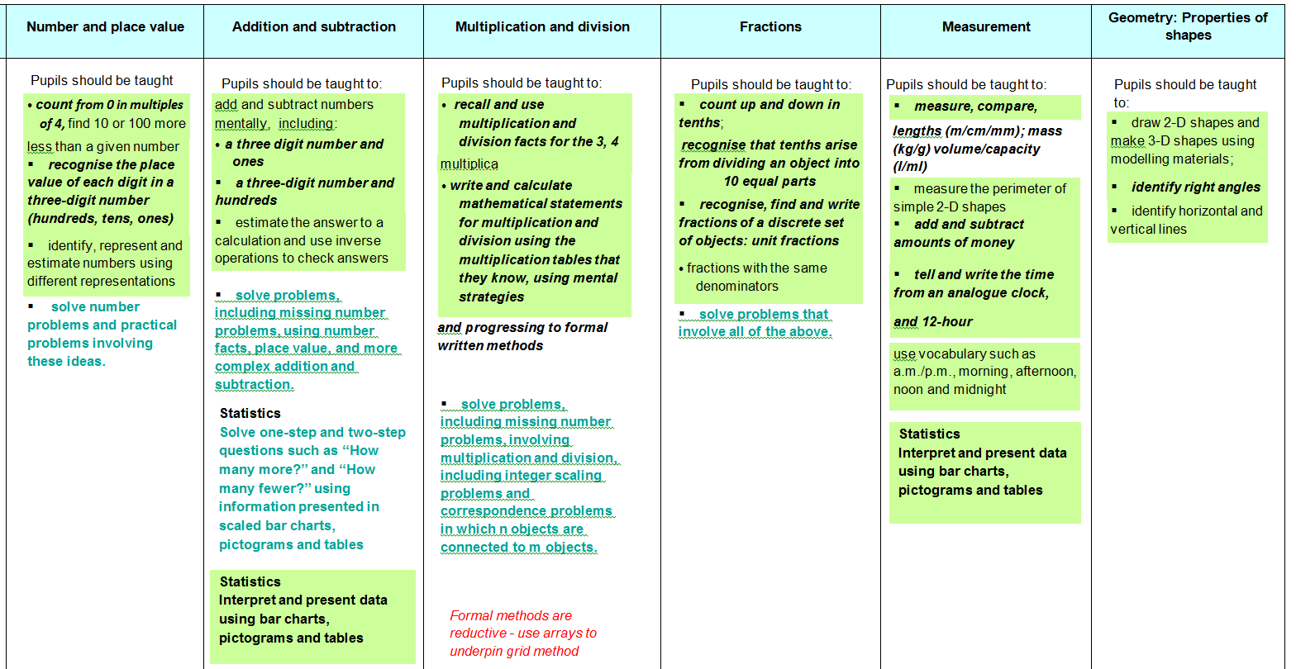
Year 3: Phase 1
Securing transition from end of key stage 1 (0-100) and beginning work on 0-1000
Fluency: Representing two digit numbers with a range of resources, showing & explaining +/- 10(s) from two digit numbers
Fluency: Number bonds to all numbers to 10 and 20
Fluency: Add/subtract 2 digits (mentally and recording), using inverse and commutativity in calculation (money and measures)
Fluency: multiples of 2,5,10 to also support division
Fluency: Half, quarter and three quarters of numbers and shapes
Fluency: in use of models such as number lines, arrays and bar models as tools for thinking

Slide 44
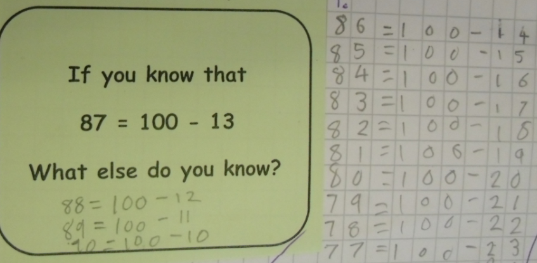
Year 3
solve problems, including missing number problems, using number facts, place value, and more complex addition and subtraction

Slide 45
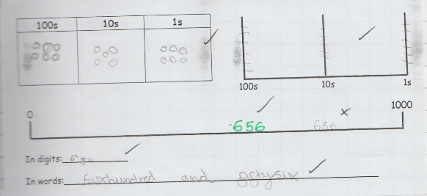
recognise the place value of each digit in a three-digit number (hundreds, tens, ones)
identify, represent and estimate numbers using different representations

Slide 46
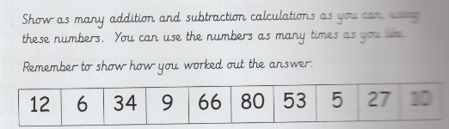
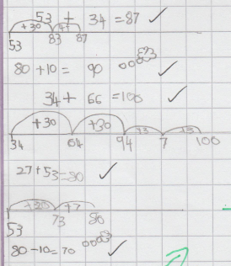
add and subtract numbers mentally
Notes:
Number lines support mental calculations
Although not seen in some of the new text books, number lines are important as part of a multi representational approach and as a conceptual route into PV and calculation, ordering and rounding.

Slide 47
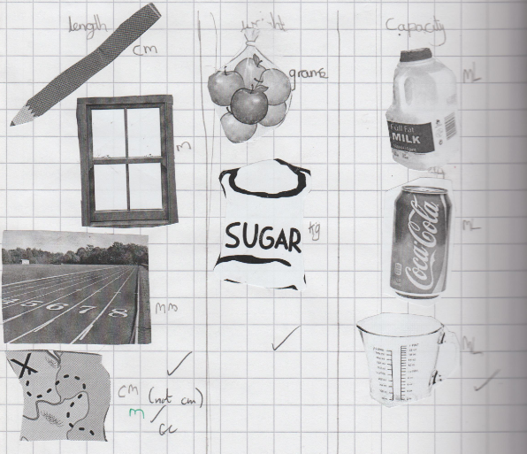
measure, compare, add and subtract: lengths (m/cm/mm); mass (kg/g); volume/capacity (l/ ml)
Notes:
Really getting a chance to be hands on with measures is important – children need concrete examples to ‘hang’ things on. Give a few egs.

Slide 48
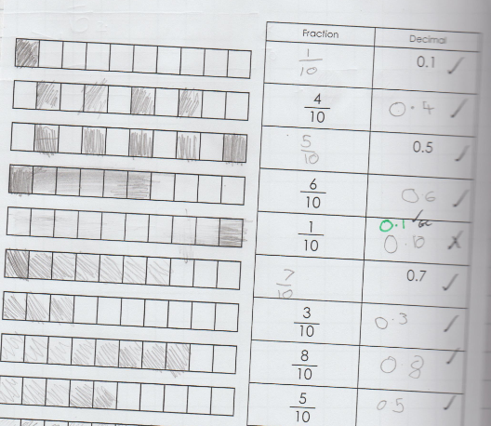
count up and down in tenths; recognise that tenths arise from dividing an object into 10 equal parts

Slide 49
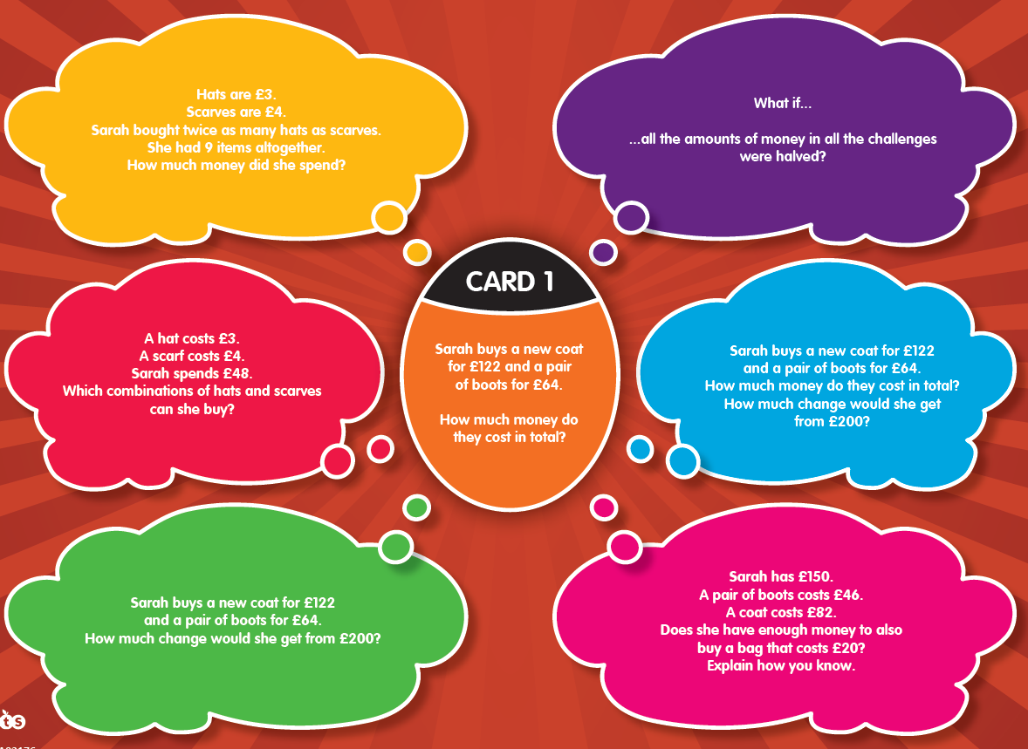
By end of phase 2
Dip and Pick problem solving TTS

Slide 50
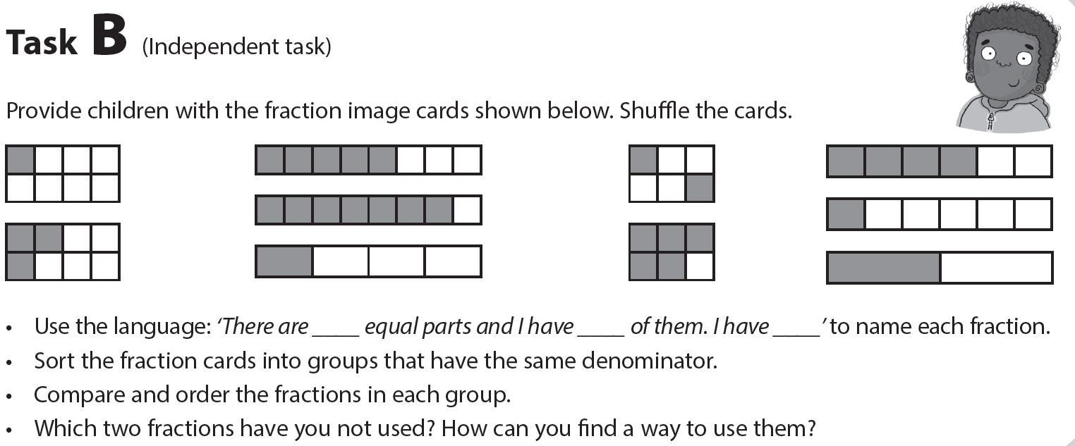
By end of phase 2

Slide 51
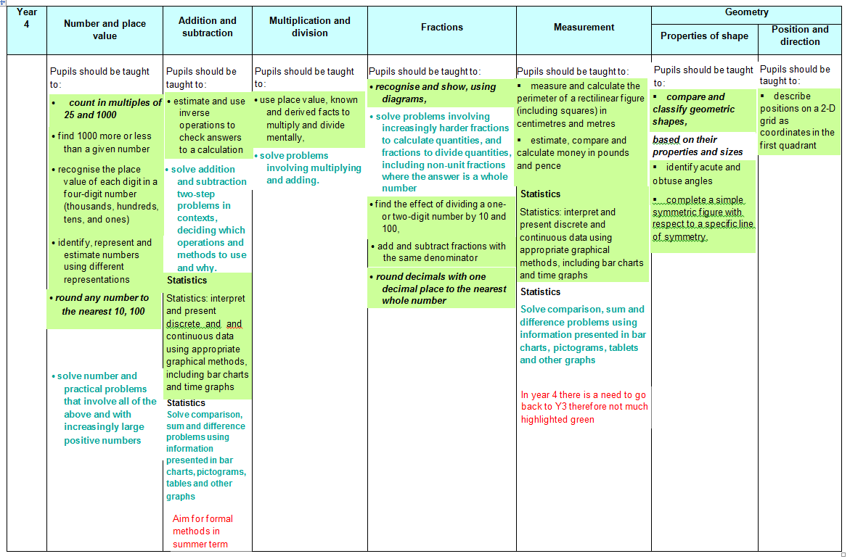
Year 4 phase 1
Y3 Fluency: Representing three digit numbers with a range of resources, showing & explaining +/- 1000/ 500/50(s) from three digit numbers
Y3 Fluency: Use of key facts like 640+360= 1000 , using inverse and commutativity in calculation (money and measures)
Y3 Fluency: multiples of 2,5,10,3,4,8 to also support division. Knowing how/ why multiples relate to each other eg x4 with x8
Y3 Fluency: Knowing all unit fractions when working with numbers and shapes, inc tenths as decimals (measures)
Y3 Fluency: in use of models such as infinite number lines, arrays ( towards grid method) and bar models (calculation/ problem solving as tools for thinking

Slide 52
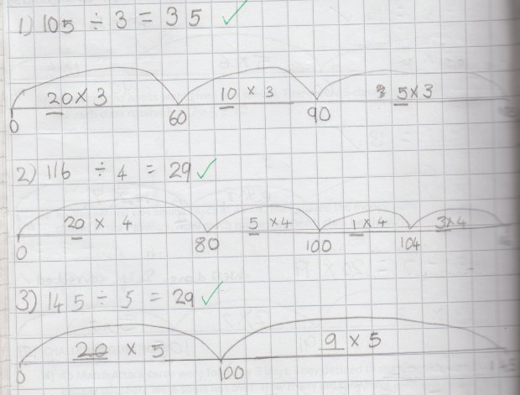
Year 4
use place value, known and derived facts to multiply and divide mentally
Notes:
Again use of number lines to support mental strategies.
Phase 1 assessment focuses on mental calculations. That’s not to say there wouldn’t be written calculations in the books too.

Slide 53
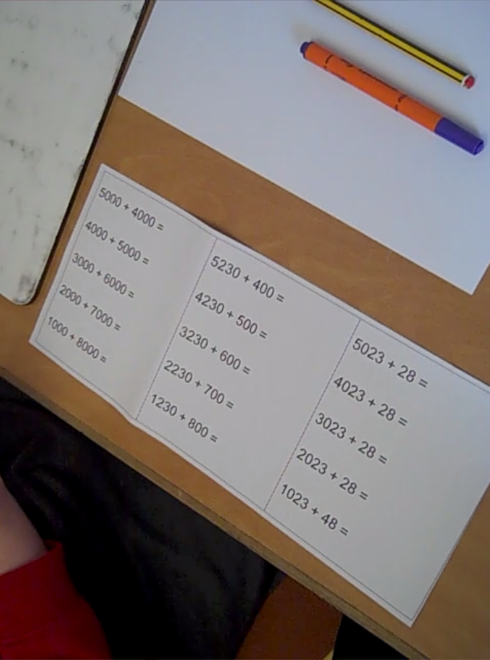
HTLC Leadership Moodle:
Assessment video clips Y1-Y6 phase 1
Y4 pupil conferencing to support teacher assessment…

Slide 54
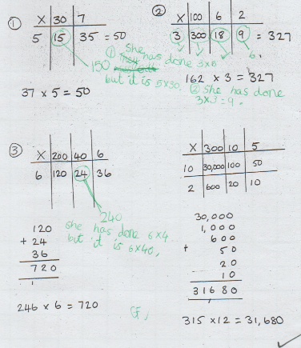
Use of error spotting for multiplication

Slide 55
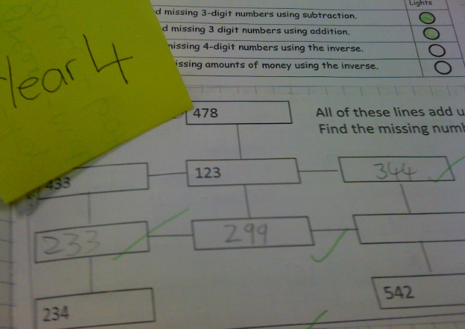
solve addition and subtraction two-step problems in contexts, deciding which operations and methods to use and why

Slide 56
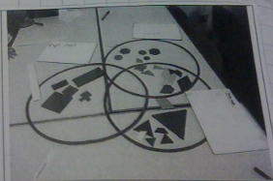
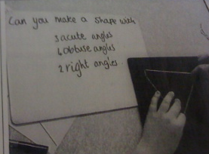
compare and classify geometric shapes, based on their properties and sizes identify acute and obtuse angles

Slide 57
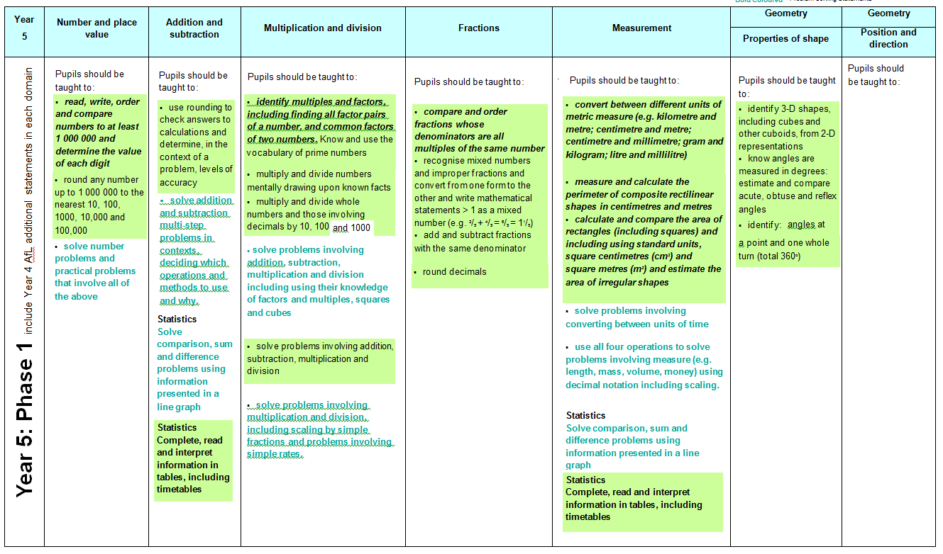
Year 5 phase 1

Slide 58
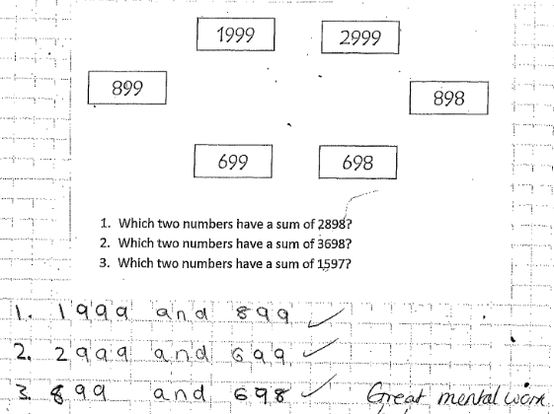
Year 5
use rounding to check answers to calculations
Notes:
Also non-statutory guidance: pupils identify the place value in large whole numbers

Slide 59
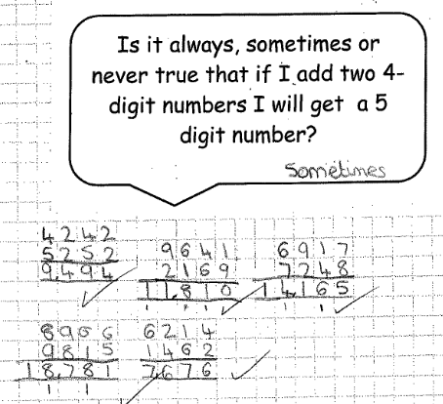
Notes:
Again the phase 1 assessment is mental strategies and language but we would expect to see written calculations too.
This is an investigation which brings in reasoning (how do we articulate reasoning?)

Slide 60
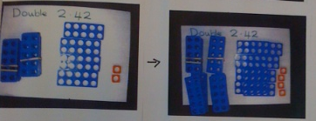
solve problems involving number up to three decimal places
Notes:
Resources are important in year 5 too.

Slide 61
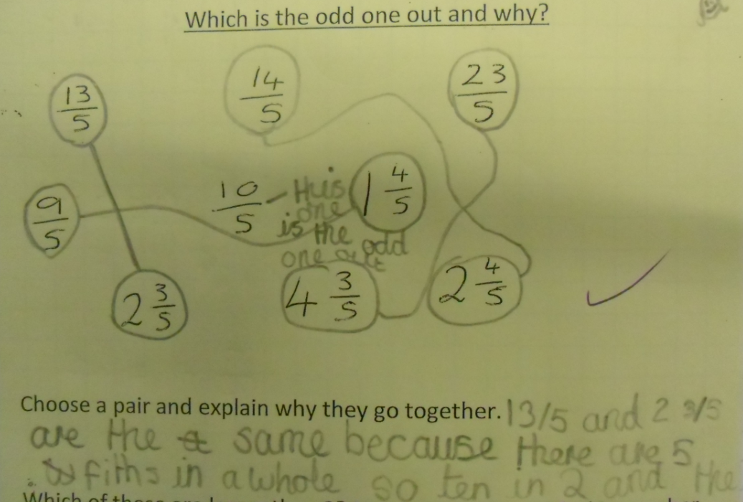
compare and order fractions whose denominators are all multiples
of the same number
recognise mixed numbers and improper fractions and convert from one
form to the other

Slide 62
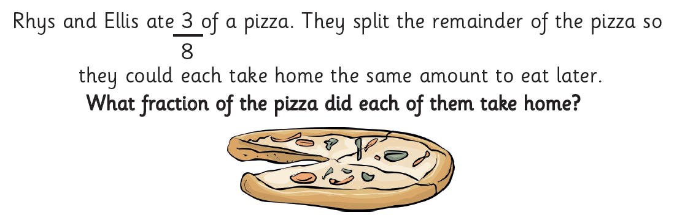
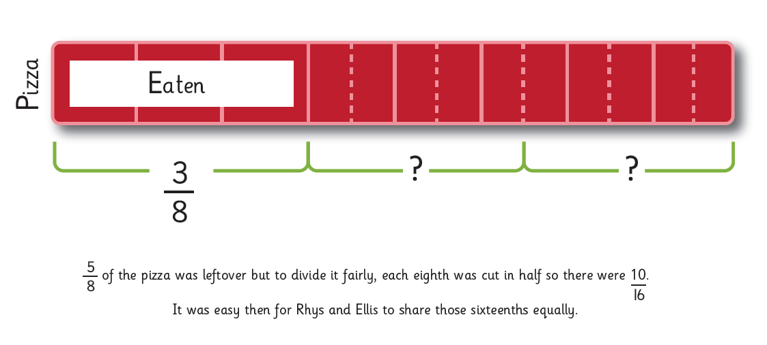
Y5 by the end of phase 2

Slide 63
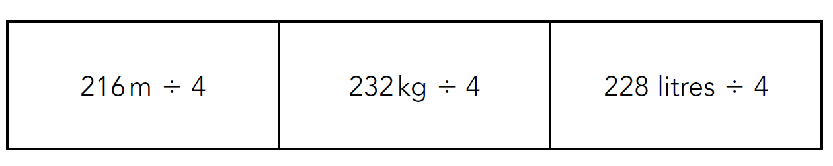
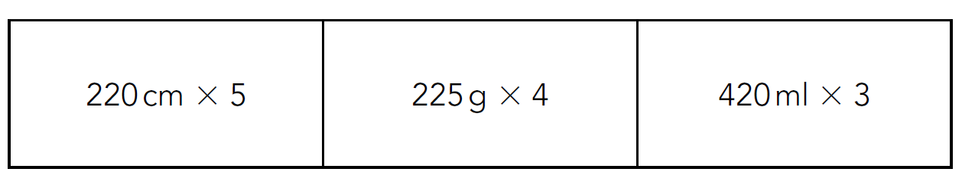
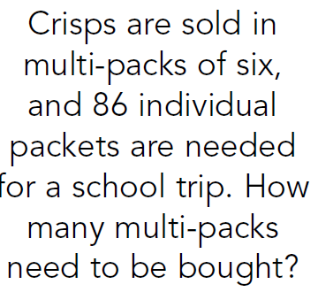
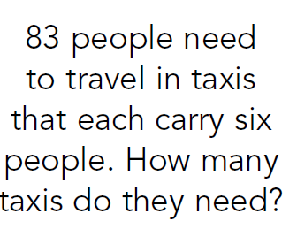
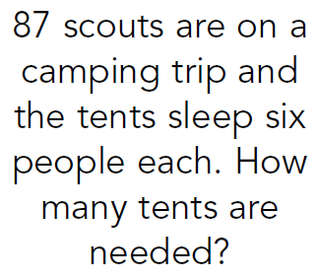
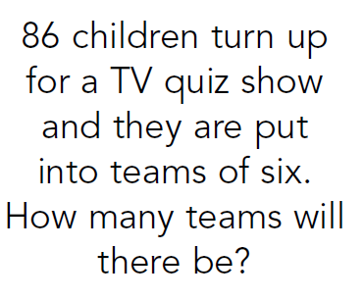
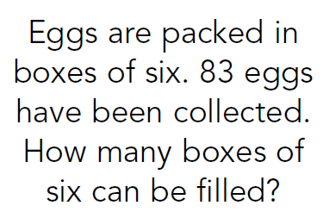
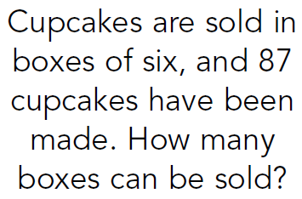
Y5 by end of phase 2
Suggest and record different calculation strategies including conversion of units, know related facts, suggest and write problems for these calculations
Notice links and connections between the same calculations. Explain why the solution may be different depending on the context

Slide 64















KS2 Arithmetic paper 2016:
Q:1, 2,3,4,5,6,7,8,9,10,11,12,13,14,15
More questions than minutes…
Notes:
Pink: Y3
Green: Y4
Blue: Y5

Slide 65
Questions for further CPD
Does the “on track” or “beyond” look like there is sufficient evidence of
Fluency
Reasoning
Problem solving
Mental strategies?
What do you notice about the not “on track” work?
Notes:
An ‘on track’ child is like tumble weed – gathering new skills and embedding the original (phase 1 ) objectives.
Maths conferencing/diagnostics with a child will unpick what they are struggling with – have they just forgotten or is it because their brick wall is not stable and they do not feel able to take risks and builds higher?

Slide 66
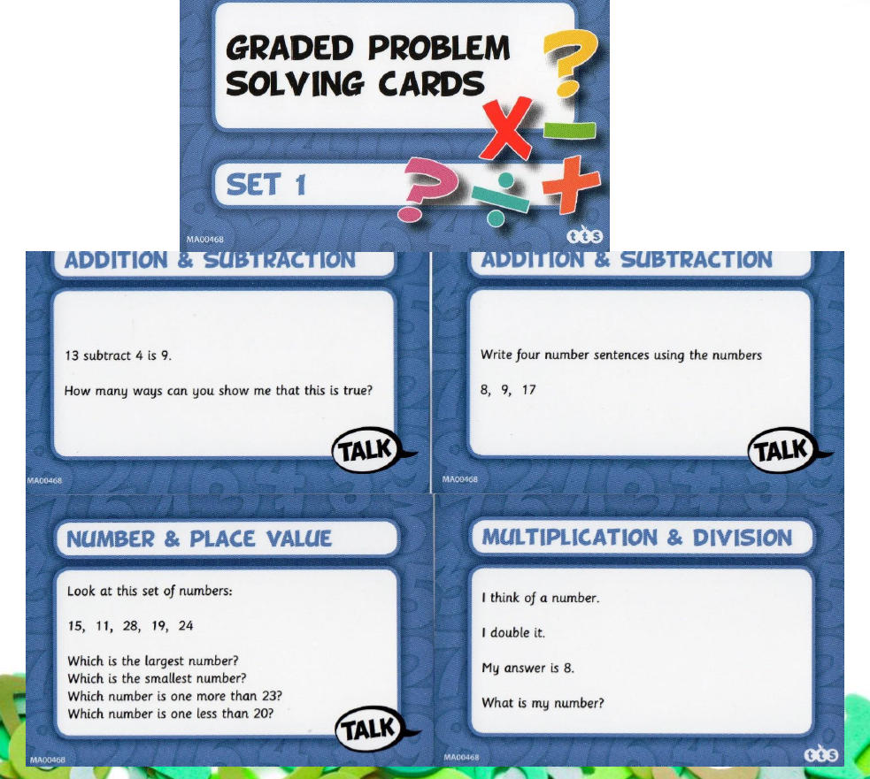
Problem Solving Resources
PNS: Challenges for More Able Pupils
Badger Maths: Problem Solving Bk1 and 2
Rising Stars:
Fluency with Fractions (Y1-Y6)
Assessment Tasks (Y1/2, Y3/4, Y5/6)
TTS ( all Y1-Y6 sets)
Graded Problem Solving Cards
Convince Me Cards ( Thinking Tom)
Bar Model Cards/ DVD
Real Life Maths Cards/DVD
Dip and Pick Problem Solving Cards/DVD

Slide 67
Break and refreshments

Slide 68
Hampshire Assessment Model
Exemplification to Support Standardisation
Notes:
1 hour
Share exemplification and carry out standardisation milestone 1.

Slide 69
‘A MODEL’ – The journey to Mastering EOY expectations
Building independence and resilience, by removing the scaffolding over time
Level of Support
Precise learning objectives are used to ensure focus is clear
Time
Apprentice
Competent
Expert
EOY Mastery
Notes:
Schools have greater confidence in their understanding of the model

Slide 70
Learning over the year is not linear – think of a curve …
Curriculum content
Time
Apprentice
Competent
Expert
EOY Mastery
Notes:
Schools have greater confidence in their understanding of the model

Slide 71
Objectives have to be “sufficiently” secured at each strategic assessment for a pupil to be “on track”.
To be “on track” at….. | Phase 1 statements |  | Phase 2 statements |  | Phase 3 statements
Milestone 1 (November) | Apprentice |  | Not yet introduced |  | Not yet introduced
Milestone 2 (February) | Competent | and | Apprentice |  | Not yet introduced
Milestone 3 (April) | Expert | and | Competent | and | Apprentice
End of Year Age Related Expectations | Expert | and | Expert | and | Competent/Expert
Notes:
Challenge is now to ensure there is ‘agreement’ as to what apprentice, competent and expert might look like in books at different Milestones

Slide 72
Challenges
Every school has its own curriculum: books and writing outcomes will not be the same.
Clarity around ‘what’ the materials exemplify
  Evidencing how / where pupils have applied skills at different phases with growing independence and accuracy
Notes:
We are not exemplifying writing tasks or the learning journey that led to outcomes
The materials identify where pupils have applied ‘apprentice skills’ at different milestones and reference those applied at ‘competent’ and ‘expert’ stages.

Slide 73
Writing exemplification
Year 1, 3, 4, 5

Slide 74
Evidence and Independence
Evidence
The writing was produced as part of normal classroom practice and drawn from the entire year (Sep – June).
Independence
The use of success criteria with children does not exclude the work from the evidence base where evidence is at an ‘apprentice’ level.
Notes:
Discussion of ideas in no way disqualifies the writing from the evidence base, in fact at KS1 the statements for the expected standard state ‘after discussion with the teacher’.
The key point about independence is that children are making their own choices about how to apply the things they have been
taught, the ideas discussed etc.

Slide 75
Handwriting and Spelling
Handwriting
References are made to handwriting. Once a child has met the expected standard these references are less frequent.
Spelling
Where a child has used a particular word / spelling pattern this may be noted. Not all evidence for spelling is apparent in the published materials but sufficient evidence was seen in books.
Notes:
The handwriting statements do apply if a child is to meet the ‘greater depth’ standard unless they have a physical disability that prevents them from being able to write. In that case handwriting can be excluded from the judgement completely.

Slide 76





Slide 77
Contents
How to use the HAM exemplification materials
Layers of proficiency
Exemplification summary
HAM overview
Exemplification of:
  Milestone 1 – Phase 1
  Milestone 2 – Phase 1 and Phase 2
  Milestone 3 – Phase 1, Phase 2 and Phase 3
  End of Year

Slide 78
How to use the HAM exemplification materials
The exemplification materials are annotated to help teachers interpret the phase statements outlined in the Hampshire Assessment Model (HAM) materials.
The collection comprises writing evidence from one pupil; drawn from a full range covering the entire academic year. Key pieces have been selected to exemplify specific phase statements at each Milestone.

Slide 79
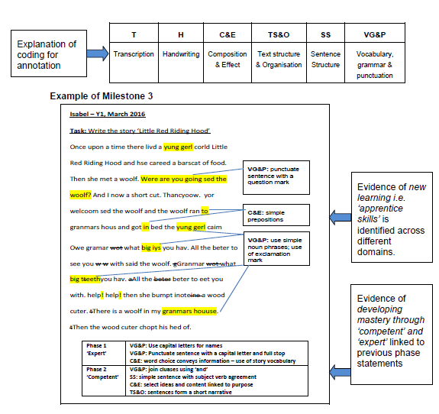
How the annotation is set out

Slide 80


Pupil work and annotations

Slide 81
Layers of proficiency
Apprentice
Has a working understanding, tends to see actions as a series of steps, can complete simpler tasks without supervision.
‘Applying with support’
Competent
Has a good working and background understanding, sees actions at least partly in context, able to complete work independently to a standard that is acceptable though it may lack refinement
‘Applying in independent work with some inconsistency in familiar contexts’
Expert
Has an authoritative, deep and holistic understanding, can achieve to a high standard routinely and deals with matters intuitively
‘Give reasons and make conscious and consistent decisions about the choices I make in unfamiliar contexts’

Slide 82
Exemplification Summary
Working at Age Related Expectations (ARE):
Year 1 – Isabel
This collection demonstrates the attainments and deepening of statements with the Hampshire Assessment Model for writing in Year 1. This pupil is working within the age related expectations.
The writing collection consists of narratives, description, letters, instructions and recounts. The pupil has written for a range of purposes and audiences throughout the year and has sufficient evidence of fiction and non-fiction writing. Key pieces have been selected to demonstrate the different assessment statements.
Correct spelling is not always applied with an over reliance at times of phonic strategies. Evidence for the transcription strand was often found in evidence outside of the collection
Notes:
Purpose to provide a pen portrait summary as to why this pupil is working at ARE
It also acknowledges that evidence for some aspects may be less evident in the collection –sufficiency has been seen – otherwise the child would not have been used!

Slide 83
Please take 5 minutes to familiarise yourself with the materials.

Slide 84

Milestone 1 moderation
Notes:
20 minutes?

Slide 85
Feedback is always welcome!

Slide 86
Questions for further CPD
Does the “on track” or “beyond” look like there is sufficient
  Depth
  Breadth
  Correction
  Enrichment
What do you notice about the not “on track” work?
Notes:
An ‘on track’ child is like tumble weed – gathering new skills and embedding the original (phase 1 ) objectives.
Writing conferencing with a child will unpick what they are struggling with – have they just forgotten or is it because their brick wall is not stable and they do not feel able to take risks and builds higher?

Slide 87
Our next step is reading…
Working with Subject Leaders through core provision to develop reading evidence 2016-17
  Record keeping
  Journals
  Video evidence
If you would like to be involved please let us know!

Slide 88
HAM Developments 2016/17

Slide 89

Revised HAM for Writing
Notes:
Handout Yr 3 writing page – 1 per school.

Slide 90

Revised HAM for Reading

Slide 91
Updates to summative tracking
Summative “Rules” changed in simple tracker and SIMS
  No below domains allowed in “close to” overall
  Close to separated in reports but included in secure+ overall, except EOY and Milestone 3 in Y2/Y6
  New combined report in “simple tracker”
New English objectives incorporated in SIMS, TT etc.
New reports in SIMS
Feedback to TT

Slide 92
Judging progress from data: increasing %On Track?
The leadership questions
The attainment tracking questions?
How does the data reflect the reality of pupils’ curriculum attainment? What does it mean? (Points/words/colours?)
How are you ensuring that this data is derived from :
  Reliable evidence?
  Consistent judgements?
  Accurate interpretations of ARE and milestones?
  Robust external moderation
What proportion of pupils are not on track to attain Age Related Expectations (ARE)?
What proportion of pupils are close to being on track to ARE?
What proportion of pupils are securely “on track” to attain ARE
What proportion of pupils are on track to attain beyond ARE?

Slide 93
Professional Objectives? By the end of the year/key stage…
Expected progress
“Keep up”
(Almost all of) the pupils who are at ARE, remain at ARE
(Almost all of) the pupils who are Beyond ARE, remain Beyond ARE
Pupils with SEN remain at ARE in areas unaffected by their needs and meet personalised objectives in their EHCP
More than expected progress
“Catch up”
(Almost all of) the pupils who are not at ARE, narrow the gap
A “significant” proportion of pupils who are not at ARE, reach ARE
Exceptional progress
“stretch”
A “significant” number of pupils who are securely at ARE, reach Beyond ARE

Slide 94
Accountability: challenging ambitions
What pupil progress is being expected (ambition) of teachers and leaders in performance management?
  Keep up Objectives?
  Catch up Objectives?
  Stretch Objectives?
Context is everything….. discuss

Slide 95
EYFS - HAM
‘The EYFS profile was due to become non-statutory from September 2016. The DfE has confirmed that the EYFS profile will remain statutory for the 2016 to 2017 and 2017 to 2018 academic years.’
2017 Assessment and Reporting Arrangements
October 2016

Slide 96
EYFS - HAM
Developed in response to the removal of the GLD measure in the Summer Term 2016 which was then re-introduced!
Developed by Simon Francis with support from members of the HAM team and representative EYFS leaders and Headteachers from schools
Follows the principles of the HAM and covers all of the areas of learning linked to GLD
Front cover gives an overview – as per reading, writing and mathematics

Slide 97

Five Areas of learning
Two or three domains in each area
Total fit tracking of domains in each area
Total fit of all areas in overall EYFS

Slide 98
EYFS - HAM
40-60 statements from Early Years Outcomes used extensively in phase 1
Early Learning Goals identified in bold text
Red text are additional statements added by the Early Years team
Phase 3 links with the Year 1 HAM in the same way as with other year groups
Based on the same ‘total fit model’ as HAM which is not the same as the current ‘windscreen’ of ‘expected’
Transition tool given that EYFS profile and GLD are staying?

Slide 99
Who is not on track? Why?
Children working below the age related expectations for that year group, there are two groups:
Group One – pupils who are below because they are catching up from lower starting points and should be expected to get there
Group Two – pupils with inhibiting SEND
Notes:
Group 1
Pupils who are below because they are catching up from lower starting points and should be expected to get there. These pupils may have delayed progress
Pupils who are under-attaining because of relative disadvantage (without SEN), or a low starting point on entry to school, who should reasonably be expected to “catch up”.
Pupils affected by teaching that has not been effective over time or where there are other short term, causal factors.
Group 2:
Pupils with inhibiting SEND that means that they will inevitably make slow progress, not just delayed progress.
For these pupils not only will they need to be working towards statements in earlier year groups, but the steps between the statements may well need unpacking into appropriate and personalised steps
They will not move through the typical statements at the same rate as other pupils.

Slide 100
SEND Tracker- Our working definition
Their learning difficulty or disability calls for special educational provision, namely provision different from or additional to that normally available to pupils of the same age (SEN Code of Practice)
Children with many domains that are below ARE e.g. a profile of ‘not attained/below’ across significant domains in the Hampshire Model
Children who will not have completed the relevant programme of study when they have reached the appropriate chronological age – (Rochford Review)
Notes:
The key to our working definition is, the group of children who you are going to keep a forensic, close and frequent check to ensure they are making better progress and who also have different and or additional provision
The definitions above come from the following sources:
Many domains below - HAM model (this group may, over time be expected to catch-up e.g. significant disadvantage that will need the whole of the primary time to ‘catch-up), we will look at a later stage to see if this trial supports these children.
Code of practice definition – is our main working definition
Rochford review statement: ‘many of these pupils have special educational needs… others may be working below the standards of the national curriculum tests for a range of reasons. They may be experiencing significant disadvantage or living in challenging circumstances or may be new arrivals to the county with undeveloped language skills

Slide 101
HAM – SEND tracker
E.g. not likely to catch up and reach Age Related Expectations by the end of the Key Stage.
This is due to individual needs that require a personalised curriculum, founded on the learning stage of the child
This means they will not fully complete the appropriate statutory curriculum by the end of the Key Stage.
E.g. children who are not likely to catch up and reach Age Related Standards by the end of this Key Stage.
Notes:
We are in the process of developing an electronic tracker for children who are not expected to follow the same curriculum pathway as their peers because of additional, specific and global, needs.

Slide 102
Addressing the needs of those not on track:
Using the in-school, summative domain model, to identify where a child is performing at age-related expectations
Scrolling back in specific domains to find the appropriate point of learning and setting accelerated and timely targets against this assessment of current achievement.
Requires excellent subject and curriculum knowledge – informed by deeper knowledge of SEND
Making the right choice of what to focus on to close the gap rapidly
Notes:
Difference is that Hampshire captures more strongly when children are performing at ARE within key domains and therefore more equitable and giving more opportunity to demonstrate what they have achieved and provide parents with meaningful information about how well their children are doing relative to their own starting points. And also signposts what the gaps in children’s learning are and what the school will be doing to address this (the individual plan)
Need to work on the acquisition and mastery of earlier ideas and concepts within the curriculum. This may require different curriculum content, approaches and intervention than that experience by their peers, and these children will not necessarily by those with the most sever and complex SEN but those at SEN support. However, the principle of developing deep and sustainable learning of the ideas, concepts and/or content they are working on should be applied

Slide 103

HAM – SEND tracker
Notes:
There is no set progress expected, in each domain it is specific for the child. E.g. in Number and Place Value the movement from Y2Apprentice to Y3Competent could be seen as 4 steps whilst in addition and subtraction 5 steps have been identified.
At all costs we want people to avoid ‘counting steps’ which is likely to revert to sub-levels. It is worth pointing it out so that we can absolutely indicate that that is not what we are doing.
The Goal is based on what we understand Y3C to mean with regard to skills and the application of objectives, and it is this that we are aiming to get the child to and not that particular code.

Slide 104

HAM – SEND tracker
Simple spreadsheet tracking tool is being developed to provide individual and group/cohort reports
Notes:
Fairly explanatory but would be worth going through. Schools may be tempted to put a code in each milestone box but that is reverting to the counting of steps and the desire for linear progression again so ‘on track’ refers to their progress towards the destination, ‘on track to achieve their end of year goal’.
‘Personalised progress made?’ This is so that schools can report on the number of pupils that are making progress even though not necessarily meeting their goal. This is seen in the Addition column where the EOY goal was not met but that progress that is appropriate for the child has been made.

Slide 105

HAM – SEND tracker
Notes:
For Year 2 and Year 6 children only a statutory assessment target should also be set.
The purpose for this is that a Y6 child who may be working in Y3 and Y4 objectives will have those set as goals, however there are a defined list of statements that must all be met in order for a child to meet the pre-key stage, or possibly the working towards, statements.
Teachers must not lose sight of these statements otherwise they may get to the end of the year and find that they have not got all of the evidence for Growing Development (M5) which is where they should have achieved, and in fact have missed out a statement in Early development (M4) as well and so the school has to assess a child at Foundations when actually it is more about the evidence for statements that has been overlooked.
This actually happened to some children last summer where schools couldn’t give PKG and had to give PKF because of the requirement for a complete fit.

Slide 106
Tracking objectives
The fundamental question for teachers and school leaders to consider in evaluating systems for collecting and reporting assessment data is what purposes the data is intended to support
Why would you?
Final report of the Commission on Assessment without Levels
Formative assessment
In-school summative assessment
….. is intended to inform teaching and learning. There is no intrinsic value in recording formative assessment; what matters is that it is acted on.
..to evaluate pupils’ learning and progress at the end of a period of teaching. (so..)
  what uses the assessments are intended to support,
  what the quality of the assessment information will be,
  how much time it would take teachers to record the information, and
  how frequently it is appropriate to collect and report it.

Slide 107
Guidance
Tracking every objective for every individual pupil level represents a considerable challenge. There is no intrinsic value in tracking at this level of detail unless it informs day to day teaching and learning
There is no formula that links achievement of individual objectives directly to the milestone assessments in each domain. Teachers have to consider whether the curriculum coverage and depth of learning represents sufficient progress to give confidence that the child will reach at least Secure ARE by the end of the year.
All objectives are end of year objectives and therefore none should necessarily be expected to be secured at expert level until well into the academic year.
The phasing of objectives is not directly a suggested teaching progression. Ideas from phase 2 and 3 may well need to be introduced earlier in the year than they are assessed. The phases offer a suggestion of a range of criteria that would be most helpful to establish a reliable assessment view of the child at each point in the year.

Slide 108


Slide 109
Professional Learning
HAM follow on sessions
Spring half day
(date?)
Summer half day
(date?)
Autumn Day
(date?)
Assessment Networks
Y2/Y6 standardisation meetings

