Slide 1
Overview of the session
9.00 Effective practice – moment to share
9.10 The use of the NAHT KPI
9.25 Mathematics: The mastery journey
Review pupils’ books to evaluate the journey
10.30 Break
10.45 The mastery journey: English
11.30 Action points
Learning journey collections – exemplifying the school journey
Maintaining a view of prior attainment

Slide 2
Developing practice
Earlier in the year you shared one of the following:
  Enrichment and extension for higher attaining pupils
  Classroom approaches to mastery teaching and learning
  Using formative day to day assessment
  Using summative periodic assessment
  Working with parents/pupils/governors etc to present information
  What have been the further developments and what has been the impact?
Notes:
Each school to take the appropriate colour-coded piece of paper on entry so that it is evident what aspects are being covered within each group
If you have PPT or notes please email to PPI so that it can be shared with the rest of the group on the Moodle.

Slide 3
Moment to share
Share your effective practice – what element of the Hampshire Assessment Model has had the greatest impact on teaching and learning?
What continues to be a challenge? (Remember this was never going to be a one year journey)

Slide 4
End of year assessment
Children have achieved ‘expert’ against all objectives
  secure in all domains and may be beyond in some so met or exceeded ARE
Children have achieved ‘expert’ in most objectives, particularly phase 1 and 2, but are competent in phase 3
  professional judgement but likely to be secure in all domains so met ARE
Children have a mixture of expert, competent and apprentice in a variety of objectives
  professional judgment but likely to be below so not met ARE

Slide 5
End of year assessment
What if they are ‘close to’?
  Make a decision and decide if they have met ARE or not.

Slide 6
NAHT:
Key performance Indicators
There are national NAHT end of year ‘Performance Standards’ for each year group. These are informed by ‘key performance indicators’ in each domain.
The performance indicators are therefore a proxy for the whole domain- not a reduced curriculum for teaching.
Used by many schools last year as a baseline for the Hampshire Assessment model.
To support HAM tracking of end of year attainment these performance standards can be used as a final assessment (and compared against last summer?)
The set of NAHT documents for Y1-Y6 were adjusted slightly to ensure a KPI for each domain. Available on HTLC Leadership Moodel. Excel file tracker for each year group also available.

Slide 7

Example NAHT Performance Standards (Hampshire amendments in red)

Slide 8
Performance Standard – Y4 mathematics
By the end of Y4, a child should be fluent with whole numbers and the four operations, including number facts and the concept of place value.
A child will be developing efficient written and mental methods and performing calculations accurately with increasingly large whole numbers.
A child can:
solve a range of problems including those with simple fractions and decimal place value;
draw shapes with accuracy using mathematical reasoning and analyse shapes and their properties, confidently describing the relationships between them;
use measuring instruments accurately, making connections between measure and number;
recall the multiplication tables up to and including the 12 multiplication table and show precision and fluency in the work; and
read and spell mathematical vocabulary correctly and confidently using a growing word reading knowledge and a knowledge of spelling.

Slide 9
Using KPIs and/or performance standards?
KPIs – to provide comparative benchmark data if you used only the KPIs last year
Performance standards – to assist teachers in making their judgments if there is a child who they are unsure whether they have met the end of year ARE.

Slide 10
Hampshire Assessment Model network meetings
Mathematics: Session 4

Slide 11
Have a look at these lower key stage 2 tasks:
How do they help pupils on their journey to experts by the end of the year?
What do these strategies look like in other year groups?

Slide 12
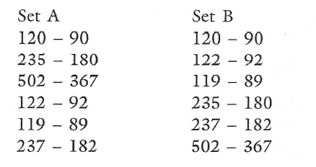
Compare the two sets of calculations
What’s the same, what’s different?
Notes:
First set if worked through as a list from top to bottom would provide ‘practise’ at subtraction. By scanning across the set of calculations, finding some sort of ‘order’ links between calculations can be noticed providing ‘intelligent practice’ and opportunities for discussing facts/ related facts and the key reasoning approach in mathematics, ‘if I know this, what else do I know?’
What recording strategies would help pupils share and discuss what is happening with the sets of calculations? (Number lines probably?)
Can they come up with some calculations that would ‘belong’ to the set? What about addition examples?
Pupils producing written explanations helpful in clarifying their thinking and use of appropriate vocab etc

Slide 13
True or false?
37 + 56 = 56 + 37
37 + 56 = 38 + 59
37 + 56 = 38 + 55
Notes:
Providing whole calculations including answer takes the focus away from getting answers ‘first’!
Helps with a focus on reasoning, noticing and using commutative law, thinking about facts and related facts

Slide 14
Mastery of Mathematics
‘A mathematical concept or skill has been mastered when, through exploration, clarification, practice and application over time, a person can represent it in multiple ways, has the mathematical language to be able to communicate related ideas, and can think mathematically with the concept so that they can independently apply it to a totally new problem in an unfamiliar situation’
Drury, H (2014) Mastering mathematics, Teaching to transform achievement OUP

Slide 15
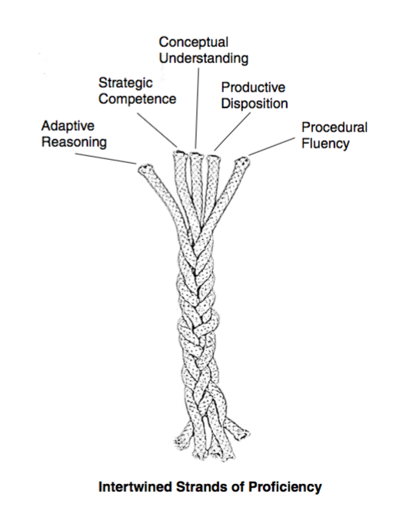

From Mike Askew Conference: Hampshire HT and MM Conferences 2016
Notes:
Adding it Up, Helping Children Learn Mathematics: National Research Council 2001

Slide 16
Five proficiencies
conceptual understanding — comprehension of mathematical concepts, operations, and relations
procedural fluency — skill in carrying out procedures flexibly, accurately, efficiently, and appropriately
strategic competence — ability to formulate, repre- sent, and solve mathematical problems
adaptive reasoning — capacity for logical thought, reflection, explanation, and justification
productive disposition — habitual inclination to see mathematics as sensible, useful, and worthwhile, coupled with a belief in diligence and one’s own efficacy
From Mike Askew Conference: Hampshire HT and MM Conferences 2016

Slide 17
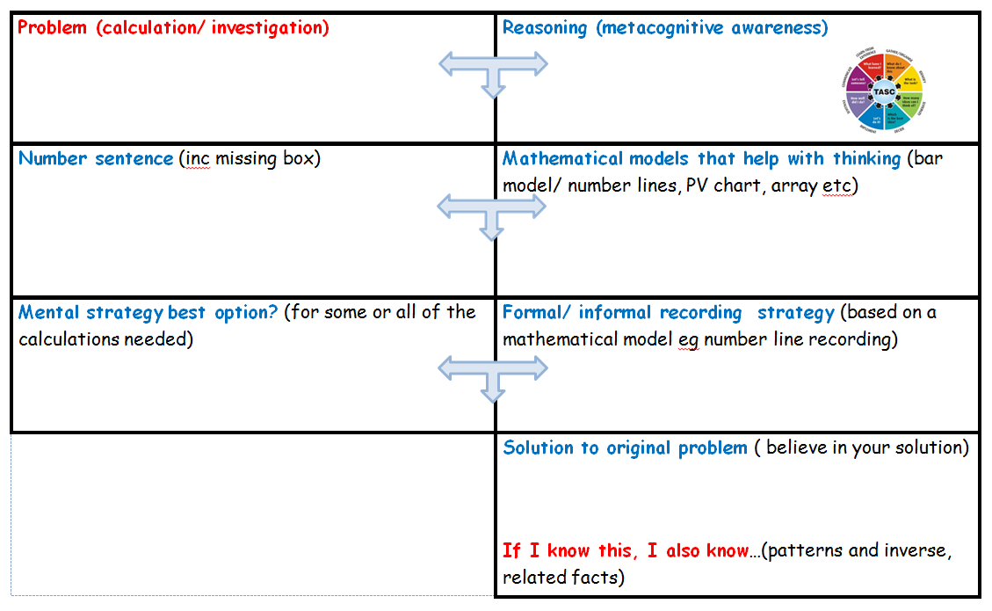
Working towards expert ARE

Slide 18
APPRENTICE mathematician (November)
Relies heavily on the teachers’ modelling to solve calculations and problems tending to repeat exactly what the teacher/ adult has said to describe process used
Uses success criteria as a checklist
Relies upon adult guidance and reminders when ‘stuck’ particularly when remembering meanings of new technical vocabulary or language
Makes choices based heavily on previous year group’s successes
Works ‘mentally’ or with pencil and paper recording as directed by the teacher
Uses concrete resources and models and images as shown by the teacher or adult. May still be building understanding of the connections between concrete modelling and informal/ formal recording
Some solutions are based on counting in 1s rather than making using appropriate use of number bonds (10, 100, 1000, 1) or other known facts
Notes:
Based on the Dreyfus model A Five-Stage Model of the Mental Activities Involved in Directed Skill Acquisition’

Slide 19
Apprentice + COMPETENT mathematician (February)
Can anticipate and independently suggest an appropriate mathematical model which has been used in previous work so far in the year when solving a problem or a calculation.
Can make some suggestions for success criteria to clarify their thinking
Beginning to independently explain their reasoning with peers and adults using some new vocabulary accurately
Developing resilience to ‘being stuck’ by using more than one approach independently before asking for adult help
Can accurately identify and record the number sentence involved when working mentally using a missing box to show the unidentified part.
Able to draw on more than one different representation of the same concept, skill or solution to a routine problem including using concrete resources, models and images and informal recording based on these models
Beginning to notice, talk about, demonstrate and use inverse relationships in calculation, for example responding confidently to ‘ if you know this, what else do you know?’
Some use of known facts and related facts made to check reasonableness of answer and or to identify a calculation that could be solved easily mentally
Notes:
Based on the Dreyfus model A Five-Stage Model of the Mental Activities Involved in Directed Skill Acquisition’

Slide 20
EXPERT mathematician (end of year) make links to DfE interim performance descriptors for end of key stage in Y2 and Y6 ‘working at expected’ +
Pupils can suggest and draw on a range of appropriate models to represent a mathematical concept, or solution including a missing box number sentence
Able to talk about their reasoning using accurate vocabulary when engaged in ‘intelligent practice’ tasks
Can discuss what is mathematically the same and different about a range of problems because the context is not distracting from the mathematics required.
Pupils respond flexibly and with resilience to non- routine problems
Make decisions confidently about which calculations could be worked out mentally and which calculations need pencil and paper recording.
Pupils able to discuss and illustrate connections between domains of mathematics
Pupils can independently use informal and formal notation to share their solutions with peers
Pupils independently use known facts involving all four operations to both simplify calculations and check reasonableness of answers including in the context of measures
Notes:
Based on the Dreyfus model A Five-Stage Model of the Mental Activities Involved in Directed Skill Acquisition’

Slide 21
Hampshire Assessment Model
Once phase 3 assessment completed there is a ‘gap’ until the end of term. This gap is intended for:
Revisiting the whole curriculum focusing particularly on the domains that pupils need more time on to develop fluency in fundamental ideas (interventions?)
Ensuring that the last, end of year assessment can be based on pupils independently solving a range of routine and non-routine problems within their year group’s curriculum expectations
Supporting pupils to understand and use the links between domains when reasoning and solving problems
Supporting pupils to be able to work mentally appropriately and confidently using known and related facts
As a final summary of attainment, the NAHT Key Performance Indicators can be used. This KPI summary data can then be compared with last year’s data.
KPI documents and a tracking grid can be found on HTLC leadership moodel

Slide 22
Working towards expert ARE

Slide 23
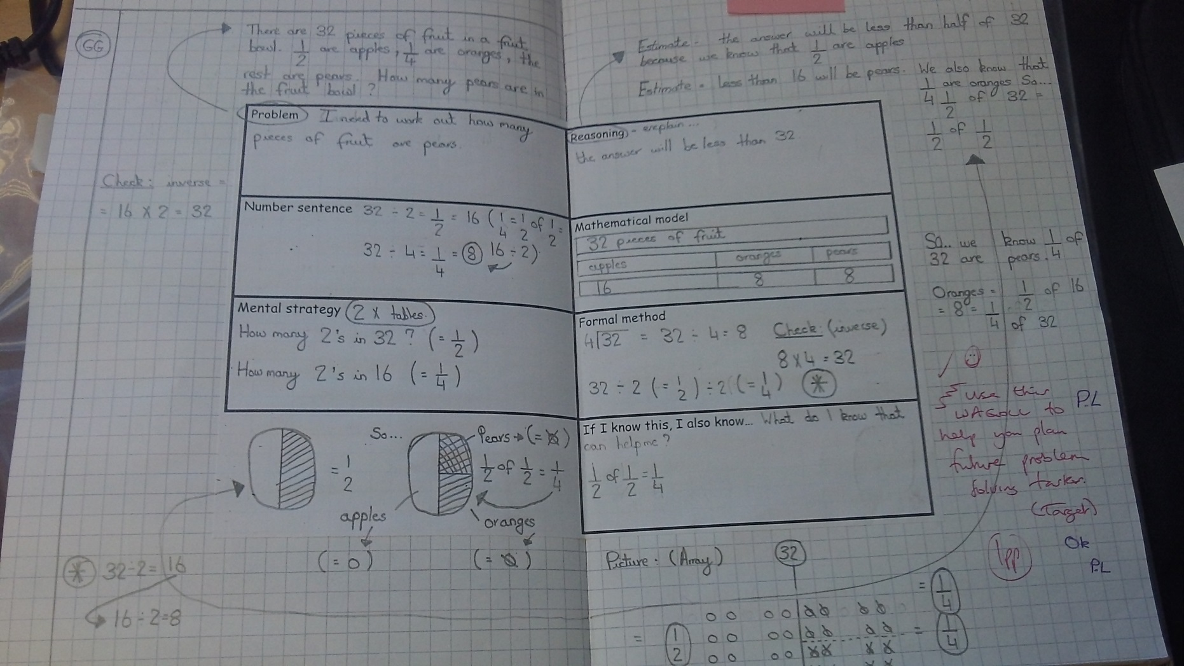

Slide 24
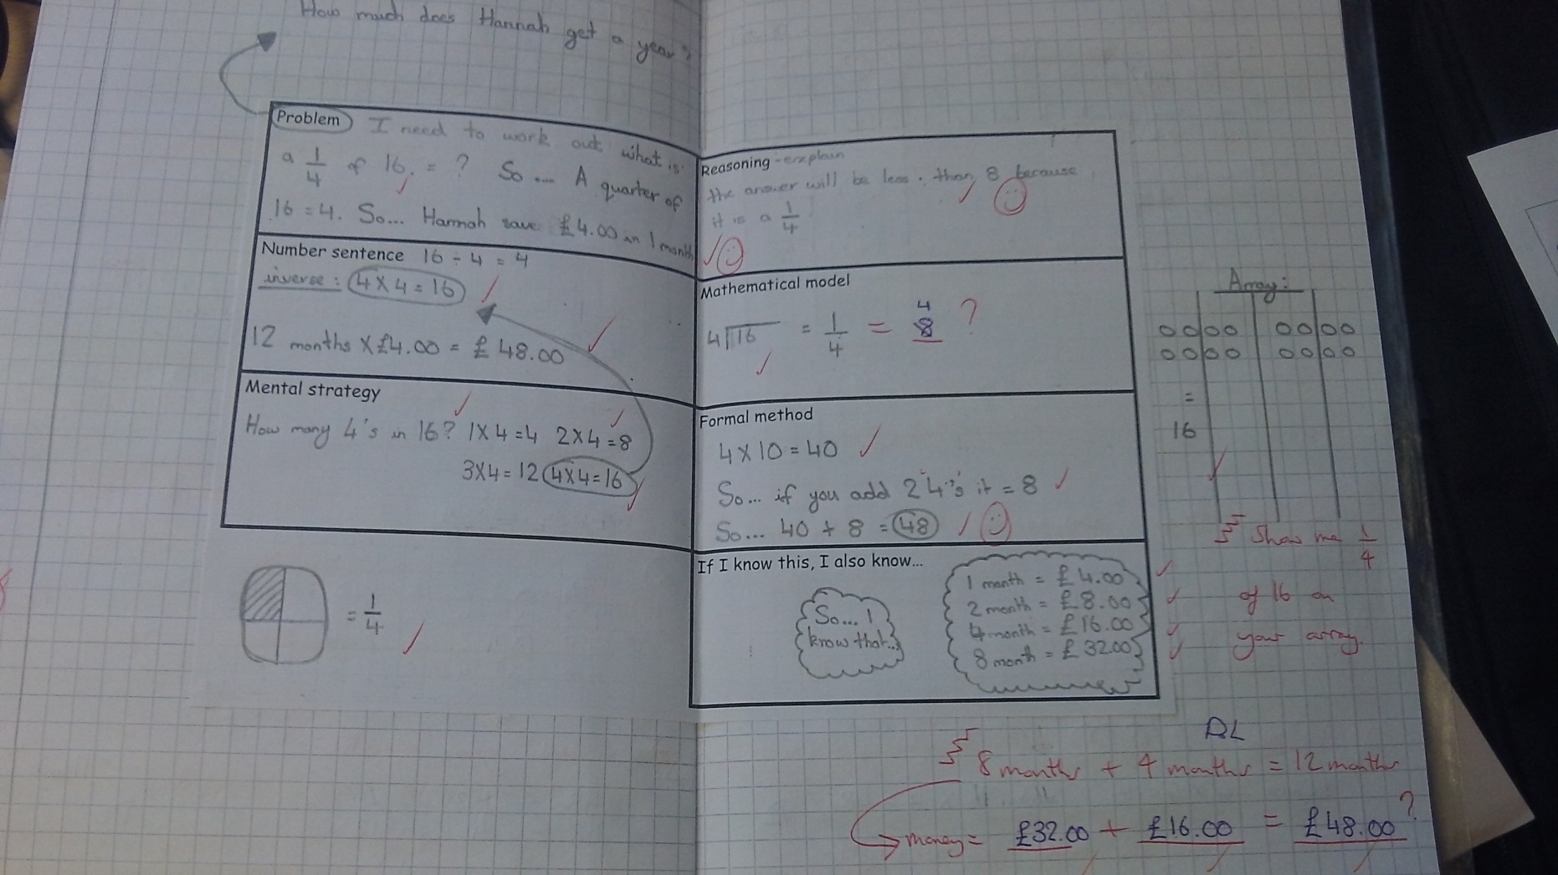

Slide 25
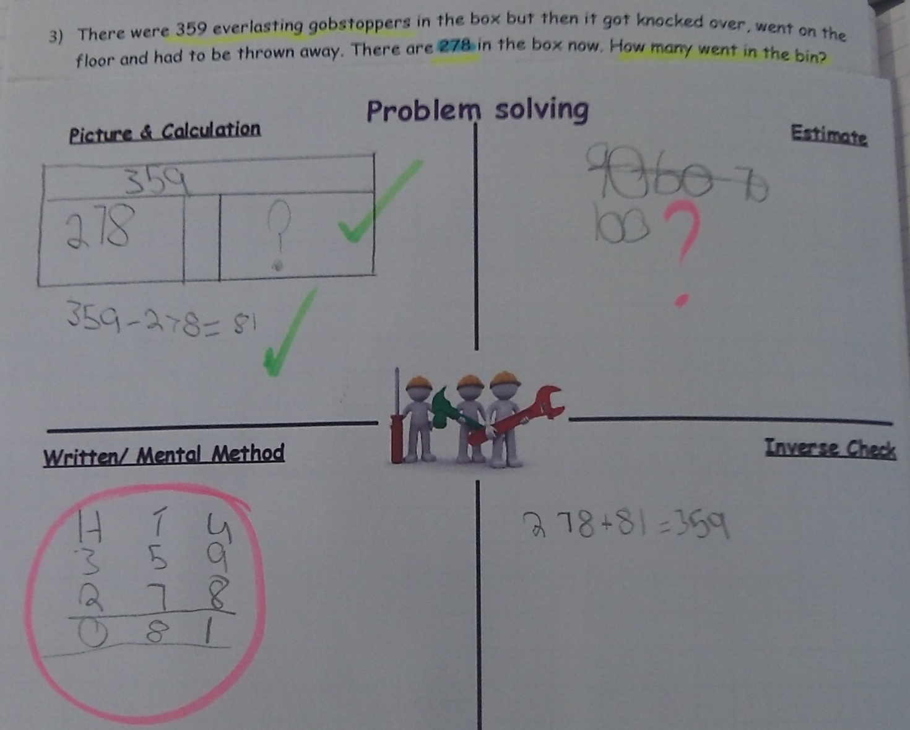

Slide 26






NCETM Teaching for Mastery
Can be used to support:
‘cold’ / ‘hot’ tasks
Diagnostic conferencing (video clips)
Interventions/ catch up
Pre -teaching
end of year expectations
https://www.ncetm.org.uk/resources/46689

Slide 27
NCETM Mastery Tasks this year can be part of assessing end of year expectations in each year group…
…in September 2015 we looked at using previous year’s examples diagnostically to inform first units of work.

Slide 28

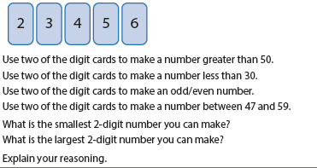
Year 1: Number and place value
Notes:
Can all pupils engage with this ‘key’ task confidently and fluently? Can they use resources and diagrams/ models to explain their reasoning?

Slide 29
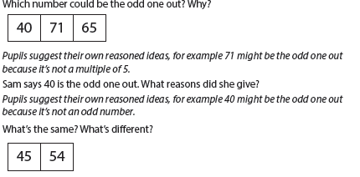
Year 1: Number and place value

Slide 30
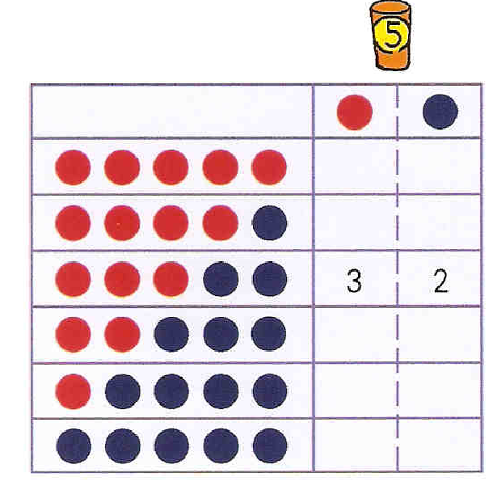
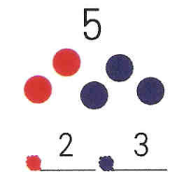
Representing the Part - Part Whole Model
Attention to Structure
Shanghai Textbook Grade 1 Semester 1
Notes:
Really key mental image developed through repeated and ongoing concrete work….the basis for ‘getting’ inverse, commutativity and related facts…
Deep understanding of all numbers to 20- how they can be partitioned and whether the resultant partitions are ‘equal’ or ‘unequal’ another key concept as this will lead into multiplicative reasoning and fractions…

Slide 31

Year 1: Addition and subtraction

Slide 32
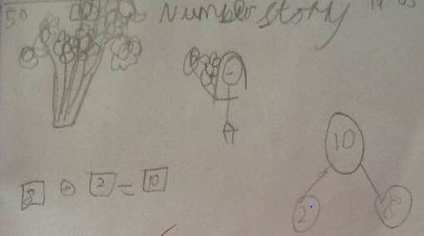
8 flowers and 2 flowers
Notes:
Range of recording to show partition of 10 as 8 and 2

Slide 33
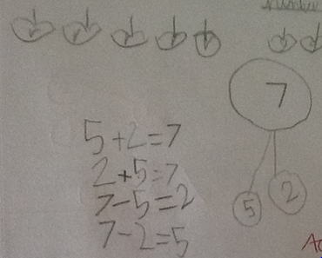
5 apples and 2 apples
Notes:
Facts and related facts

Slide 34
Year 1: Addition and subtraction
Builds imagery linked to bar models…

Slide 35
Year 1: Addition and subtraction
Notes:
Children need the concrete experiences using the models as frames to help them with mental imagery and reasoning to be able to think thorugh ‘missing box’ logic. Getting pupils to explain how they are working it out very important- could be a lucky guess!
Could ask pupils to record the same fact in different ways eg bar model (using squared paper)
Pupils need to have moved on from numbers as adjectives eg 4 jam tarts to number as a noun.

Slide 36
Partitioning and number bonds
10
10
10
5
1
2
8
3
9
3
5
2
2
4
3
8
10
Notes:
Variation here, same task…different presentation/ model as well
Which ones have more than one answer? How do you know?
Although this is a ‘paper and pencil’ task it doesn’t mean the pupils should do it without concrete resources…consider the impact this has on the pupils who need to ‘catch up’ seeing their peers manipulate resources in response to the formal notation…
Need to check too that pupils who give the ‘right answer’ can also show what this looks like concretely!

Slide 37
10
10
10
10
5
5
1
9
2
8
7
3
9
9
8
3
2
5
3
2
0
7
4
10
8
4
Notes:
Can discuss which ones have more than one answer…

Slide 38
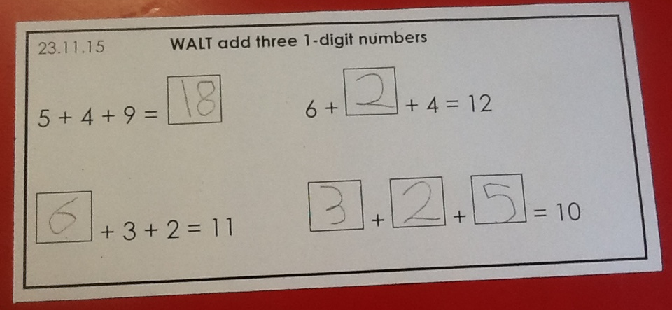
Adding 3 numbers…
Notes:
Adding three numbers… so much more useful than adding two all the time….
Which two would you choose and why is a key discussion pupils should have….helps with associative law, looking for and using known number bonds….
Again recording the same calculation on number lines and in bar models (squared paper) helps pupils to see links with ad/sub and multiplication/ division/ fractions through part/whole thinking (equal/ no equal parts).

Slide 39



Working towards expert in year 4
Jo pours 3ml of cough mixture from a bottle containing 1/10 of a litre. How much cough mixture is left? Does she have enough for two more 30ml doses?
Chloe shares a bag of grapes between 6 friends. Each friend gets 23 grapes and there are 2 grapes left.
How many grapes were in the bag?
Which of these amounts of money can you make using only 3 coins each time?
£1.12 83p £1.05 46p £2.71 16p
Ruth says that the calculation 50÷8 gives a remainder of 2. Is she correct?
Can you give five other examples of division calculations with a remainder of 2?
Notes:
From session 3….what has been put into place?

Slide 40
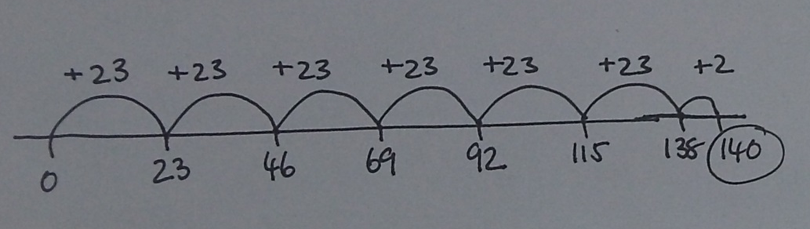
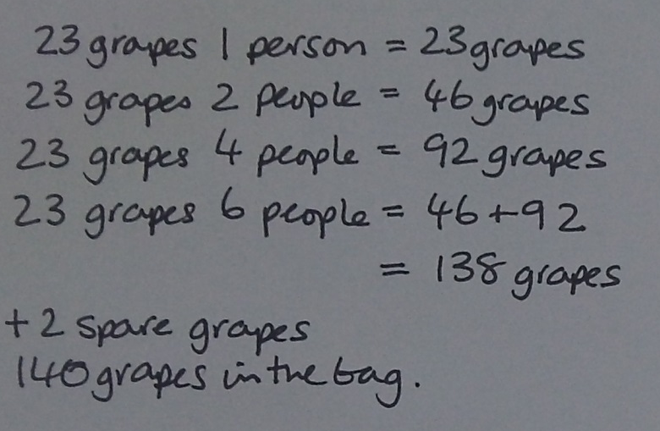


Chloe shares a bag of grapes between 6 friends. Each friend gets 23 grapes and there are 2 grapes left.
How many grapes were in the bag?
Notes:
From session 3….

Slide 41
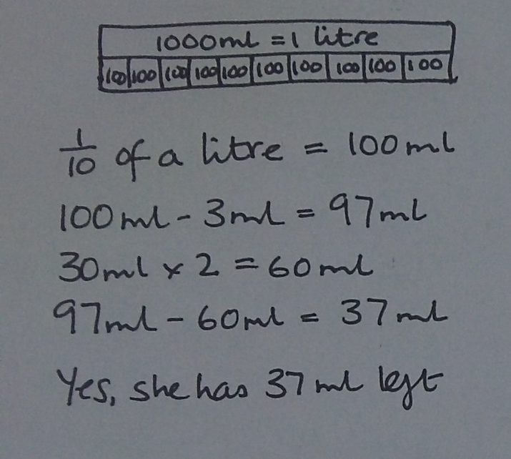
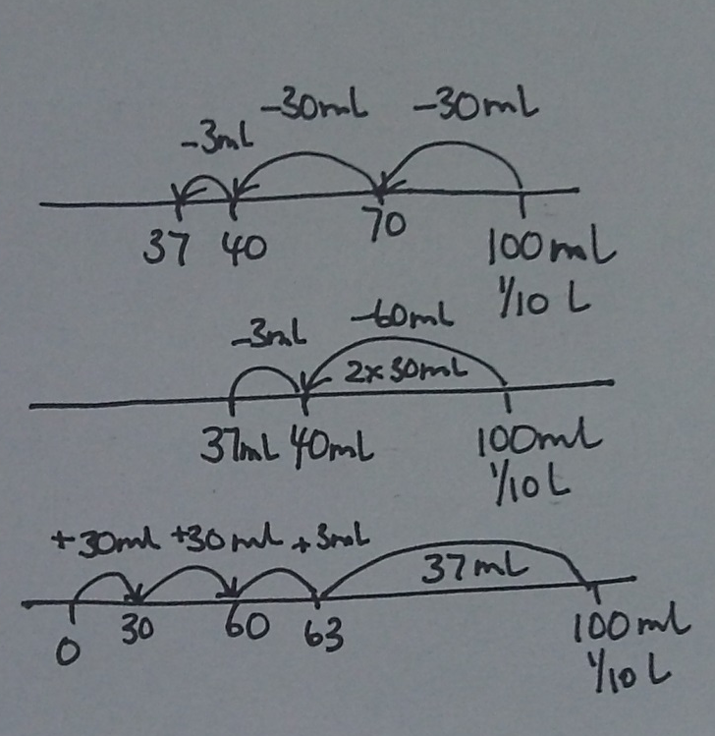

Jo pours 3ml of cough mixture from a bottle containing 1/10 of a litre. How much cough mixture is left? Does she have enough for two more 30ml doses?
Notes:
From session 3

Slide 42
Support- independence/ fluency in a focused aspect of maths
Intelligent practice possibilities
Change amount of cough mixture (check pupils know how much this is practically)
- And or change total amount in bottle (check pupils know how much this is, read scale)
- And or change fraction of bottle
- And or change number of doses needed
- And or change amount in each dose
Generate similar problems (look for changes that you can quickly know the answer to because you have worked out one solution already)
Jo pours 3ml of cough mixture from a bottle containing 1/10 of a litre. How much cough mixture is left? Does she have enough for two more 30ml doses?
Write own problem like this one.
Linked practical work, measuring and reading amounts eg of litres expressed as x mls and or fractions of whole litres
Practise:
1/10 of 100ml / 1000ml
3/10 of 100ml/ 250ml
1/5 of 100ml/ 1000ml
4/5 of 100ml/ 1000ml
Missing box examples
Use bar models/ number lines, sequence of number sentences to record solutions
Notes:
From session 3

Slide 43
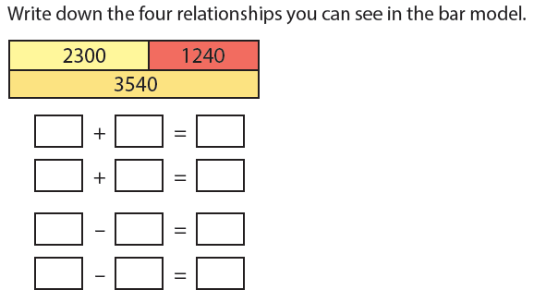
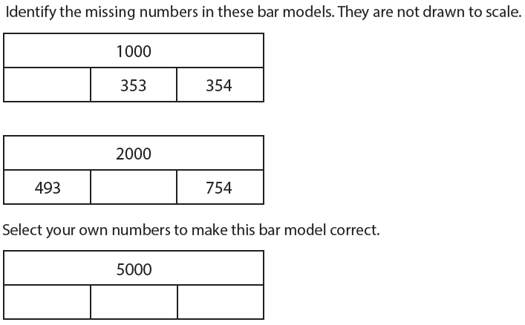
Year 4: addition and subtraction
NCETM Mastery Tasks
Strategic gap can be used to ensure pupils ‘get’ fundamental ideas…commutativity/ inverse etc
Bar model scale has moved on to be representative/ model
Notes:
The NC at year 4 appears to put great emphasis on formal methods but this is not the only key concept in calculation needed for future progress…

Slide 44
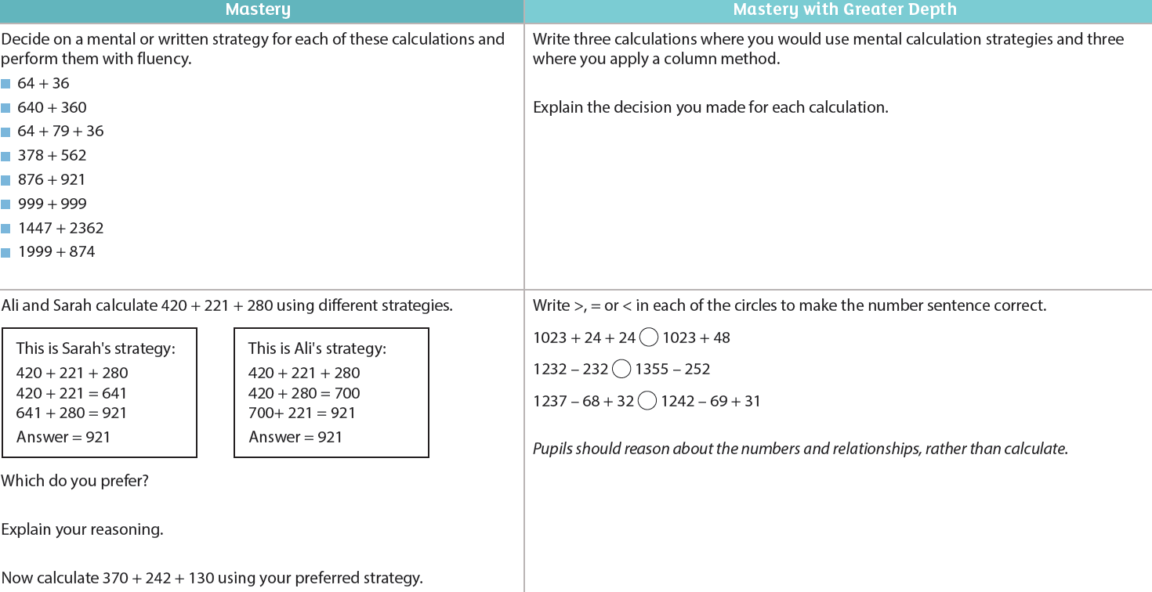
Year 4: Addition and subtraction
NCETM Mastery Tasks
Notes:
Video clip of top left.
Range of different types of calculations, focus on mental or written ( can extend this to showing as number line and or bar model), comparing strategies and use of <> and = signs
Important pupils leave y4 with confidence to decide which strategy to use depending on the numbers- they also need to be able to record the steps they have taken to reach a solution- not just write the answer.

Slide 45
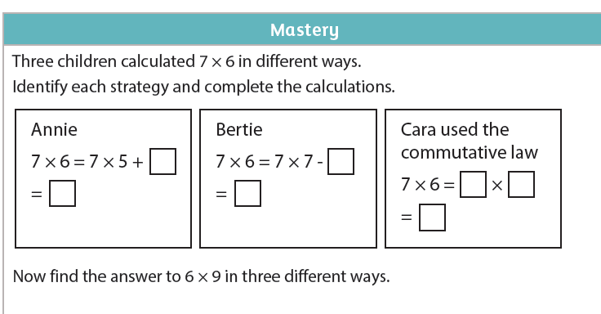
Y4: multiplication and division NCETM (discussed at Mike Askew conference)

Slide 46
Reasoning mini-lessons
10 x 8
2 x 8
12 x 8
6 x 16
From Mike Askew Conference: Hampshire HT and MM Conferences 2016
18

Slide 47

Chains
Dashboard (display) engine (structure)
R x C = array
8
10 x 8 =
2 x 8 =
10
10 x 8 = 80
8
2
2 x 8 = 16
Symbols are the end record of what’s going on in the array
From Mike Askew Conference: Hampshire HT and MM Conferences 2016
Notes:
Closed array (all the squares drawn in)

Slide 48
Chains
Dashboard (display) engine (structure)
12 x 8 =
8
10
12
2
12 x 8 = 96
AND
12 x 8 = (10 x 8) + (2 x 8)
Symbols are the end record of what’s going on in the array
From Mike Askew Conference: Hampshire HT and MM Conferences 2016

Slide 49
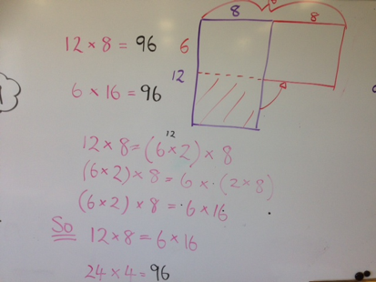

Slide 50
Book look
Is there evidence of pupils securing their understanding of the curriculum through:
Range of key tasks (which ones would you select?)
Sharing their reasoning with peers and adults using appropriate vocabulary and models
What needs to be a focus before end of year?

Slide 51
Using the strategic gap: Interventions
Interventions more successful when:
Pupils working in classroom with peers where there is an expectation that all pupils work with concrete resources and use informal and formal recording strategies
Pupils talking about their actions and their thinking using appropriate vocabulary
Pupils taking the lead in modelling with resources and making a connection between what they say and do with what/ how they record
‘Key tasks’ from whole class planning are the focus so that pupils acquire foundations for future learning
Pre- teaching seems to be more effective than post interventions…
Notes:
These pupils are not on a separate learning journey to their peers. They need support and teacher belief that they can address individual misconceptions that are holding them back. Making sure that maths is presented as concretely as possible to all pupils in the first instance is critically important…problem solving helps this

Slide 52
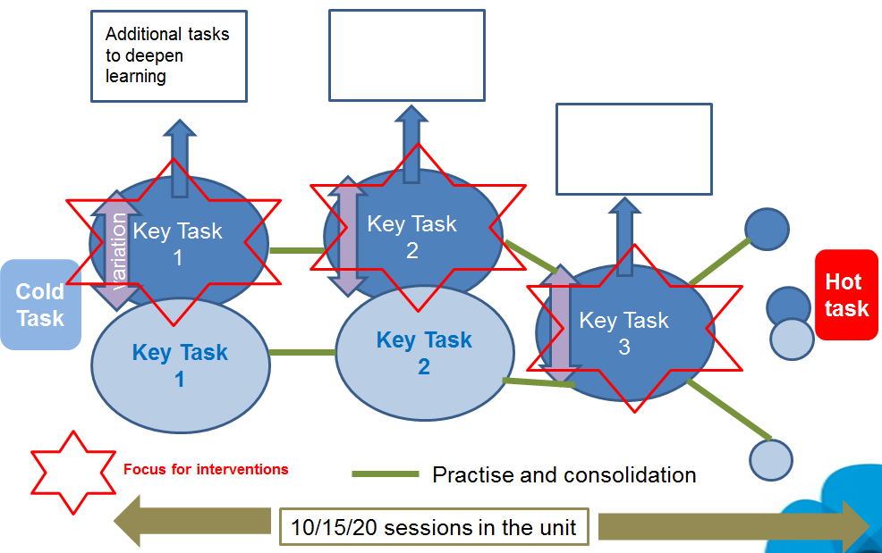
Using the strategic gap: interventions
Hot task
Notes:
Reminder of planning model again.
Pace of moving on with a new but related task is linked to the time needed by ‘catch up’ pupils to make sufficient progress….so in books there would be several lessons on a type of task showing pupils gaining confidence and independence. Always plenty of ‘additional problems for challenging pupils who ‘get’ this bit of expected learning.
Remembering to ensure QFT starts with low threshold starting points ie concrete, informal recording, a problem context that can be discussed etc etc.

Slide 53
Transition
What strategies are used to support continuity of learning between summer and autumn terms ?
Collaborative cross year team planning for first unit of work in September based on assessment of individuals and groups? Eg YR/ Y1
Visits to classrooms summer term and revisit autumn term? Eg Y2/Y3
Using the same pupil books in autumn term (unless it would be beneficial for some pupils to have a new book)
Notes:
Key issue with transition between any year is pitch and expectation is too low resulting in pupils spending too long in low level tasks building back up to where they might have been in the previous summer term. CTs planning with next year group teacher thinking about – ‘if I planned the next unit (ie autumn term one) what would I expect pupils to be able to do and what would be the challenge?’

Slide 54
Reminders:
The assessment documents are not the teaching schedule…
Planning and teaching needs to support pupils to understand and use the links across domains eg NPV+ calculation+ measurement; fractions+ multiplication &division+ measurement/ geometry
Pre- teaching rather than additional time after lessons seems to be more effective with pupils who need some ‘catch up’ support. What would you ‘pre teach’ in each domain?

Slide 55

BREAK

Slide 56
HAM Session 4
English

Slide 57
HAM for
Reading and Writing
Final Revision

Slide 58
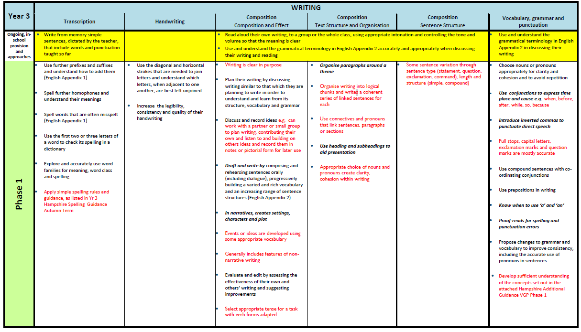
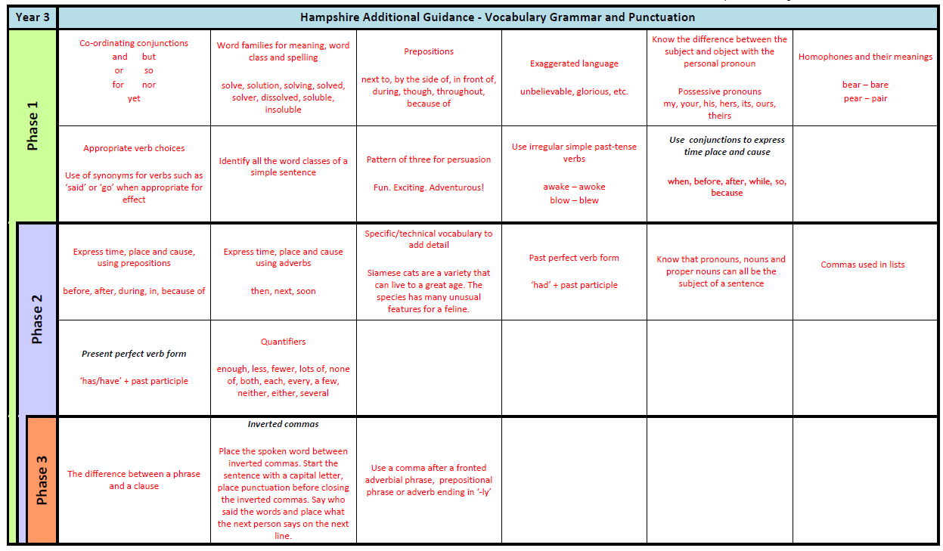
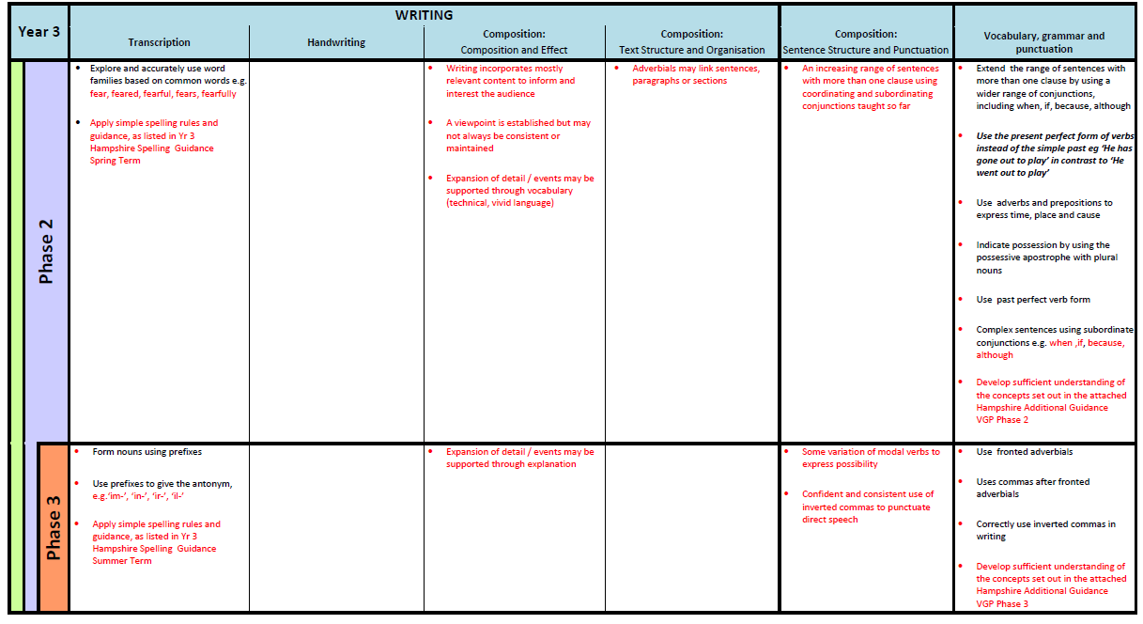
Notes:
Current documents are overloaded 3 pages long…
Hampshire elements repeated NC at times …
Phase 1 ‘over loaded’

Slide 59
Summary of the changes to version 5
Reduced content as there are no repetitions and only assessable statements
Reshaped for a clearer progression of skills:
  Across Phase 1, 2, 3 for each year
  Within Key stage 1, Lower KS2, Upper KS2
  Year 1 ⇨ 6
Removal of additional grammar grid (writing)
Repositioning of ‘themes and conventions’ (reading)
Notes:
Having worked with the document and listened to feedback from schools this year – we recognised the need for revisions.
Bullet 1 – still contains all NC statements and KPIs – additions reflect Yr2 / Yr6 end of KS expectations : each Yr group now fits on 1 side of A4, yellow removed as this suggested curriculum
Bullet 2 – cross checked for progression Year 1 - Phase 1 to Year 6 – Phase 3: some statements have been moved to different phases / domains following feedback from schools
Bullet 3 – now encompassed in the main document
Bullet 4 – in line with higher order reading skills materials

Slide 60
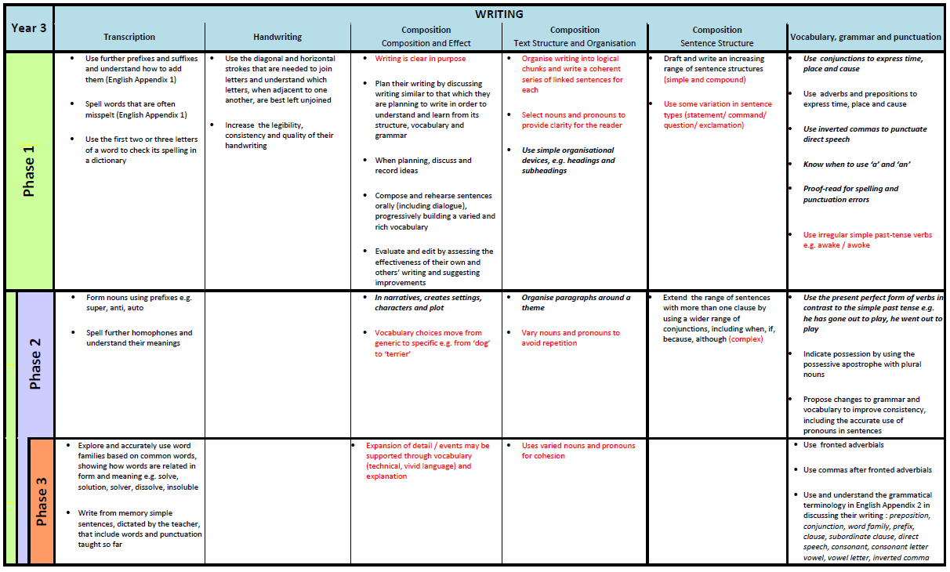
Revised HAM for Writing
Notes:
Handout Yr 3 writing page – 1 per school.

Slide 61
Next steps
Materials will be available through the Moodle by 1st July to allow schools time review and prepare for the new academic year.
SIMS will be adjusted to reflect changes and available in time for first data collection (November)

Slide 62





Learning sufficiently embedded -demonstrated with independence and resilience
Gaps in learning from previous year group, new learning
Deepening understanding in a range of contexts
End of Year
End of Year

Slide 63
Domain Bricks: Building the wall
Reading | Writing
Word Reading | Transcription
Comprehension: Clarify | Handwriting
Comprehension: Monitor and Summarise | Composition: Composition and Effect
Comprehension: Select and Retrieve | Composition: Text Structure and Organisation
Comprehension: Respond and Explain | Composition: Sentence Structure
Inference | Vocabulary, grammar, & punctuation
Language for Effect
Themes and Conventions

Slide 64
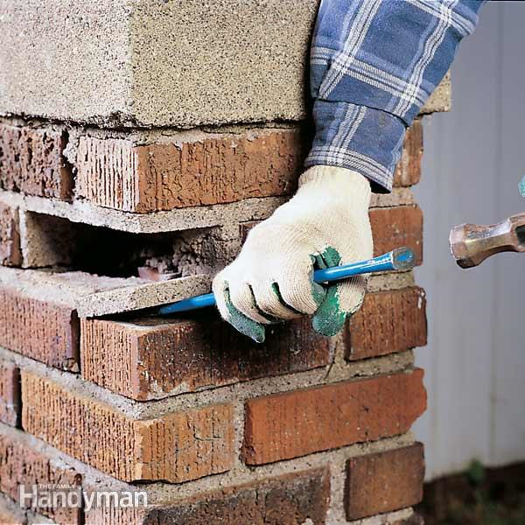
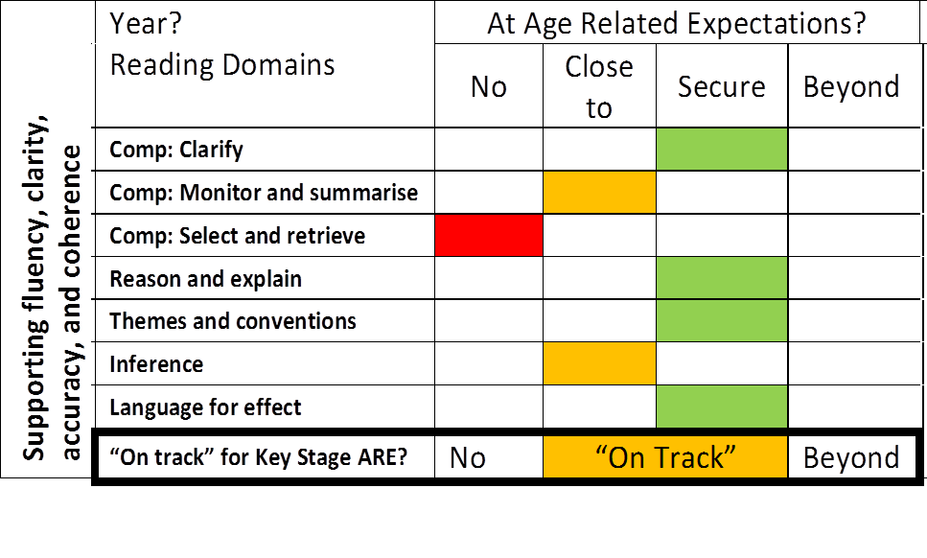
‘Mastery’ teaching - filling the gaps
Notes:
Brick Wall: Filling those gaps in learning in different contexts, adding layers to the learning to embed deep mastery
HAM –KPIs optional – EOY
Identify targeted teaching for those pupils that need it

Slide 65
Identify weaknesses and gaps in current year
Current Year
Plan for ‘quick fix’ lessons within a learning journey
Tailored teaching for small groups and individuals
Next Year
Co-construct planning to address areas for consolidation and teaching
Utilise the end of year and transition through rich drivers and tasks

Slide 66
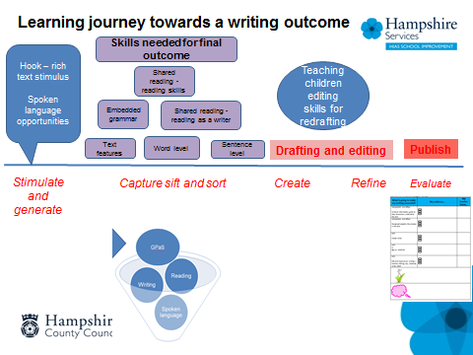
Transition –
Collaborative Planning
  Co-construction of the first learning journey to reinforce known weaknesses and teach to close to gap
Notes:
Engaging literacy driver is essential
Accessible to all – film, image or picture book

Slide 67

Transition –
Collaborative Planning
Choose a high quality text driver that is easily accessible to all abilities e.g. picture book, short film animation, painting
Consider rich tasks that will enable assessment of reading and writing skills in all domains
Ideally choose a text driver that is appropriate for a range of year groups – this will enable collaborative planning

Slide 68
EFFECTIVE TASK DESIGN WILL SUPPORT END OF YEAR TEACHER ASSESSMENTS …
READING
Spend time designing a few high quality questions that require higher cognitive thinking
Deeper answers will require children to use higher order skills e.g. justify, explain, compare
Consider all the reading domains
Depending on age and ability, answers could be oral or written
Notes:
Applicable to all year groups
Use domain key question stems created by English team to support

Slide 69
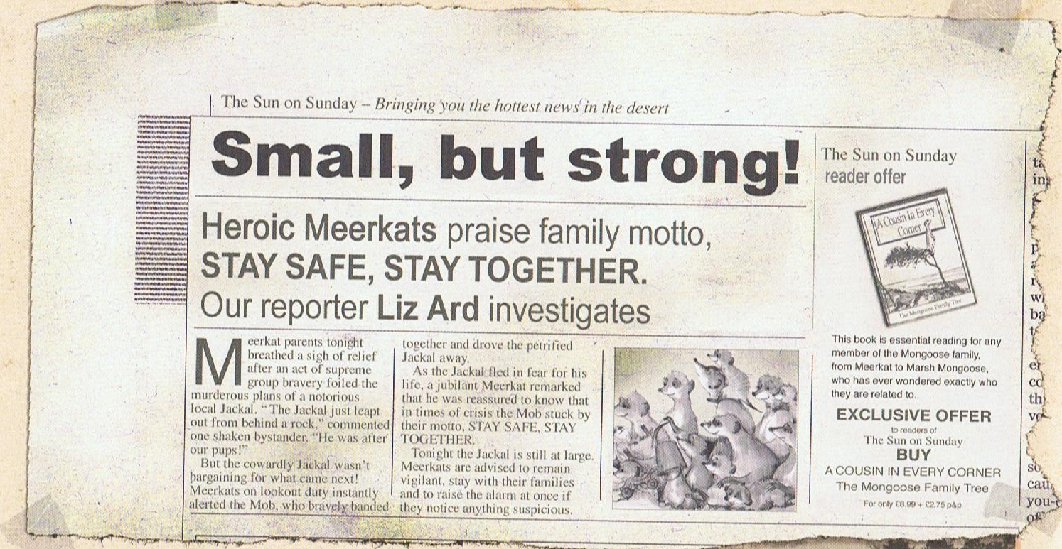
What significance does the family motto ‘Stay safe, stay together’ have in the story?

Slide 70
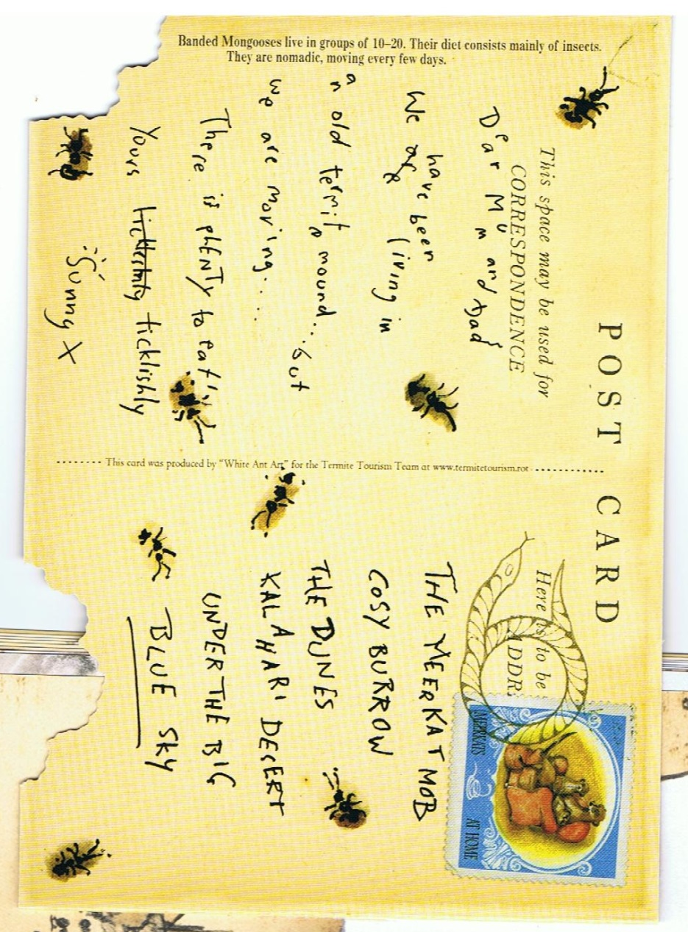
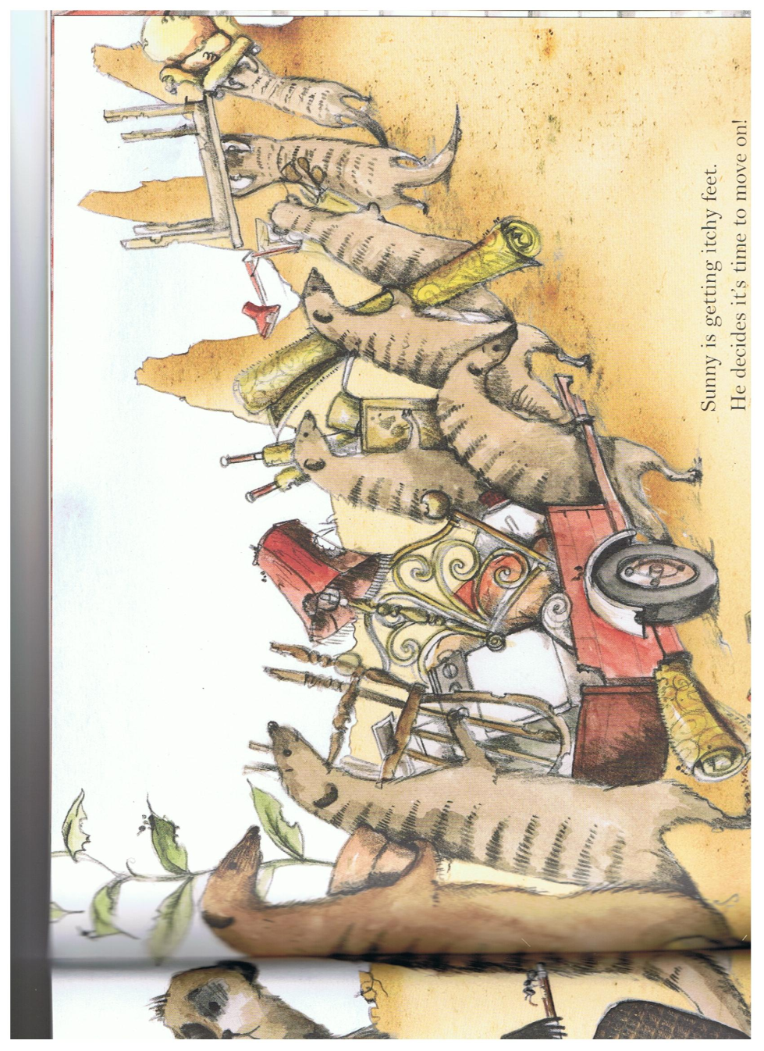
Why has the author chosen the phrase ‘Sunny is getting itchy feet’ on this page?

Slide 71
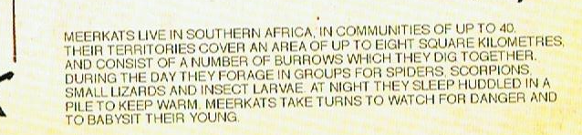
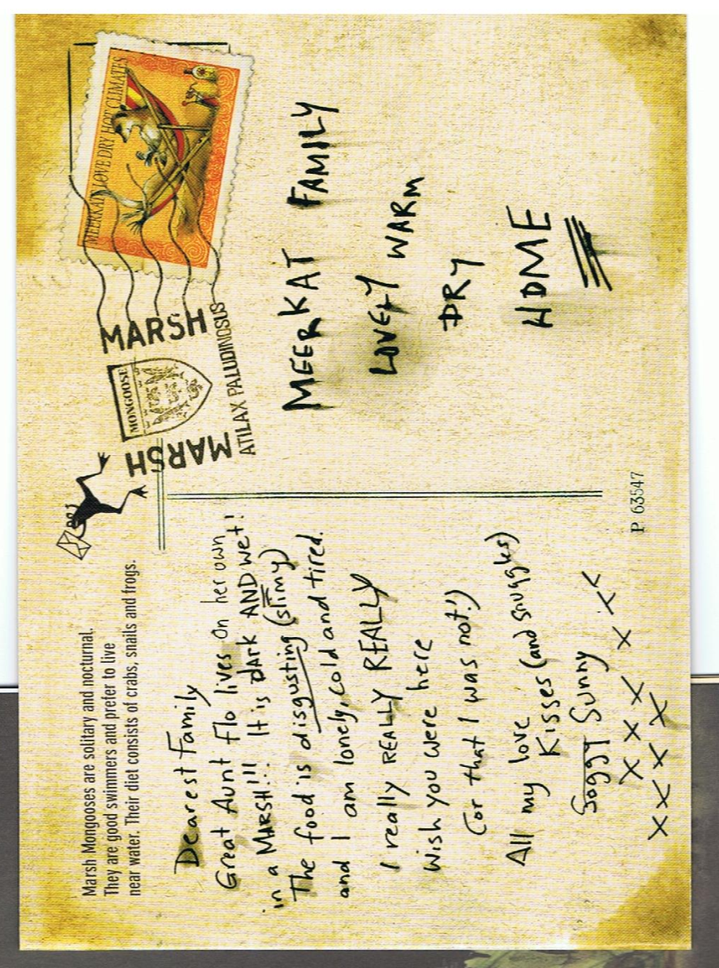
How does life for Aunt Flo contrast with the life Sunny is used to? Give examples

Slide 72
EFFECTIVE TASK DESIGN WILL SUPPORT END OF YEAR TEACHER ASSESSMENTS …
WRITING
Consider more than one writing outcome from the same driver - this will enable teachers to assess ability to vary ‘author’s voice’ depending on audience and purpose of task
Genres should already have been a focus within the year
Ensure children consider their success criteria across all the domains – giving sound evidence for assessment

Slide 73
Sunny’s mother writes for two reasons the day he goes missing …
Her diary entry
Dear Diary,
Today is the worst day I can remember. My beloved Sunny has packed his bags and left home…
Her letter to his headteacher
Dear Mr M. Kat,
I am writing to inform you that my son, Sunny, will not be in school for the next two weeks…

Slide 74
A return to ‘layered learning’ and cutaway groups
Breakaway group(s)
Prior assessment
Whole class input
Supported practise
Independent work
Plenary
Independent Improvement
Independent work
Guided session

Slide 75
A return to ‘layered learning’ and cutaway groups
Split inputs
Prior assessment
Teacher Input
Ind. work
Plenary
LSA Guided
LSA Input
Ind. Work
Ind. work
Independent work
Teacher Guided
Ind. work

Slide 76
Not forgetting to challenge the higher attaining writer
Enrichment
Widening the opportunities for writing and the forms that such writing takes.
Enhancement
Adding extra tiers of challenge to activities, in order to appropriately differentiate class / group writing activities for the more able pupil.

Slide 77
Purpose
Author’s voice
Audience
Enrichment
Form
AVOID – ‘write some more’
ENCOURAGE – ‘enrich the task by purpose/ audience/ form / audience

Slide 78
Audience
Child
Adult
Competition
Web
Real purpose
What conditions/skills are necessary if we are to empower children as writers for any audience and purpose?

Slide 79
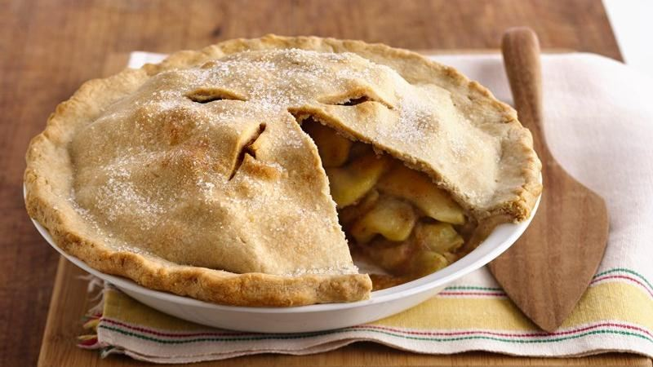
Purpose
3 main reasons to write
PIE
Persuade
Inform
Entertain

Slide 80
Persuade
Delectable, sweet and mouth-watering, this Mr Kipling apple pie is a must for your shopping basket. Oozing with flavour and healthy apples, surely you cannot deny your taste buds this experience. Not only is the pastry crisp and light, but the filling is delicious too.
Inform
A Mr Kipling apple pie is a desert for four people. It is made from short crust pastry and contains a cooked apple filling, which counts towards your five a day. Furthermore, the desert can be served hot or cold, with ice cream, cream or custard. The pie is sold in a foil casing and cardboard box.
Entertain
Last night, James (my best friend) came round for tea after football training. I asked Mum if we could have the apple pie she had bought as a treat. Embarrassingly, she burnt it in the oven and we ate very crisp pastry with custard that burnt our mouths!

Slide 81
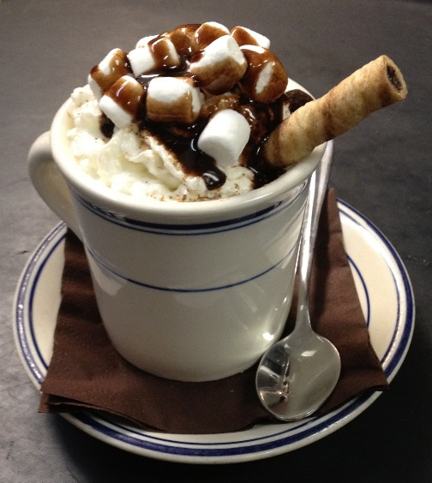

Author’s voice
Persuade | Inform | Entertain
TASK:
Give it a go!

Slide 82
Form
Report information leaflet tourist guide encyclopaedia entry magazine article non-fiction book letter | Recount: letter autobiography diary or journal newspaper report magazine article science experiment | Discussion newspaper editorial non-fiction book on an ‘issue’ write up of a debate formal essay leaflet or article giving balanced account of an issue
Explanation encyclopaedia entry non-fiction book technical manual question and answer articles and leaflets write-up of science experiment Multi-modal | Persuasion advertisement catalogue travel brochure pamphlet from pressure group Newspaper or magazine article poster or flier book blurb letter to editor or editorial | Instructions technical manual non-fiction book timetable, route-finder list of rules posters, notices, signs sewing or knitting pattern instructions on packaging

Slide 83
Mastery in English
At any one moment in time, a skill can be said to have been mastered when the child has sufficient knowledge and understanding in order to appropriately use and apply it in contexts – both familiar and unfamiliar – without the need for guidance or scaffolding.
As listening, reading, speaking and writing are all combinatorial processes – they rely on a person’s ability to make decisions, to select from a range of processes, strategies and skills, and to blend these appropriately to produce successful outcomes – mastery in a single or, even, a number of skills is not sufficient to say that a child has ‘mastered’ the content of their year group’s programme of study.
Judging mastery in this instance would require the child to demonstrate that they are versatile: that they are able to select and combine elements from across appropriate domains with sufficient proficiency over time, in a range of known and unknown contexts to successfully comprehend or communicate meaning and intent.

Slide 84
A further end of year task
Reflect on text drivers used this year:
What units have been successful? Why?
What units need replacing/ rethinking?
Has there been a broad range of ‘texts’ across each year group?
Is there a clear progression in drivers across the year groups?
Are the children exposed to a wide range of quality authors across the year groups?

Slide 85
Learning journey exemplification
Identify examples of pupil learning journeys /books for pupils who began the year as:
Below
close to
securely on track
beyond
to at least ARE by the end of the year.

Slide 86
Learning journey exemplification
Creating a shared resource/school exemplification of the journeys for pupils with different starting points
Collecting books that exemplify effective but typical journeys of pupils – expected progress
Collecting books that exemplify effective journeys of pupils that have made more than expected progress

Slide 87
Keeping sight of Prior Attainment
“The new progress measures at the end of KS2 2016 aim to capture the progress that pupils make from the end of key stage 1 to the end of primary school. They are a type of value added measure, which means that pupils’ results are compared to the actual achievements of other pupils nationally with similar prior attainment.”
The new progress measure is a school only measure at the end of KS2.
Pupils will be placed into a KS1 prior attainment group based on KS1 results English (reading & writing): mathematics 50:50 to calculate their KS2 Value Added
The average scale score will be calculated for each group and individual progress calculated against this. For writing pupils will be allocated nominal points for the purpose of calculating school Value Added.

Slide 88

Keeping sight of Prior Attainment

Slide 89
What the transition matrices tell us from 2015……
Reading:
Level 1 Expected 84% More than 62%
Level 2C Expected 84% More than 18%
Level 2B Expected 95% More than 33%
Level 2A Expected 99% More than 61%
Level 3 Expected 89% More than 1%
Overall Expected 91% More than 33%
Notes:
A conversation around the potential progress trajectory of prior attainment groups nationally – given the progress of Level 1s there should be a sig proportion of the schools cohorts who will be moving from below to expected – as is the drive of the curriculum and also prior attainment 2As are likely to move faster to attain GD/ or be beyond throughout the school – achieving a higher scale score
Writing Value added is likely to be a very blunt instrument as it has been over the last few years – with nominal scores awarded for KS2 outcomes.

Slide 90
Keeping sight of Prior Attainment
To what extent have you worked as a school to maintain an oversight of prior attainment EYFS to Y1/ end of KS1 and KS2 to every year group – but particularly end of KS2?
To what extent have you used prior attainment as a driver in pupil progress reviews?
Has this formed a focus of book looks?
Discuss with the other school teams – how have you addressed this aspect?

Slide 91
 |  | End of Key Stage 2 – July 2016
 |  | Pre KS | WTS | EXS | GDS
End of Key Stage 1 – July 2012 | Level 1 |  |  |  |  | %
 | Level 2c |  |  |  |  | %
 | Level 2b |  |  |  |  | %
 | Level 2a |  |  |  |  | %
 | Level 3 |  |  |  |  | %
 |  | % |  | % | %

Slide 92
Action Points
Make a note of key aspects from today that you will take back as a leadership team.

