Slide 1


Slide 2
Overview of the session
9.00 The journey to ‘mastery’ Implications for leaders
9.15 Focus groups: Mixed age classes; reporting to parents and reporting to governors and other stakeholders
10.00 Break
10.20 What does ‘expert’ look like? – the final part of the mastery journey – Mathematics and English teams
11.20 Target group pupils – catch up and adapted planning
11.40 High Impact Interventions

Slide 3
The journey to ‘Mastery’
Implications for leaders
How often are you monitoring planning and its adaption?
What are you evaluating it for?

Slide 4
The Prize
As many children as possible are…
able to achieve essential skills, knowledge and understanding
have skills, knowledge and understanding will be embedded and secure
not going to have gaps in their skills, knowledge and understanding that become barriers to learning and progressing

Slide 5
Some key ‘mastery’ ideas
1. The majority of pupils will move through the programmes of study at broadly the same pace.
2. Decisions about when to progress should always be based on the security of pupils’ understanding and their readiness to progress to the next stage.
3. Pupils who grasp concepts rapidly should be challenged through being offered rich and sophisticated problems before any acceleration through new content.
4. Those who are not sufficiently fluent with earlier material should consolidate their understanding, including through additional practice, before moving on.

Slide 6
1. The majority of pupils will move through the programmes of study at broadly the same pace.
Mastery learning expects that children will deepen their grasp of key ideas, over time, rather than move on and leave gaps behind
Through being well taught and given curriculum opportunities they will develop and demonstrate their resourcefulness and versatility, (in an age appropriate way)
This does not mean that all pupils achieve the same degree of mastery… but it is at least sufficient, so that they can make successful progress through the fundamental ideas. No one left behind…

Slide 7
Questions to ask of planning
Medium Term Planning
Are teachers clear about the learning intentions for each unit?
Have they ensured that additional objectives are identified that can be taught in the same context?
Is coverage sufficient?
Have they used subject knowledge to identify possible misconceptions?
Has an appropriate amount of time been allocated so learning intentions can be sufficiently learned?

Slide 8
2. Decisions about when to progress should always be based on the security of the pupil’s understanding and their readiness to progress to the next stage.
Need truly ‘independent’ evidence of security e.g. can children do something with out too much modelling, prompting and by doing the ‘thinking and application’.
This needs teachers to set independent tasks for children that can be used as evidence and further assessment.
Assessing alongside the child as is best practise in EYFS – guided reading and mathematics.

Slide 9
Questions to ask of planning
Unit Planning
Where are teachers identifying the tasks that are being used for assessment to evidence the security of
understanding
knowledge
Skill
through application within a known/familiar context?
How are teachers using this evidence to regroup and reteach/model?
What is the evidence of assessment between lessons?

Slide 10
Mastery also involves assessing:
The children’s capacity to applying their knowledge, skills and understanding with (sufficient):
  Independence
  Resilience to deal with complexity and new contexts
  Fluency
  How have you been developing the three above, especially for children that have previously not had it?

Slide 11
In planning and therefore books
ASSESS ASSESS ASSESS ASSESS
Evidence evidence evidence evidence
surface learning deep learning
secure embedded applied
INDEPENDENCE

Slide 12



A working model for
“Masterly Learning”?
Yes
enrich
Unit of learning and objectives
Next unit of learning and objectives
Sufficiently Learnt?
No
No
Correct
Don’t forget that children will need to have application skills modelled.
Correct
Adapted from Bloom, 1971
Notes:
The expectation is that the majority of pupils will move through the programmes of study at broadly the same pace. However, decisions about when to progress should always be based on the security of pupils’ understanding and their readiness to progress to the next stage. Pupils who grasp concepts rapidly should be challenged through being offered rich and sophisticated problems before any acceleration through new content. Those who are not sufficiently fluent with earlier material should consolidate their understanding, including through additional practice, before moving on.
Bloom, B. S. (1971a). Mastery learning. In J. H. Block (Ed.), Mastery learning: Theory and practice (pp.
4 7–63). New York: Holt, Rinehart & Winston.
Bloom, B. S. (1971b). Individual differences in school achievement: A vanishing point? Bloomington, IN:
Phi Delta Kappan International.
Bloom, B. S. (1974 ). An introduction to mastery learning theory. In J. H. Block (Ed.), Schools, society and
mastery learning (pp. 3–14 ). New York: Holt, Rinehart & Winston.

Slide 13
3. Pupils who grasp concepts rapidly should be challenged through being offered rich and sophisticated problems before any acceleration through new content.
How well are teachers designing activities that are rich and sophisticated?
How is planning enabling more opportunities for children to evidence depth of learning outside of the taught/known context/familiar as the year continues?
Is homework being set that deepens understanding?

Slide 14
4. Those children who are not sufficiently fluent with earlier material should consolidate their understanding, including through additional practise before moving on.
Is pre-teaching being used to ensure more fragile learners are ready for the lesson?
Where in your time table is ‘adequate time for practise to embed’? (We all really don’t want children counting on their fingers or not being able to spell ‘they’ at the end of KS2!)
Does the timetable allow for “air bricks” along the way? Revisits over time? Warm ups?
Do teachers sometimes move on earlier, as well as stay still or go back?
How are teachers identifying homework that can be used to consolidate learning and prepare them for work to come?

Slide 15
Some tracking questions
“Close to”: should they have caught up in that domain between November and February? It should be flagged but what is your response?
Can you have too many “close to” in a profile for a subject?
A single domain below: This child would be regarded as “close to” because they can catch up. Are they catching up? (e.g. now close to?
The principle of good tracking is the responsive actions that it provokes. “There is no intrinsic value” in simply having the information.

Slide 16
Focus Groups
Mixed Age Classes
Reporting to Parents
Reporting to governors and other stakeholders

Slide 17

BREAK

Slide 18
Objectives have to be “sufficiently” secured at each strategic assessment for a pupil to be “on track”.
To be “on track” at….. | Phase 1 objectives |  | Phase 2 objectives |  | Phase 3 objectives
Milestone 1 (November) | Apprentice |  | Not yet introduced |  | Not yet introduced
Milestone 2 (February) | Competent | and | Apprentice |  | Not yet introduced
Milestone 3 (April) | Expert | and | Competent | and | Apprentice
End of Year Age Related Expectations | Expert | and | Expert | and | Competent/Expert
Notes:
Four strategic assessments (“stop and think”) consider whether the pupil has or not yet reached the appropriate standard to be on track to secure Age Related Expectations (ARE) e.g. at least Milestone 1 by November, Milestone 2 by February etc. (one page for each subject)
In our model we have used separate terms to indicate a standard that deepens over time. There are three levels of proficiency: Apprentice, Competent and Expert.
As time goes on, children are expected to achieve greater mastery, in other words “deepen” their grasp. By the next assessment window in February greater fluency is expected in those aspects already introduced (defined as Competent standard), whilst achieving at least Apprentice standards in the more recently introduced phase 2 elements.

Slide 19
Mastery of Mathematics
‘A mathematical concept or skill has been mastered when, through exploration, clarification, practice and application over time, a person can represent it in multiple ways, has the mathematical language to be able to communicate related ideas, and can think mathematically with the concept so that they can independently apply it to a totally new problem in an unfamiliar situation’
Drury, H (2014) Mastering mathematics, Teaching to transform achievement OUP

Slide 20
Within learning journeys - ‘break away groups’ / open ended tasks etc. enable independence where appropriate
Learners are dependent
Teacher instructs
Learners are responsible
Teacher guides
Learners are resourceful
Level of Support
Teacher facilitates
Learners are creative
Teacher consults
Academic year
Apprentice
Competent
Expert

Slide 21
What might these ideas mean in the context of learning?
Apprentice- Fundamental ideas that build on previous year’s work
Competent- builds on ideas initially developed at the Apprentice stage
Expert- builds on Competence and achieves sufficient mastery for next year’s work
Fluency over time?
Independence?
Resilience to deal with complexity and new contexts?

Slide 22
Use ‘big ideas’ from previous year’s NCETM Mastery booklet to review previous curriculum for cold task
‘Cold’ Task
What tasks / calculation would represent the progress in learning expected by the end of the unit?
Key task
Check previous learning:
Calculation (mental/ written)
Inverse links
Missing box equations
Vocab definition etc
Key task
Key task
Example of the sort of mathematics the unit is going to focus on (which pupils already able to use this well and need tasks to deepen understanding?)
Key task
‘Hot’ Task
Include pupil self review/ personal next steps

Slide 23
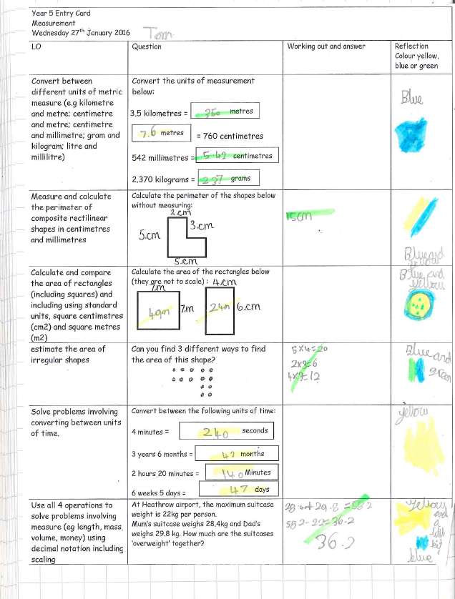
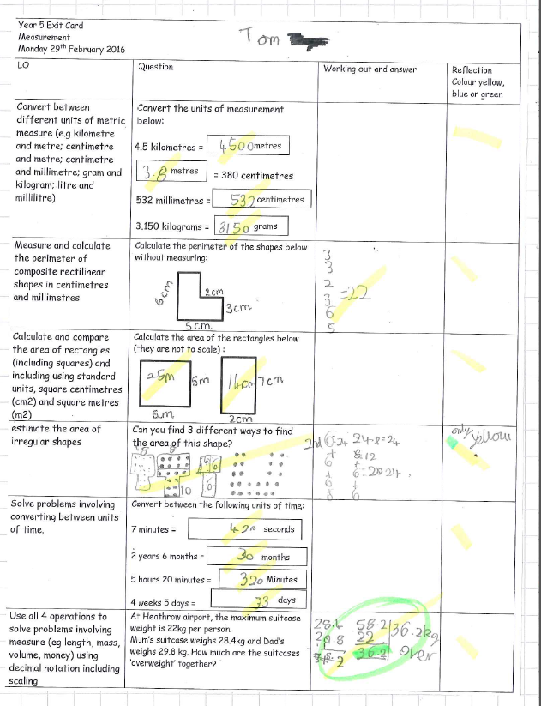
‘Entry’ & ‘Exit’ pass eg Year 5

Slide 24
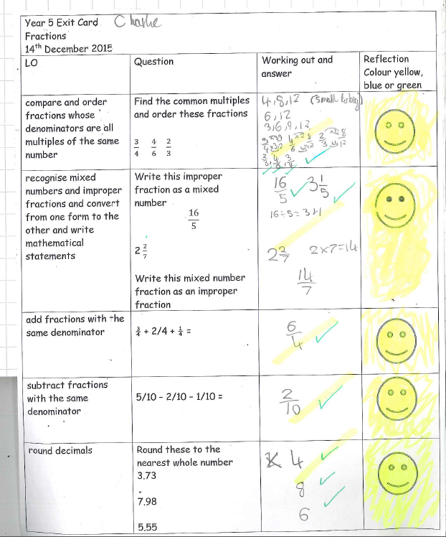
Y5 ‘exit’ pass Fractions

Slide 25
Additional tasks to deepen learning
Key Task 1
Key Task 2
variation
Cold Task
Key Task 3
Hot task
Key Task 1
Key Task 2
Focus for interventions
Practise and consolidation
10/15/20 sessions in the unit

Slide 26
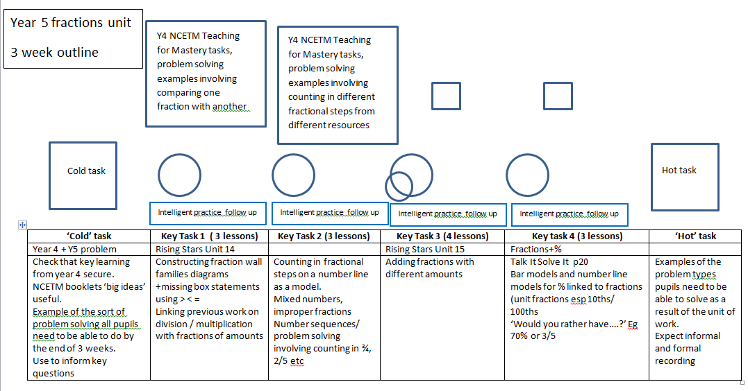
Year 5 Fractions unit

Slide 27
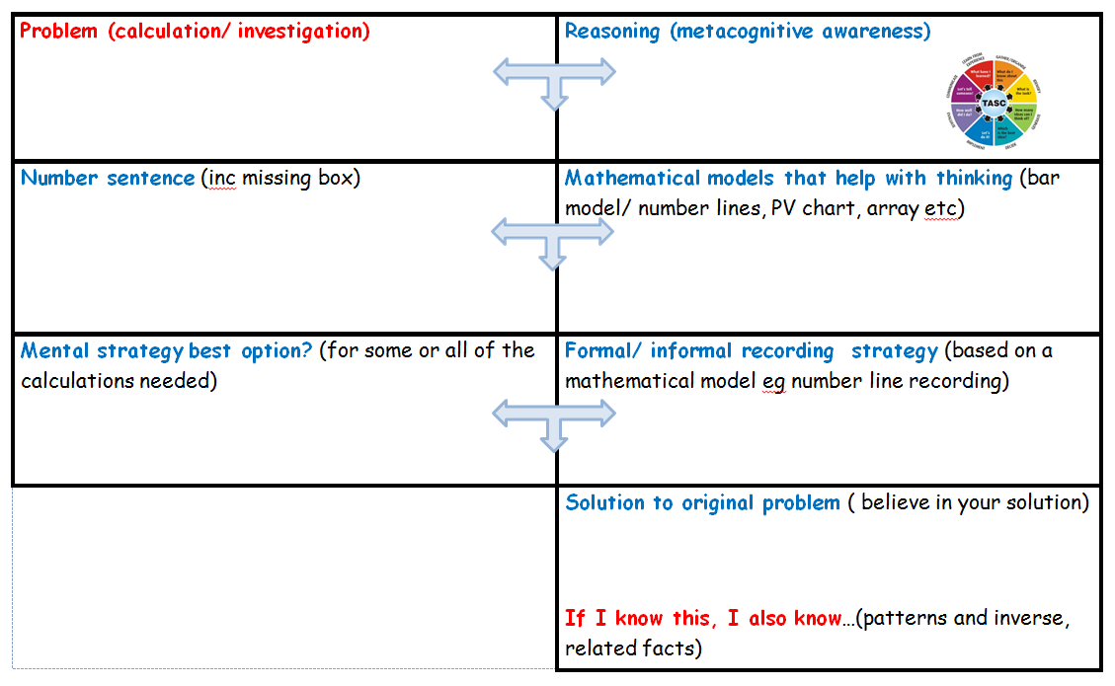
Working towards expert ARE

Slide 28
APPRENTICE mathematician (November)
Relies heavily on the teachers’ modelling to solve calculations and problems tending to repeat exactly what the teacher/ adult has said to describe process used
Uses success criteria as a checklist
Relies upon adult guidance and reminders when ‘stuck’ particularly when remembering meanings of new technical vocabulary or language
Makes choices based heavily on previous year group’s successes
Works ‘mentally’ or with pencil and paper recording as directed by the teacher
Uses concrete resources and models and images as shown by the teacher or adult. May still be building understanding of the connections between concrete modelling and informal/ formal recording
Some solutions are based on counting in 1s rather than making using appropriate use of number bonds (10, 100, 1000, 1) or other known facts
Notes:
Based on the Dreyfus model A Five-Stage Model of the Mental Activities Involved in Directed Skill Acquisition’

Slide 29
Apprentice + COMPETENT mathematician (February)
Can anticipate and independently suggest an appropriate mathematical model which has been used in previous work so far in the year when solving a problem or a calculation.
Can make some suggestions for success criteria to clarify their thinking
Beginning to independently explain their reasoning with peers and adults using some new vocabulary accurately
Developing resilience to ‘being stuck’ by using more than one approach independently before asking for adult help
Can accurately identify and record the number sentence involved when working mentally using a missing box to show the unidentified part.
Able to draw on more than one different representation of the same concept, skill or solution to a routine problem including using concrete resources, models and images and informal recording based on these models
Beginning to notice, talk about, demonstrate and use inverse relationships in calculation, for example responding confidently to ‘ if you know this, what else do you know?’
Some use of known facts and related facts made to check reasonableness of answer and or to identify a calculation that could be solved easily mentally
Notes:
Based on the Dreyfus model A Five-Stage Model of the Mental Activities Involved in Directed Skill Acquisition’

Slide 30
EXPERT mathematician (end of year) make links to DfE interim performance descriptors for end of key stage in Y2 and Y6 ‘working at expected’ +
Pupils can suggest and draw on a range of appropriate models to represent a mathematical concept, or solution including a missing box number sentence
Able to talk about their reasoning using accurate vocabulary when engaged in ‘intelligent practice’ tasks
Can discuss what is mathematically the same and different about a range of problems because the context is not distracting from the mathematics required.
Pupils respond flexibly and with resilience to non- routine problems
Make decisions confidently about which calculations could be worked out mentally and which calculations need pencil and paper recording.
Pupils able to discuss and illustrate connections between domains of mathematics
Pupils can independently use informal and formal notation to share their solutions with peers
Pupils independently use known facts involving all four operations to both simplify calculations and check reasonableness of answers including in the context of measures
Notes:
Based on the Dreyfus model A Five-Stage Model of the Mental Activities Involved in Directed Skill Acquisition’

Slide 31
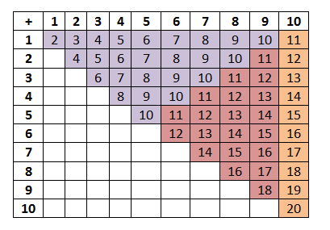
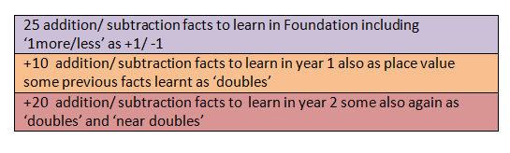
Fluency with addition/ subtraction facts
Develop with concrete resources, number lines and bar models
Learnt as ‘addition/ subtraction’ and ‘multiplication/ division’ as x2, doubles and halves
Learnt as ‘addition/ subtraction’ and ‘near doubles’
In year 2 apply to bonds within 100 eg
3+5= 8/ 5+3=8
30+50=80/ 50+30=80
8-5=3/ 8-3=5
80-50=30/ 80-30-50

Slide 32
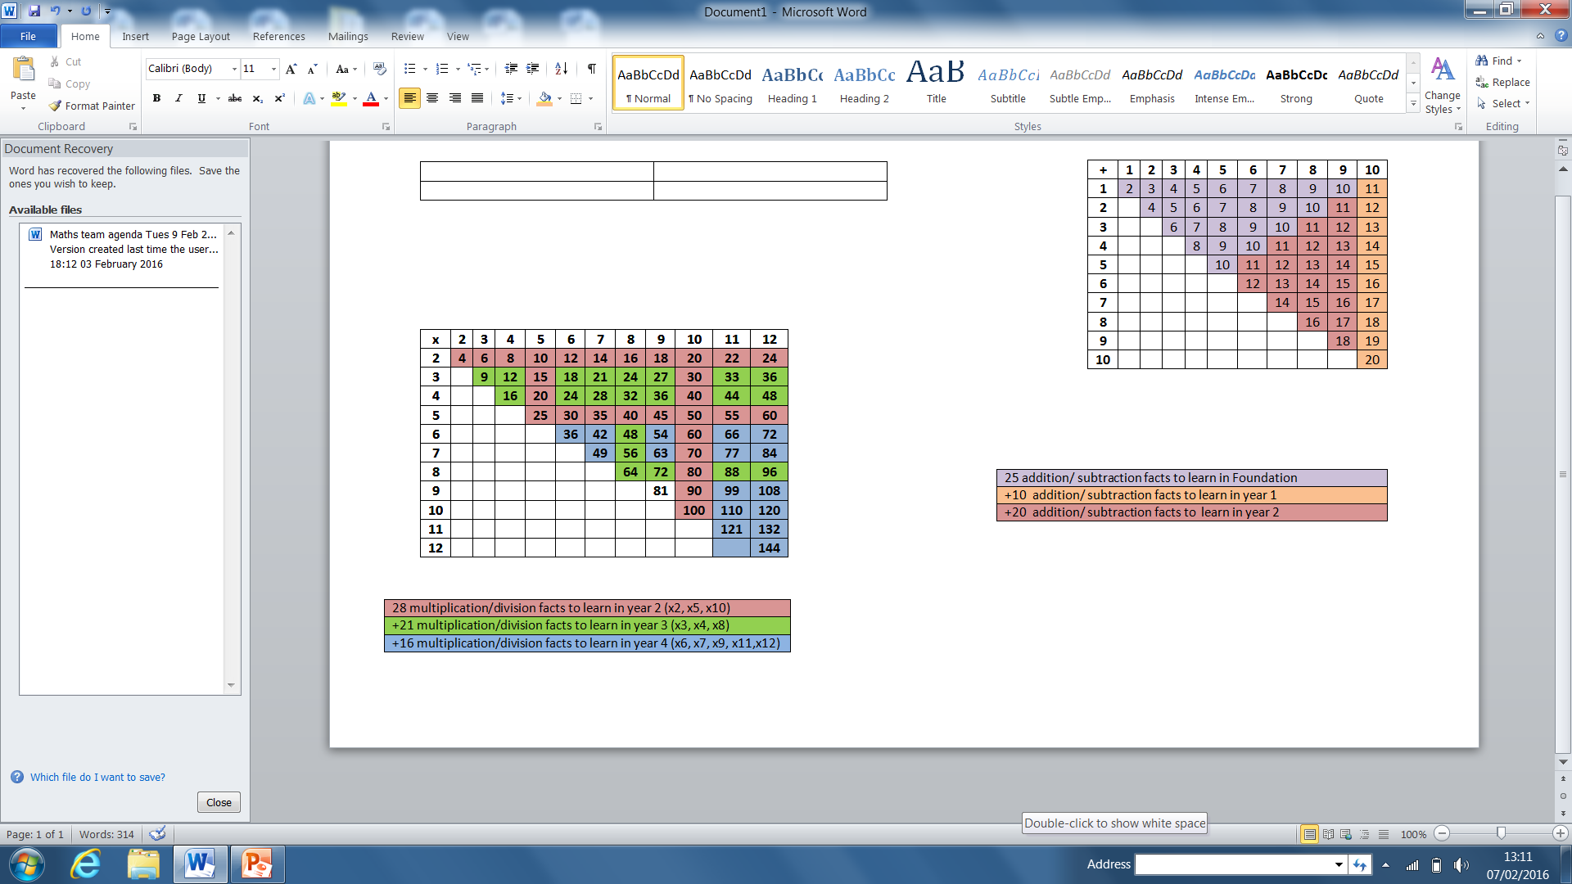
Fluency with multiplication/ division facts
Represented using counting in multiples, number lines, arrays and bar models
Year 3
3x4= 12/ 4x3=12
12÷4=3 / 12÷3=4
30x4= 12/ 40x3=12
120÷4=30 / 120÷3=40
TU x U
eg15x 5= (10x5)+(5x5)
75÷5=15
Year 4
HTU/TU x U
Looking for connections
Eg 30x40=1200
40x30=1200
1200÷40=30
1200÷30= 40

Slide 33



Working towards expert in year 4
Jo pours 3ml of cough mixture from a bottle containing 1/10 of a litre. How much cough mixture is left? Does she have enough for two more 30ml doses?
Chloe shares a bag of grapes between 6 friends. Each friend gets 23 grapes and there are 2 grapes left.
How many grapes were in the bag?
Which of these amounts of money can you make using only 3 coins each time?
£1.12 83p £1.05 46p £2.71 16p
Ruth says that the calculation 50÷8 gives a remainder of 2. Is she correct?
Can you give five other examples of division calculations with a remainder of 2?

Slide 34
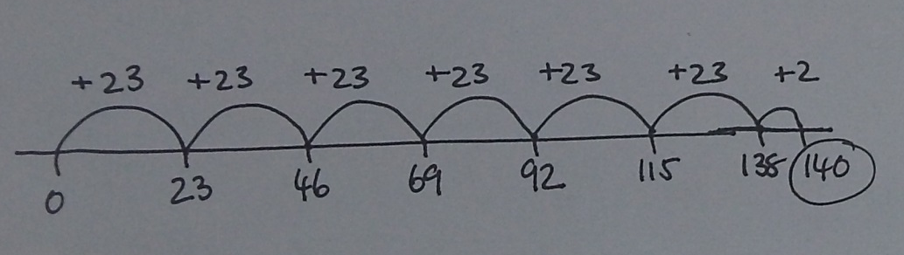
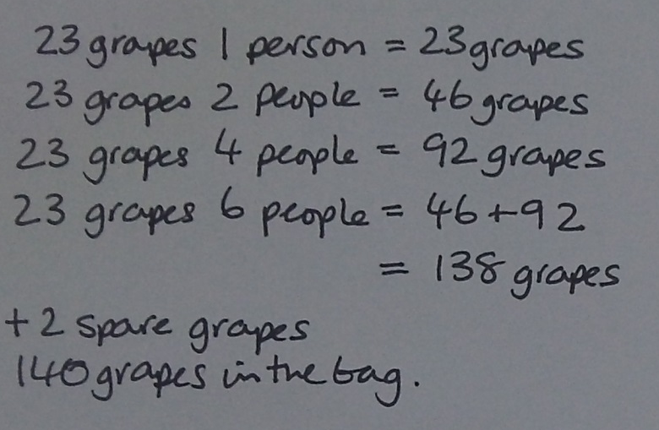


Chloe shares a bag of grapes between 6 friends. Each friend gets 23 grapes and there are 2 grapes left.
How many grapes were in the bag?

Slide 35
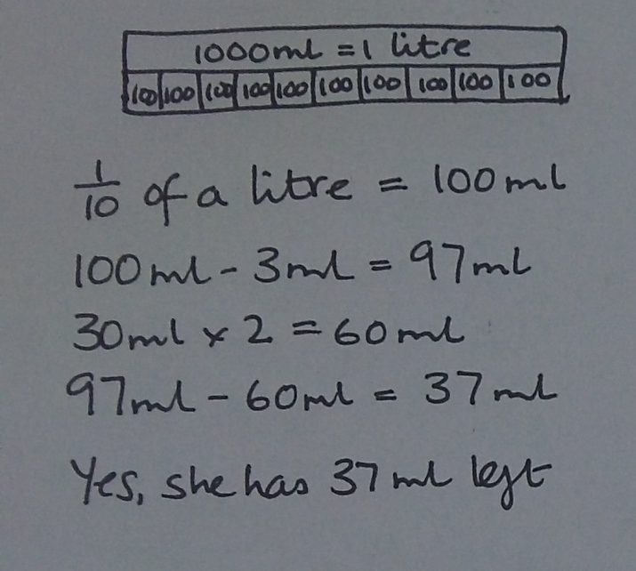
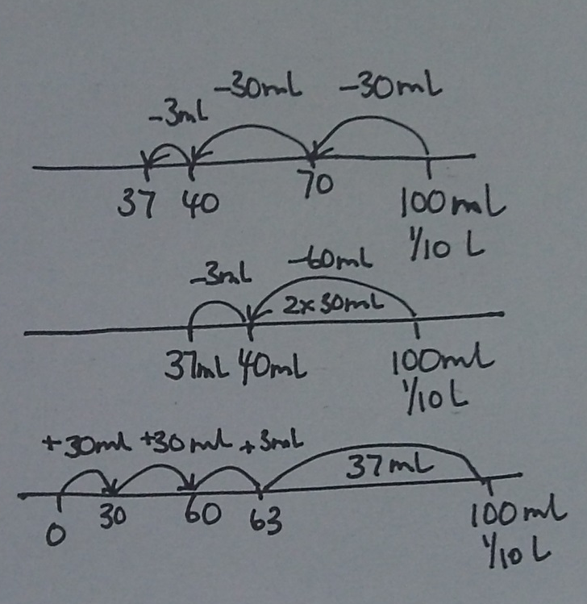

Jo pours 3ml of cough mixture from a bottle containing 1/10 of a litre. How much cough mixture is left? Does she have enough for two more 30ml doses?

Slide 36
Support- independence/ fluency in a focused aspect of maths
Intelligent practice possibilities
Change amount of cough mixture (check pupils know how much this is practically)
- And or change total amount in bottle (check pupils know how much this is, read scale)
- And or change fraction of bottle
- And or change number of doses needed
- And or change amount in each dose
Generate similar problems (look for changes that you can quickly know the answer to because you have worked out one solution already)
Jo pours 3ml of cough mixture from a bottle containing 1/10 of a litre. How much cough mixture is left? Does she have enough for two more 30ml doses?
Write own problem like this one.
Linked practical work, measuring and reading amounts eg of litres expressed as x mls and or fractions of whole litres
Practise:
1/10 of 100ml / 1000ml
3/10 of 100ml/ 250ml
1/5 of 100ml/ 1000ml
4/5 of 100ml/ 1000ml
Missing box examples
Use bar models/ number lines, sequence of number sentences to record solutions

Slide 37
Year 6
Build confidence through discussion and working on the aspects pupils feel they need to improve on
Ensure pupils are conceptually fluent with the parts of the number system they need to calculate with so that they can judge reasonableness of answer
Pupils need to develop a toolkit of calculation approaches – mental, mental with jottings and written methods so that they can independently choose an appropriate approach that will lead them to a solution they can believe in.
Pupils need to understand and use links between domains to find the simplest approach and support their reasoning.
Look at groups of problems and talk about what is the same and what is different about them

Slide 38


The “Competent” Year 2 mathematician…
I have kept up with the learning mapped out in our curriculum so far.
I use resources to support, explain and clarify my thinking
My learning of mathematical concepts and skills is embedded in problem solving and related to appropriate contexts
I am showing sufficient understanding at this time of the end-of-year “big ideas”
My work shows conceptual understanding – and sufficient fluency and confidence with the learning to this point
The work in my books shows sequences of lessons where I have applied, practised and consolidated the core “Phase two” learning
My work shows that I have rich opportunities to practise skills in varied ways that make me think
The sequences of lessons in my book show clear learning journeys.
When I have carried out calculations, my use of appropriate mental skills and strategies is clarified in my work.
Talk and discussion are a big part of my learning in mathematics. My reasoning and explanations are captured
Notes:
HTLC Year 2 standardisation sessions 2016.
Have included moving on to “competent” to show how the learning in the Hampshire model develops over Phase 2. (This slide is the same as for Apprentice – and will be the same in all three phases).

Slide 39

I can confidently use and apply my mental and written calculation skills (+ and -) to solving problems in other domains e.g. measures
My addition and subtraction strategies are becoming more efficient – I can add multiples of ten and bridge through tens numbers (using a number line to scaffold the steps.)
I can quickly add together three single digit numbers.
I can choose and use appropriate standard units for measuring length/height (m/cm)
I have extended my counting skills to include confident counting in steps of 5 from zero
I can calculate mathematical statements involving multiplication – using the symbols correctly.
I can show and explain that I understand that addition of can be carried out in any order (commutativity) but subtraction cannot.
Notes:
The “competent” (phase 2) mathematician.

Slide 40
I can recognise and use symbols for pounds and pence
I can combine different amounts to make a particular value
I can work out change.
I can tell the time on an analogue clock – including quarter to and quarter past – and I can show these times accurately.
I know the number of minutes in an hour and hours in a day.
I can identify and describe the properties of 3D shapes – including the number of faces, edges and vertices.
I can interpret and construct simple pictograms, tally charts, block diagrams and simple tables. I can
ask and answer simple questions by counting the number of objects in each category and sorting the categories by quantity
I have extended my understanding fractions to a non-unit fraction (3/4)
I can use mathematical vocabulary to describe position, direction and movement
Notes:
Competent continued

Slide 41
‘Expert’ in English
The following messages should be applied to your internal assessment of pupils in Year 1, 3, 4 and 5.
End of Key Stage assessment and reporting does not reflect a ‘mastery’ curriculum.
End of Key Stage assessment is based on the ‘interim performance descriptors’ and standards as exemplified in the STA materials.

Slide 42
What might these ideas mean in the context of learning?
Apprentice- Fundamental ideas that build on previous year’s work
Competent- builds on ideas initially developed at the Apprentice stage
Expert- builds on Competence and achieves sufficient mastery for next year’s work
Fluency over time?
Independence?
Resilience to deal with complexity and new contexts?

Slide 43
Within learning journeys - ‘break away groups’ / open ended tasks etc. enable independence where appropriate
Leaners are dependent
Teacher instructs
Leaners are responsible
Teacher guides
Level of Support
Learners are resourceful
Teacher facilitates
Learners are creative
Teacher consults
Academic year
Apprentice
Competent
Expert

Slide 44
Suggestions for a journey to fluency, accuracy, clarity and coherence - WRITING
Level of Support
ARE
Time
FOCUS ON TEACHER LED LEARNING WITH SPECIFIC OUTCOMES
Word banks
Apprentice writes
Teacher demonstrating
Genre features explicitly taught
Structured learning journey to site of instruction writing
Teacher agreed success criteria
Guided editing/ redrafting
FOCUS ON FACILITATING OPPORTUNITIES FOR APPLYING TAUGHT SKILLS INDEPENDENTLY
Pupil choice in writing outcomes – consider audience/ purpose/ author’s voice
Meaningful ‘site of application’ writes
Challenge pupils to generate own success criteria
Empowering pupil choices
Independent editing and redrafting
Reduce the scaffolding over time

Slide 45

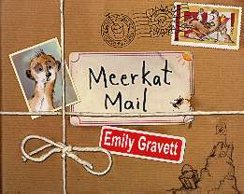





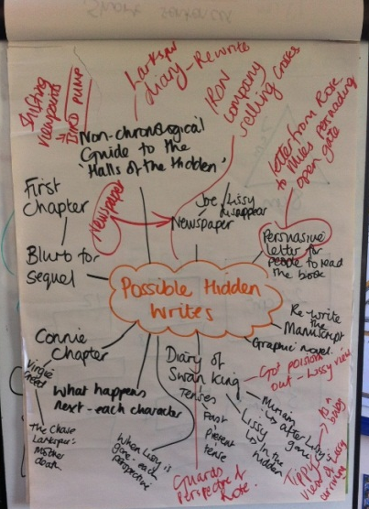
Developing independence and resilience in writing
Choose a stimulus with multiple writing outcomes:
Quality picture books – including for older readers
Wordless picture books
Purpose
Form
Audience
Current local/ national/ world event or issue
Real school event:
School production
Summer fayre
Residential/ day visit
3 ways to tell the same fairy tale
Think genres … think beyond the traditional genres
Writing narrative from a different viewpoint
Email to another character / blog the event
Formal letter & informal diary – same character, same event
– change the style

Slide 46
Suggestions for a journey to fluency, accuracy, clarity and coherence - READING
Level of Support
ARE
Time
FOCUS ON TEACHER LED LEARNING WITH SPECIFIC OUTCOMES
Specific tasks focusing on one or more of the domains
Building a skills base
FOCUS ON FACILITATING OPPORTUNITIES FOR APPLYING TAUGHT SKILLS INDEPENDENTLY
A focus on higher order skills
Deep questioning
Tasks that require answers using skills from across the domains
Range of stimulus e.g. ‘read a painting’ focus on the comprehension skills
Reduce the scaffolding over time

Slide 47







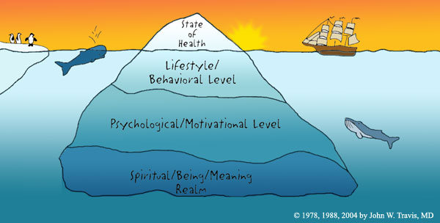

Reading domains: HAM
Developing independence and resilience in reading
Higher cognitive demand, but it is possible to train these thinking muscles at all ages
Making meaning is the guide and the goal
Word reading | Comprehension (knowledge and experience of the world brought to bear alongside strategies) |  |  |  | Inference | Language for effect | Themes and conventions
Cracking the code: piecing together the cues to make a word make sense in context | Clarify | Monitor and summarise | Select and retrieve | Respond and explain | Empathise Predict See layers of meaning | How part relates to whole: writer’s choices in relation to intention | Categorisation: similarities and differences between like texts/ other texts I have read
 | Noticing the bits that don’t make sense | Developing a mental map of the text | Seeking the specific… | What you think and feel

Slide 48
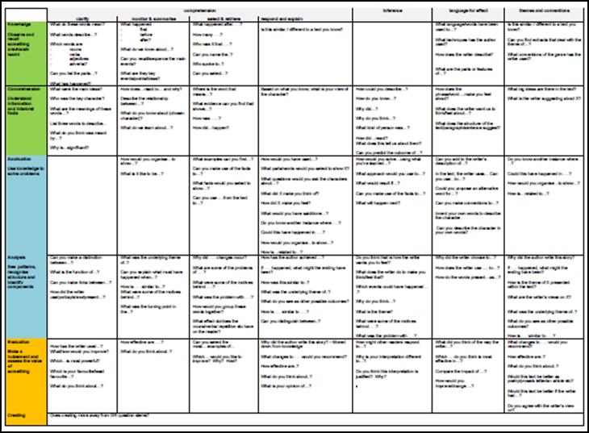
Questioning HO link to Blooms

Slide 49
APPRENTICE WRITER (November)
Copies words and phrases directly from models into own writing
Relies heavily on the model text to shape their own writing
Uses SC as a checklist
Relies upon scaffolds and frames to support writing structure
Relies upon adult guidance and reminders to include essential elements of writing
Writing is functional
Makes some inappropriate choices at word, sentence and text level
Makes choices based heavily on previous successes
Based on the Dreyfus model A Five-Stage Model of the Mental Activities Involved in Directed Skill Acquisition’
Notes:
Based on the Dreyfus model A Five-Stage Model of the Mental Activities Involved in Directed Skill Acquisition’

Slide 50
COMPETENT WRITER (February?)
Draws upon model texts as a guide to shape their own writing
Writes intentionally rather than functionally
Is aware of differences in genres and/or forms of writing
Is able to make appropriate choices of features and organisation according to the genre and/or form
Can make increasingly appropriate choices at word, sentence and whole text level
Is able, at least some of the time, to adapt choices based on previous successes to the needs of the current task
Based on the Dreyfus model A Five-Stage Model of the Mental Activities Involved in Directed Skill Acquisition’

Slide 51
EXPERT WRITER (April+?)
Uses awareness of intended outcome to drive choices made
Choices made when writing are based on the breadth of experience of model texts to date
Writing is developed effectively to match the purpose
Can select an appropriate form or genre of writing to effectively communicate in a given situation
Draws upon the range of experiences they have had and makes appropriate word, sentence and whole text level choices, especially when writing for familiar purposes, genres or forms
Based on the Dreyfus model A Five-Stage Model of the Mental Activities Involved in Directed Skill Acquisition’

Slide 52
EXPERT READER (April+?)
Reads age appropriate texts with increased stamina
Approaches familiar texts with confidence: increased fluency aids comprehension and allows them to self-correct
Selects books independently, reads for pleasure and can use information books and materials for reference purposes
Understanding of different literary drivers revealed through discussion and writing
Infers beyond the literal; draws on multiple skills across domains
Makes links between texts, experiences and the wider world
Notes:
Look at this alongside the yellow band on HAM – Do pupils exemplify these behaviours within the rich range of opportunity outlined in the curriculum?

Slide 53
Yr 1,3,4,5 Expert
.
Notes:
Behaviours – fluency – accuracy – coherence – clarity
Task working on tables begin to identify ‘key behaviours’ a Yr X child will demonstrate at ‘expert’ reading and writing
Work on tables – collect in – align with our thinking and publish on Moodle

Slide 54
Pupils Below ARE

Slide 55
Pupils who are ‘Below’
Below pupils are likely to fall into three groups:
catch up children
specific domain (children identified in current research group) – scrolling back in specific domains
Global – opportunity to join a research group
Activity: work with your leadership team to sort the children into the three groupings – what effective practices have you for catch up children…..and to what extent have you employed scrolling back fro specific domains? Recording of this?

Slide 56
High Impact Interventions
Making use of all time available
Using diagnostic assessment to ensure that the interventions are well focused – diagnostic mathematics activities/reading miscue analysis/PM benchmarking/Language Links?
Having a clear suite of interventions that are well known by the school team so that they can be used effectively – ideally members of the team will create some expertise that can be effectively shared with all/drawn upon
Ensuring the timescale is brisk for interventions – short sharply focused and high impact – demonstrating double ratio gains
Ensuring clear entry and exit measures are in place – measurable
Ensuring that interventions used are the most effective and best value
Involving parents/carers in the drive for ARE – ensuring that parents are enlisted in aspects that are easy to practise/where over-learning is essential

Slide 57
The value of pre-teaching and keep up sessions
Making use of pre-teaching proven to be highly effective so that pupils are supported before the teaching cycle
Enlist the use of parents/carers to support the building of key ideas/confidence before the teaching cycle
Ensuring that post-teaching is timely and misconceptions addressed quickly – use of catch up time in the afternoon? Over lunch? Use of other adults to enable the teacher to focus on the misconceptions – Shanghai mathematics model
Use of teacher time to effectively address misconceptions as soon as they occur – next lesson ready

Slide 58
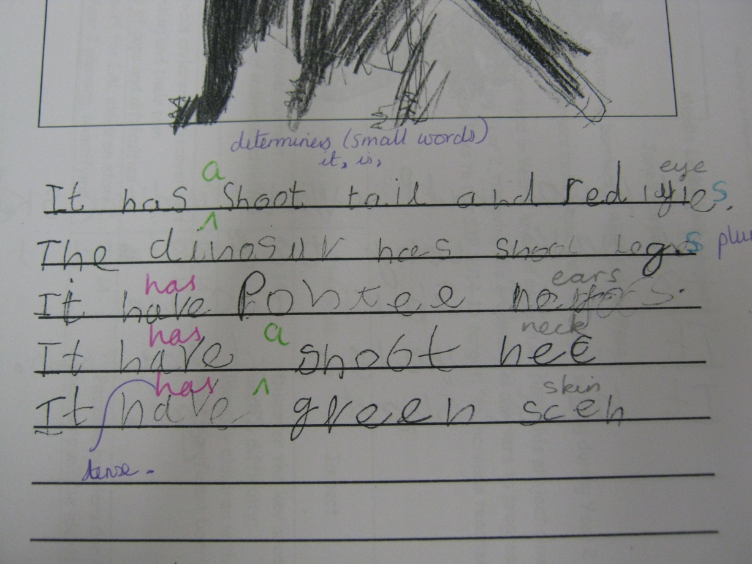
Before pre-teaching - sample
Formative assessment – identified barriers
Verb tenses
Plurals
Missing determiners

Slide 59
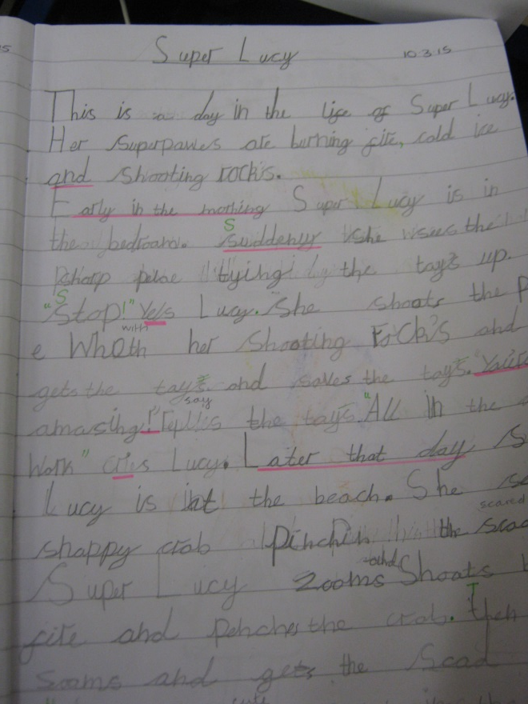
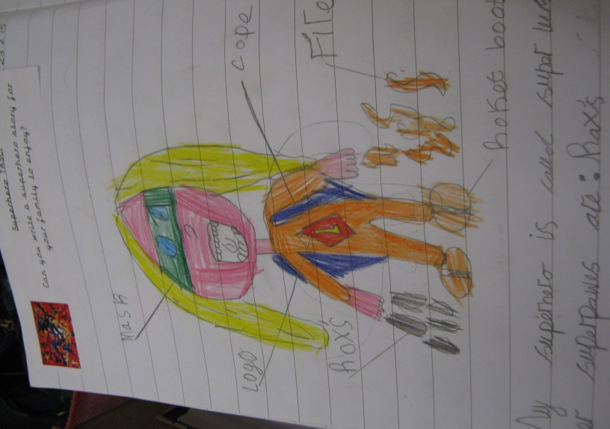
Actions…
Pre-teaching for focus children – 20mins a week – two groups
  Generalisers for report writing
  Imperatives for instructions
  Present tense for story writing

Slide 60

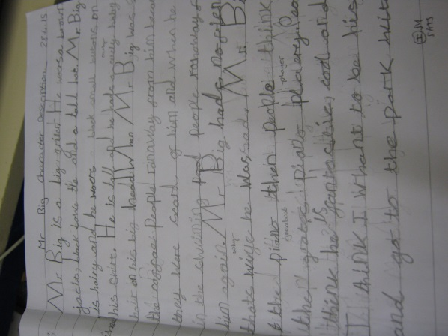
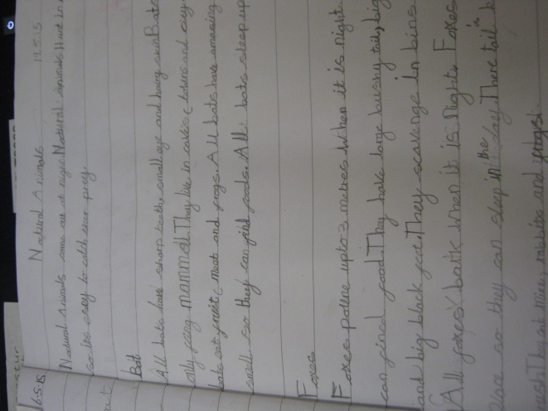
Impact
Focus child made 3 sublevels of progress in writing (even though early Spring looked unlikely)
Focus child now corrects the writing of others orally – can hear when determiners / plurals / ed are missing

Slide 61

Literacy provision with evidence evaluated by Institute of Education
Reading and / or spelling
Writing
Acceleread, Accelewrite
Better Reading Partnership
Catch-up Literacy
Paired Spelling
FFT Wave 3
Inference Training
Paired Reading
Phonographix
Reading Recovery
Reciprocal Reading
Paired Writing
Reading Recovery
Write Away Together
Notes:
interventions have been reviewed by Greg Brooks in ‘ What works for pupils with literacy difficulties? The effectiveness of intervention schemes’
Use this and the next slide to summarise current evidence on what works. Make clear that some widely used interventions (such as PAT- Phonological Awareness Training) are not on the list because they have been evaluated and not proved to double children’s rate of progress.

Slide 62

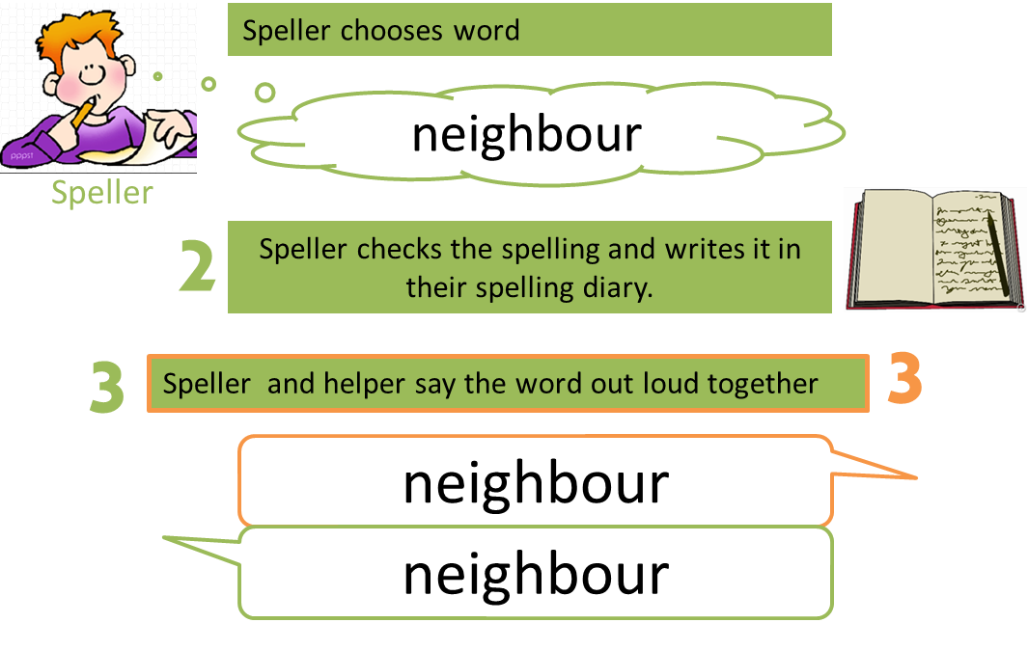



Paired Spelling

Slide 63
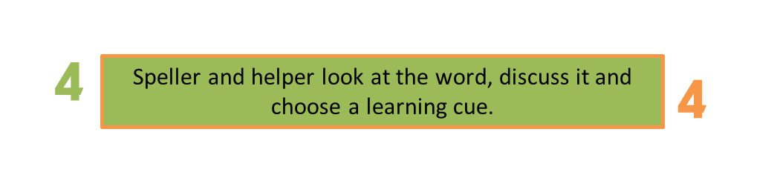
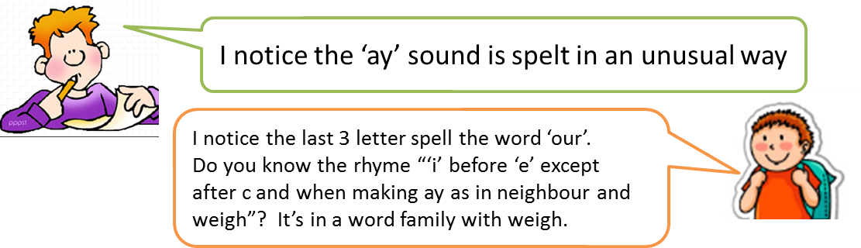



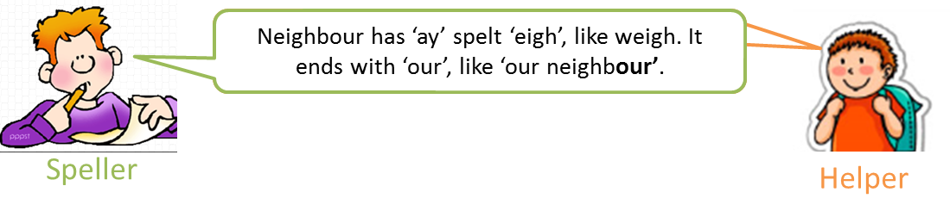

Slide 64


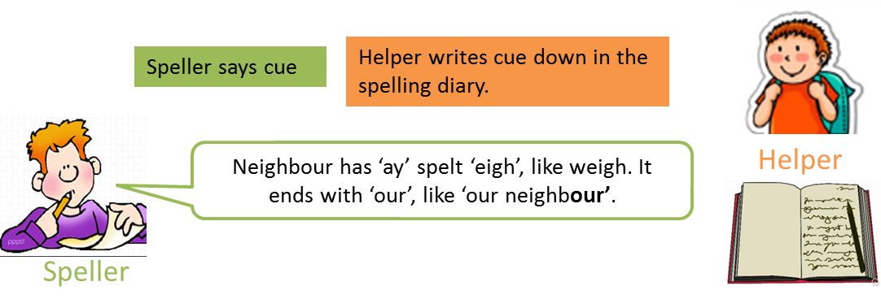
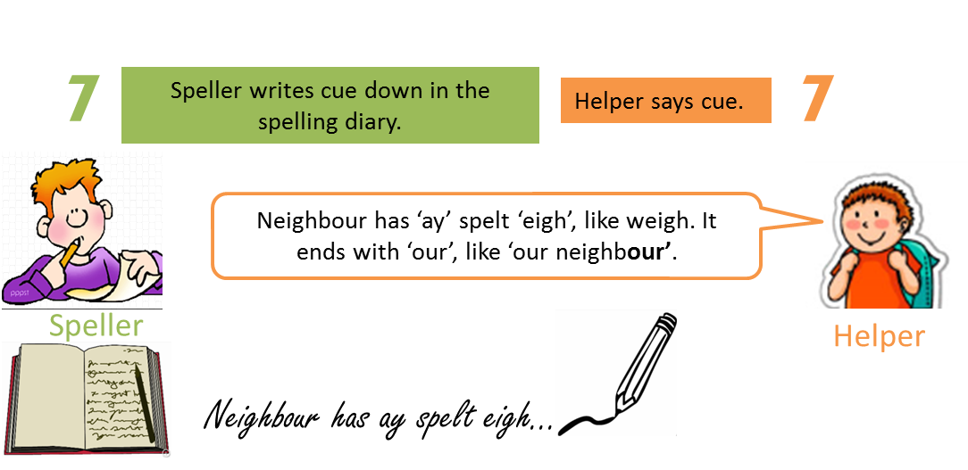

Slide 65
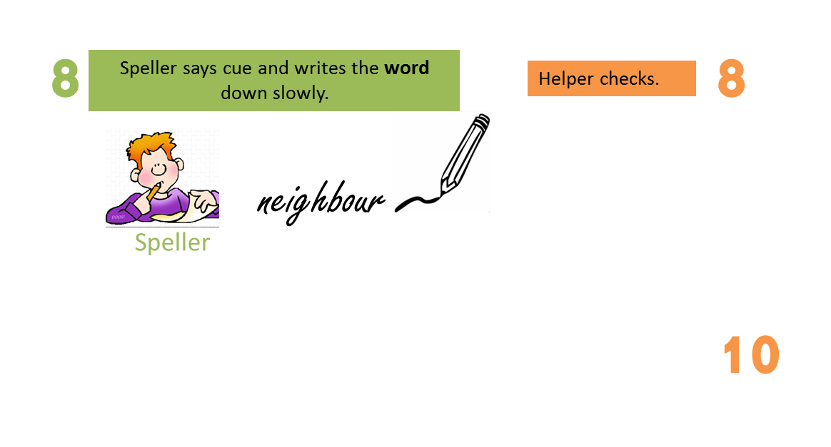
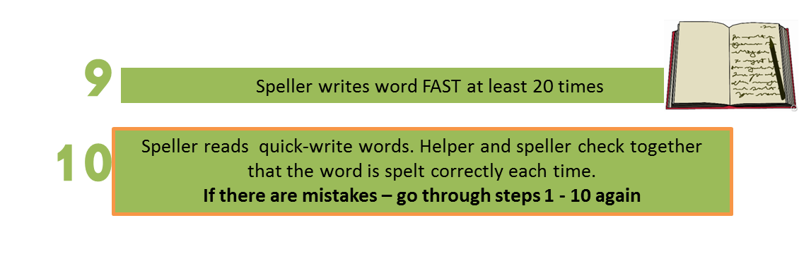
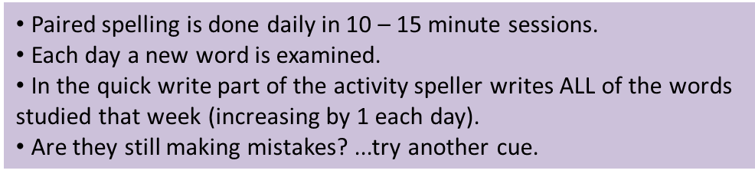

Slide 66


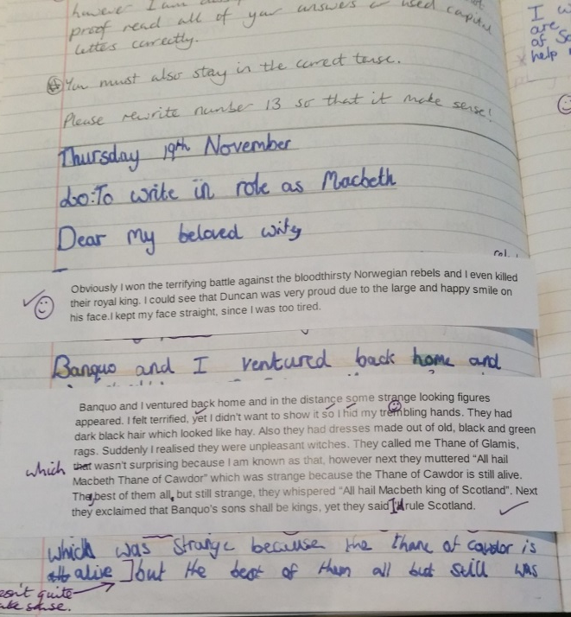
EDITING TOOLKIT – encouraging independent and resilient learners
‘Monkey talking’
Whole class read work aloud with fingers in their ears. Technique enables child to hear their work aloud and check for sense/ improve word choices etc without disturbing others.
Editing flaps
Focused editing on a particular section – could be directed by teacher or child initiated. Enables teacher and child to see redrafting easily.

Slide 67

EDITING TOOLKIT – encouraging independent and resilient learners
Spelling:
‘Dot it, don’t dodge it’
Child identifies known spelling errors as they write (by underlining or dotting) but are not distracted from the flow of their writing. Child returns to the words later with a dictionary/ word bank to correct.
‘Spelling Spyglass’ (KS2)
Child reads their work backwards: from bottom right to top left. Checking for spelling errors without distraction of context
Coloured marking (KS1)
Teachers identifies word spelt incorrectly with a specific colour, but does not write new spelling. Child independently finds correct word on a given word bank e.g. blue dot – find word on blue word bank of second hundred high frequency words.
Coloured margin marking (KS2)
As above, but teacher identifies in the margin. Growing independence ensures child finds word within the line that is incorrect.

Slide 68


Slide 69

Aiming for success
ECC interventions aim to help schools to help pupils who have fallen behind to get back on track and catch up with their peers so that they can go on succeeding in class lessons afterwards.
They are time-limited:
10 to 18 weeks
3 to 5 days a week
30 to 40 minutes
Pupils continue take part in class lessons.

Slide 70
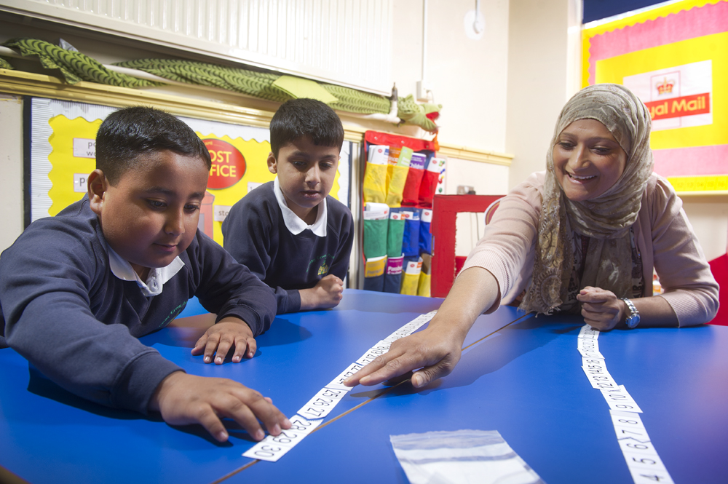
1stClass@Number
for children who need a helping hand with mathematics
1stClass@Number 1
Year 2
1stClass@Number 2
Years 3 and 4
delivered by a teaching
assistant
UPDATED
Sept 2015

Slide 71
How 1stClass@Number works
Organisation | The Lessons
up to 4 children in a group 30-minute lessons 3 times a week 10 weeks | Post Office theme real-life scenarios for stimulus and application enjoyable activities to build confidence focus on understanding number, place value and calculation adaptable to children’s needs
Training
7 half days for the TA 2 half days for a Link Teacher extensive plans & resources

Slide 72
1stClass@Number outcomes
number age gain | 12 months in 3.5 months
improved attitude in class | 93 %
“This is the best programme we have ever had for teaching assistants. It was not only effective but children gained an enthusiasm for their maths work”
Redlands PS, Tower Hamlets
“Going to 1stClass@Number was like when I got my glasses. Now I can see how maths works, just like everyone else!”
Child, London

Slide 73
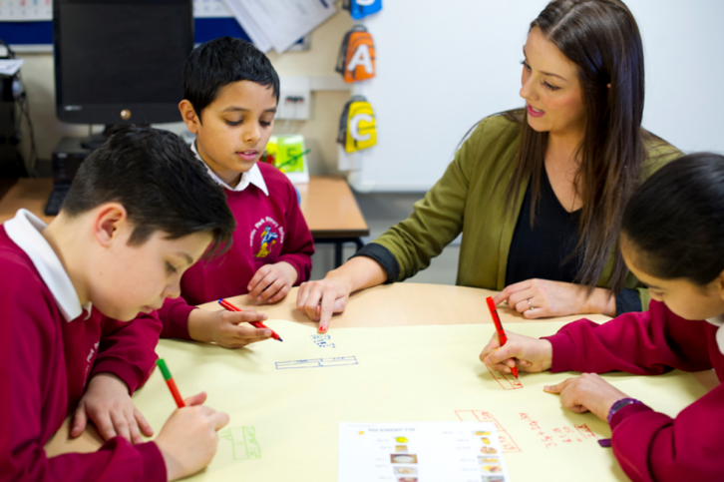
Success@Arithmetic
for pupils who find calculation difficult
S@A: Number Sense
for pupils in Years 3 to 5 who
need support to understand
the number system and
become fluent with number facts
NEW
Sep
2015
S@A: Calculation
for pupils in Years 5 to 8 who need support to understand calculations and develop fluency with written methods
led by a teacher and a teaching assistant

Slide 74
How Success@Arithmetic works
Organisation | The Lessons
3 pupils in a group 40-minute lessons 3 times a week 10 weeks | a Lead Teacher conducts a diagnostic assessment and plans the steps a teaching assistant delivers the steps build understanding with number rods, bar models and base-10 apparatus promote fluency with daily skills practice develop efficient use of written methods
Training
2½ days for the teacher and teaching assistant detailed plans key teaching resources

Slide 75
Success@Arithmetic outcomes
number age gain | 16 months in 4 months
improved attitude | 91 %
“The use of base-10 alongside the standard written method for subtraction is nothing short of inspirational. In over 20 years of teaching I’ve never seen such rapid progress.”
Bramley St Peter’s CEPS, Leeds
“We are very impressed with Success@Arithmetic. The children have made accelerated progress, grown in confidence and enjoyed their lessons.”
Friarage CPS, N Yorkshire

Slide 76
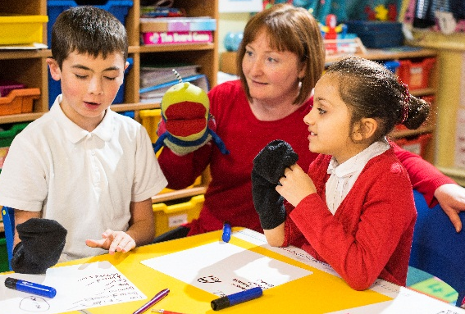
Talk 4 Number
NEW
April
2015
for pupils who find it hard to talk about
mathematics
for pupils in Years 3 and 4 who
need support to:
use and understand mathematical language
talk fluently about their mathematics
and
for pupils in Year 3 or above who are in the later stages of learning English as an Additional Language
led by a teaching assistant

Slide 77
How Talk 4 Number works
Organisation | The Lessons
4 pupils in a group 30-minute lessons 3 times a week 8 weeks | enjoyable, multisensory activities help pupils to talk confidently about number in a wide range of contexts key vocabulary and language structures strengthening reflection and metacognition group talk and paired talk
Training
2 days for the TA 1 day for a Link Teacher detailed plans key teaching resources

Slide 78

Talk 4 Number outcomes
number age gain | 10 months in 2.5 months
improved confidence | 92 %
“Talk 4 Number equips teaching assistants with the strategies to help pupils find their mathematical voice and express their mathematical ideas.”
Willow Tree PS, Ealing

Slide 79
Next session…..session 4

