Slide 1
Reporting to stakeholders
HAM Session 3
Rationale
Schools should now have completed two data drops
They will need to be able to show progress and attainment for all pupils, vulnerable pupils, etc. to a range of audiences including governors and external audiences in reading, writing and mathematics across all year groups
Schools will be using a variety of evidence for this purpose and we need to explore these to ensure that they are fit for purpose
Issues are arising for schools that are using SIMS for a number of reasons including
  the distinction between ‘close to’ and ‘securely on track’ is proving a challenge for some schools and this is creating data that is not reflective of the cohort and this is not separated in SIMS (doesn’t show shift in ‘secure’)
  the number of potential reports can be overwhelming if schools are not precise about what they need to be able to show
Sue Savory is working with SIMS team in order to ensure that it fully meets the requirements of the HAM. She is keen that schools are able to contribute to this process.

Slide 2
Key Questions/issues
To what extent have you been able to enable governors and other stakeholders to gain a clear view of the position of attainment within the school for overall cohorts? Pupil groups and individual subjects (domain analysis)? To what extent is the work of other school leaders being supported by the degree of detail available through the tracking information? To what extent is CPD being targeted effectively?
How are you ensuring that the data is based on robust evidence? How are you articulating this to governors and other stakeholders?
Issues around ‘close to’ twice (milestone one and two. If schools have interpreted the guidance then they cannot enter back to ‘close to’ twice. This means if schools enter this judgement at milestone 1 they may have entered N at milestone 2 which then affects the data. What have schools been doing? Robust conversations? Pupil progress meetings? School curriculum….accepting red
There is also a need to show that more pupils are secure rather than ‘close to’ and often these judgements are combined in SIMS. SIMS wont show this through a report at domain level so if schools want this they need to generate their own format using the data
I can’t find a way to do…….
  a whole school domain analysis (i.e. spelling across the school) without taking the data for each year and combining separately
  Group analysis at domain level (school example included)

Slide 3
Ofsted - Outcomes
Inspectors will take account of current standards and progress, including the school’s own performance information, and make a relevant judgement on academic and other learning outcomes for pupils by evaluating the extent to which all pupils:
progress well from their different starting points and achieve or exceed standards expected for their age nationally (at the end of a key stage), or within the school’s own curriculum
In judging achievement, inspectors will give most weight to pupils’ progress.
They will take account of pupils’ starting points in terms of their prior attainment and age when evaluating progress. Within this, they will give most weight to the progress of pupils currently in the school, taking account of how this compares with the progress of recent cohorts, where relevant.
Inspectors will consider the progress of pupils in all year groups, not just those who have taken or are about to take examinations or national tests. As part of pupils’ progress, inspectors will consider the growth in pupils’ security, breadth and depth of knowledge, understanding and skills.
Primary School Accountability in 2016 – A technical guide for primary maintained schools, academies and free schools

Slide 4
Ofsted – Role of governors
provide a balance of challenge and support to leaders, understanding the strengths and areas needing improvement at the school
provide support for an effective headteacher or are hindering school improvement because of a lack of understanding of the issues facing the school
understand how the school makes decisions about teachers’ salary progression and performance
understand the impact of teaching, learning and assessment on the progress of pupils currently in the school
ensure that assessment information from leaders provides governors with sufficient and accurate information to ask probing questions about outcomes for pupils/pupil groups
ensure that the school’s finances are properly managed and can evaluate how the school is using the pupil premium and the primary PE and sport premium
are transparent and accountable, including in recruitment of staff, governance structures, attendance at meetings and contact with parents.

Slide 5
SIMS Example -
Cohort tracker (2 sheets combined)

Slide 6
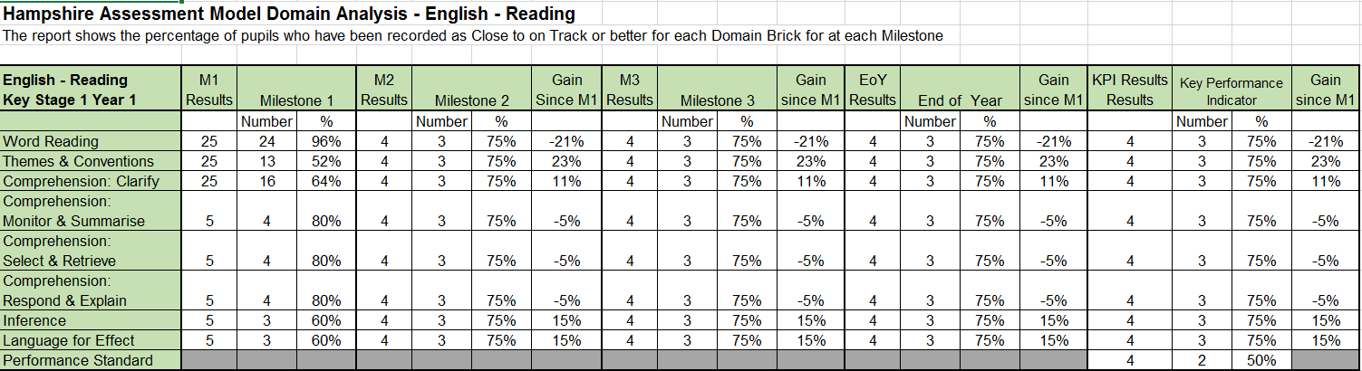
SIMS Example –
Domain Analysis

Slide 7
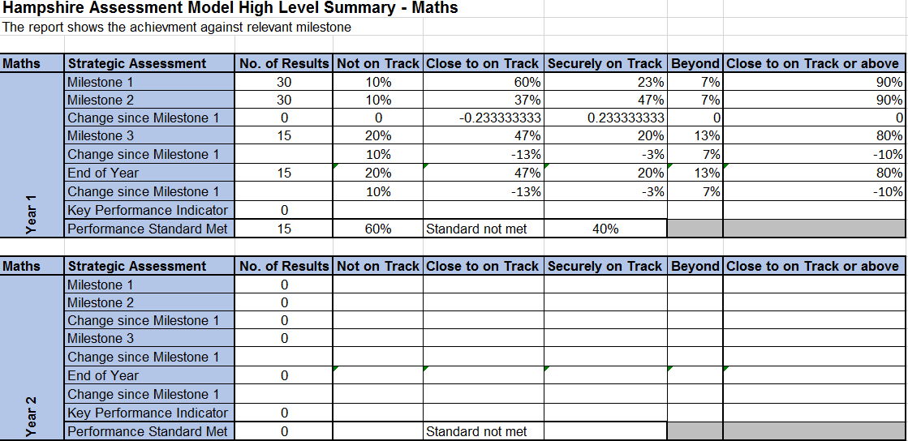
SIMS Example –
High level summary - subject

Slide 8
SIMS Example –
High level summary – Year Group

Slide 9
School example –
Domain analysis by groups
Reading | Y6 | Word Reading |  |  |  | Themes and Coventions |  |  |  | Comp: Clarify |  |  |  | Comp: Monitor and summarise |  |  |  | Comp: Select and retrieve |  |  |  | Reason and explain |  |  |  | Inference |  |  |  | Language for effect
Feb 16 |  | N | C | S | B | N | C | S | B | N | C | S | B | N | C | S | B | N | C | S | B | N | C | S | B | N | C | S | B | N | C | S | B
All chn |  | 22 | 8 | 69 |  | 3 | 25 | 71 |  | 2 | 3 | 95 |  | 22 | 3 | 75 |  | 14 |  | 86 |  | 46 | 5 | 49 |  | 42 |  | 58 |  | 46 | 19 | 36
Boys |  | 27 | 12 | 61 |  | 6 | 36 | 58 |  | 3 | 6 | 91 |  | 30 | 6 | 64 |  | 21 |  | 79 |  | 52 | 9 | 39 |  | 48 |  | 52 |  | 55 | 18 | 27
Girls |  | 15 | 4 | 81 |  |  | 12 | 88 |  |  |  | 100 |  | 12 |  | 88 |  | 4 |  | 96 |  | 38 |  | 62 |  | 35 |  | 65 |  | 35 | 19 | 46
PP6 |  | 21 | 8 | 71 |  |  | 17 | 83 |  | 4 | 4 | 92 |  | 13 | 8 | 79 |  | 13 |  | 88 |  | 46 | 4 | 50 |  | 50 |  | 50 |  | 42 | 25 | 33
PP6 |  | 23 | 9 | 69 |  | 6 | 31 | 63 |  |  | 3 | 97 |  | 29 |  | 71 |  | 14 |  | 86 |  | 46 | 6 | 48 |  | 37 |  | 63 |  | 49 | 14 | 37
SEND |  | 44 | 22 | 33 |  |  | 67 | 33 |  | 11 | 11 | 78 |  | 33 | 22 | 44 |  | 22 |  | 78 |  | 78 | 11 | 11 |  | 78 |  | 22 |  | 67 | 33 | 11
EHCP |  | 100 |  |  |  | 50 |  | 50 |  |  | 50 | 50 |  | 50 |  | 50 |  | 100 |  |  |  | 100 |  |  |  | 100 |  |  |  | 100
SEND |  | 15 | 6 | 79 |  | 2 | 19 | 79 |  |  |  | 100 |  | 19 |  | 81 |  | 8 |  | 92 |  | 38 | 4 | 58 |  | 33 |  | 67 |  | 40 | 19 | 42
EAL |  | 14 | 29 | 57 |  | 14 | 29 | 57 |  |  |  | 100 |  | 43 |  | 57 |  | 14 |  | 86 |  | 57 |  | 43 |  | 29 |  | 71 |  | 57 | 29 | 14

Slide 10
School example
High level summary
Y3 | Summer EOY (Y2) |  |  | November 26% SEN |  |  |  | February 25% SEN |  |  |  |  |  |  |  | April |  |  |  |  | EOY
 | B | ARE | B+ | Below | On track |  | beyond | Below |  | On track |  |  |  | Beyond |  | Below | On track |  |  | beyond | Below | ARE | beyond
 |  |  |  |  | Close to | secure |  |  |  | Close to |  | Secure |  |  |  |  | Close to | secure
Reading | 33 | 67 |  | 38 | 61 | 1 |  | 25 | 48 | 14 | 11 | 61 | 41 | 1 |  | 21 | 9 |  | 70 | 14 | 21 | 79 | 31
Writing | 42 | 58 |  | 28 | 57 | 5 |  | 28 | 63 | 15 | 12 | 57 | 25 | 5 |  | 28 | 7 |  | 65 | 11 | 28 | 72 | 16
Maths | 18 | 82 |  | 17 | 56 | 27 |  | 17 | 31 | 27 | 25 | 56 | 44 | 27 |  | 17 | 15 |  | 68 | 25 | 17 | 83 | 31
Y4 | Summer EOY (Y3) |  |  | November 17% SEN |  |  |  | February 19% SEN |  |  |  |  |  |  |  | April |  |  |  |  | EOY
 | B | ARE | B+ | Below | On track |  | beyond | Below |  | On track |  |  |  | beyond |  | Below | On track |  |  | beyond | Below | On track | beyond
 |  |  |  |  | Close to | secure |  |  |  | Close to |  | secure |  |  |  |  | Close to | secure
Reading | 45 | 55 |  | 10 | 40 | 50 |  | 10 | 19 | 18 | 29 | 72 | 52 | 17 |  | 10 | 16 |  | 74 | 25 | 10 | 76 | 27
Writing | 75 | 22 |  | 18 | 80 | 2 |  | 18 | 37 | 22 | 61 | 60 | 22 | 7 |  | 18 | 19 |  | 63 | 15 | 18 | 65 | 17
Maths | 53 | 45 |  | 17 | 83 |  |  | 17 | 29 | 8 | 44 | 75 | 27 | 15 |  | 17 | 3 |  | 80 | 25 | 17 | 83 | 27

Slide 11
School example – high level targets

Slide 12
School example - tracking

Slide 13
School example – domain analysis

