Slide 1
Hampshire Assessment Model
Project Group
Eastleigh Group
Session 2, Holiday Inn
Catherine Redgrave (PPI), Emma Tarrant (English), Jenny Burn (Maths)

Slide 2
Time to re-group – while you are getting coffee talk about …
What’s different?
What are you noticing?
Trends?
Themes?
Key development areas going forward?
  (Post-it to share with colleagues in order to establish links with other schools)

Slide 3
Aims
Opportunity to take stock of developing practice using the HAM
Ensuring that the HAM is a model that is applicable to all children, including those working below the expected standard
English and mathematics - developing an understanding of what ‘on track’ at milestone 2 means
Establishing a project group identity and working with peers to explore and develop practice

Slide 4
Timetable
8:45 Re-group (while signing in etc)
9:00 Group activity to review current changes to practice
10:00 SEND
10:30 BREAK
10:45 English
11:15 Mathematics
11:45 Moodle and next steps

Slide 5
Developing practice
You were asked to come ready to share your developments with regard to:
  Enrichment and extension for higher attaining pupils
  Classroom approaches to mastery teaching and learning
  Using formative day to day assessment
  Using summative periodic assessment
  Working with parents/pupils/governors etc to present information
Notes:
Each school to take the appropriate colour-coded piece of paper on entry so that it is evident what aspects are being covered within each group
If you have PPT or notes please email to PPI so that it can be shared with the rest of the group on the Moodle.

Slide 6
Group Activity – in groups share:
The selected focus and its significance to your school’s context
The key underpinning ideas and questions that informed the practice development
Any exemplification of the development in action
Any impact that the development has had so far
Discuss what has been learned, implications, questions and next steps

Slide 7
An inclusive approach to assessment: ensuring the progress of children with SEND

Slide 8
Project Team
Penny Earl SENCO, Wallisdean Junior School
Gay Keegan Educational Psychologist
Sarah Kiel SEN inspector
Carol Koerner General Phase Inspector
Lesley Pennington H/T, Whiteley Primary School
Lynne Smith H/T, Farnborough Junior School
Suzy Wright SENCO Vigo Inf. & Junior School
Kirsty Jordan Teacher, Wolverdean School
Notes:
A group of schools are working with Sarah Kiel and Carol Koerner to develop the practice of assessment with children with SEND.
Range of different schools involved to try to capture the range of experiences schools are having to manage

Slide 9
Interim recommendations of the Rochford review
The members of the review are keen to see one inclusive system of assessment that takes into account the requirements of the Code of Practice and is applicable to pupils working below the standard of statutory assessment arrangements, including those whose attainment outcomes are currently reported using P scales. This should provide greater simplicity and clarity for teachers who are required to assess these pupils. (pp10)
Notes:
Assessment of the curriculum

Slide 10
Pupils working below the standard of the national key stage assessments
A small percentage of the population will not complete the programmes of study and therefore be unable to access standards in tests or interim teacher assessment frameworks.
The Rochford Review proposes some interim “pre-key stage 1 and 2 standards”.
However,
“the interim solution is only to be used for statutory assessment for specified pupils at the end of the key stage. It is not a curriculum and should not be used to guide teaching” (p5)
Notes:
This emphasises a point we (and the commission for assessment without levels) have made for all pupils, that the end of key stage performance standards are for use at the end and not during the key stage. They are for national summative assessment and should not be used directly for in school formative or summative assessment. The assessment approaches developed by schools should reflect the security of pupils’ achievements against the curriculum.

Slide 11
Rochford Review – interim solution for end of key stage assessments
At key stage 1, the statements within the additional standards reflect those areas of knowledge and understanding that the review has identified as core developmental milestones for progression onto the standards defined by the existing interim frameworks.
At key stage 2, some of the statements in the additional standards are based on those elements of the key stage 1 curriculum that remain relevant for pupils who have not completed the key stage 2 programme of study. They sit alongside some additional statements which define expectations appropriate for pupils working at that standard and reflect the core knowledge and skills that this group of pupils need to progress.
(Rochford Review, pp5-6)

Slide 12
Interim Pre-KS1 standards
Foundations for the expected standard
Working towards the expected standard
Working at the expected standard
Working at greater depth at the expected standard

Slide 13
Interim Pre-KS2 standards
Foundations for the expected standard
Early development of the expected standard
Growing development of the expected standard
Working towards the expected standard (writing only)
Working at the expected standard
Working at greater depth at the expected standard (writing only)

Slide 14
Rochford Review
‘To consider the best way to ensure that pupils who have not completed the relevant key stage programme of study, and are therefore working below the standard of statutory testing arrangements, have the opportunity to demonstrate attainment and progress at primary school’
Next steps: “may also make some recommendations about good practice in non-statutory assessment of pupils working below the standard of the national curriculum tests” (p10)
Notes:
Share ‘Pre-Key Stage: pupils working below the test standard’ interim teacher assessment framework documents KS1 and KS2
These are end of key stage documents and should not be used by schools at other points to evaluate children’s ‘on trackness’.
Rochford Review brief similar to ours in that it is crucial that what we do is equitable, demonstrates/celebrates progress, as reporting to parents and the child that they are below age related year on year is not an option
The following are the key questions we are currently working on…

Slide 15
The challenge for schools is to create an approach to day to day assessment
“…which works for pupils with special education needs, some of whom may be following an alternative curriculum..”
“Any assessment methods and tools used should reflect this and support a personalised approach.”
(Final report of the Commission on Assessment without levels, p16, September 2015)
Notes:
Our core enquiry was to identify key principles and solutions for continuous and diagnostic assessment to support the most vulnerable children.

Slide 16
Which pupils?
Not pupils who are working within P levels and likely to remain in this band for their primary education.
Not pupils who are under-attaining because of relative disadvantage,(without SEN), or a low starting point on entry to school, who should reasonably be expected to “catch up”.
Not pupils affected by teaching that has not been effective over time or where there are other short term, causal factors.
Notes:
Key to this was clarity around the group of children we were focusing on.
P levels currently provide a good tool to track those children with complex and multiple difficulties
And we are not talking about those children who, with high quality inclusive teaching, are able to keep up within a relatively short period of time.
NOT children who have gaps because of the changes to the curriculum, nor those who have been disadvantaged by weak teaching

Slide 17
Who is the target group?
‘Children who are making less than expected progress given their age and individual circumstances.
This can be characterised by progress which:
Is significantly slower than that of their peers starting from the same baseline
Fails to match or better the child’s previous rate of progress
Fails to close the attainment gap between the child and their peers
Widens the attainment gap’
(SEND Code of Practice p95, para 6.17)
Notes:
Definition taken from SEN code of practice p95
Children that have been identified by the school and included on the SEN register but who do not need to be assessed at P levels.

Slide 18
Our working definition
Their learning difficulty or disability calls for special educational provision, namely provision different from or additional to that normally available to pupils of the same age (SEN Code of Practice)
Children with many domains that are below ARE e.g. a profile of ‘not attained/below’ across significant domains in the Hampshire Model
Children who will not have completed the relevant programme of study when they have reached the appropriate chronological age – (Rochford Review)
Notes:
The key to our working definition is, the group of children who you are going to keep a forensic, close and frequent check to ensure they are making better progress and who also have different and or additional provision
The definitions above come from the following sources:
Many domains below - HAM model (this group may, over time be expected to catch-up e.g. significant disadvantage that will need the whole of the primary time to ‘catch-up), we will look at a later stage to see if this trial supports these children.
Code of practice definition – is our main working definition
Rochford review statement: ‘many of these pupils have special educational needs… others may be working below the standards of the national curriculum tests for a range of reasons. They may be experiencing significant disadvantage or living in challenging circumstances or may be new arrivals to the county with undeveloped language skills

Slide 19
An assessment model that has the following features and principles:
Diagnostic
Broad (‘communication, social skills, physical development, and independence, CAWL p38)
Personalised
Equitable
Effort is valued
In the moment
Frequently reviewed
Notes:
Approach created follows closely the SEN graduated approach: assess, plan, do, review and critically must be equitable and value effort children make
Diagnostic – range of standardised and diagnostic tests, teacher knowledge of child, parent and specialist services
Broad – whole child eg. SDQ (social difficulties questionnaire), Boxall Profile, Behaviour for Learning – the six strands (Sarah Cobb?)
Personalised – diagnostic assessments lead to individual or group plans, high quality inclusive teaching, SEN support
Equitable and effort valued – noticing and recording success, within some domains they will be at ARE, achieving outcomes that are appropriate and relevant to them.
In the moment – skilled staff who notice children’s responses and so ensure that that provision is flexible, adjusted and constantly refine to more closely meet the needs of the child.

Slide 20
Hampshire Trial
Using the in-school, summative domain model, identifying where a child is performing at age-related expectations
Scrolling back in specific domains to find the appropriate point of learning and setting accelerated and timely targets against this assessment of current achievement.
Requires excellent subject knowledge – informed by deeper knowledge of SEND
Making the right choice of what to focus on
Notes:
Difference is that Hampshire captures more strongly when children are performing at ARE within key domains and therefore more equitable and giving more opportunity to demonstrate what they have achieved and provide parents with meaningful information about how well their children are doing relative to their own starting points. And also signposts what the gaps in children’s learning are and what the school will be doing to address this (the individual plan)
Need to work on the acquisition and mastery of earlier ideas and concepts within the curriculum. This may require different curriculum content, approaches and intervention than that experience by their peers, and these children will not necessarily by those with the most sever and complex SEN but those at SEN support. However, the principle of developing deep and sustainable learning of the ideas, concepts and/or content they are working on should be applied

Slide 21
Child in year six identified as dyslexic - Writing
Domain | Comments | Action
Transcription | Year 3: ARE | Intervention: computer based daily spelling
Handwriting | Year 2: ARE letters correctly formed some natural joins | Able to write with sufficient speed – no action currently
Composition and effect | Year 6: ARE | No additional action
Text Structure Organisation | Year 6: ARE | No additional action
Sentence Structure | Year 4: ARE Variation in sentence structure | Focus group work on this target within usual writing lessons
Vocabulary, grammar and punctuation | Year 6: ARE for Vocabulary Year 3: ARE Proof read for punctuation errors | 1 to1 LSA support during plenaries to read work out and notice where punctuation is needed.
Notes:
complete

Slide 22
Activity
Review the books for children who are SEND
Look for evidence of children working at ARE within one of the domains with sufficient independence, resilience and fluency
If they are not working at ARE start looking at objectives within other year groups
Given that assessment, are the activities and feedback appropriately matched to the needs of the child?

Slide 23
Frequent and close review
Using standardised scores to show double ratio gains against the base-line
Targets achieved within the time frame against Age-Related Expectations
Visible progress in the child’s book
A journey through fluency, independence and resilience
Greater access to academic learning measured through broader profiling for example those children with social emotional and mental health needs. (SEMH)
Seeks and encompasses the views of the parent and child
Notes:
Brief activity/discussion what range of information are you currently using to show better progress, real achievement for children with SEN?
How best to incorporate and demonstrate within those systems the progress and attainment of children with SEND and the impact of sen support?
Need to be wary of using one off summative testing as the skills may not be truly mastered.
Point 3 and 4 the use of Haring et al’s 1978 instructional hierarchy
Accuracy – getting it right
Fluency – getting it right quickly
Mastery – maintaining this performance when retested over several days or occasions
Generalisation – applying this learning in a variety of different contexts
Adaptation – adapting the learning to new situation, not directly taught.
(for our target group we need to ensure at least the first ¾ of these are achieved)

Slide 24
Frequent and close review - monitoring activity
Child’s individual plan
Child’s Book
Standardised score from testing – linked to specific intervention
Age Related Expectations – summative tracker
Comments from the members of staff that highlight achievement
Planning
The child's viewpoint, what knowledge, understanding and progress can they articulate
Do they match? How coherent is provision?
Notes:
Outline that this type of review should be carried out by the SENCo to review the provision for children identified as having SEND
This collection of evidence would demonstrate the progress of a child who is working below expectations rather than just ‘no’ for each domain over a long period of time.
Also shows how the school is taking effective action to meet the child’s needs.

Slide 25
Key questions for target groups of children
What methods of effective formative assessment provide high quality diagnostic information?
How do we make mastery for all a reality?
How will our school ensure teachers can accurately assess the progress, attainment and wider outcomes of pupils with SEND, including those with complex needs?
How do we ensure assessments are inclusive for all children?
What models of assessment help teachers to assess depth and breadth of learning as well as extended learning?
How can we ensure that assessment recognises the effort made alongside outcomes achieved, whilst also maintaining that high expectations and aspirations are key to securing good progress?
How can we ensure that pupil’s outcomes are valued?
How can we ensure that assessments are equitable?
How can assessment contribute to the early and accurate identification of children and young people’s special education needs and any subsequent support and intervention requirements?
Notes:
Hand out

Slide 26

Coffee

Slide 27
English – Emma Tarrant

Slide 28
‘A MODEL’ – The journey to Mastering EOY expectations
Building independence and resilience, by removing the scaffolding over time
Level of Support
Precise learning objectives are used to ensure focus is clear
Time
Apprentice
Competent
Expert
EOY Mastery

Slide 29
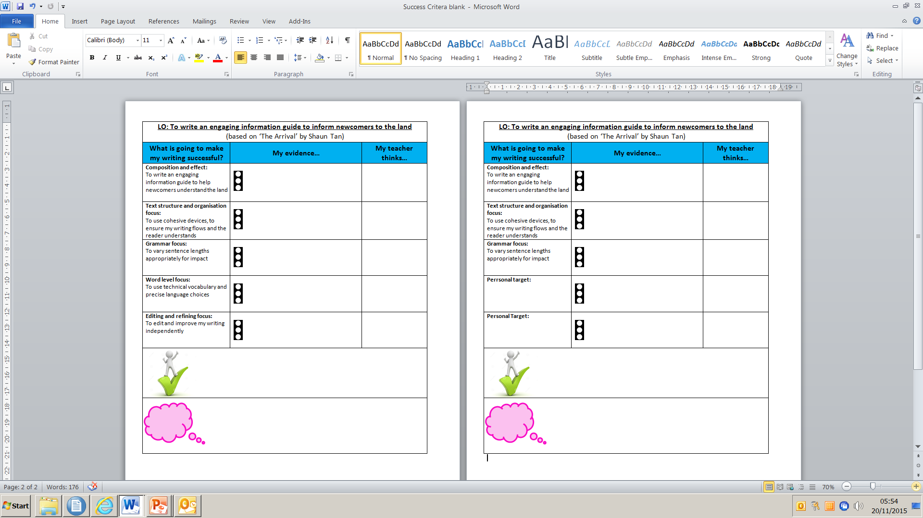
Apprentice
Competent
Success criteria reflects new learning in phase 2
Phase 1 objectives not yet ‘sufficiently’ secured become individual targets, identified in feedback
Objectives not required in success criteria
Evidence of competence in phase 1 objectives - pupils apply with greater independence and resilience in new contexts
Notes:
Success criteria used for sustained writes
Success criteria generated with children
Statements reflect the learning journey of focused teaching from phase 1.
Not a tick list of genre features

Slide 30

Year 3 assessment of learning
Phase 2 writing (VGP)
Use adverbs and prepositions to express time, place and cause
Phase 2 writing (VGP)
Expansion of detail / events may be supported through vocabulary (technical, vivid language)
Phase 1 writing
(Composition and Effect) Events or ideas are developed using some appropriate vocabulary
Phase 1 writing
(Composition and Effect)
Draft and write by composing and rehearsing sentences orally, progressively building a varied and rich vocabulary
Phase 1 reading (Respond and Explain)– Yr 3
Discuss words and phrases that capture the reader’s interest and imagination
Phase 2 reading (Respond and Explain) Yr 3
Begin to use vocabulary from the text to support responses and explanations
Phase 2 reading (Language for Effect)
Discuss the effect specific language has on the reader
Spoken Language
Developing a broader, deeper and richer vocabulary

Slide 31
Assessing ‘competence’ of phase 1 content and ‘apprentice’ of phase 2 content
STIMULUS: Dreaming The Unicorn by Tony Mitton
Outcome:
Write own poem about a mystical beast:
Ideas are developed using technical, vivid language Ph2
Adverbs and prepositions to express time, place and cause
Ph2
Begin to use vocabulary from the text to support responses and explanations (Ph2)
Share ‘The Unicorn’ with the children, discuss images the poem creates in their heads.
Children refer to specific word choices made by the poet and support answers with explanation of impact
Share purpose and audience of unit:
Poems to engage and entertain through language choice.
Publish on poetry website.
Ideas are developed using some appropriate vocabulary (Ph1)
Pupils create their own noun phrases using words collected from original (Ph1)
(technical, vivid language)
Share phrases and discuss effect on the reader.
Develop a broader, deeper and richer vocabulary
Discuss words and phrases that capture the reader’s interest and imagination
Introduce Wordle of the unicorn poem – do not reveal what the subject / poem is.
Pupils identify words that engage and capture imagination. Discuss impact on the reader.
Use adverbs and prepositions to express time, place and cause (Ph2)
Share an image of a mystical setting / creature.
Develop adverbial / prepositional phrases to support description.
Remind pupils to use technical, vivid language.
Draft and write by composing and rehearsing sentences orally, progressively building a varied and rich vocabulary (Ph1)
Pupils construct poetic sentences that ‘paint a picture’ stimulated by their own selected image.
Teacher assesses for ability to apply vocabulary choices that are appropriate and have an impact on the reader

Slide 32
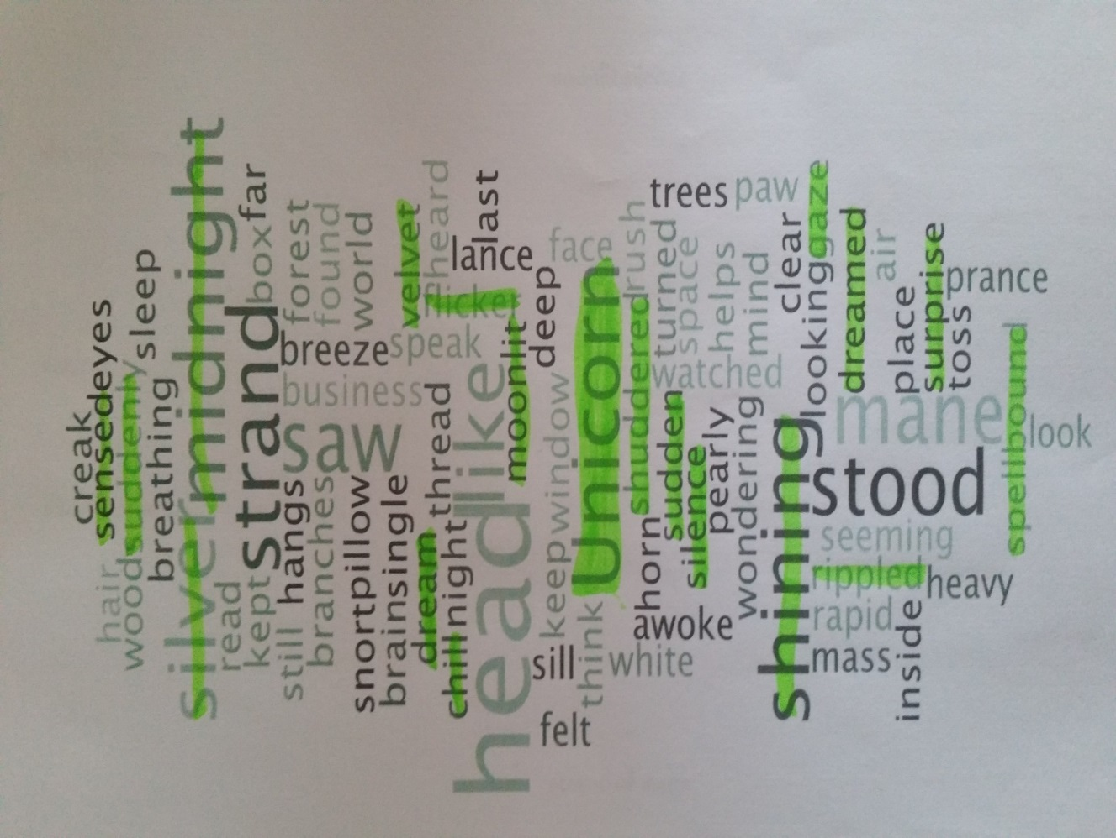
T: teacher dialogue, C:child dialogue
Develop a broader, deeper and richer vocabulary
Discuss words and phrases that capture the reader’s interest and imagination
spellbound
T: “So amazed, you are caught in the ‘spell’ of the thing - you can’t look away or move.”
C: “Is it the same as being astonished?”
shuddered
T: “Can you show me how you might shudder?”
sensed
T: “It means knowing but not seeing”
velvet
T: “It’s a material that’s really soft and smooth when you touch it.”
C: “I can feel it when I say it”
rippled
C: “I think of waves silently moving up and down on a lake”
moonlit
C: “When the moon is shining down on something and you can see it”
gaze
T: “Which word is better ‘look’ or ‘gaze’?”
C: “Gaze - because it shows you how”

Slide 33
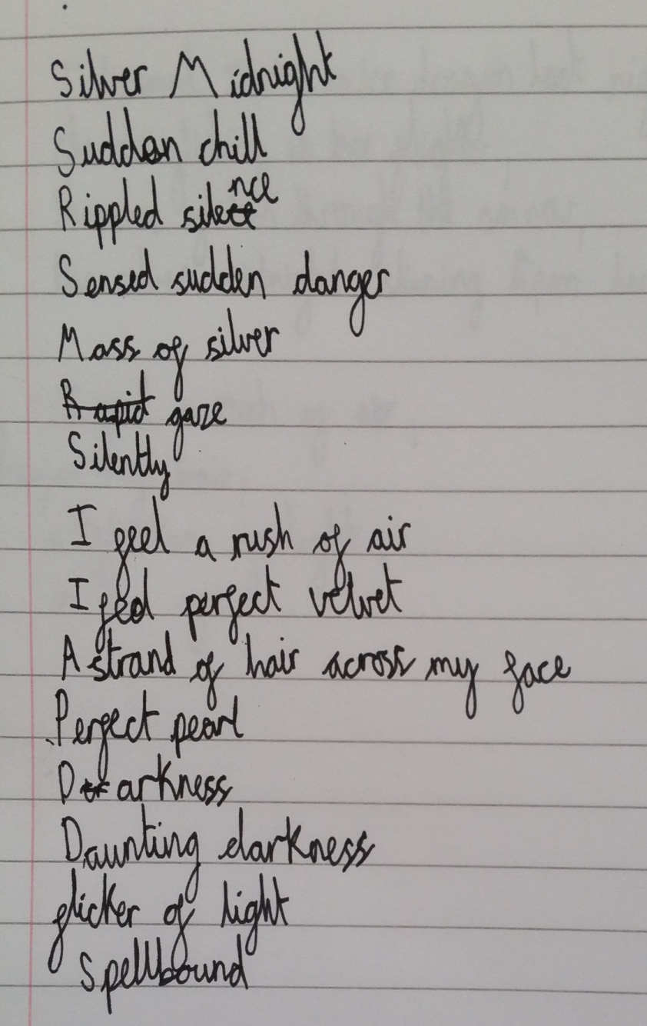
Ideas are developed using some appropriate vocabulary
Teacher comment / observations:
Initially child only paired up highlighted words e.g. silver midnight were words near each other on the Wordle
After mini plenary to encourage children to adapt into their own ideas, child took greater ‘risks’ e.g. ‘sensed sudden danger’
Child not yet confident to apply some new vocabulary into their own noun phrase e.g. ‘spellbound’ only listed
Child has used good level of rich vocabulary and deepened knowledge of word choices during the task
Child now needs to apply in context to embed understanding

Slide 34
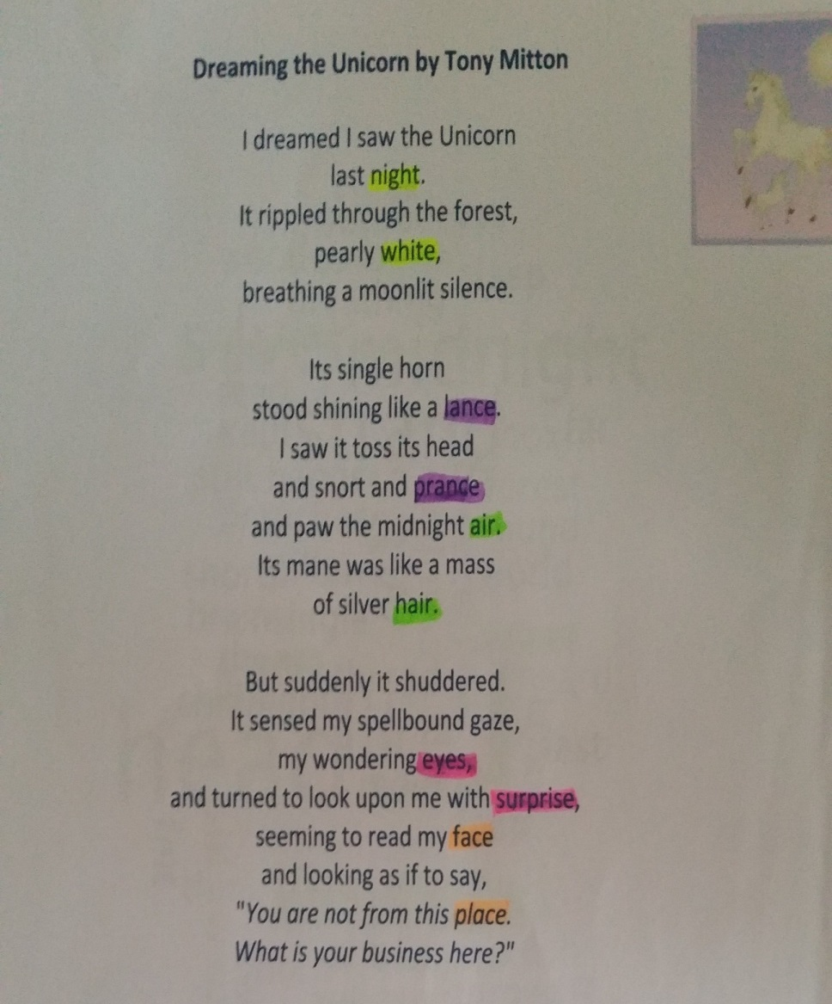
Begin to use vocabulary from the text to support responses and explanations
I saw these words in the Wordle yesterday!
‘Suddenly’ is a good word because it shows how quickly something happened
It shows how the unicorn moves like a horse, because horses ‘prance’ around
I have highlighted the rhyming words in different colours.
The hardest to find were ‘eyes’ and ‘surprise’ because they are not spelt like each other
I understand ‘spellbound’ now it is in the poem – the person is looking at the unicorn for a long time, they are curious about it. It says they are ‘wondering’

Slide 35


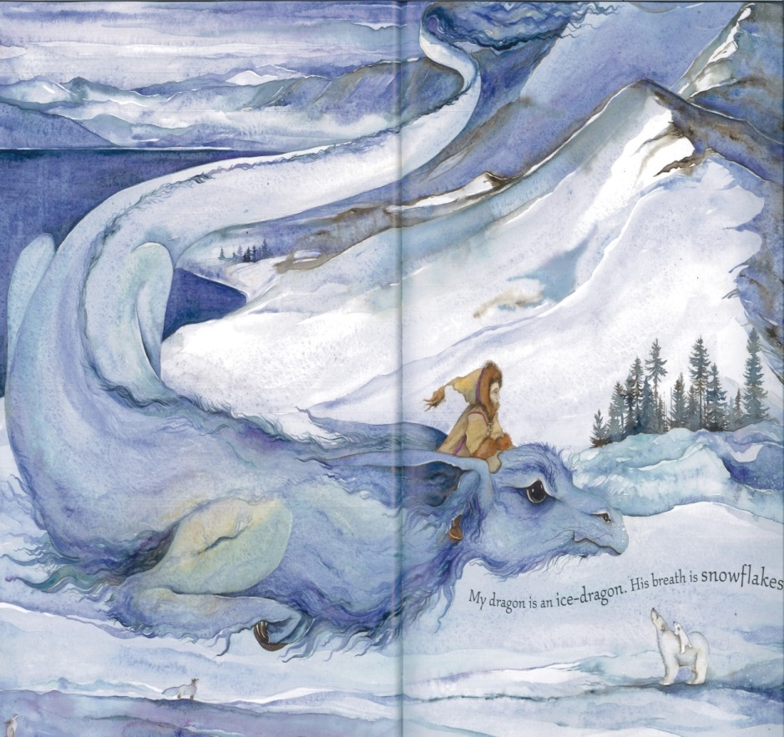
Images of mystical creatures/ dragons used to stimulate poetry writing
Tell Me Dragon
Jackie Morris

Slide 36

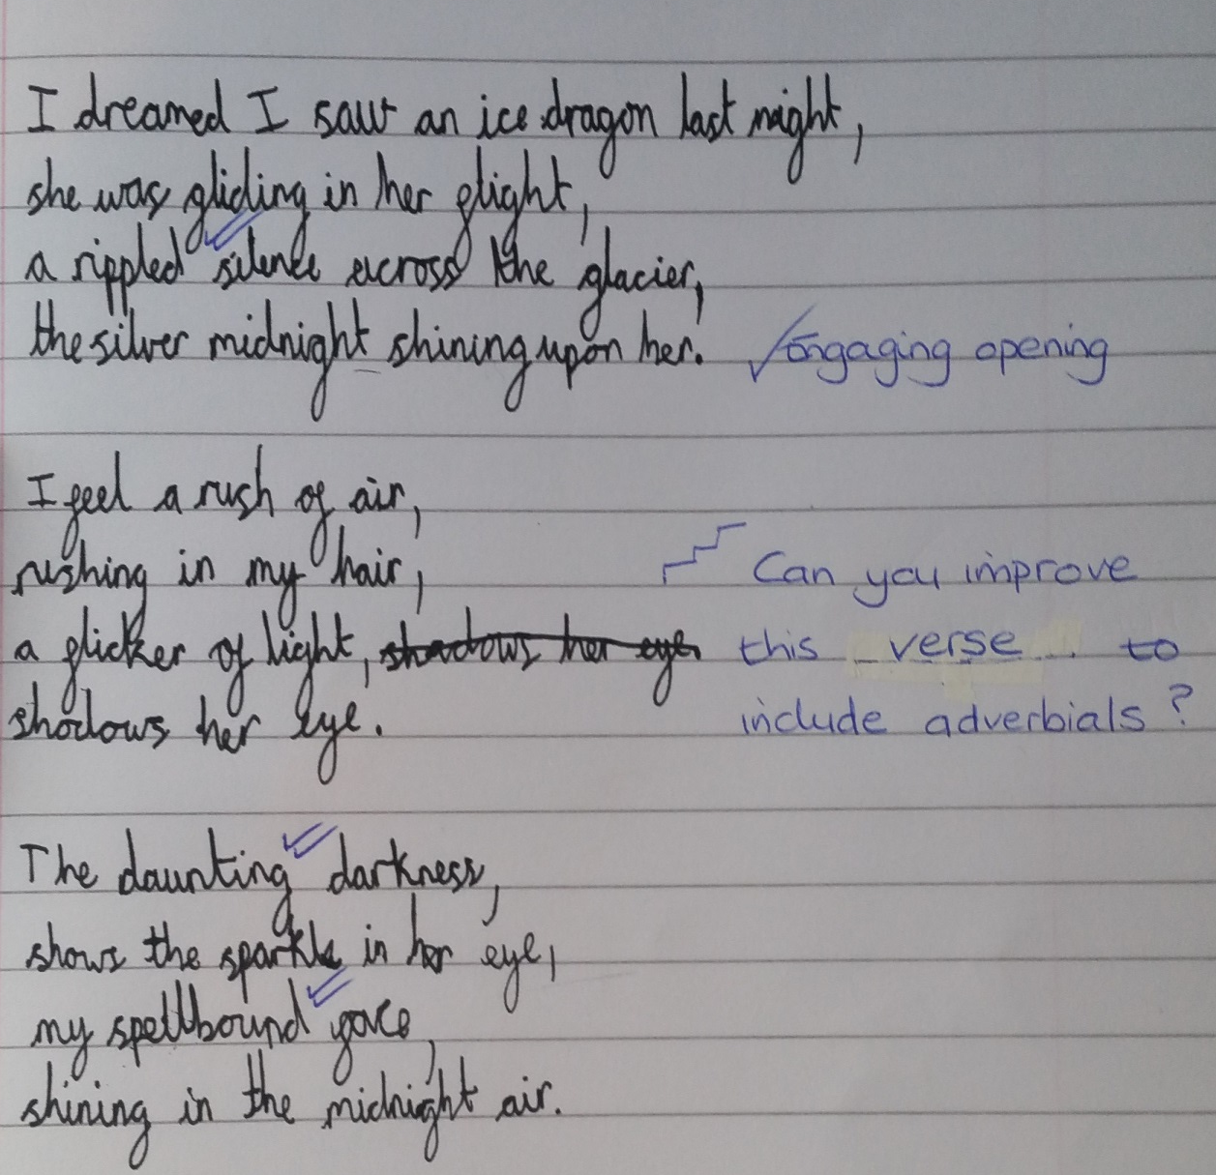
Draft and write by composing and rehearsing sentences orally, progressively building a varied and rich vocabulary

Slide 37

Use adverbs and prepositions to express time, place and cause

Slide 38
Activity
Review the English books that you have brought
Begin to identify where children are beginning to show greater competence in phase 1 objectives
What can be done to further deepen the child’s understanding in that area?
Are there areas or domains where there is limited evidence of deepening understanding?

Slide 39
Mathematics

Slide 40
‘A MODEL’
– The journey to Mastering EOY expectations
Building independence and resilience, by removing the scaffolding over time
Level of Support
Precise learning objectives are used to ensure focus is clear
Time
Apprentice
Competent
Expert
EOY Mastery

Slide 41
Going deeper spring term
Greater focus on pupil independence based on previous experiences. Asking pupils for steps/ ideas rather than always providing the model at the beginning of a session
Greater focus on pupils’ use of accurate vocabulary and language
Greater focus on what is the same about the mathematics making links across domains
Providing ‘answer’ along with problem/ calculation can help to focus discussion on reasoning and alternative solutions/ models.
Use of ‘intelligent practise’ with discussion/ diagnostic assessment-not enough for pupils to just ‘practise’ getting ‘right answer’ this term…

Slide 42

Teaching for Mastery (in Shanghai)
The key principles are
PROCEDURAL VARIATION provides a process for formation of concepts stage by stage, in which pupils' experience in solving problems is manifested by the richness of varying problems and the variety of transferring.
CONCEPTUAL VARIATION provides pupils with multiple perspectives and experiences of mathematical concepts.
INTELLIGENT PRACTICE: when designing exercises, the teacher is advised to avoid mechanical repetition and to create an appropriate path for practising the thinking process with increasing creativity.
c.f. Gu, Huang & Marton, 2004 and Lo, Chik & Pang, 2006
Gu, 1981

Slide 43
Procedural Variation
Multiple examples of the problem: extending the original problem by varying the conditions, changing the results, and moving towards generalization.
Multiple methods of solving a problem by varying the different processes of solving a problem and associating different methods of solving a problem.
Multiple applications of a method by applying the same method to a group of similar problems.

Slide 44
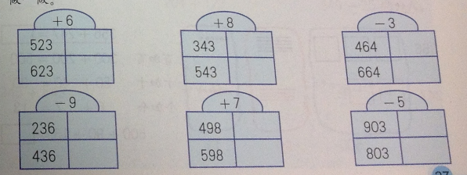
Be careful!
“Variation” does NOT mean “a variety”. Each step from one question to the next is small and precise. Each question has been very carefully designed. How are the essential features highlighted by varying the non-essential features?
What’s being kept the same; why is it being kept the same?
What’s being made different; why is it being changed?
Identify all the question design choices that have been made.
Why were precisely these numbers chosen?
Notes:
An opportunity to look more closely at our number structure and the relationships within it.

Slide 45
45 ÷ 5 =
90 ÷ 5 =
180 ÷ 5 =
45 x 6 =
45 x 3 =
45 x 8 =
45 x 2 =
45 x 4 =
11- 3 =
11- 4 =
11- 2 =
11- 5 =
27 + 20 =
27 + 10 =
27 + 30 =
27 + 50 =
27 + 40 =

Slide 46
Intelligent practice
‘Practice is most effective when it is intelligent practice, i.e. where the teacher is advised to avoid mechanical repetition and to create an appropriate path for practising the thinking process with increasing creativity. (Gu 20045)’
NCETM Mastery Assessment documents 2015
Intelligent practice is a term used to describe practice exercises that integrate the development of fluency with the deepening of conceptual understanding. Attention is drawn to the mathematical structures and
relationships to assist in the deepening of conceptual understanding, whilst at the same time developing fluency through practice.
Gu, L., Huang, R., & Marton, F. (2004). Teaching with variation: A Chinese way of promoting effective mathematics learning. In Lianghuo, F., Ngai-Ying, W., Jinfa, C., & Shiqi, L. (Eds.) How Chinese learn mathematics: Perspectives from insiders. Singapore: World Scientific Publishing Co.
Pte. Ltd. page 315.

Slide 47
Intelligent Practice
I’ve drawn a 4cm by 6cm rectangle, a 12cm by 2 cm rectangle, and a 3cm by 8cm rectangle. What’s the same? What’s different?

Slide 48
Intelligent Practice
In each number sentence, replace the boxes with different whole numbers less than 20 so that the number sentence is true:
1 / ☐ > 1 / ☐
☐ / 3 < ☐ / 12
☐ / ☐ > ☐ / ☐
☐ ÷ ☐ < ☐ . ☐
30 / ☐ > 45 / ☐

Slide 49
Intelligent Practice
Match a word problem in the left hand column to a symbol number sentence in the right hand column. There are four matching pairs to find.
Now write a symbol number sentence for the unmatched word problem. Also, write a word problem for the unmatched symbol number sentence.
What unknown number is three more than 15? | 15 = ★ ÷ 3
What unknown number is one third of 15? | ★ – 3 = 15
What unknown number is three times 15? | 15 + ★ = 3
What unknown number goes into 3 fifteen times? | 15 = 3 × ★
What unknown number is three less than 15? | 15 – ★ = 3

Slide 50
Intelligent Practice
Miriam buys 19 tins of soup. All the tins cost the same price.
She goes to the shop with just one note, and comes home with the tins and the change in coins. On the way home she drops the change. She looks carefully and she thinks she picks it all up. When she gets home she gives £2.23 change to her mother.
Do you think that Miriam picked up all the change that she dropped? Explain your reasoning.

Slide 51
‘Intelligent practice’ focused on this number sentence
Show these calculations on a number line…
Show these calculations as fractions…
Write a problem using these numbers that would be solved with addition/ subtraction (take away and finding the difference)
What would happen if 9.5 was changed to 95?
Use this number sentence to find 3 more pairs of decimal numbers that sum to 9.5. Show solutions using a bar model. Explain any patterns you are using
Explore another number sentence, perhaps with a value missing in the bar diagram?
Notes:
Year 5 end of year example of expected ‘mastery’ - challenge pupils further who have the basics secure whilst providing time for other pupils to secure this understanding.

Slide 52
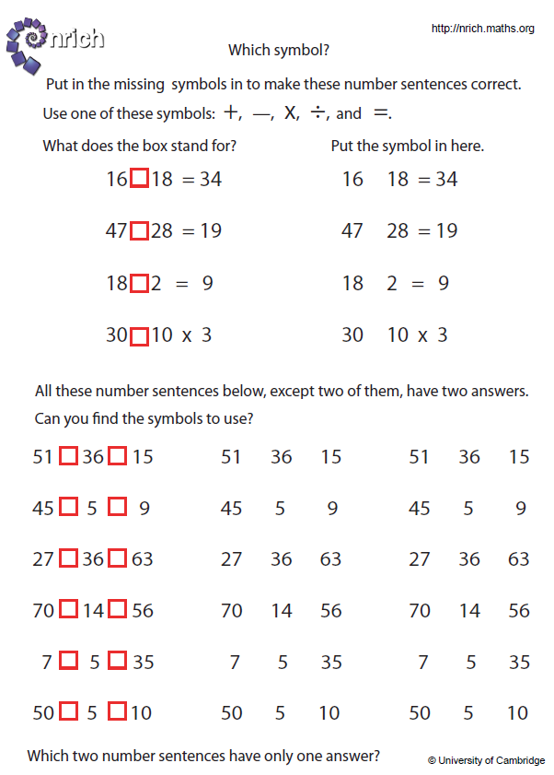
Intelligent practice
Notes:
Nrich: which symbol?

Slide 53
Mastery of Mathematics
‘A mathematical concept or skill has been mastered when, through exploration, clarification, practice and application over time, a person can represent it in multiple ways, has the mathematical language to be able to communicate related ideas, and can think mathematically with the concept so that they can independently apply it to a totally new problem in an unfamiliar situation’
Drury, H (2014) Mastering mathematics, Teaching to transform achievement OUP

Slide 54
Mastery
What does “mastery” mean?
I know how to do it.
It becomes automatic and I don’t need to think about it.
I do it confidently.
I do it well. (Does “well” mean “quickly”? Sometimes?)
I can do it in a new way, or in a new situation.
I can now do it better than I used to.
I can show someone else how to do it.
I can explain to someone else how to do it.

Slide 55
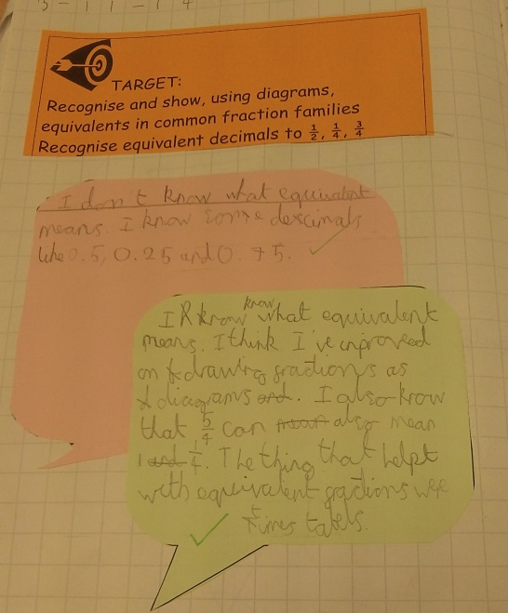
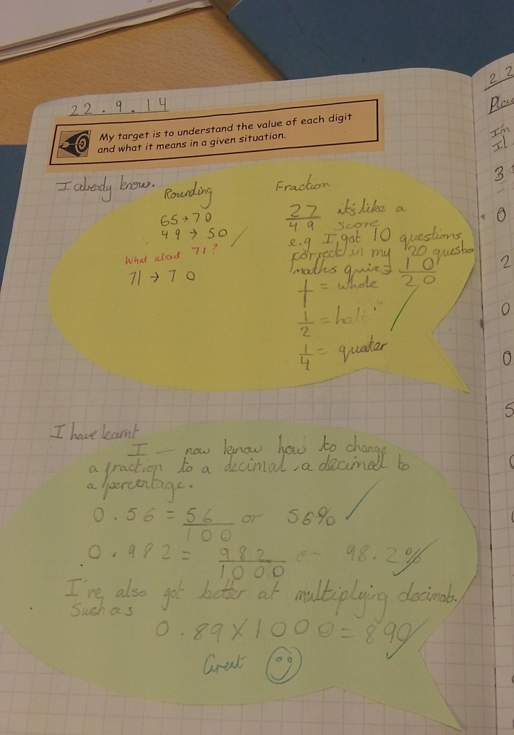

Slide 56
Year 1: NPV and calculation
Count in multiples of 2s and 10s
Read, write and interpret mathematical statements involving addition/ subtraction and equals signs
Represent and use number bonds and related subtraction facts within 20
Add and subtract one digit and two digit numbers to 20 including 0
Solve one step problems that involve addition and subtraction, using concrete objects and pictorial representations and missing number problems
Solve one step problems involving multiplication using concrete objects, pictorial representations and arrays with the support of the teacher

Slide 57
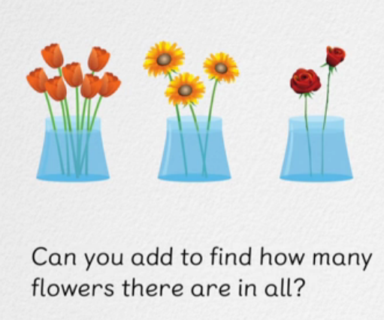
Whole class interactive input…

Slide 58
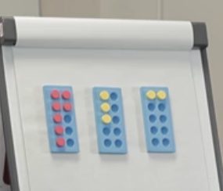
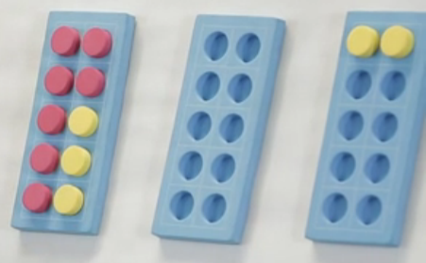
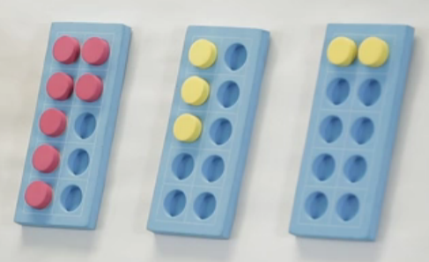
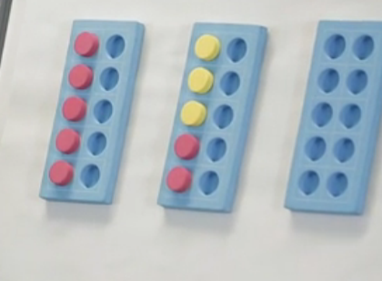
So what ways can we use?
From class discussion pick the main strategies.
Count them… model that, should have done this before.
We know the answer is 12 so that is not important anymore. What else?
Make 10… Can you imagine, what if we move these three over here…
Can you see how many there are altogether now?
Are you surprised it is the same answer?
This is another way. We always have at least two ways.
Do we have another?
If you make 5 then you could put that with the 7…
Can you imagine this idea, can you make 5 ? Why would he do that? Is that useful? How is that useful?
You might see 5 plus 5 is 10 and then 2 more.
7 is also 5 and 2

Slide 59
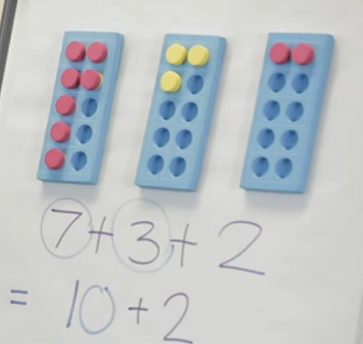
Followed by pupils showing, recording and comparing their solutions to some examples of different solutions…to see which ones are the same as their methods and which ones are different and how…
Concrete materials , pictorial and abstract -Bruner

Slide 60
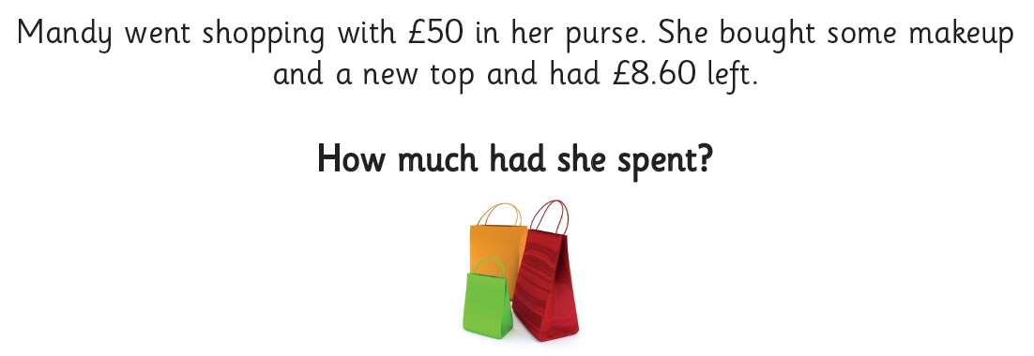
Year 3
For example, £50
(£ and p, one step problem)
Whole pounds: mental strategies/ number facts
For example: £330 spent £60
£45 spent £18

Slide 61
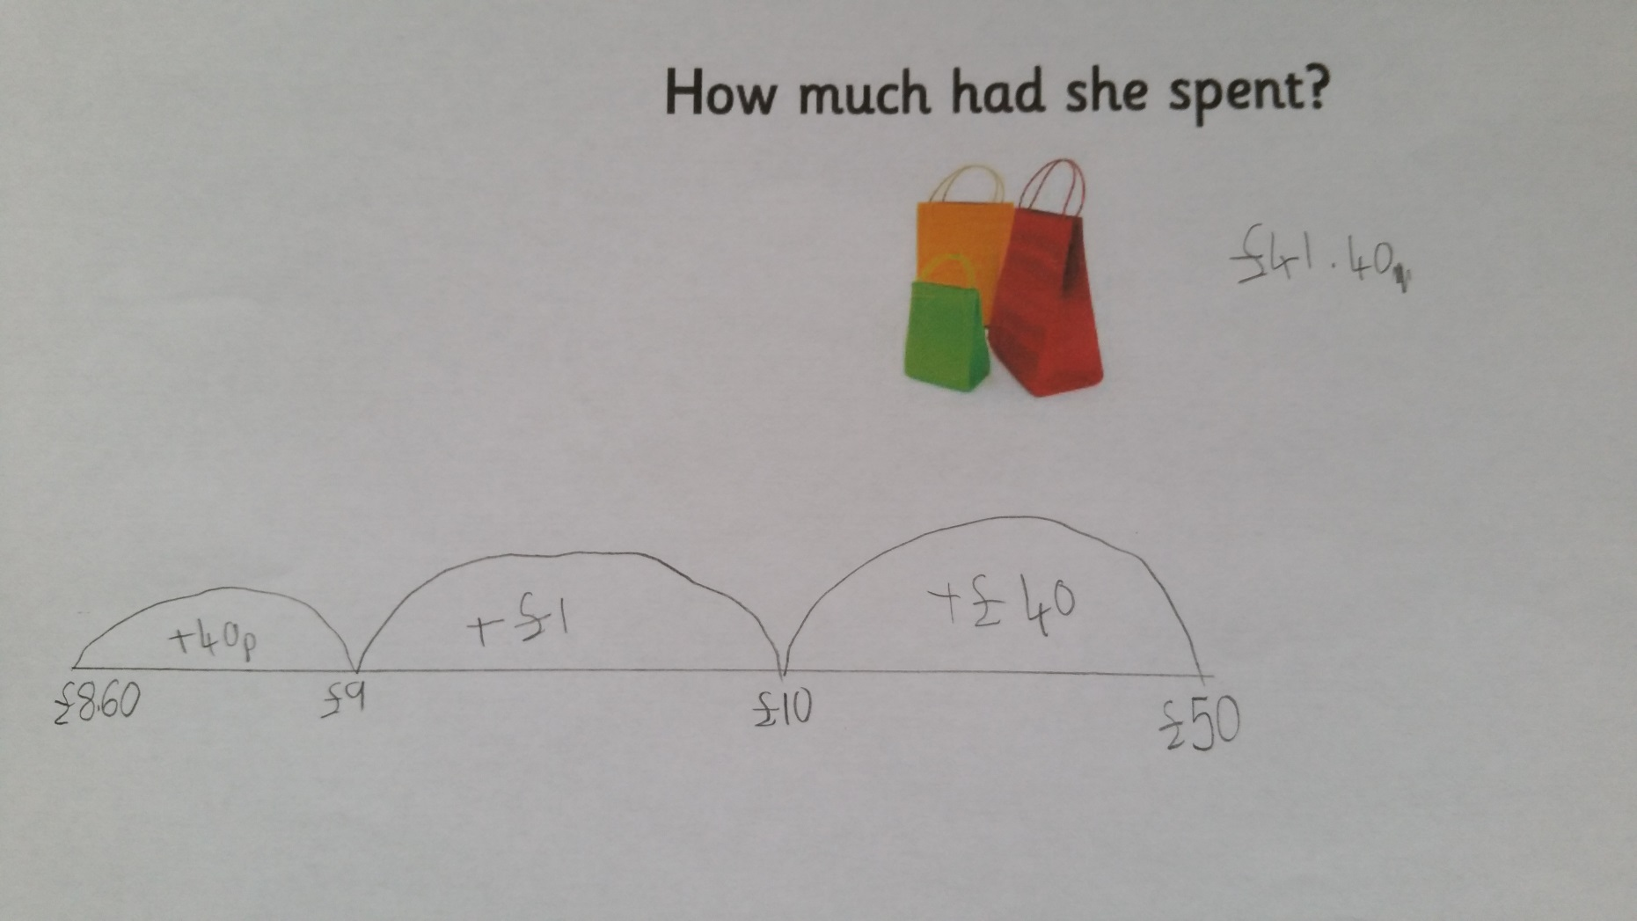

Slide 62
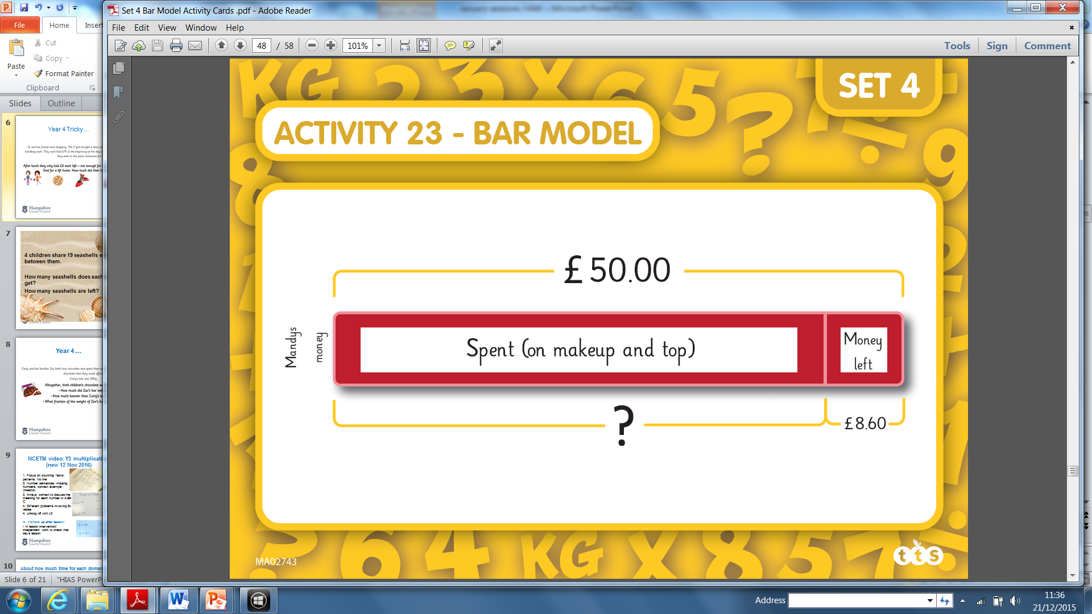
Going deeper
Mental add/sub 2 digit numbers in the context of money
Use real money. Write a subtraction or addition number sentence. Use a number line to show how much was spent. Use a bar model alongside
Add and subtract amounts of money to give change using both pounds and pence in practical contexts. Use real money to give change.

Slide 63
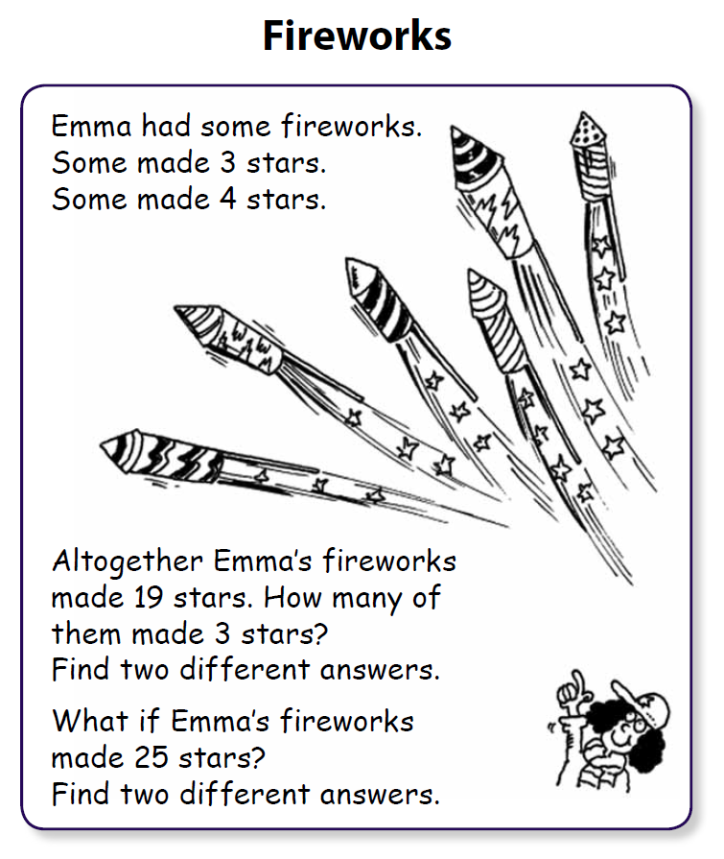
With support, starting to discuss other possible versions of this problem based on combining multiples of 3 and 4…
Using the same context of fireworks and then different contexts…
Fluency and resilience expectations?

Slide 64
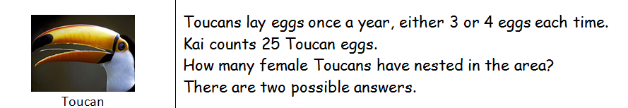
What’s the same and what is different?

Slide 65
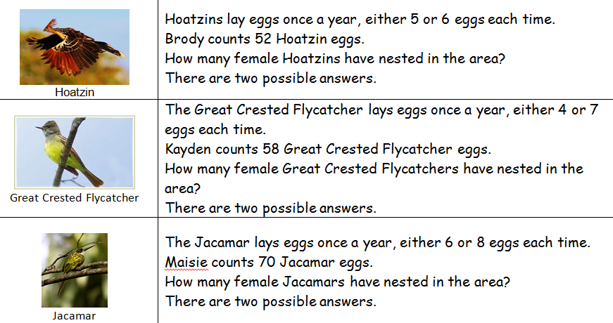

Slide 66

Year 3
4 children share 19 seashells equally between them.
How many seashells does each child get?
How many seashells are left?

Slide 67
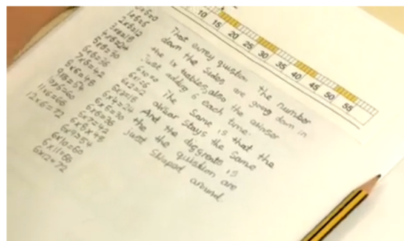

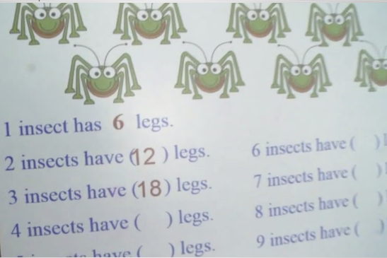
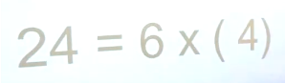
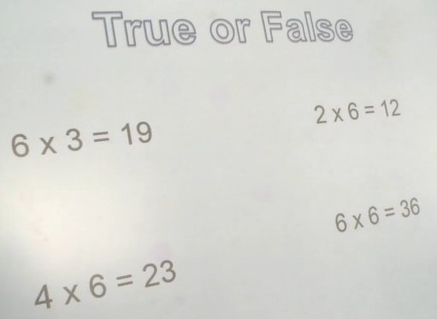
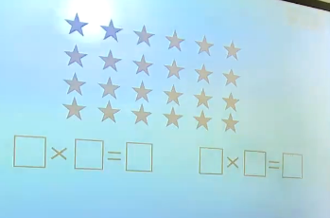

NCETM video supporting teaching for mastery: Y3 multiplication
(new 12 Nov 2016)
Techniques used in one lesson:
1. Focus on counting/ facts/ patterns using number line
2. Number sentences, missing numbers, context example (insects)
3. Arrays, context to discuss the meaning for each number in A x B = C
4. Different problems involving 6x tables
4. Linking x6 with x3
Follow up after lesson:
- In lesson intervention/ independent work to check that day’s lesson
https://www.ncetm.org.uk/resources/48211

Slide 68
Year 4 phase 2
There were 1200 adults and children at the concert.
There were 380 adults.
How many children were there?
Year 4: How many fewer adults than children were there?
1200 people
380 adults
Children?
Fluent with one step?
adults
380
Compare total of adults with children using subtraction
=1200 adults + children
children
( Total- adults= children)
With support?
Solve addition and subtraction 2 step problems
Add and subtract numbers with up to 4 digits

Slide 69
Write your own 2 step problem…
Here are some words to use…
concert 1450 adults children How many 580 fewer
Fluency at responding to this type of problem…

Slide 70
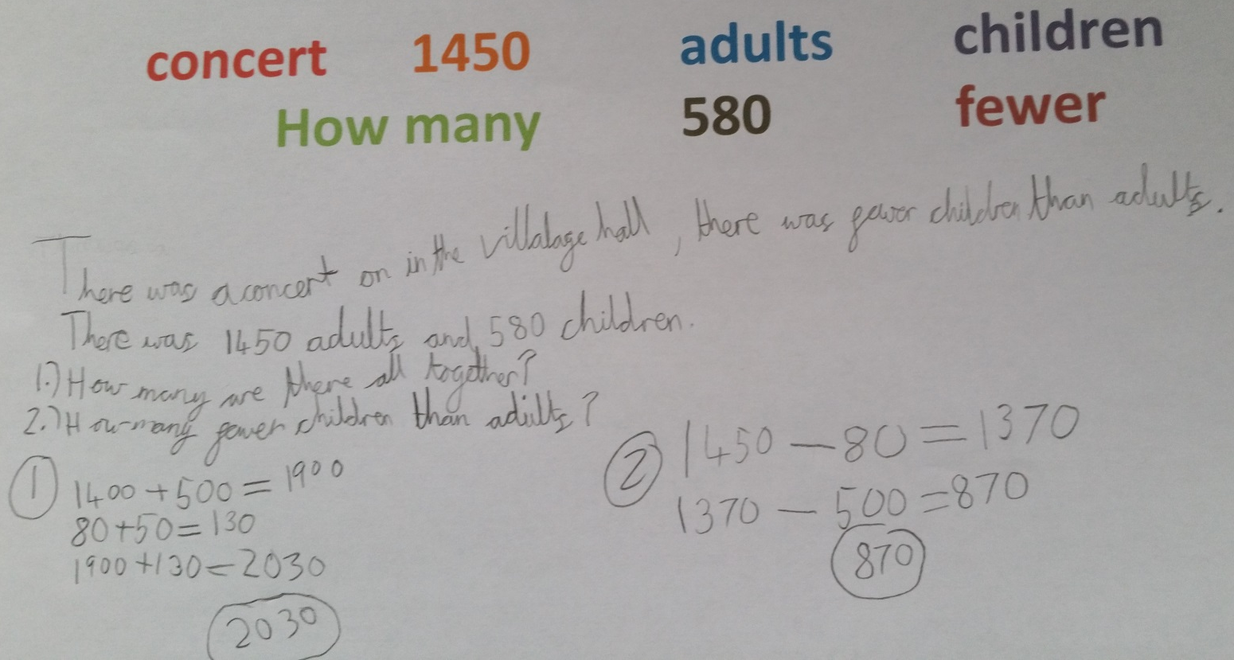
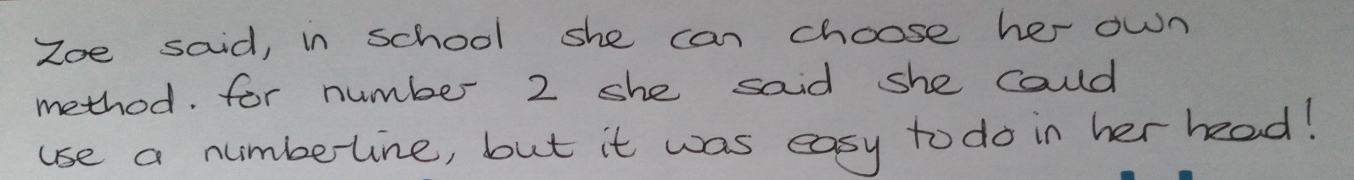
We only know how Zoe can work with these numbers because we asked and checked…
We also need to quickly check that when pupils say something is ‘easy’ it also means they can do it…

Slide 71
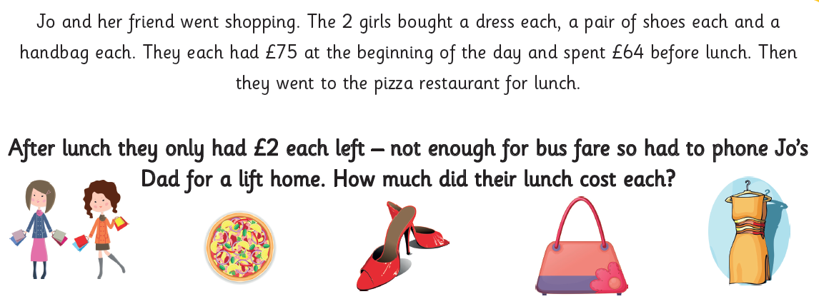
Year 4 …

Slide 72
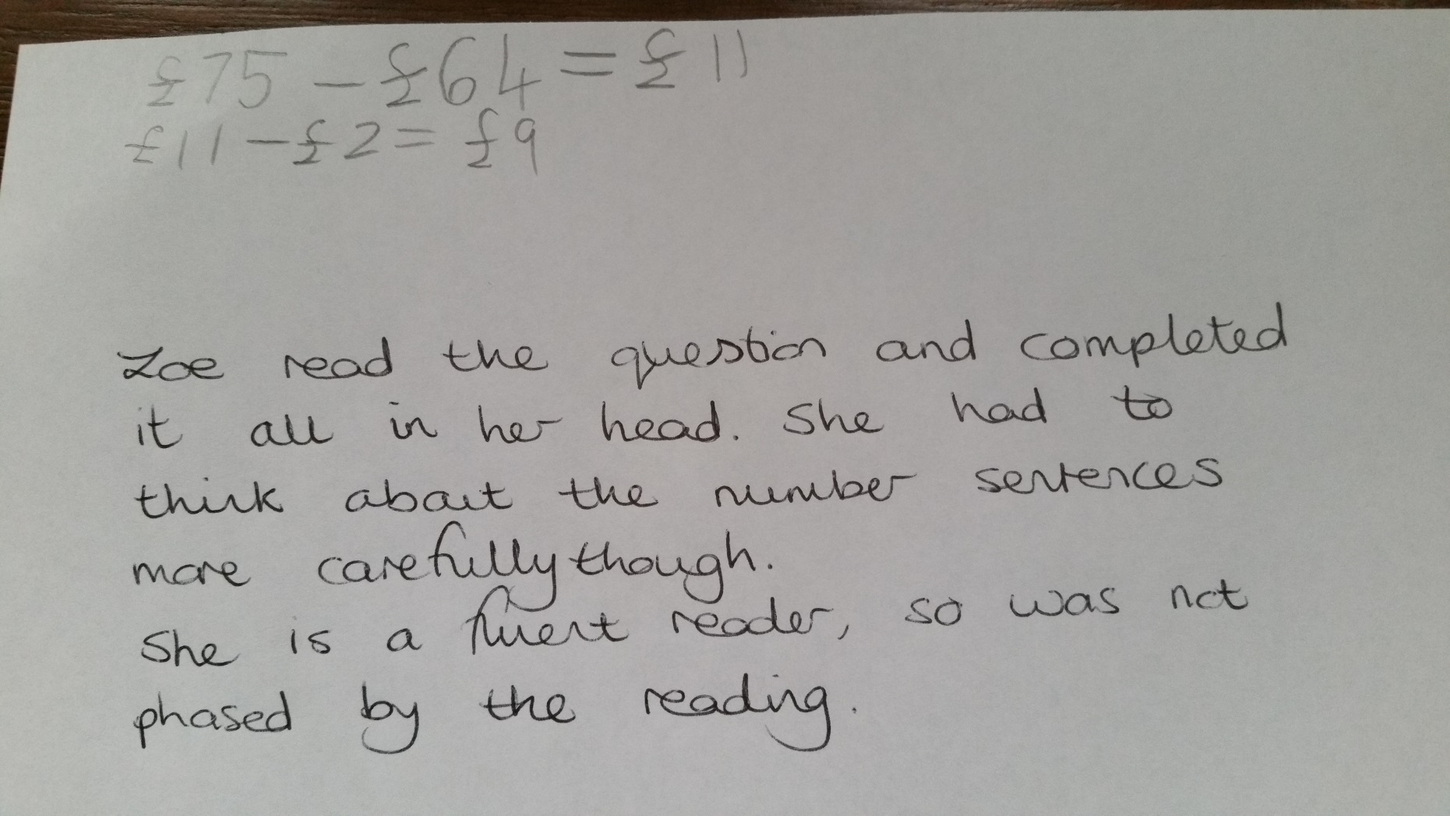

Slide 73
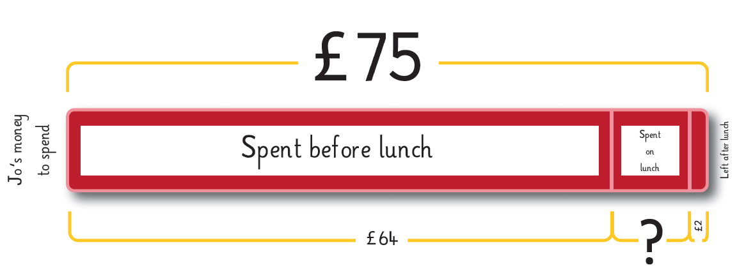
Year 4 phase 2
Can use inverse to calculate either as £64+ ?= £75 or £75- £64= ?
Solve addition and subtraction 2 step problems using bar models alongside number sentence and number line recording

Slide 74
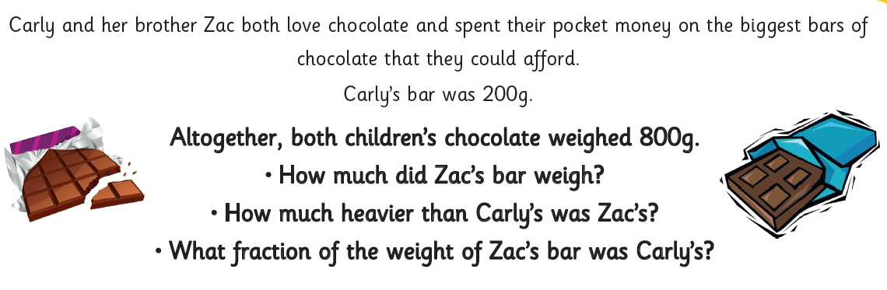
Year 4 …
Combining addition and subtraction with fractions
Solve simple money and measures problems involving fractions

Slide 75
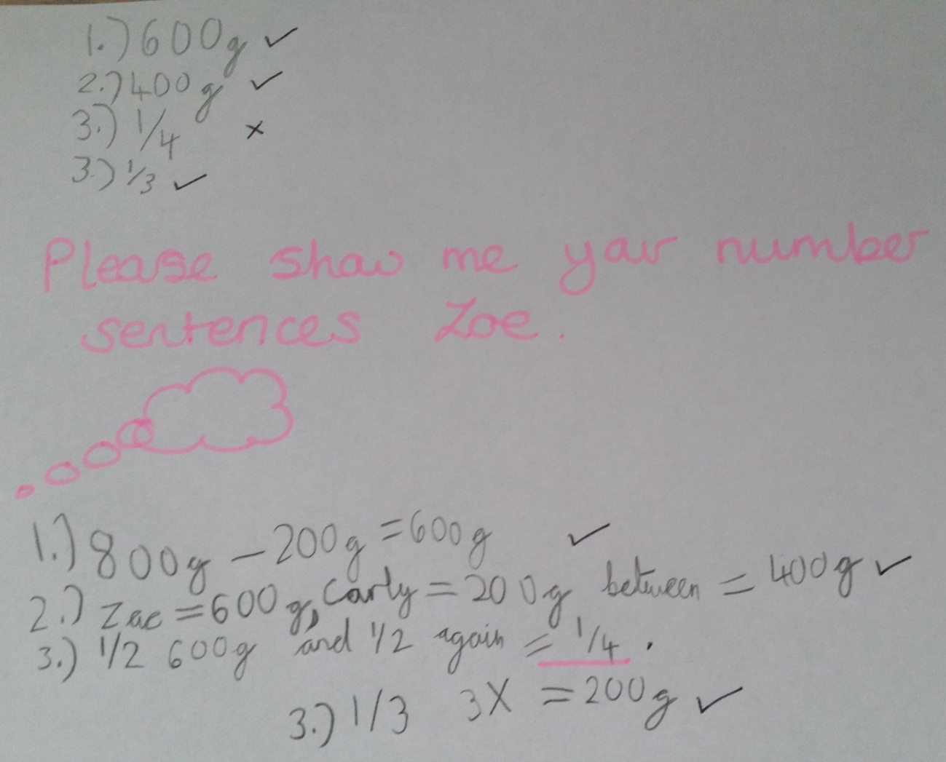
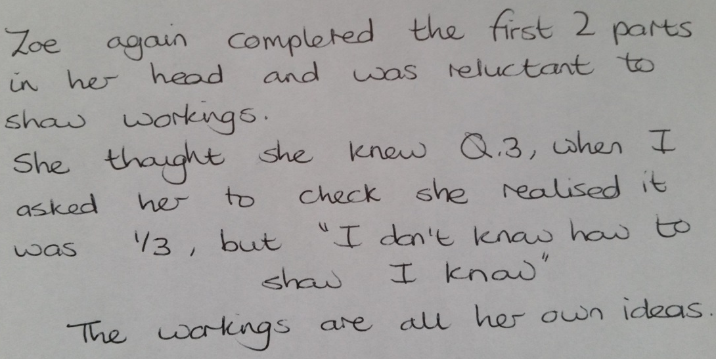

Slide 76
About how much time for each domain?
NPV
Add/sub
Multi/div
Fractions
Measurement
Geometry
Phase 1
15
15
6
3
4
2
45
Phase 2
12
10
8
5
8
2
45
Phase 3
?
?
?
?
?
?
Phase 4 to end of year…
?
?
?
?
?
?
ARE mastery learning of the curriculum
Units of work need to combine domains.
Amount of time spent focusing on particular domains will change during the year.
An assessment point in all domains each time important -based on differing numbers of lessons appropriate to the point in the year

Slide 77
End of phase 2 assessment
- mid point
Two ‘layers’ to consider whether a pupil is securely on track at this point: competent (with phase1) and apprentice (with phase 2)
Work scrutiny – some key questions
Teacher/ LSA annotations: supported/ independent; pupil reasoning (how well does this pupil use vocabulary when explaining in grammatically correct sentences?)
Pupil knowledge and use of key skills and facts; inverse and patterns of calculation (which models does this pupil know, understand and use?)
Pupil choice about whether to work mentally or with paper and pencil recording. Can this pupil do previous year group’s calculations in their head?
Pupil repertoire of recording based on conceptual models and images, working with concrete resources (is this pupil on the journey to mastery learning of ARE?)
Pupil experiences of a range of types of problem solving (routine/ non-routine problems for this pupil)
Pupils who were ‘close to’ in November have caught up and are keeping up

Slide 78
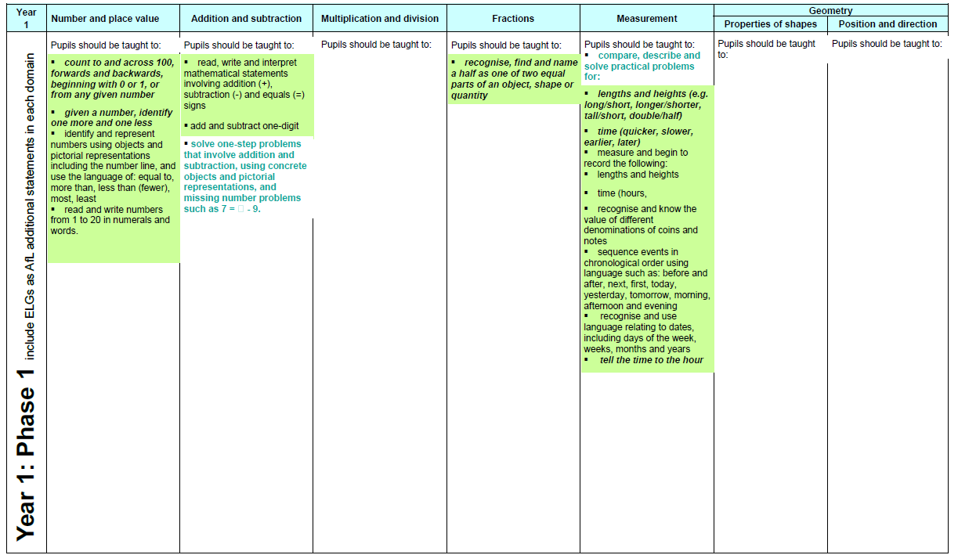
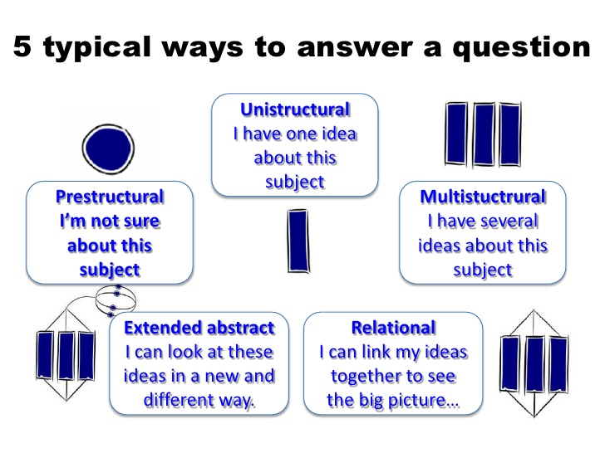
Phase 1- largely understanding within domains, single ideas
Key conceptual ideas supported by the use of key models and images within domains

Slide 79
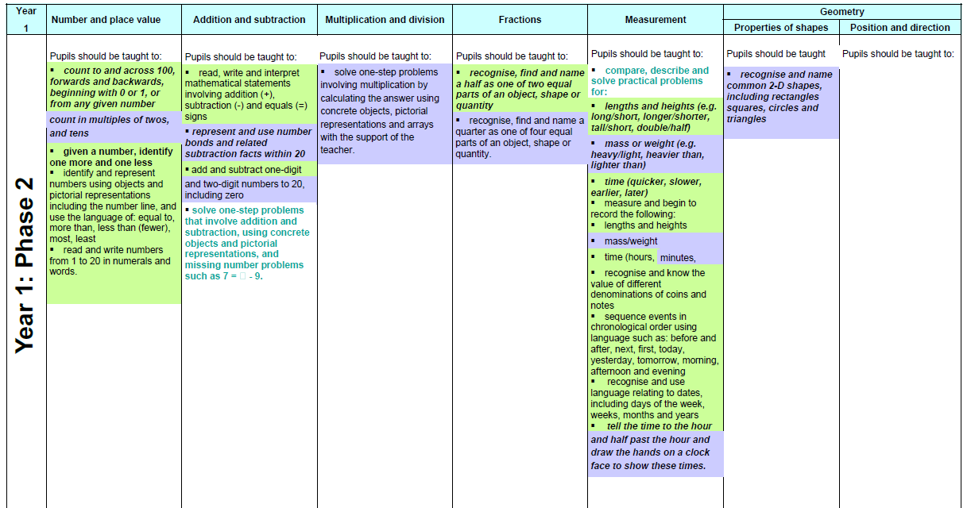
Phase 2- conceptual understanding still mostly within domains, beginning to link some ideas
Linking between key conceptual ideas supported by the use of key models and images within (and sometimes across) domains

Slide 80
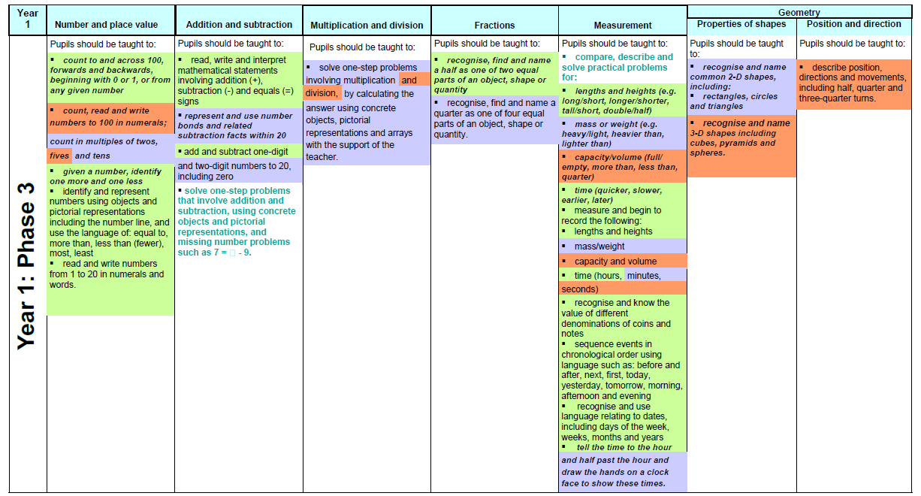

Phase 3- phase 1and 2 becoming relational ideas across domains, phase 3 unistructural at first, towards relational by end of year
End of year:
Pupils have multi structural understanding for all domains and relational understanding across most domains
Deep relational understanding supported by key models and images within and across domains as key ideas

Slide 81
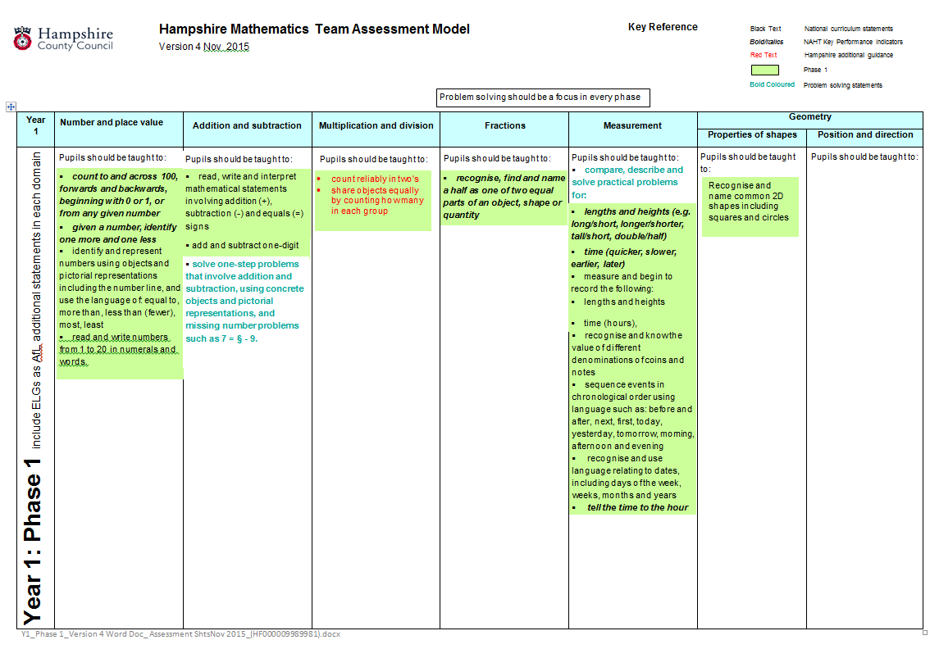
Year 1 Phase 1: updated Version 4 Nov 2014
Notes:
Two changes to year 1 phase 1 as without an assessment focus the tracking document doesn’t work well. The new multiplication/ division assessment links with counting (2s) and the fractions focus about halves. This is Hampshire guidance and not NC statement

Slide 82
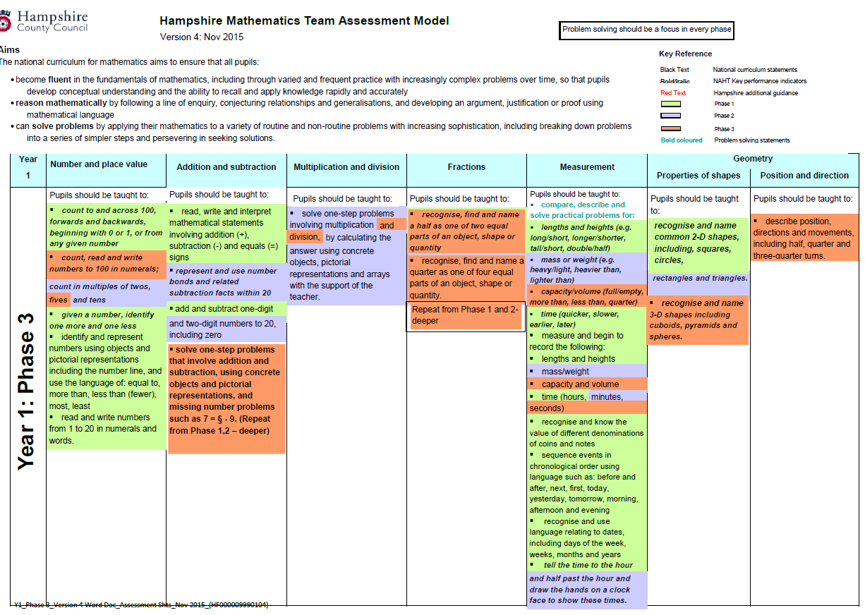
Year 1 Phase 3: updated Version 4 Nov 2015
Notes:
Update is to support tracking in each domain in each phase. Provides a new focus for geometry in phase 1 (previously only phase 2 and 3).
The addition and subtraction statement is ‘green’ in phase 1 and 2 so should be used throughout. Use this in phase 3 to focus on problem solving skills to at least ‘apprentice’ giving the rest of the summer term to deepen pupils’ experiences and expertise by the end of the year. Use a range of models and recording inc missing box equations, bar models etc to show solutions to problems. Use the two fractions statements together for phase 3 assessment- phase 1 is focused on finding a half, pahse 2 is focused on knowing about quarters so phase 3 could be about pupils knowing and using both halves and quarters to solve problems.

Slide 83
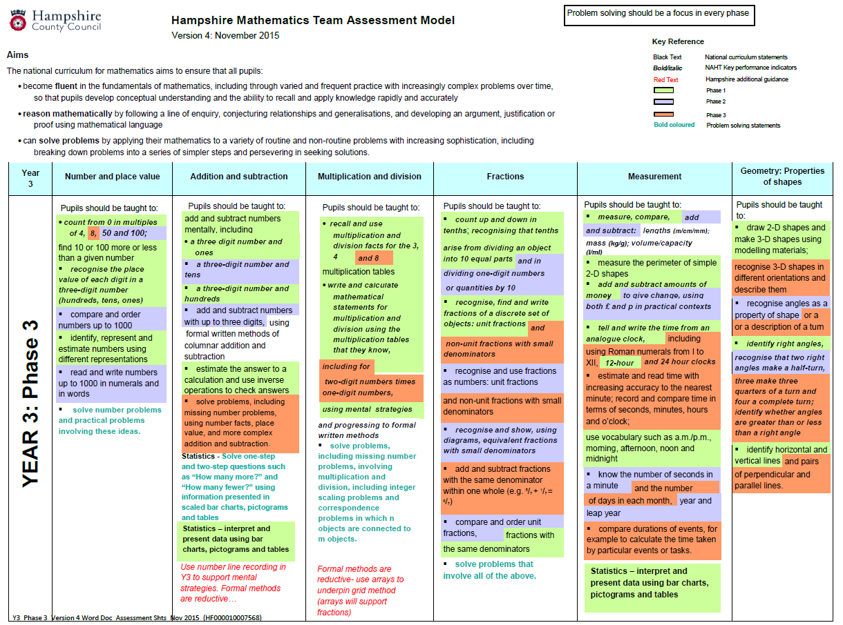
Y3 Phase 3: updated version 4 Nov 2015
Phase 2
Multiplication and division more fluency with 3x 4x (and 2x, 5x, 10x) including problem solving also links with:
counting in multiples of 50 and 100 (NPV)
Comparing and ordering numbers to 1000 (NPV)
Add/subtract with up to 3 digits
Notes:
Update is to support tracking in each domain in each phase. This statement is ‘green’ in phase 1 and 2 so should be used throughout. Use this in phase 3 to focus on problem solving skills to at least ‘apprentice’ giving the rest of the summer term to deepen pupils’ experiences and expertise by the end of the year. Important strategically to secure add/sub conceptually 0-1000+ using a range of models and recording inc missing box equations, bar models etc to show solutions to problems

Slide 84
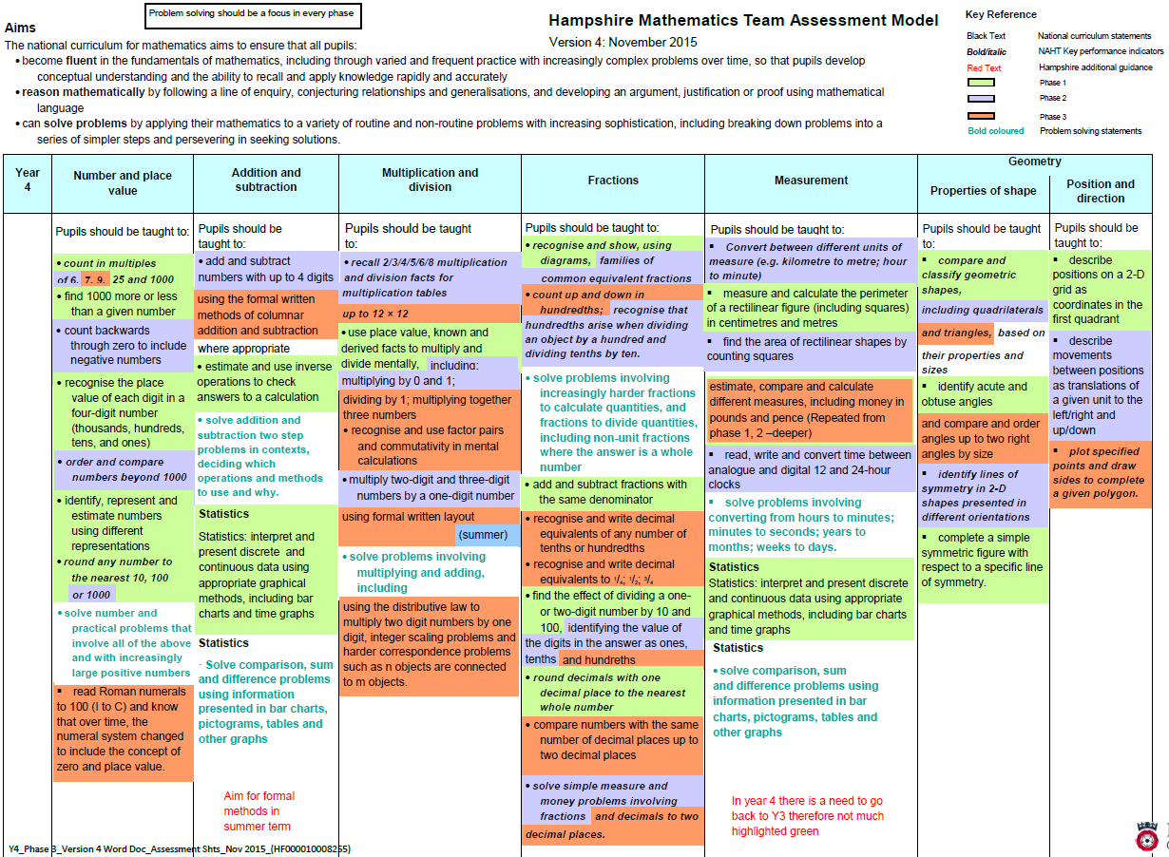
Y4 Phase 3: updated version 4 Nov 2015
Notes:
Update is to support tracking in each domain in each phase. This statement also used in phase 1 and phase 2. Use in phase 3 to check pupils are making links across all measures and able to solve problems using measures including converting between units. Use this in phase 3 to focus on problem solving skills to at least ‘apprentice’ giving the rest of the summer term to deepen pupils’ experiences and expertise by the end of the year. Measures is an important strategic context for end of year 4 to prepare for year 5 and year 6 curriculum (fractions and decimals)

Slide 85
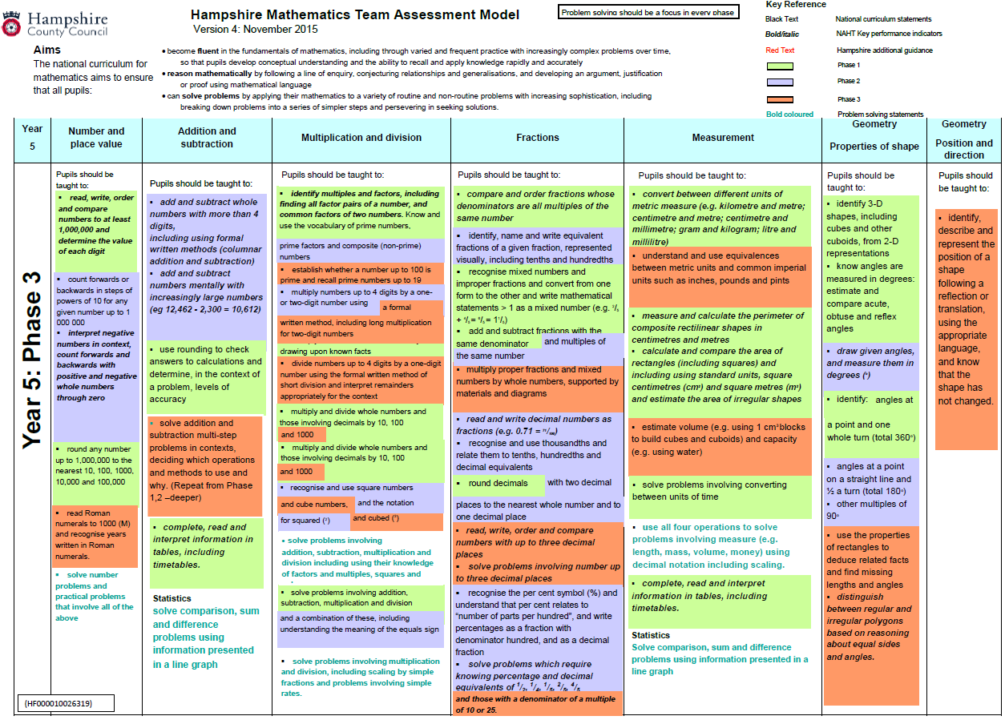
Y5 Phase 3: updated version 4 Nov 2015
Notes:
Update is to support tracking in each do main in each phase. Use this assessment to focus on problem solving skills. This statement is ‘green’ in phase 1 and 2 so should be used throughout. Use this in phase 3 to focus on problem solving skills to at least ‘apprentice’ giving the rest of the summer term to deepen pupils’ experiences and expertise by the end of the year.

Slide 86
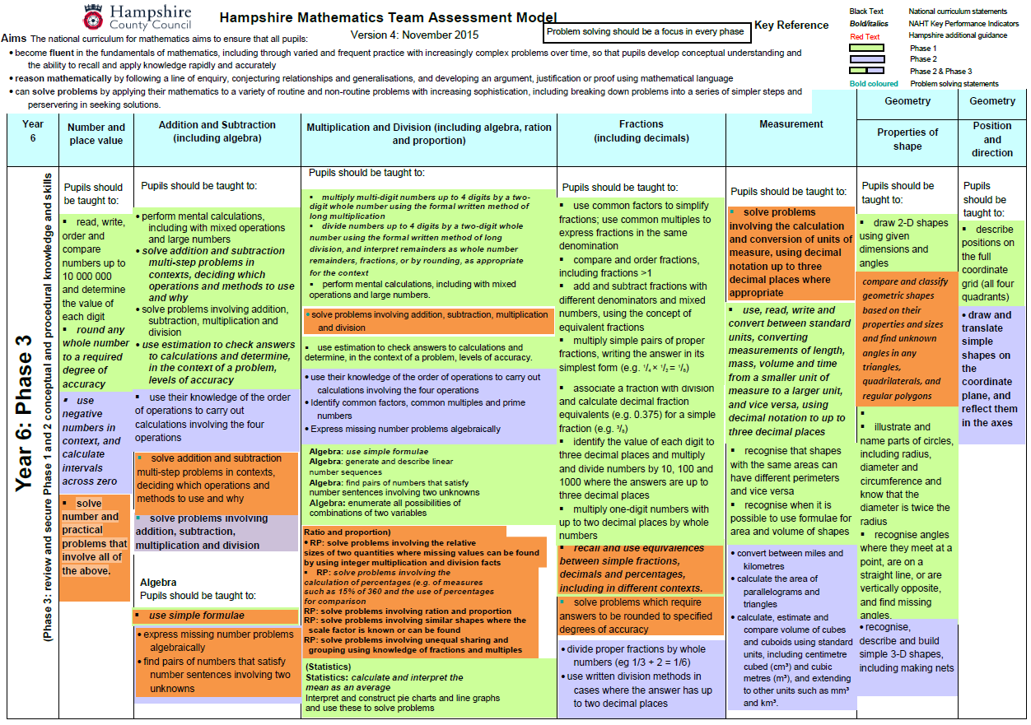
Y6 Phase 3: updated version 4 Nov 2015
Notes:
Update is to support tracking in each do main in each phase. Use this assessment to focus on problem solving skills. This statement is ‘green’ in phase 1 and 2 so should be used throughout. Use this in phase 3 to focus on problem solving skills to at least ‘apprentice’ giving the rest of the summer term to deepen pupils’ experiences and expertise by the end of the year.

Slide 87
Activity
Review the mathematics books that you have brought
Identify evidence of mathematical reasoning and greater application of phase 1 objectives
What can be done to further extend their application of skills learnt to so that they can demonstrate their deeper understanding?
Are there areas or domains where there is limited evidence of their application of skills?

Slide 88
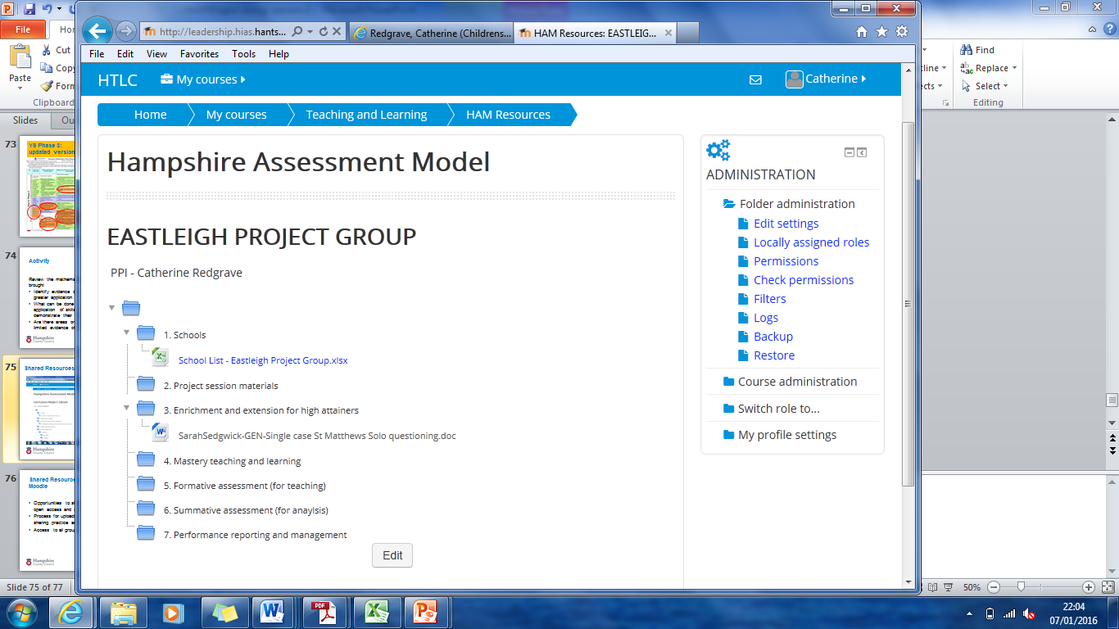
Shared Resources through Moodle

Slide 89
Shared Resources through Moodle
Opportunities to share ideas through the blog – open access and support for one another
Process for uploading useful documents – sharing practice and asking questions
Access to all groups as well as own resources
Notes:
NOTE – can contribute to the blog dialogue but resources need to come through project lead for uploading

Slide 90
Session 3 – 14/03/16
What areas do you want to cover in the next session?
What shape do you want the morning to take?

