Slide 1
Assessing ‘competence’ of phase 1 content and ‘apprentice’ of phase 2 content
STIMULUS: Dreaming The Unicorn by Tony Mitton
Outcome:
Write own poem about a mystical beast:
Ideas are developed using technical, vivid language Ph2
Adverbs and prepositions to express time, place and cause
Ph2
Begin to use vocabulary from the text to support responses and explanations (Ph2)
Share ‘The Unicorn’ with the children, discuss images the poem creates in their heads.
Children refer to specific word choices made by the poet and support answers with explanation of impact
Share purpose and audience of unit:
Poems to engage and entertain through language choice.
Publish on poetry website.
Ideas are developed using some appropriate vocabulary (Ph1)
Pupils create their own noun phrases using words collected from original (Ph1)
(technical, vivid language)
Share phrases and discuss effect on the reader.
Develop a broader, deeper and richer vocabulary
Discuss words and phrases that capture the reader’s interest and imagination
Introduce Wordle of the unicorn poem – do not reveal what the subject / poem is.
Pupils identify words that engage and capture imagination. Discuss impact on the reader.
Use adverbs and prepositions to express time, place and cause (Ph2)
Share an image of a mystical setting / creature.
Develop adverbial / prepositional phrases to support description.
Remind pupils to use technical, vivid language.
Draft and write by composing and rehearsing sentences orally, progressively building a varied and rich vocabulary (Ph1)
Pupils construct poetic sentences that ‘paint a picture’ stimulated by their own selected image.
Teacher assesses for ability to apply vocabulary choices that are appropriate and have an impact on the reader

Slide 2
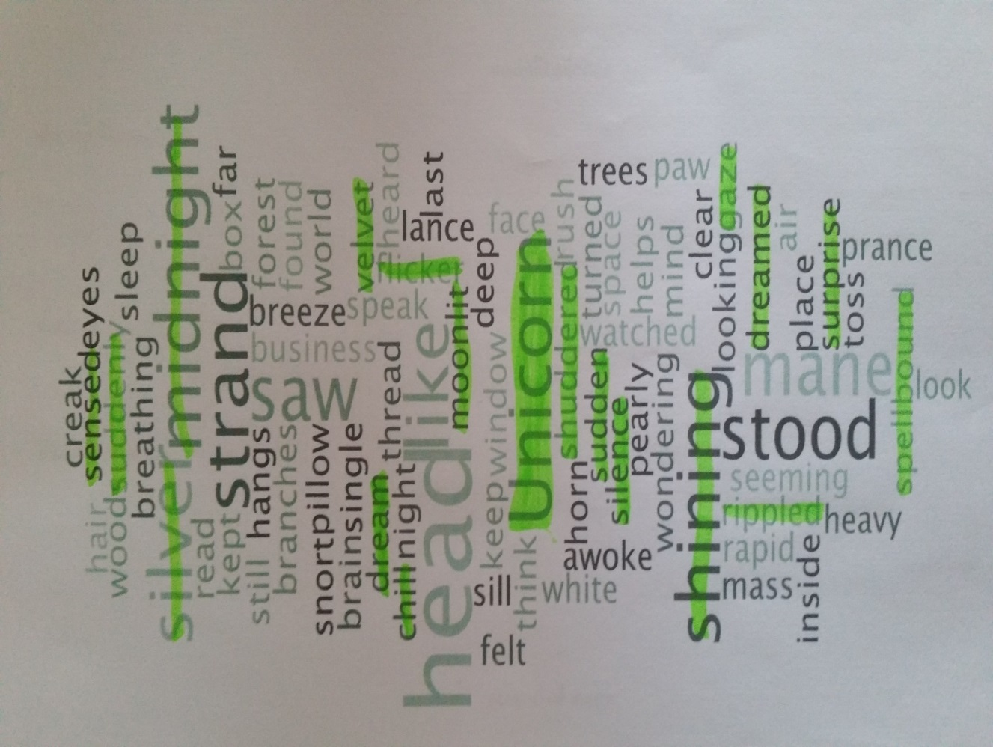
T: teacher dialogue, C:child dialogue
Develop a broader, deeper and richer vocabulary
Discuss words and phrases that capture the reader’s interest and imagination
spellbound
T: “So amazed, you are caught in the ‘spell’ of the thing - you can’t look away or move.”
C: “Is it the same as being astonished?”
shuddered
T: “Can you show me how you might shudder?”
sensed
T: “It means knowing but not seeing”
velvet
T: “It’s a material that’s really soft and smooth when you touch it.”
C: “I can feel it when I say it”
rippled
C: “I think of waves silently moving up and down on a lake”
moonlit
C: “When the moon is shining down on something and you can see it”
gaze
T: “Which word is better ‘look’ or ‘gaze’?”
C: “Gaze - because it shows you how”

Slide 3
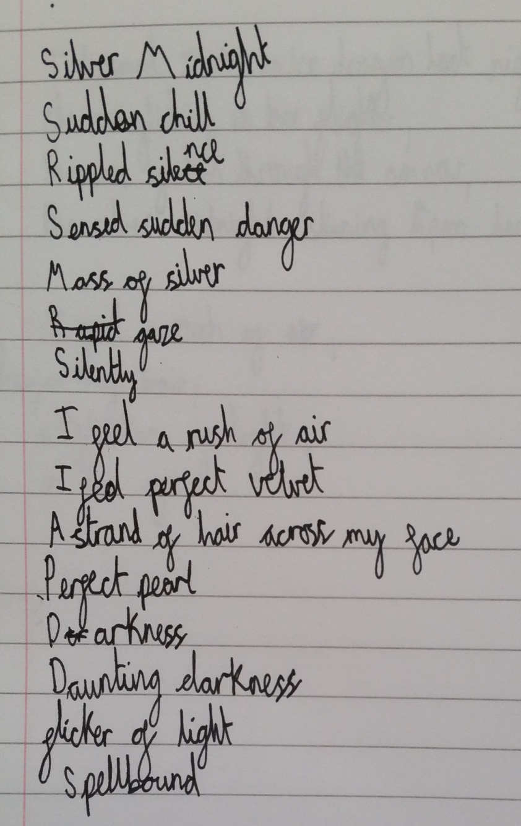
Ideas are developed using some appropriate vocabulary
Teacher comment / observations:
Initially child only paired up highlighted words e.g. silver midnight were words near each other on the Wordle
After mini plenary to encourage children to adapt into their own ideas, child took greater ‘risks’ e.g. ‘sensed sudden danger’
Child not yet confident to apply some new vocabulary into their own noun phrase e.g. ‘spellbound’ only listed
Child has used good level of rich vocabulary and deepened knowledge of word choices during the task
Child now needs to apply in context to embed understanding

Slide 4
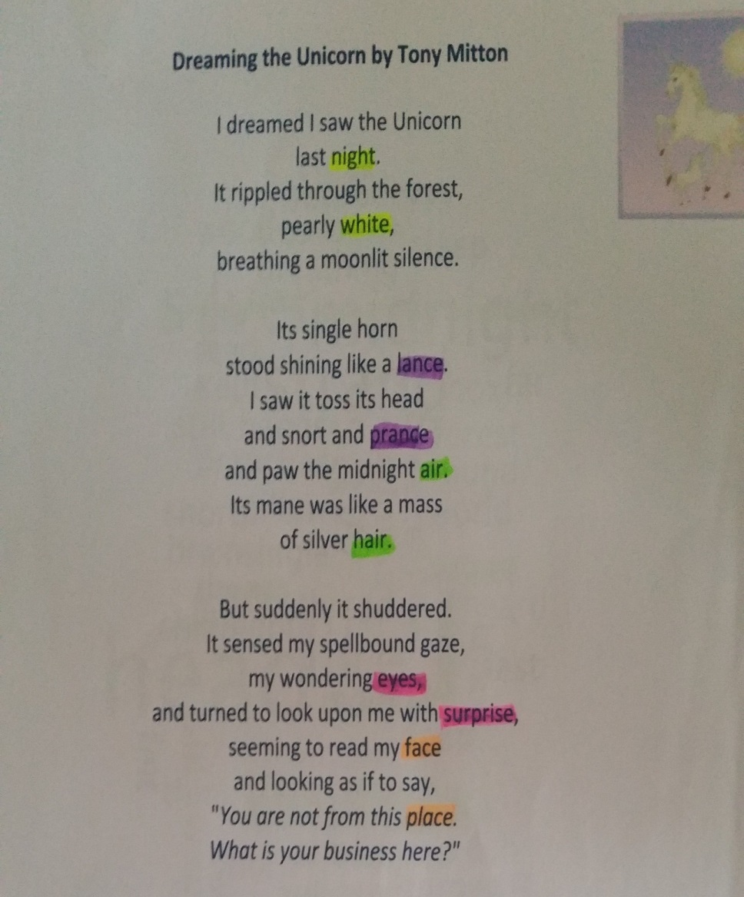
Begin to use vocabulary from the text to support responses and explanations
I saw these words in the Wordle yesterday!
‘Suddenly’ is a good word because it shows how quickly something happened
It shows how the unicorn moves like a horse, because horses ‘prance’ around
I have highlighted the rhyming words in different colours.
The hardest to find were ‘eyes’ and ‘surprise’ because they are not spelt like each other
I understand ‘spellbound’ now it is in the poem – the person is looking at the unicorn for a long time, they are curious about it. It says they are ‘wondering’

Slide 5
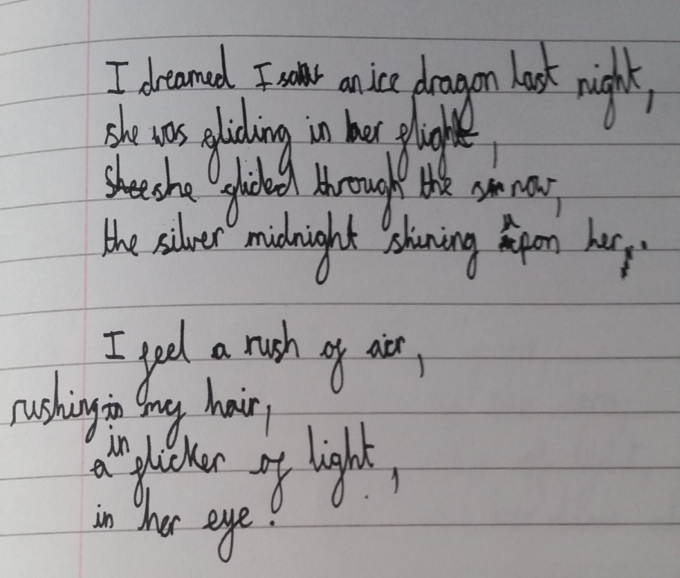
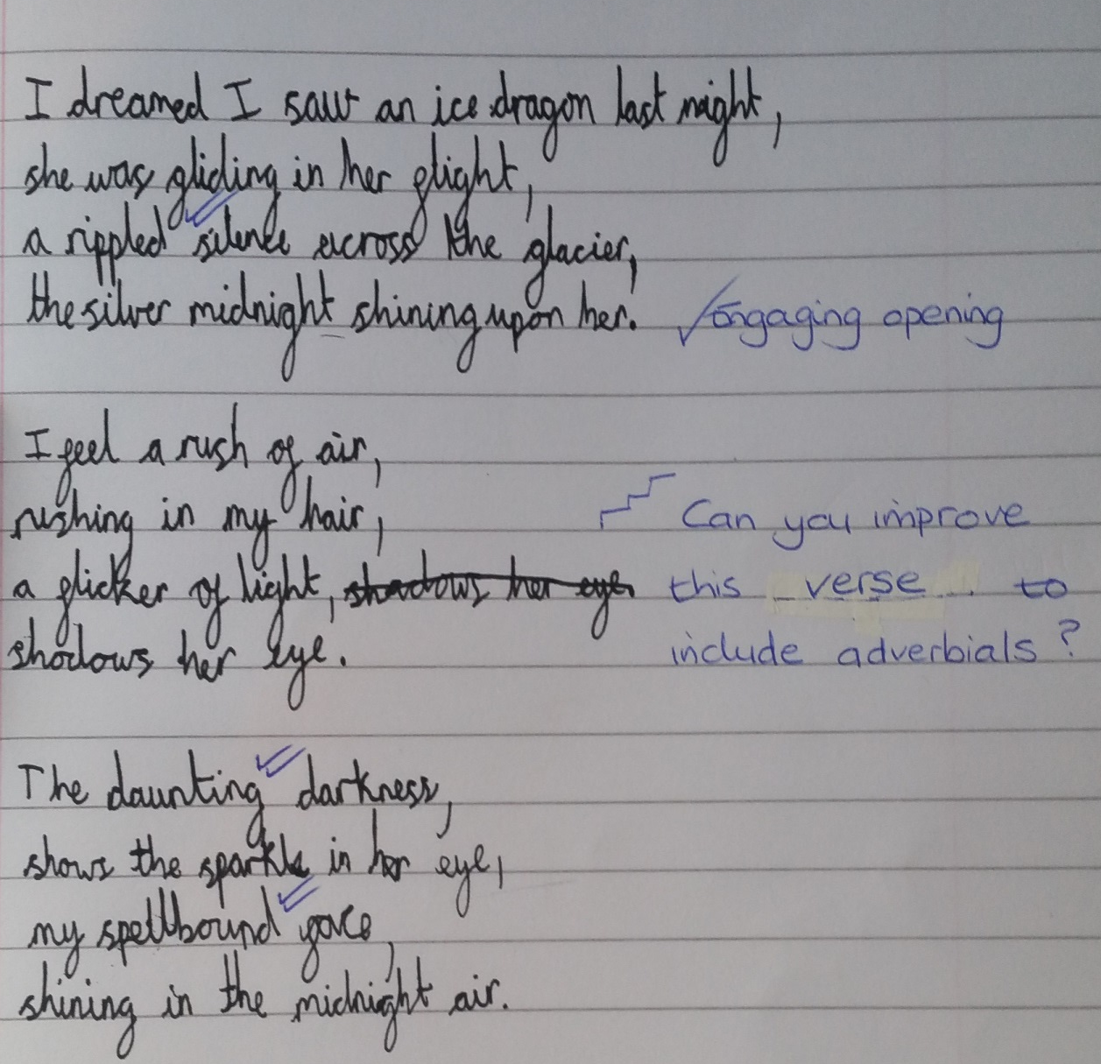
Draft and write by composing and rehearsing sentences orally, progressively building a varied and rich vocabulary

Slide 6
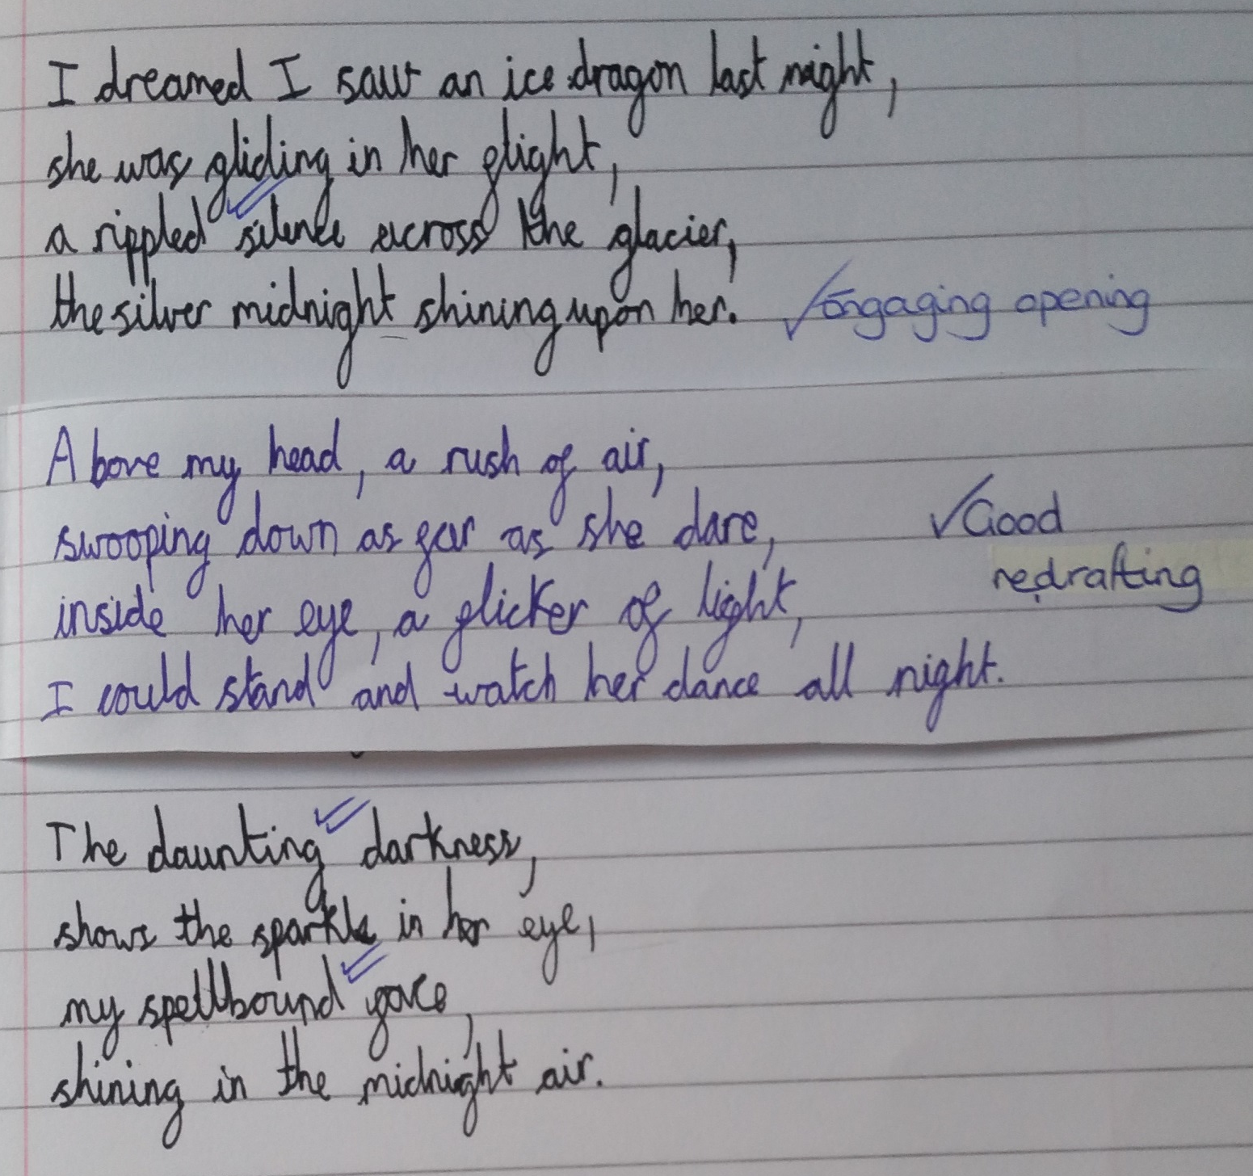
Use adverbs and prepositions to express time, place and cause

