Slide 1


Slide 2
Hampshire Assessment Model
Project Group
Eastleigh Group
ARRA1836-15AA
Session 1, Chilworth Manor

Slide 3
Agenda 9:00-16:00
9:00 National and Hampshire updates
9:20 Where are we now?
9:40 Assessment in the New National Curriculum:
What is good progress?
10:30 Break
10:45 Updates on developments in Hampshire Assessment Model tracking systems including SIMS, Target Tracker and Classroom Monitor
12:00 Lunch
12:45 The mastery journey and achievement of Age Related Expectation whilst enriching and extending learning for higher attainers.
(Evolving indicative standards for Autumn Term moderation activities in Y2 and Y6)
3:15 Action planning in your school’s context

Slide 4
Welcome to the project group
What’s the big idea?
Big questions and solution focused enquiry and problem solving
Responding to local and national context
Part of a network of thinking
Working collaboratively
Introductions to the team and each other

Slide 5
National Update
Report of commission
Interim performance objectives
Trial test materials
National SEN research group
Inter LA discussions
Ofsted and Assessment

Slide 6
Final report of the Commission on Assessment without Levels
September 2015
‘Mastery learning’ is a specific approach in which learning is broken down into discrete units and presented in logical order.
Pupils are required to demonstrate mastery of the learning from each unit before being allowed to move on to the next, with the assumption that all pupils will achieve this level of mastery if they are appropriately supported. Some may take longer and need more help, but all will get there in the end.
Assessment is built into this process. Following high-quality instruction, pupils undertake formative assessment that shows what they have learned well and what they still need to work on, and identifies specific ‘corrective’ activities to help them do this.
After undertaking these corrective activities (or alternative enrichment or extension activities for those who have already achieved mastery), pupils retake a parallel assessment.

Slide 7
Interim Maths
What do the following indicate?
Performance standard
Trial test materials
Arrangements for KS1 and Ks2 assessment

Slide 8
Interim English
What do the following indicate?
Performance standard
Trial test materials
Arrangements for KS1 and Ks2 assessment

Slide 9
Hampshire Assessment Model
Wide participation and engagement
Moodle based assessment forum
Revised Phase materials
Tracking tools

Slide 10
A sequence of principled steps that inform our model
1. The prize for getting this right: turn opportunities into improvement
6. redefine the nature and purposes of intervention and differentiation
7. Create effective recording and tracking systems
2. The principles of linked curriculum, teaching and assessment thinking
5. Modelling planning processes that embed assessment activities
8. Develop robust moderation processes to exemplify the journey to "mastery"
3. Defining clearly the learning journey in each subject domain
4. Exemplify a range of revealing assessments activities
9. Create clear models for reporting to internal and external audiences

Slide 11
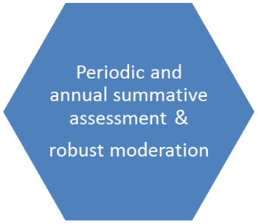

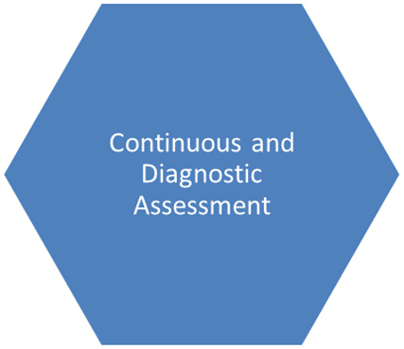
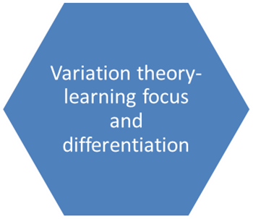
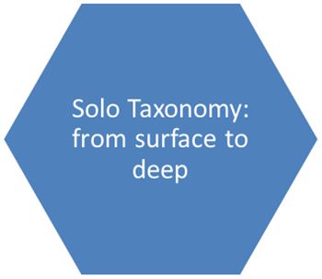
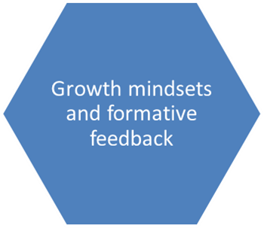
Developing a coherent assessment strategy
Mastery Learning and goals;
catch up/ keep up
Some big ideas

Slide 12
Guiding principles of an assessment model
Uses assessment to focus teachers on the content which must be secured before moving on
Content is introduced in an order which, once secured, supports achievement of the more challenging expectations of the national curriculum
Promotes a ‘recursive curriculum’ approach, enabling objectives to be returned to thus securing and deepening children’s understanding
Opportunities to develop links across subject domains are built into the content progression

Slide 13
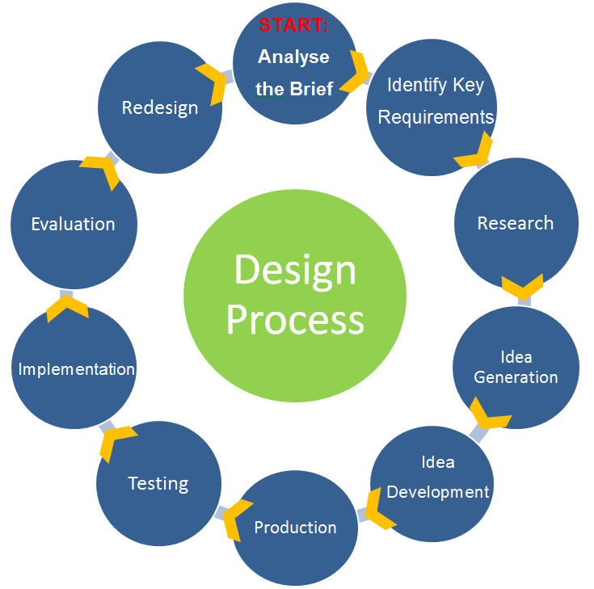

Begin to clarify your thinking
What are you currently doing that you are pleased with?
What are the main questions for you at the moment?

Slide 14
Assessment in the
New National Curriculum
What is good progress?

Slide 15
Agenda
Curriculum Structure: without levels
Breadth: “Feel the width” of the curriculum
Depth: Avoiding “Lily pad” learning
Progress tracking: Are they getting there?
Leadership implications: Are we sure?
Accountability: challenging ambitions (performance objectives)

Slide 16
Challenges
The legacy of levels based thinking:
  Linear language
  Time bounded and regular progression steps
  Good progress/ outstanding progress expressed in levels and APS and transition matrices
  Deeply entrenched behaviours, processes and reference points linked to tracking and performance accountability
  From unconscious or conscious competence to unconscious or conscious incompetence?
Freedom for schools to develop own systems

Slide 17
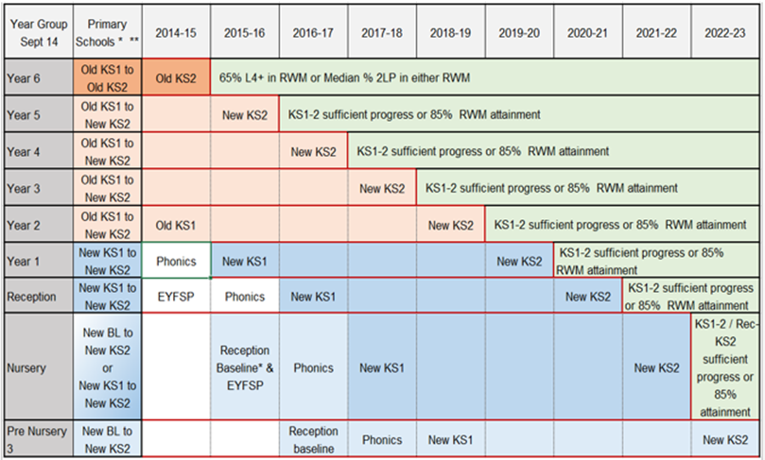

Slide 18
Progress tracking:
Are they getting there?
Progress between key stages:
  The calculation of the difference between a baseline measure and an exit measure.
  Becoming increasingly non-predictable in the context of changing measures at either end?
  Reference to baselines and terminal assessments impossible to use on the journey?
  Underlines the importance of securing the curriculum that is the basis for the assessments at the end:
  all the curriculum for all the pupils

Slide 19
Curriculum Structure: without levels
Notes:
Assessment is the knowing and understanding of learning, a continual process involving both learners and teachers. As part of this process, teachers need to analyse and record key pieces of assessment information and utilise these to make informed decisions about how to support on-going learning and development. The base for collection of assessment evidence should be as wide as possible to provide the best foundation for judgements.
Recording, with its documentation, is a by-product of the process reflecting the assessments made, but is not an assessment in itself. Its purpose is to provide a clear understanding of the knowledge and understanding of the pupil as a learner; it supports the knowledge but does not replace it; it assists in recalling and remembering information, but is not a substitute for it. Any recording and documentation should never be at the expense of interaction.
How and when evidence of learning is recorded should be a whole school decision. There are no set formulae. Scribbled notes, post its, photographs and longer narrative all have their place but this recording is not the assessment itself but merely a means to help the adults recall or remember what they know. Assessment is the “accurate and usable knowing and understanding of children, not the quantity or form of recorded information.” (Dubiel 2014)

Slide 20
“The content of the National Curriculum (and the extent to which it has been taught and learned)”
National Curriculum subject content
Curriculum objectives
Key Performance indicators
NAHT Year Group Performance standard
Key Stage performance standards, assessments and tests

Slide 22
Reframing assessment thinking
Assessment processes are directly linked to the aims and objectives of the curriculum and should inform teaching and learning
Tracking is a by-product of assessment and not the outcome
“Accurate and usable knowing and understanding of children, not the quantity or form of recorded information.” (Dubiel, 2014)

Slide 23
Depth: Avoiding “Lily pad” learning
Where would you expect a typical “on track” pupil to be after 9 weeks (at the start?), 18 weeks (in the middle?), 27 weeks (near the end?)
Is the pupil covering the national curriculum or learning it?
How do teachers measure achievement in the curriculum, as it progresses over the year?
What about a pupil who has SEN, is lower attaining or is higher attaining, (based on prior learning)?

Slide 24
Breadth: “Feel the width”
Periodic strategic assessment: “Stop and Think”
  Is this pupil “on track” to achieve the performance standard?
  How much “achievement” of the curriculum’s objectives would be a reliable indicator of future success after 9 weeks, 18 weeks, 27 weeks?
  What evidence of achievement would give us all confidence that the prediction will materialise in the final outcome?
From “Best Fit” to “Good Fit”?

Slide 25
When evaluating a schools’ approach to assessment
What depth of mastery does the school expect to see in the learning at each of the school’s assessment points for a pupil to be securely “on track” to ARE e.g.
  Apprentice/ beginning/ Foundation
  Competent/ securing/ Developing
  Expert/ mastering/Secure
  Beyond ARE/Extended response /Enriched application/Hypothetical thinking
How does the school focus the assessments of teachers e.g. How many NC objectives are included in the teacher’s overall judgement at each point?
How does the school ensure a curriculum that gives pupils have opportunities to show evidence of deepening and broadening grasp of the curriculum?
How are the schools’ standards/expectations exemplified and moderated for consistency?

Slide 26
Why track? (AAIA)
Tracking can serve a number of purposes that can include:
  enabling teachers to see the journey of a child’s learning
  helping teachers to plan appropriate learning experiences that will meet their children’s needs
  identifying pupils who are making slow progress, so that action may be taken
  providing the school leadership team with information about the progress pupils are making across the school
  providing the school leadership team with information about whether pupils are meeting age-related expectations and are ‘on track’ to meet expected end of key stage outcomes used for accountability
  providing the school leadership team with information about whether pupils are on track to meet outcomes based on high expectations.
Primarily it should serve the learner by ensuing that appropriate intervention can take place, and other purposes should not work against these.
Tracking is, however, not the main reason for assessment!

Slide 27
On Track?
The leadership questions
The attainment tracking questions?
How does your data reflect the reality of pupils’ curriculum attainment? What does it mean? (Points/words/colours?)
How are you ensuring that this data is derived from :
  Reliable evidence?
  Consistent judgements?
  Accurate interpretations of ARE and milestones?
  Robust external moderation
What proportion of pupils are not on track to attain Age Related Expectations (ARE)?
What proportion of pupils are close to being on track to ARE?
What proportion of pupils are securely “on track” to attain ARE
What proportion of pupils are on track to attain beyond ARE?

Slide 28
How does the school measure progress?
What is the new curriculum baseline/benchmark?
How frequently is curriculum attainment re-assessed ? (Milestone)
What is measured between any two milestones?
What is the right amount of progress between milestones? (equal, increasing, reducing steps?)
What model for “pace”: Hare or tortoise?

Slide 29
Floor standards / Coasting schools (Primary)
2015 FLOOR STANDARD
Less than 65% L4+ RWM & less than median progress in ALL subjects
2016 FLOOR STANDARD
Less than 65% ‘national standard’
& less than median progress in ONE subject
COASTING
Less than 85% in 2014 and 2015 & less than ‘average’ progress plus below ‘coasting level ‘ in 2016
2017 FLOOR STANDARD
Not published
COASTING
Less than 85% in 2015 & less than ‘average’ progress plus below ‘coasting level ‘ in 2016 and 2017
2018 FLOOR STANDARD
Not published
COASTING
Below ‘coasting level ‘ in 2016, 2017 and 2018

Slide 30
Comparability?
“85% or more of pupils meet the new expected standard at the end of key stage 2 (similar to a level 4b under the current system)” vs 2015 attainment 4B+ or 2B+
High attainment e.g. KS1 L3B+/ KS2 L5B+ = ?
FIGURES HERE FROM STAT NEIGHBOURS

Slide 31
Good (expected) Cohort Progress?
Currently (approximately)
EYFS
  90+% 40-60m to GLD
KS1
  90+% GLD to 2B+
KS2
  90+% of pupils make 2 levels
  30+% of pupils make 3 levels
  Groups close the gap
KS4
  65+% of pupils make 3 levels
  30+% make 4 levels
Without levels?
EYFS
  90+% 30-50m to GLD
KS1
  90+% GLD/Y1 ARE to Secure Y2 ARE
  Where ARE is below 85%, the % on track in each cohort, increases over time
KS2 (KS3?)
  100% stay on track in each year group and over key stage
  Where ARE is below 85%, the % on track in each cohort, increases over time
KS4
  Progress 8

Slide 32
Good Progress
The simple questions-
  Are more/less/ the same pupils now on track to ARE than were at the start of the assessment period?
  Are more/ less/ the same pupils on track to attain beyond ARE?
  Are the pupils who were not on track closer, catching up or securing appropriately personalised and challenging curriculum objectives?
How does school account for this?
  What does the schools’ assessment information tell you about achievement? (high and secure? improving? declining?)
  What does it tell you about the relative achievement of groups
  What does it tell you about achievement over time, in each cohort and between cohorts?
To what extent is assessment and tracking “primarily serving the learner by ensuing that appropriate intervention can take place”?

Slide 33
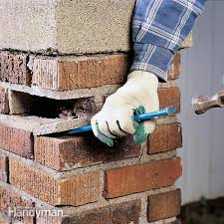

There is no reliable translation between levels and a “mastery approach”
KS1 70% 2B+ “Best fit”
April: 50% Year 5 Competent

Slide 34
What stops a pupil from achieving ARE in a test or moderated teacher assessment?
  Not sufficiently fluent?
  Not sufficiently independent?
  Not sufficiently resourceful and resilient?
  ……..in all the subject curriculum as experienced by each child

Slide 35
By the end of the year/key stage
Expected progress
“Keep up”
(Almost all of) the pupils who are at ARE, remain at ARE
(Almost all of) the pupils who are Beyond ARE, remain Beyond ARE
Pupils with SEN remain at ARE in areas unaffected by their needs and meet personalised objectives in their EHCP
More than expected progress
“Catch up”
(Almost all of) the pupils who are not at ARE, narrow the gap
A “significant” proportion of pupils who are not at ARE, reach ARE
Exceptional progress
“stretch”
A “significant” number of pupils who are securely at ARE, reach Beyond ARE

Slide 36
Accountability: challenging ambitions
What pupil progress is being expected (ambition) of teachers and leaders in performance management?
  Keep up Objectives?
  Catch up Objectives?
  Stretch Objectives?
Context is everything….. discuss

Slide 37
Break
10:30-10:45

Slide 38
Excellence and Equity is about…
Insightful knowledge of the pupil
Clear and challenging expectations for all
Secure knowledge of the subject
Progress

Slide 39
The Global Model for English, Mathematics and Science
We are developing an example of one model for assessment that is intrinsically linked into curriculum and teaching - there will be others
Schools must do their own hard thinking to make this all work well in terms of improving the quality of individual pupils’ ‘knowing about the matters, skills and processes specified in the relevant programmes of study’
The role of this model is to provide a well-thought out example to help schools on that development, that they can appropriately adopt and refine or adapt to their own contexts

Slide 40
Mastery learning
The Hampshire model expects that children will deepen their grasp of key ideas, over time, rather than move on and leave gaps behind
Through being well taught and given curriculum opportunities they will develop and demonstrate their resourcefulness and versatility, (in an age appropriate way)
This will be evident in their capacity to applying their knowledge, skills and understanding with (sufficient):
  Fluency over time
  Independence
  Resilience to deal with complexity and new contexts
This does not mean that all pupils achieve the same degree of mastery… but it is at least sufficient, so that they can make successful progress through the fundamental ideas. No one left behind

Slide 41
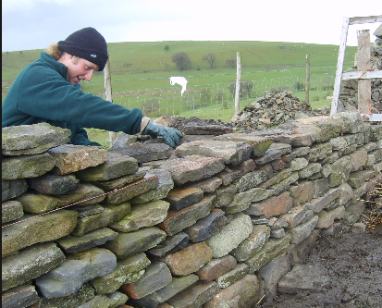
Based on the idea of a wall…

Slide 42
Domain Bricks: Building the wall
Maths | Reading | Writing
Number and place value | Word Reading | Transcription
Addition and subtraction | Themes and Conventions | Handwriting
Multiplication and division | Comprehension- Clarify | Composition: Composition and Effect
Fractions (including decimals) | Comprehension- Monitor and Summarise | Composition: Text Structure and Organisation
Measurement | Comprehension- Select and Retrieve | Composition: Sentence Structure
Geometry: properties of shape, position & direction | Comprehension- Respond and Explain | Vocabulary, grammar, & punct.
 | Inference
 | Language for Effect

Slide 43
Hampshire Model: Manageable Phases

Slide 44
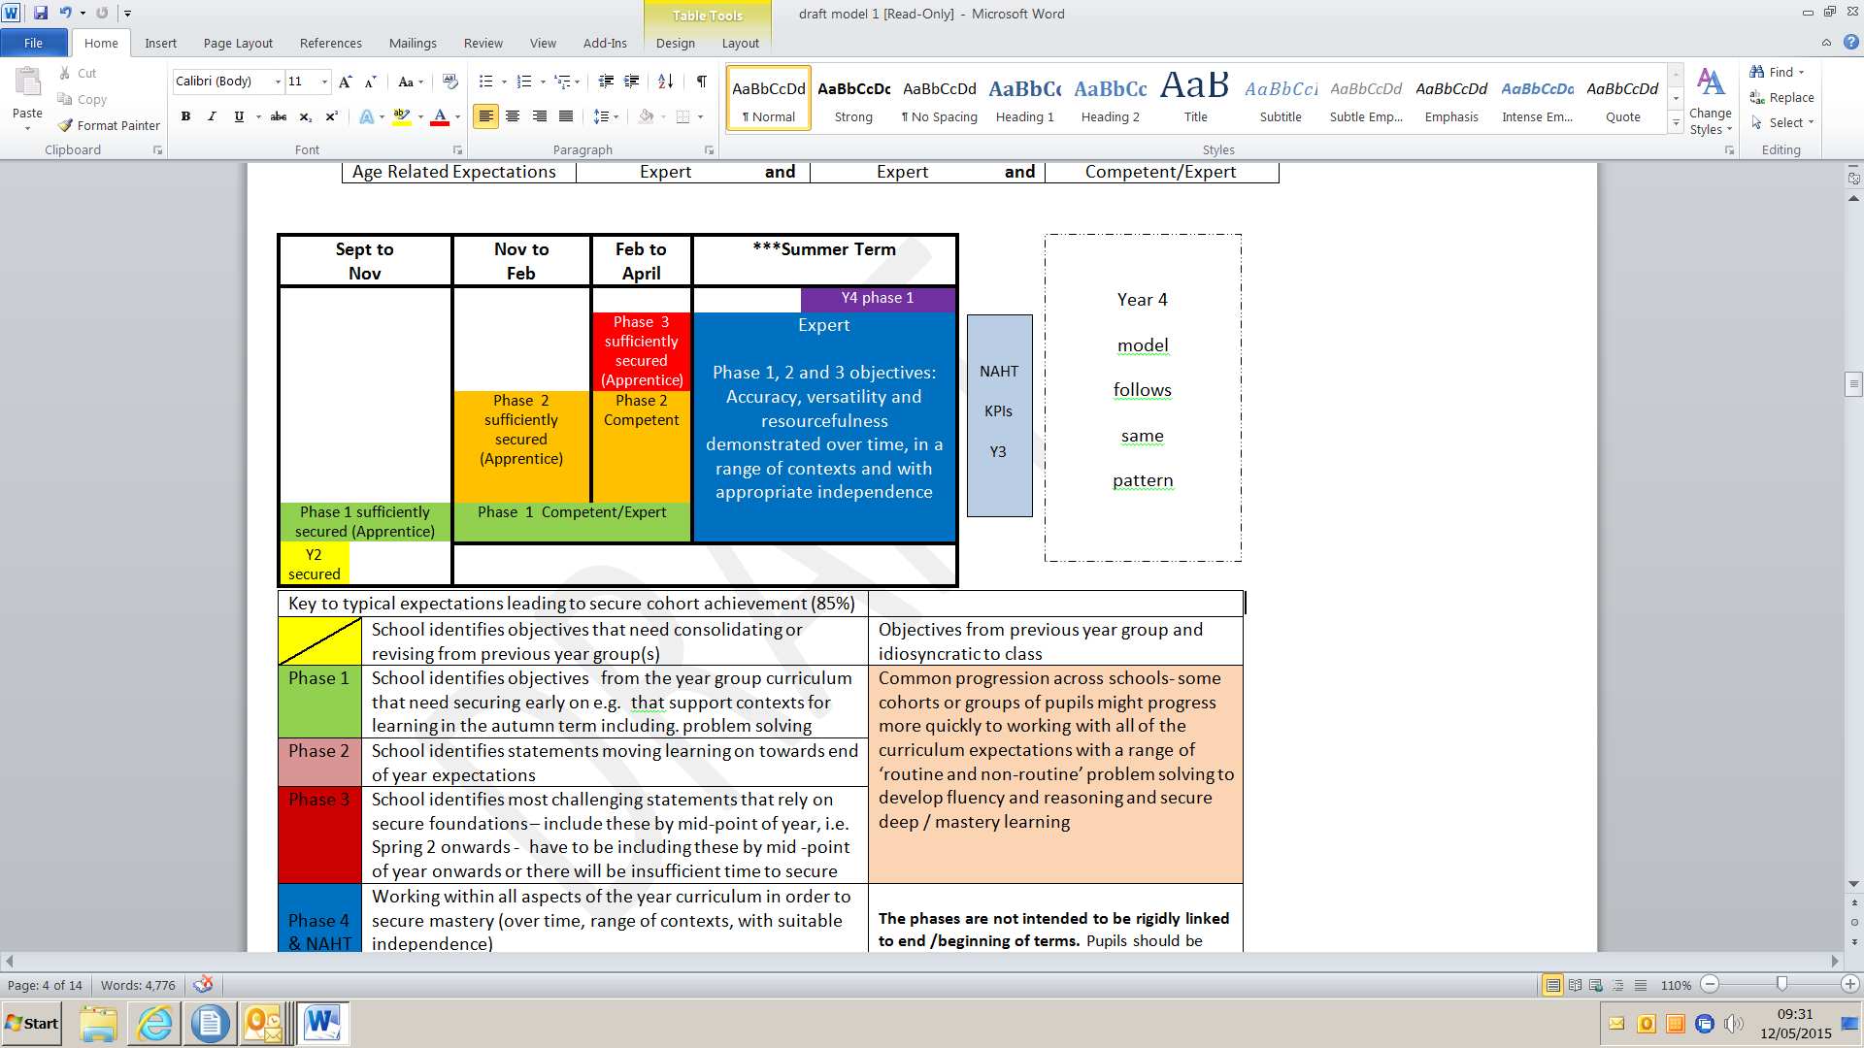

Assessment Model
- a chance to stop and check…
Adopt or adapt…
Notes:
New slide 12 May

Slide 45
Objectives have to be “sufficiently” secured at each strategic assessment for a pupil to be “on track”.
To be “on track” at….. | Phase 1 objectives |  | Phase 2 objectives |  | Phase 3 objectives
Milestone 1 (November) | Apprentice |  | Not yet introduced |  | Not yet introduced
Milestone 2 (February) | Competent | and | Apprentice |  | Not yet introduced
Milestone 3 (April) | Expert | and | Competent | and | Apprentice
End of Year Age Related Expectations | Expert | and | Expert | and | Competent/Expert
Notes:
Four strategic assessments (“stop and think”) consider whether the pupil has or not yet reached the appropriate standard to be on track to secure Age Related Expectations (ARE) e.g. at least Milestone 1 by November, Milestone 2 by February etc. (one page for each subject)
In our model we have used separate terms to indicate a standard that deepens over time. There are three levels of proficiency: Apprentice, Competent and Expert.
As time goes on, children are expected to achieve greater mastery, in other words “deepen” their grasp. By the next assessment window in February greater fluency is expected in those aspects already introduced (defined as Competent standard), whilst achieving at least Apprentice standards in the more recently introduced phase 2 elements.

Slide 46
Guiding principles of the assessment model
Uses phases as a strategic assessment device to focus teachers on the content which must be secured before moving on
Content is introduced in an order which, once secured, supports achievement of the more challenging expectations of the national curriculum
Promotes a ‘recursive curriculum’ approach, enabling objectives to be returned to if not sufficiently secured within the phase, thus securing and deepening children’s understanding
Opportunities to develop links across domains are built into the content progression

Slide 47

Hampshire Model
Summative judgements:
  A manageable range of objectives inform judgements in each domain “brick”
  Judgments are linked to increasing expectations of mastery over time
  Judgements in all bricks are aggregated to arrive at an overall judgement for the subject:

Slide 48

Close to?
If pupils are getting there but not quite there…
In the Hampshire Model this means:
  As a result on QFT and planned interventions this pupil will both catch up what’s missing and keep up with progress made by the pupils who were secure at the same time
  100m + 100m = 200m
  80m + 120m = 200m

Slide 49
Lunch 12:00

Slide 50
12:45 This afternoon
How do we help teachers (CPD) ensure all (almost all) the pupils “master” all the curriculum, sufficiently well to meet Age Related Expectations?
  Clarify the mastery journey
  Exemplify the expected standards at milestone 1
  Introduce some sympathetic pedagogical approaches
    Masterly learning (Correction and Enrichment)
    Deepening learning through Solo Taxonomy/ Depth of Knowledge
    Precision teaching

Slide 51
Revealing Assessment and the Mastery Learning journey towards
Achievement of Age Related Expectations

Slide 52
Assessment
‘By the end of each key stage, pupils are expected to know, apply and understand the matters, skills and processes specified in the relevant programme of study.’
National Curriculum (2014)

Slide 53

Carol Dweck: Growth Mindsets
The division between people who believe that intelligence and talent are fixed versus those that believe they are capable of growth…
Notes:
In what way is your classroom a ‘talent factory’? Not a talent refinery? How does the ethos, routines, classroom environment, your beliefs create achievement?? Create talent?? What you believe matters and the children know!!!

Slide 54
What kind of schools have we had?
Descriptor of School | School Ethos | Key Process
Talent Refineries | School must provide opportunities for children to show what they can do | Ensuring good teaching and curricular coverage
Talent Incubators | All children can learn but not all can achieve high levels | Drawing out what is within the student
Talent factories | Almost all children can achieve at high levels | Whatever it takes

Slide 55
Day by day assessment influencing teaching
The expectation is that the majority of pupils will move through the programmes of study at broadly the same pace.
However, decisions about when to progress should always be based on the security of pupils’ understanding and their readiness to progress to the next stage.
Pupils who grasp concepts rapidly should be challenged through being offered rich and sophisticated problems before any acceleration through new content.
Those who are not sufficiently fluent with earlier material should consolidate their understanding, including through additional practice, before moving on.
Bloom, B. S. (1971a). Mastery learning. In J. H. Block (Ed.), Mastery learning: Theory and practice (pp.
4 7–63). New York: Holt, Rinehart & Winston.
Bloom, B. S. (1971b). Individual differences in school achievement: A vanishing point? Bloomington, IN:
Phi Delta Kappan International.
Bloom, B. S. (1974 ). An introduction to mastery learning theory. In J. H. Block (Ed.), Schools, society and
mastery learning (pp. 3–14 ). New York: Holt, Rinehart & Winston

Slide 56
Achievement in a ‘Life without Levels’ must be underpinned by Secure Pedagogical Understanding
People understand new ideas by relating them to existing ones.
If they don’t know enough about a subject they won’t have a solid base from which to make connections to prior knowledge.
People are more likely to remember learning if they make their own sense of what they are learning and relate it to what they know – this applies to adults and children alike!

Slide 57
What makes it difficult?
What do teachers need to think about when planning lessons?
They need to be able to work through the process of learning e.g.
Prompt investigation by posing questions
Determine the key facts that pupils will need to know in order to access the investigation
Decide what to teach and how to teach to those who have no, little, some, confused, lots...of learning
Support learners, facilitate discussion, promote opportunities to focus on the key learning ideas
Spend time underlining the most significant aspects of the learning for the session
They need to know how to:
Deconstruct the learning
Check for prior learning
Check learning efficiently and quickly during the lesson
Deal with the spread of understanding identified
They need to be able to build:
Fluency
Independence
and
Resilience
in learners
They need to know how to help pupils Catch Up and Keep Up
They need to provide rich opportunity for Mastery Learning
Clarity is essential
Teachers need to know what they want pupils to learn and understand
They need to know what progression from Apprentice to Expert looks like

Slide 58
Teachers as researchers
Our view is that the best way to develop challenge and enrich the curriculum for all pupils, including the highest attainers, is through a process of enquiry based learning for teachers who in an “open source culture” develop and share best practice within and beyond their classrooms

Slide 59
Teaching and Learning today depends upon skilled and reflective practitioners able to construct a Pedagogical Marriage for their learners
Solo Taxonomy
Bloom’s Taxonomy/Depth of Learning
Catching up, Keeping up and Mastery Learning
Precise teaching and variation
Could these pedagogical approaches be helpful in refining your school’s professional practices?

Slide 60
SOLO
Structure of observed learning outcomes
SOLO is a model of learning that helps develop a common understanding & language of learning that helps teachers (and students) understand the learning process.
With SOLO Taxonomy, teachers and students are able to;
Thoughtfully design learning intentions and learning experiences
Identify and use effective strategies and success criteria
Provide feedback and feed forward assessment of learning outcomes
Reflect meaningfully on what to do next

Slide 61
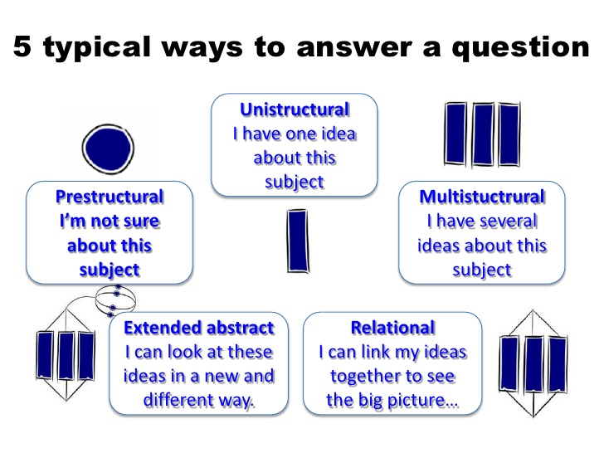
SOLO TAXONOMY
(Structure of Observed Learning Outcomes)

Slide 62
Solo with minecraft
https://www.youtube.com/watch?v=4XrxiHHHaQA

Slide 63


PRESTRUCTURAL…
learning outcomes show unconnected information with no organisation.
I don’t know what a habitat is. I think it’s a skateboard company. I need help with a definition.

Slide 64

Unistructural…
learning outcomes show simple connections but the importance of different parts is not noted
A habitat is a place.
My definition has one relevant idea.

Slide 65

Multistructural
learning outcomes show connections are made, but significance of parts to overall meaning is missing
As for unistructural plus… plants and animals live in habitats. Different habitats are characterised by different living things.
My definition statement has several relevant ideas about habitat.

Slide 66

Relational
Learning outcomes show full connections are made, and synthesis of parts to the overall meaning
As for multistructural plus… this is because the different environmental factors a habitat affect an organism’s chances of survival and reproduction. For example, the environmental factors in a lake habitat are suited to the survival and reproduction of ducks, swans, water beetles, leeches and floating duckweed.
My definition statement has several related ideas about habitat, and links these in some way

Slide 67

Extended abstract
Learning outcomes go beyond subject and links are made to other concepts – generalisations
As for relational plus… I think we should care more about habitats, because changes affect the survival and reproduction of the organisms that live there
My definition statement has several relevant ideas about habitat, links these and looks at these linked ideas in a new way

Slide 68
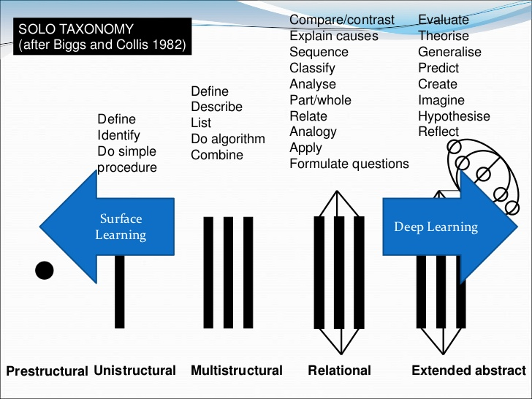

Slide 69
The Language of Learning
SOLO level | Verbs
Unistructural | Define, identify, name, draw, find, label, match, follow a simple procedure
Multistructural | Describe, list, outline, complete, continue, combine
Relational | Sequence, classify, compare and contrast, explain (cause and effect), analyse, form an analogy, organise, distinguish, question, relate, apply
Extended abstract | Generalise, predict, evaluate, reflect, hypothesise, theorise, create, prove, justify, argue, compose, prioritise, design, construct, perform

Slide 70
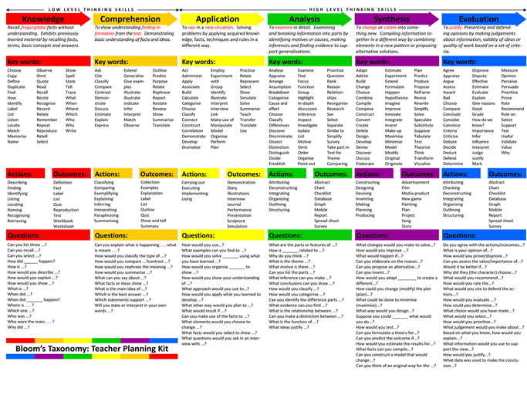

Slide 71
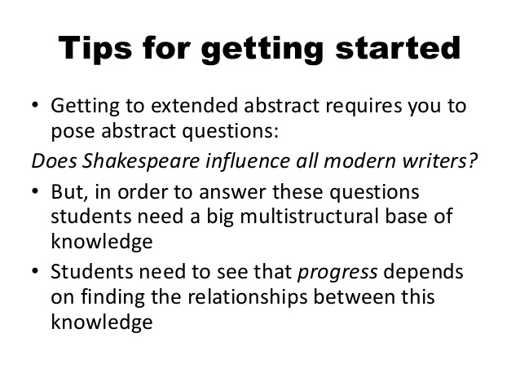
Enriching and extending

Slide 72
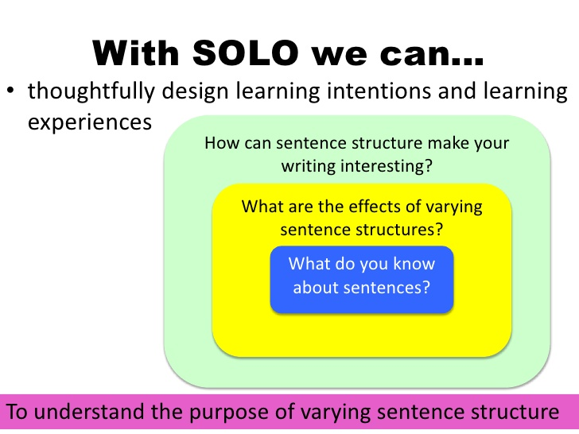
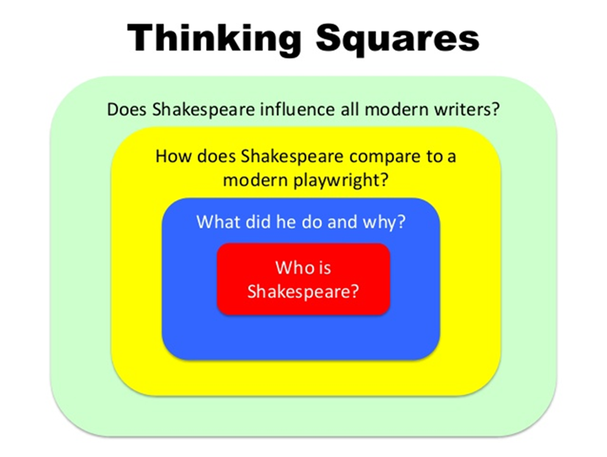

…And Design
to scaffold deeper learning
ARE Mastery?
ARE+ Enriched Mastery?

Slide 73
Writing to persuade from…
What is persuasion?
I have never heard the word before and don’t know what it means.

Slide 74
Through the next three phases to…. Writing to persuade
I can write to persuade (purpose) an audience (headteacher) to keep or abandon school uniform. Form (possibly a letter- or a speech) to be decided by pupils and teachers together (to make it particularly challenging ask pupils to write from the point of view they do not share personally.)

Slide 75
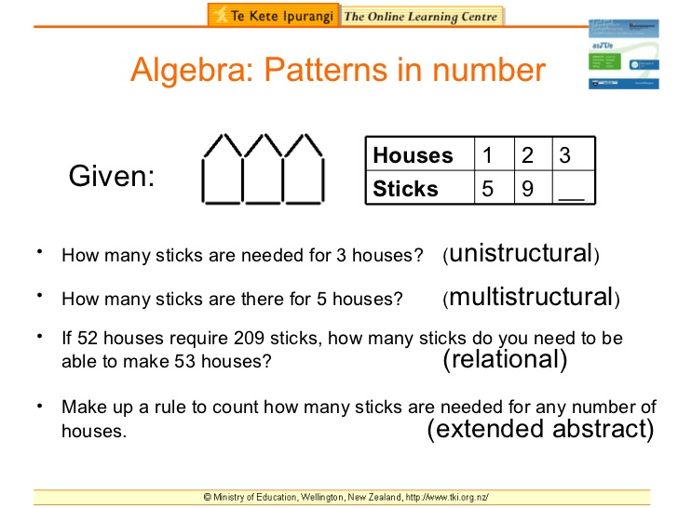

Slide 76
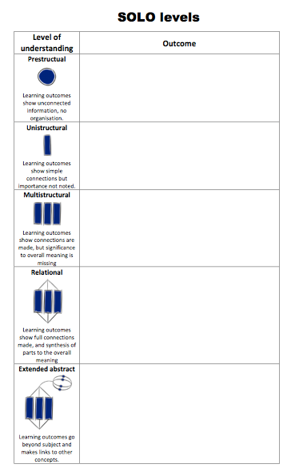
Solo Taxonomy
~
Planning a
Sequence of
Learning

Slide 77
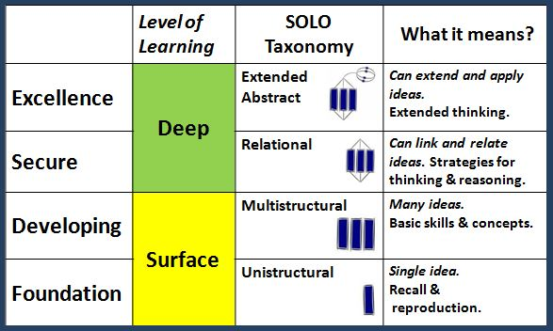

From Surface to Deep
In what circumstances would it be appropriate for higher attaining pupils to be using the following year’s curriculum objectives rather than deepening their learning in the age relevant curriculum?
Bright Spots: 10th September 2014
Biggs & Collis, 1982

Slide 78
Managers programme
This programme for leaders of provision for higher attaining pupils is to be developed over six integrated sessions aimed at enabling middle leaders to develop curricular, teaching and learning strategies to enrich learning experiences of and challenge thinking.
6 X half day sessions one each half term across the calendar year
Course leaders: Ian Troup; Primary Inspector; Sarah Sedgwick; Teaching and Learning adviser; Subject inspectors/consultants for English, Mathematics, science and computing
The aim of the course is to equip leaders, who are responsible for the highest attainers, to develop strategic and practical responses to meeting their pupils' needs and developing the quality of provision in their schools. The programme includes six half day sessions one each half term from spring 2016. delegates will be expected to complete a GAP task between each session.
Session 1 reviewing how best to develop enriched and extended learning experiences for higher attaining pupils utilising SOLO Taxonomy amongst other tools.
Sessions 2 - 4 subject based sessions including English, Mathematics, Computing and Science
Session 6 Consolidation, evaluation and forward planning

Slide 79

Deep thinking…?
What questions are posed about current classroom practices?

Slide 80
Depth of Knowledge or DOK
(Norman L. Webb 2002 )
Used by NY Department of Education
Provides a vocabulary and a frame of reference when thinking about how pupils engage with learning content
Offers a common language to understand cognitive demand
Has 4 DOK levels that grow in cognitive complexity and provide educators a lens on creating more cognitively engaging and challenging tasks
Is linked to Bloom’s Taxonomy
http://schools.nyc.gov/Academics/CommonCoreLibrary/ProfessionalLearning/DOK/default.htm

Slide 81
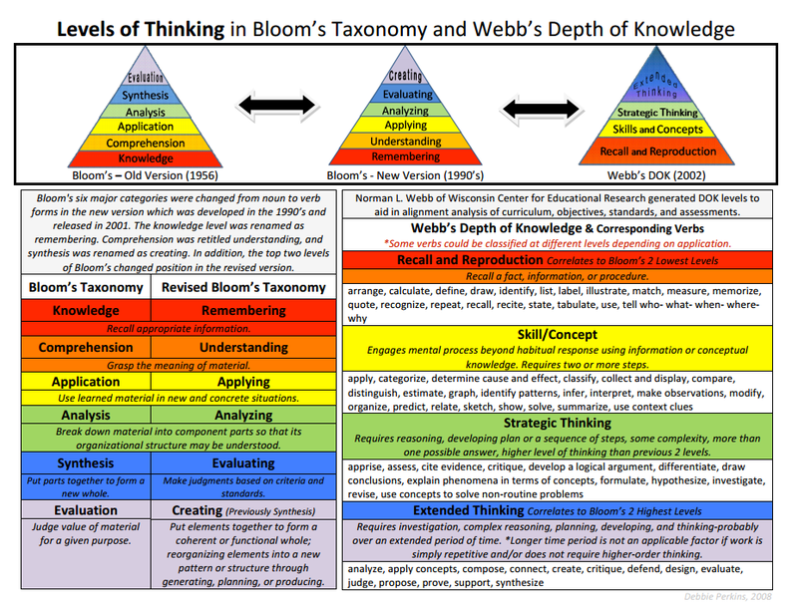

Slide 82
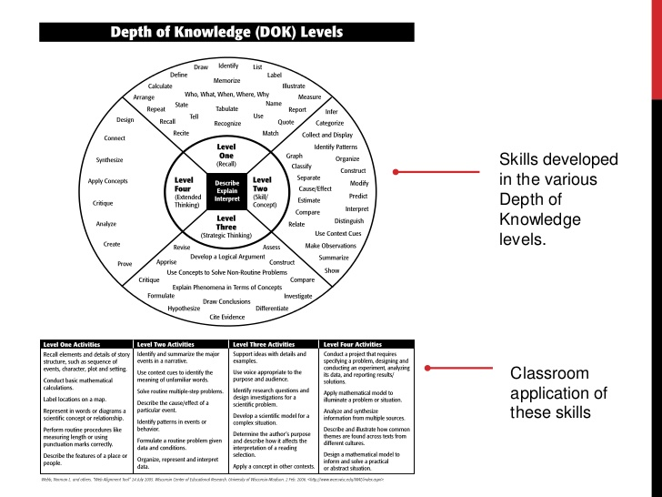

Slide 83
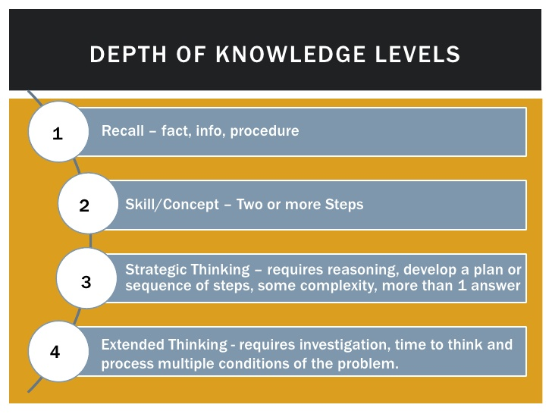
It’s not Bloom’s by another name and it’s not harder learning ~ it’s deeper learning!

Slide 84
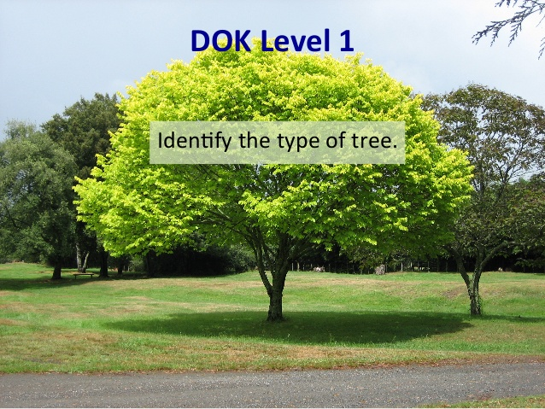
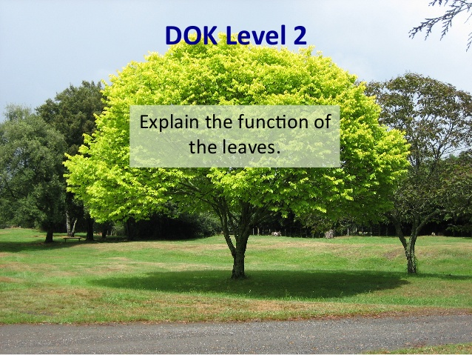
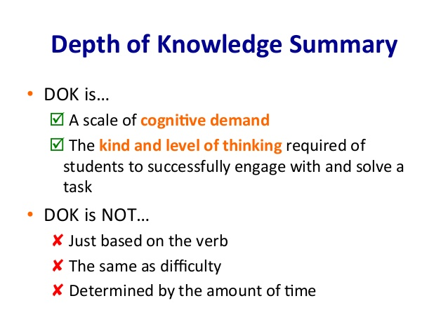
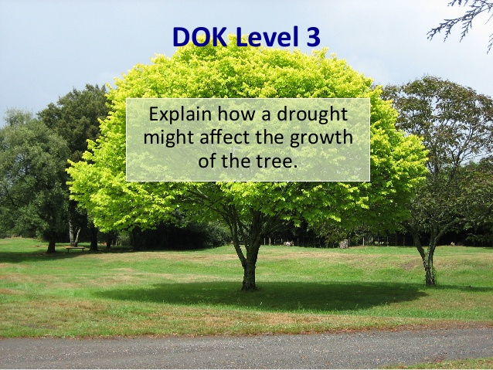
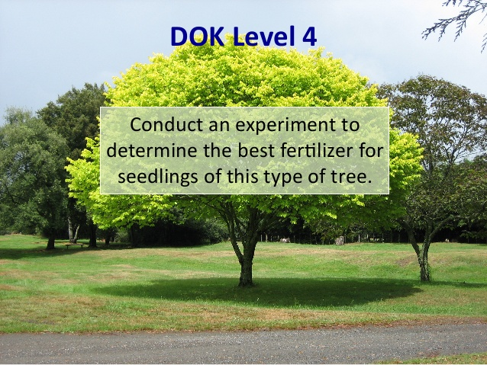

Slide 85
© 2009 Karin Hess permission to reproduce is given when authorship is fully cited khess@nciea.org

Slide 86
Benefits? https://www.youtube.com/watch?v=iQWvc6qhTds
Pupils learn more deeply
As a result of pupils taking responsibility, interacting meaningfully and often with their instructor and peers, and getting and giving frequent feedback, they acquire a deeper understanding of the content and how to use it
Pupils are more active participants in learning
The pupil role shifts from passive recipient to active constructor of knowledge, giving them opportunities to practice using the intellectual tools of the discipline
Interaction increases and pupils learn from one another
With more opportunities for pupils to apply their knowledge and therefore demonstrate their ability to use it, gaps in their understanding become visible to both themselves and the teacher

Slide 87

Questions this raises?
Implications for…?
What, if anything, might we do about developing our teachers’ pedagogy?

Slide 88



A working model for
“Masterly Learning”?
Yes
enrich
Unit of learning and objectives
Next unit of learning and objectives
Sufficiently Learnt?
No
No
Correct
Correct
Adapted from Bloom, 1971
Notes:
The expectation is that the majority of pupils will move through the programmes of study at broadly the same pace. However, decisions about when to progress should always be based on the security of pupils’ understanding and their readiness to progress to the next stage. Pupils who grasp concepts rapidly should be challenged through being offered rich and sophisticated problems before any acceleration through new content. Those who are not sufficiently fluent with earlier material should consolidate their understanding, including through additional practice, before moving on.
Bloom, B. S. (1971a). Mastery learning. In J. H. Block (Ed.), Mastery learning: Theory and practice (pp.
4 7–63). New York: Holt, Rinehart & Winston.
Bloom, B. S. (1971b). Individual differences in school achievement: A vanishing point? Bloomington, IN:
Phi Delta Kappan International.
Bloom, B. S. (1974 ). An introduction to mastery learning theory. In J. H. Block (Ed.), Schools, society and
mastery learning (pp. 3–14 ). New York: Holt, Rinehart & Winston.

Slide 89
What might these ideas mean in the context of learning?
Apprentice- Fundamental ideas that build on previous year’s work
Competent- builds on ideas initially developed at the Apprentice stage
Expert- builds on Competence and achieves sufficient mastery for next year’s work
Fluency over time?
Independence?
Resilience to deal with complexity and new contexts?

Slide 90
A working model for
“Masterly Learning”?
Yes
enrich
Unit of learning and objectives
Next unit of learning and objectives
Sufficiently Learnt?
No
No
Correct
Correct
Adapted from Bloom, 1971
Notes:
The expectation is that the majority of pupils will move through the programmes of study at broadly the same pace. However, decisions about when to progress should always be based on the security of pupils’ understanding and their readiness to progress to the next stage. Pupils who grasp concepts rapidly should be challenged through being offered rich and sophisticated problems before any acceleration through new content. Those who are not sufficiently fluent with earlier material should consolidate their understanding, including through additional practice, before moving on.
Bloom, B. S. (1971a). Mastery learning. In J. H. Block (Ed.), Mastery learning: Theory and practice (pp.
4 7–63). New York: Holt, Rinehart & Winston.
Bloom, B. S. (1971b). Individual differences in school achievement: A vanishing point? Bloomington, IN:
Phi Delta Kappan International.
Bloom, B. S. (1974 ). An introduction to mastery learning theory. In J. H. Block (Ed.), Schools, society and
mastery learning (pp. 3–14 ). New York: Holt, Rinehart & Winston.

Slide 91
Student paced, masterly learning
How universally could this model be applied?
What are the possible benefits and limitations?
What aspects of pedagogy are most important to being able to use this model effectively?
What does it mean for “tracking” progress and attainment?

Slide 92
Research
Whiting and Render 1984
Critique?
Success for 80%+
Improved engagement
High retention
Surface learners close the gap on deep learners
Mitigates against the impact of expectations based on notions of ability/ prior attainment
Student independence?
Requires “time” flexibility?
Faster learners “Wait around”?
Resources focused on lower/slower attainers?
Assumes everything needs to be learned equally?
Suits “hierarchical” learning programmes

Slide 93
What is Student-Paced Mastery Learning?
Students do not move on until they have successful met benchmarks, demonstrated mastery or met whatever standard the teachers has set for them
Students are often provided with a variety of options for learning material
Formative assessment becomes a frequent, low-risk, useful tool for determining when a student is ready to move on to the next material.
Students may not get through all the content, but what they get through they will understand!
future content builds on previous content knowledge.
.
See more at: http://kellymorganscience.com/science-mastery-learning/#sthash.bFxVAglP.dpuf

Slide 94
What Student-Paced Mastery Learning is NOT
Self-taught/ abandoned learning.
Students need teachers, mentors, guides…they just need them at different times and in different ways.
Where progress is likely to be linear, flight path, points and steps….

Slide 95
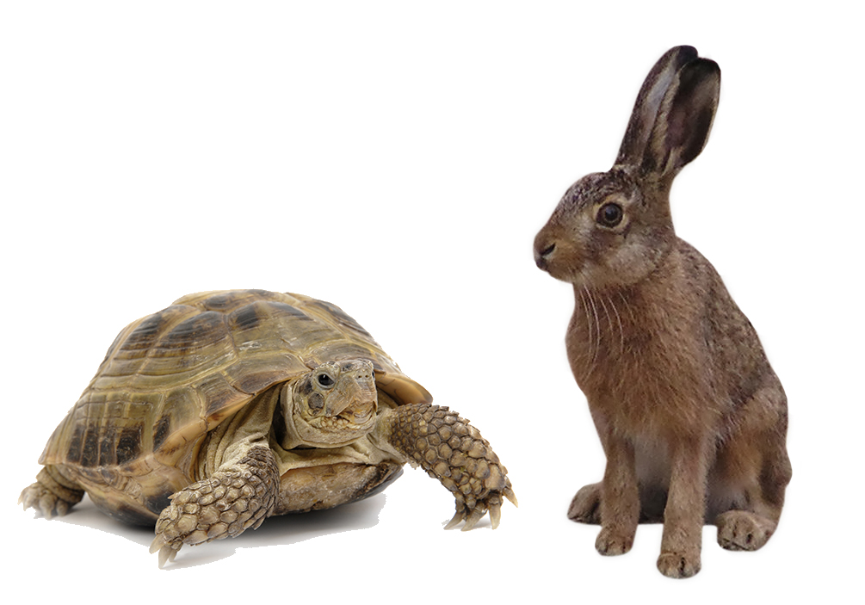
Who was ultimately successful here?

Slide 96


Slide 97
Mastery journey in maths
Over time
Apprentice exemplified, especially in Y2 and Y6
Enrichment ideas
Application of some of the pedagogical approaches

Slide 98

Mastery approach to mathematics and the new national curriculum
‘Making connections in mathematics deepens knowledge of concepts and procedures, ensures what is learnt is sustained over time, and cuts down the time required to assimilate and master later concepts and techniques.’
NCETM October 2014

Slide 99
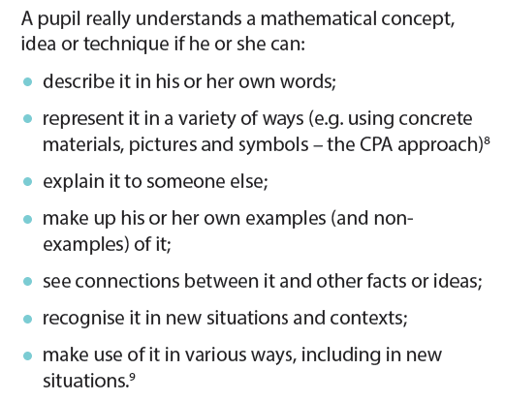
NCETM Teaching for Mastery…
‘Apprentice’ level for November…

Slide 100
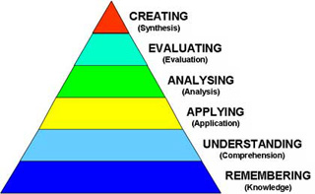
Creating: personal understanding/ links across domains
Embedding knowledge and deepening understanding
through engaging in a range of problematic tasks using the same mathematical knowledge, skills and understanding. Starting with a task can be more productive than with a narrow skill/ procedure.
Evaluating
Analysing
Application
Understanding (comprehension)
Teach understanding and check
Understanding
Knowledge (recall and remembering)
Teach knowledge and check
Notes:
Think about a particular English teaching context. – red line is a pulse
Understanding & knowledge are the essential bricks – concrete preparation
You want you children to be able to use fronted adverbials in their writing – not just today’s writing, but consistently, across a range of writing, without needing constant prompting. You want them to be able to use examples you give them and also think of others, really creative ones, perhaps gathered from reading or they could even create their own similes to use as a fronted adverbial phrase. This is the stuff above the red line. But we can’t just talk about it and expect them to do it. We need to make sure that the areas below the red line are really secure.
So, within a particular unit of work and a particular lesson, you need to work out what knowledge and understanding you want the children to be secure in before they can do the things above the line. For fronted adverbials, this will be things like knowing/understanding what an adverb does (time / place / manner), being able to identify adverbs, using an adverb within a sentence, using an adverb at the start of a sentence.
In terms of dealing with the spread, the things above the line can be used for enrichment while some children may need to spend longer getting the stuff below the line right.
Once teachers have deconstructed the lesson and identified what knowledge pupils need they then decide if the knowledge is new or prior learning. PREFERABLY WORK THIS OUT BEFORE THE LESSON / UNIT. Get books out while you plan. Our rich assessment tasks should stand you in a really strong position to be able to do this.

Slide 101
Deepening and extending tasks:
SOLO and HAM phases
Apprentice
Competent
Expert
Key stage 1: 0-100
Addition and subtraction
Can add or subtract numbers using 1s or PV jumps of 10
Knows/ recalls key facts eg 5+5 =10/ 6-1=5
Relies on teacher’ s strategy
Knows adding / subtracting related eg 5+3=8/ 8-5=3
Knows one add/sub fact linked to another eg 16+7/ 16+8
Links bonds to 10 with bonds to 20
Recognises ‘missing box’ equations
Sometimes deviates from ‘routine’ strategies
Uses inverse relationships and patterns in a range of contexts Inc. measures, money
Begins to apply knowledge to no bonds to 100
Considers diff strategies according to numbers involved

Slide 102
National Curriculum
Spoken language
‘The national curriculum for mathematics reflects the importance of spoken language in pupils’ development across the whole curriculum – cognitively, socially and linguistically. The quality and variety of language that pupils hear and speak are key factors in developing their mathematical vocabulary and presenting a mathematical justification, argument or proof. They must be assisted in making their thinking clear to themselves as well as others and teachers should ensure that pupils build secure foundations by using discussion to probe and remedy their misconceptions.’

Slide 103
Apprentice: By November Y2 pupils sufficiently secure with:
Number and place value
Counting forwards/ backwards in 1s (over 100)
Counting forwards/ backwards in 10s starting from any number (over 100)
Representing 1 and 2 digit numbers using a range of resources- particularly structured resources.
Comparing numbers- able to say/use vocabulary of more/ less and associated symbols (also using this in context of length)
Writing all numbers in numerals and words to at least 20 (Year1)
Demonstrating what adding/ subtracting 10 or 1 to and from any 2 digit number looks like with resources and on a number line (also making links with PV and adding/ subtracting 10p).
Making links between counting/ ordering &comparing calculating

Slide 104
Apprentice: By November Y2 pupils sufficiently secure with:
Addition and subtraction
(Number and measures/ money)
Modelling number bonds (add/sub) to all numbers to 10 explaining how they use their personally ‘known facts’ to help figure out other bonds. (Making links with context of money 10p/1ps)
Modelling number bonds to 20 using what they know about number bonds to 10 using resources and or a chart or model to support reasoning and recording in number sentences (Making links with context of money: 20p)
Knowing/ showing that when adding two or more numbers the order is irrelevant but that it matters with subtraction
Familiar with ‘missing box’ number sentence recording and able to explain their reasoning
Recognising vocabulary and phrases that indicate whether to add or subtract in a one step problem
Finding totals using different coins that equal the same amounts of money (Using number bonds to: check solutions, work systematically and know they have found all solutions)
Paper and pencil recording in response to problems:
Number sentences using signs and symbols (showing where the missing value is)
Number sentence + structured and unstructured number lines to 100 understanding the links between the two strategies

Slide 105

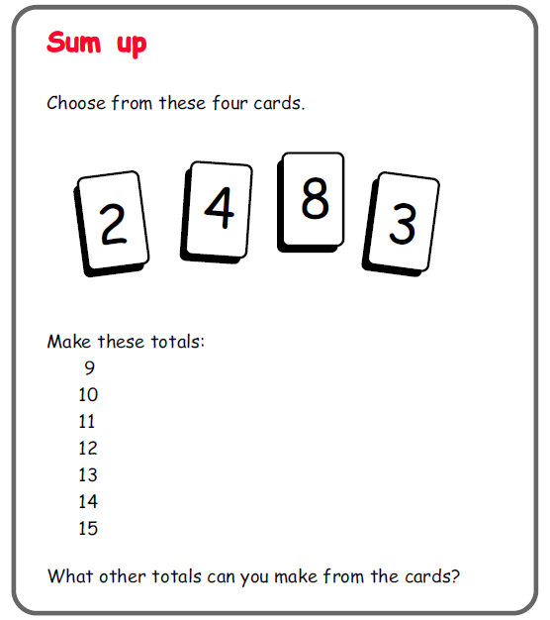
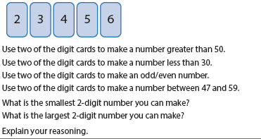
Y2 apprentice:
NPV: Deepening understanding of year 1

Slide 106
Year 2 NPV
Representing numbers
Recording solutions on number lines
Have you got them all?
Find solutions for any other combinations of 5 digits
Other similar problems eg Dan the Detective,
Yes
All pupils able to engage with the task, understand the vocabulary, justify their solutions through concrete , paper and pencil recording
Correct
Sufficiently Learnt?
Starting with 3 digits
Oral &object counting eg to 50
Check vocab: smallest/ largest; greater than/ less than; between
Reading and ordering 1/ 2 digit numbers eg to 50;
Use different resources to secure concrete PV representations;
placing on number lines 0-100;
Use concrete representations to focus on odd/even eg numicon
No
No

Slide 107
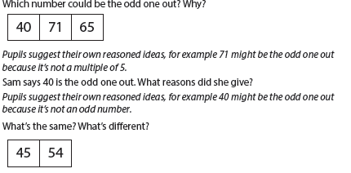
Y2 apprentice:
NPV: Deepening understanding of year 1)

Slide 108

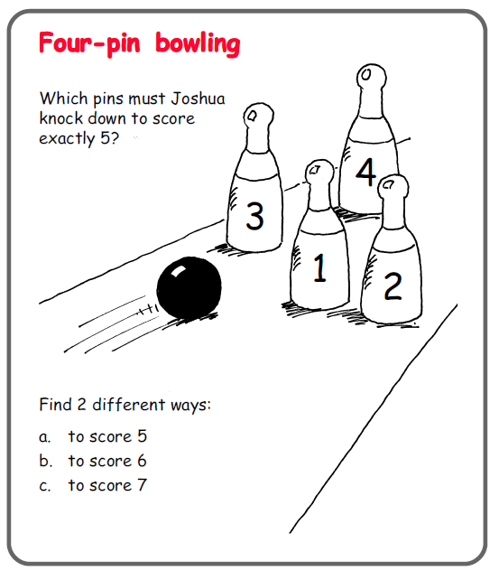
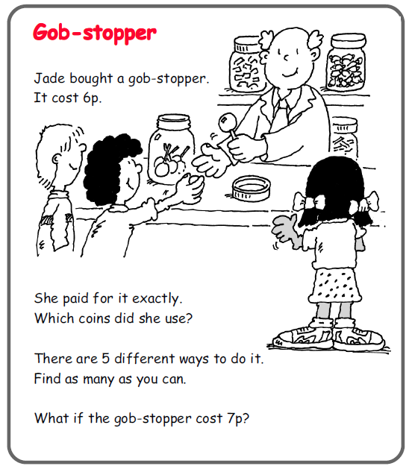
Y2 apprentice:
Add/subtraction: Deepening understanding of year 1

Slide 109
Y2 apprentice:
Addition and subtraction: Deepening understanding of year 1

Slide 110
Y2 apprentice:
Addition and subtraction: Deepening understanding of year 1
Builds imagery linked to bar models…

Slide 111
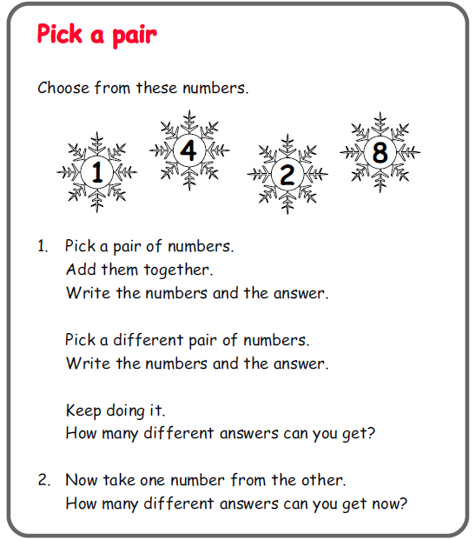
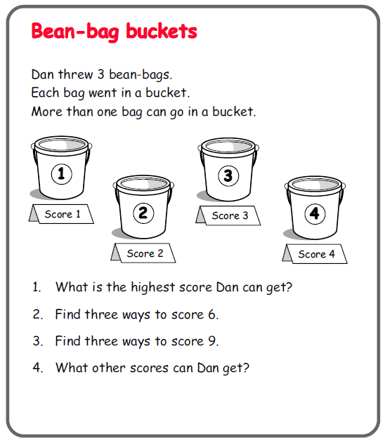
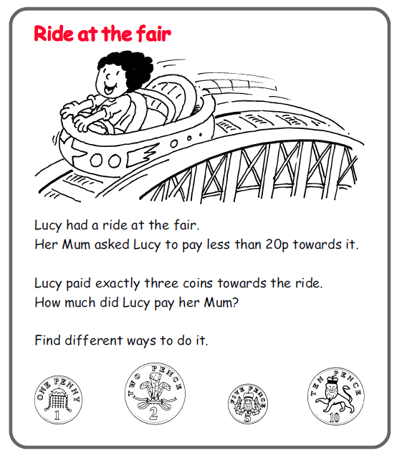
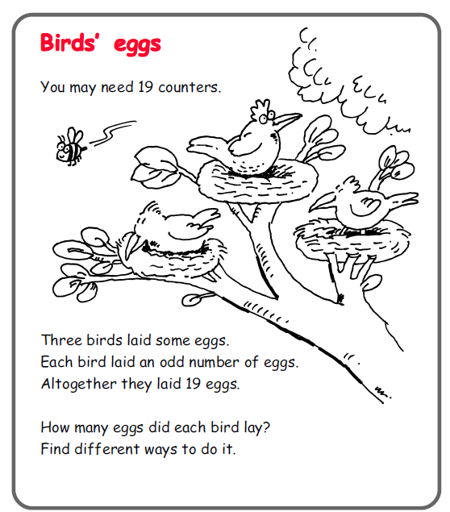
Year 2 apprentice+: NPV+ add/sub
Routine/ non-routine problem solving
Is there another way?
Do you think there are any more?
Have you found them all?
How do you know?
Y2: Use place value and number facts to solve problems
Y2: Solve problems with addition and subtraction

Slide 112

Apprentice: By November Y2 pupils sufficiently secure with
Multiplication and division
(Number and measures/ money. In year 1 pupils have also been counting in 5s)
Counting in steps of 2 and 10 from 0 to at least 20 (making links with counting 2ps and 10ps)
Using counting in 2s and 10s to solve problems involving multiplication and division (making links with 2ps and 10ps)
Linking representations of 1 and 2 digit numbers to explain which numbers are even/ odd and why. Linking counting in multiples of 2 to even numbers.
Modelling counting in 2s and 10s as jumps along a number line and by making an array becoming aware that these representations are all linked to repeatedly adding the same number.
Making an array for multiples of 2 and 10 describing it as both row x column and column x row knowing that the total will be the same.
Recognising totals in money that could be made only with 2p and 10p coins (Using counting to: check solutions, work systematically and know they have found all solutions)
Recording in response to problems:
Number sentences using signs and symbols
Number sentence + structured and unstructured number lines to 100 understanding the links between the two strategies
Number sentence and an array

Slide 113
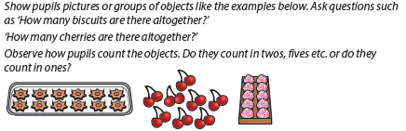
Y2 apprentice:
Multiplication and division: Deepening understanding of year 1

Slide 114




Y2 apprentice:
Multiplication and division: Deepening understanding of year 1

Slide 115
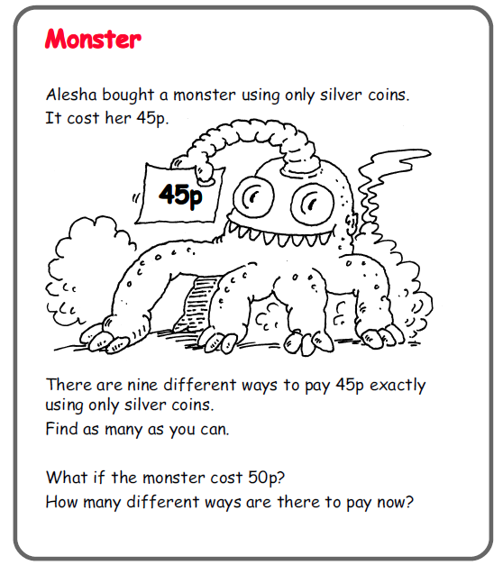
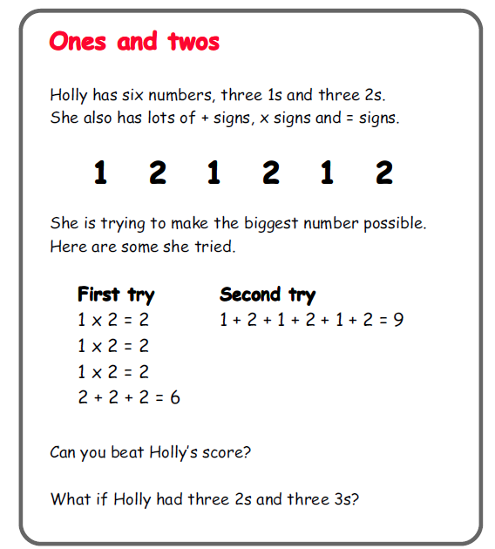
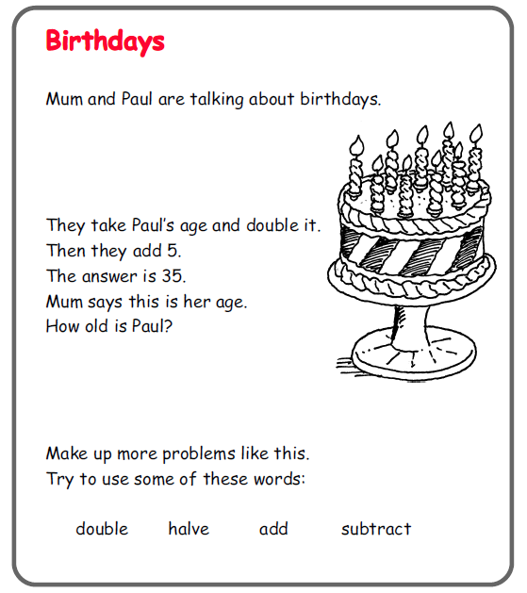
Year 2 apprentice: NPV multiplication and division
Routine/ non-routine problem solving
Is there another way?
Do you think there are any more?
Have you found them all?
How do you know?
Y2: Solve problems involving multiplication and division, using arrays repeated addition, mental methods…

Slide 116
By November Y6 pupils sufficiently secure with:
Number and place value
Reading, writing, ordering and comparing numbers to at least 1,000,000 determining the value of each digit (and using this knowledge in the context of problem solving including in measures Year 5.)
Rounding any number up to 1,000,000 to the nearest 10,100,1000, 10,000 and 100,000 (and using this knowledge in the context of problem solving including in measures Year 5.)
Using this knowledge and understanding to work mentally where appropriate, check answers to calculations and determine how accurate an answer needs to be
Using decimal notation up to 2 decimal places when converting between units of measurement

Slide 117
By November Y6 pupils sufficiently secure with:
Calculation (Number and measures/ money)
Add and subtract whole numbers with more than 4 digits using mental strategies and formal written methods
Multiply numbers with up to 4 digits by a two digit number using grid method leading to formal long multiplication
Divide numbers up to 4 digits by a one digit number using formal written method of short division, interpreting remainders appropriately for context (Year 5)
Using inverse relationships and patterns in related calculations to solve and check calculations
Multiply and divide whole numbers and decimals by 10, 100 and 1000 (Y5) and use this knowledge to solve problems in the context of measures, converting between units
Knowing the order of operations for calculations involving all four operations
Recognising vocabulary and phrases that indicate whether to add, subtract, multiply or divide
Paper and pencil recording in response to problems:
Number sentences using signs and symbols (showing where the missing value is)
Number sentence + unstructured number lines to secure conceptual understanding of decimals and fractions
Grid method recording to makes links with formal long multiplication
Bar models for all operations- supporting problem solving

Slide 118

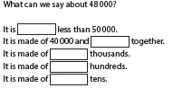
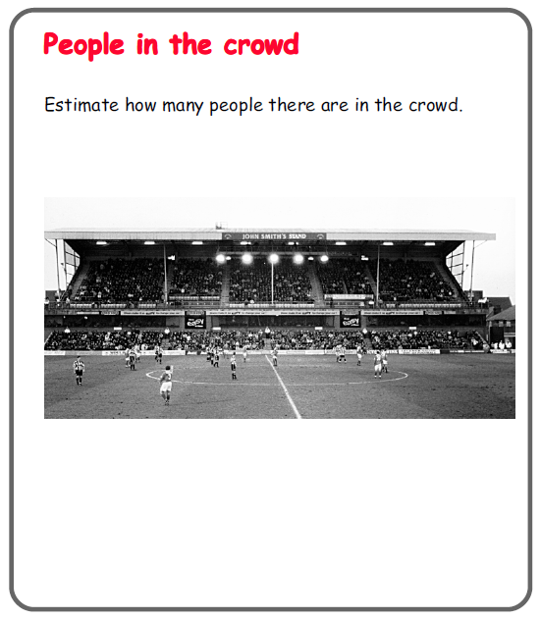

Y6 apprentice:
(NPV: Deepening understanding of year 5)

Slide 119
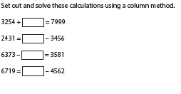
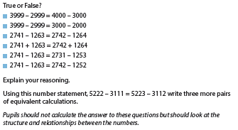
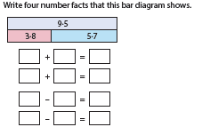
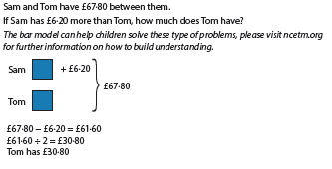
Y6 apprentice:
(Add/ subtraction: Deepening understanding of year 5)

Slide 120
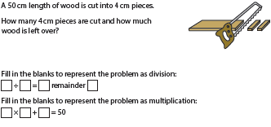

Y6 apprentice:
(multiplication/division: Deepening understanding of year 5)

Slide 121



Slide 122
Measures - money
Year one objective:
recognise and know the value of different denominations of coins and notes
This is the non-negotiable minimum expectation for all children by the end of year 1.

Slide 123
For some children, achieving this aim will require lots of experience and practice with coins – to understand the concept of a coin or note having a “value”.
This relates to their developing understanding of number (to 100)

Slide 124







0
2
100
1
5
10
20
50

Slide 125






Slide 126



Ideas of equivalence…
has the same value as
Core learning….this coin has a value of
“ten”

Slide 127

Deeper understanding of equivalence…
Extended / deepened
Learning…..
There is a different
combination of coins
that also, together,
have the same value
as a 10p coin.
(This is based on my
secure understanding of
“equivalence”)
has the same value as….
Making links….
This builds on….
My understanding of counting in 2’s
My early developing understanding of
multiplication as repeated addition

Slide 128
Even deeper understanding of coin values….
Is there another way to make 10p?
And another?
Have you found them all?
Prove it to me….
(deeper thinking, applying understanding of coin values and equivalence, reasoning, proof, communication, explanation…PROBLEM SOLVING)

Slide 129
Classic task….
Find a way to you make 30p.
Is there another way?
Do you think there are any more?
Have you found them all?
How do you know?
More thinking…more challenge… developing “staying power” resilience…perseverance… reasoning… DEEPENING UNDERSTANDING

Slide 130
From a simple starting point…
I have 23p in my purse.
There are 7 coins altogether.
What are they?
Then extend…
Is there another way?
Are there any more?
Have you found them all?
How do you know?

Slide 131
money problems\p104_Pocket money.doc
money problems\p105_Coin quiz.doc

Slide 132

Routine or non-routine…?
Version one:
Michael has these three coins in his pocket. How much money does he
Have?
Version two:
Michael has three coins in his pocket. Each coin is worth less than 20p.
How much money might he have?
Is there another solution?
Have you found them all?
Are you sure?
Prove it!

Slide 133
Which version…
Involves more problem-solving?
Makes children think more?
Require more resilience, persistence?
Demands more reasoning?

Slide 134
Deepening a problem…
Version 1 provides practice with recognising coins and adding coin values but it does not develop pupils’ problem-solving skills. If pupils are given a set of questions like this to solve, they don’t have to think about how to interpret each one or decide upon the steps to solve it.
Pupils may also form the false impression that mathematics is repetitive and doesn’t require deep thought.

Slide 135
Deepening a problem…
Version 2 requires the use of deeper problem-solving skills.
They have to draw upon their knowledge of different coins and think of different combinations based on the criteria stated
They then have to add coin values together to establish the amount of money he would have each time.
They are further challenged to prove that they have found all possible combinations.
This demands systematic working with an expectation of reasoning and proof.
What information have I got and how am I going to use it???

Slide 136
money problems\p106_How much.doc
money problems\p105_Saving.doc
money problems\p106_Sweet corner.doc
money problems\p104_Spending power.doc

Slide 137


Slide 138

Generate other unit fraction examples same format
Draw examples with different numerator but same denominator
Recognise the use of this model to solve problems involving numbers
Compare pairs of different unit fractions eg 1/3 and ¼
Make links with fraction walls and number lines
Expect use of correct vocabulary
Enrich
Yes
All pupils can produce either drawing or concrete strip to show reasoning and use term ‘denominator’ and ‘numerator’
Use paper strips
Focus on one strip/ unit fraction at a time
Focus on correct use of term denominator, numerator
More than/ less than/ equal to
Work on other unit fractions
Build ½, 1/3, ¼, 1/5 fraction walls with strips of paper- same length
Find 1/5 of two different lengths/ amounts using concrete resources
Sufficiently Learnt?
No
Cold task?
No
Hot task?
Correct
Correct
Sequence of lessons

Slide 139
Yes
Sufficiently Learnt?
No
No
Correct
Cold task
Sequence of lessons
Hot task

Slide 140
Take a look at the maths books
What do you notice about the not “on track” work?
What might you feedback. Do about it?
Does the “on track” to mastery or “beyond” look like there is sufficient
  Depth
  Breadth
  Correction
  Enrichment
What might you feedback. Do about it?

Slide 141
Mastery journey in English
Over time
Apprentice exemplified, especially in Y2 and Y6
Enrichment ideas
Application of some of the pedagogical approaches

Slide 142
Creating
Evaluating
Embedding knowledge
through doing meaningful reading and writing
Analysing
Application
Understanding (comprehension)
Teach understanding and check
Understanding
Knowledge (recall and remembering)
Teach knowledge and check
Notes:
Think about a particular English teaching context. – red line is a pulse
Understanding & knowledge are the essential bricks – concrete preparation
You want you children to be able to use fronted adverbials in their writing – not just today’s writing, but consistently, across a range of writing, without needing constant prompting. You want them to be able to use examples you give them and also think of others, really creative ones, perhaps gathered from reading or they could even create their own similes to use as a fronted adverbial phrase. This is the stuff above the red line. But we can’t just talk about it and expect them to do it. We need to make sure that the areas below the red line are really secure.
So, within a particular unit of work and a particular lesson, you need to work out what knowledge and understanding you want the children to be secure in before they can do the things above the line. For fronted adverbials, this will be things like knowing/understanding what an adverb does (time / place / manner), being able to identify adverbs, using an adverb within a sentence, using an adverb at the start of a sentence.
In terms of dealing with the spread, the things above the line can be used for enrichment while some children may need to spend longer getting the stuff below the line right.
Once teachers have deconstructed the lesson and identified what knowledge pupils need they then decide if the knowledge is new or prior learning. PREFERABLY WORK THIS OUT BEFORE THE LESSON / UNIT. Get books out while you plan. Our rich assessment tasks should stand you in a really strong position to be able to do this.

Slide 143
The way we view the weighting of writing domains can be related to Blooms
Sentence structure and punctuation
Vocabulary which is appropriate and effective
Text structure and organisation
Composition and effect

Slide 144

Child makes their own independent and adventurous choices to suit a range of audiences and purposes
Expert
Child redrafts and edits
‘making ever better choices’
Competent
Child compares and contrasts their work with others
Child uses their knowledge and understanding in a different context
Child can explain their understanding to others
Apprentice
Recall of knowledge is the core of everything the child is able to do
Bloom’s Taxonomy viewed the Hampshire way!
Notes:
This view of Blooms demonstrates how the knowledge is central to success in higher order thinking.
Without the central pulse, nothing else can grow, but each layer encapsulates the rest.
Make links to the Hampshire model for understanding the importance of composition and effect.
Shows the progress needed to develop from apprentice, to competent to expert
And as the central depth of knowledge and understanding grows over time, so does the child’s ability to grow as a reader and a writer. They need to reach the outer rings to become expert, but they have to be given the OPPORTUNITIES to do so.
Too much knowledge/ scaffolding/ spoon feeding/ adult support will not allow time for the other rings to grow.

Slide 145
APPRENTICE WRITER (November)
Copies words and phrases directly from models into own writing
Relies heavily on the model text to shape their own writing
Uses SC as a checklist
Relies upon scaffolds and frames to support writing structure
Relies upon adult guidance and reminders to include essential elements of writing
Writing is functional
Makes inappropriate choices at word, sentence and text level
Makes choices based heavily on previous successes
Notes:
Based on the Dreyfus model A Five-Stage Model of the Mental Activities Involved in Directed Skill Acquisition’

Slide 146
COMPETENT WRITER (February?)
Draws upon model texts as a guide to shape their own writing
Writes intentionally rather than functionally
Is aware of differences in genres and/or forms of writing
Is able to make appropriate choices of features and organisation according to the genre and/or form
Can make increasingly appropriate choices at word, sentence and whole text level
Is able, at least some of the time, to adapt choices based on previous successes to the needs of the current task

Slide 147
EXPERT WRITER (April+?)
Uses awareness of intended outcome to drive choices made
Choices made when writing are based on the breadth of experience of model texts to date
Writing is developed effectively to match the purpose
Can select an appropriate form or genre of writing to effectively communicate in a given situation
Draws upon the range of experiences they have had and makes appropriate word, sentence and whole text level choices, especially when writing for familiar purposes, genres or forms

Slide 148
  Mastery in English
  “Select and combine elements from across appropriate domains with sufficient proficiency over time, in a range of known and unknown contexts to successfully comprehend or communicate meaning and intent.”
  Fluency over time
  Independence
  Resilience to deal with complexity and new contexts
To enable the majority of pupils to achieve mastery, they must be given the opportunities to do so.
Teachers must allow pupils ‘choice’ and freedom to show what they can do independently – take away the scaffolding, build their resilience when the support is taken away.

Slide 149

How to create opportunities for
mastery in English:
Ask deeper questions, probe for deeper answers
In reading expect children to explain, justify, evaluate and infer – not just select and retrieve
In writing allow children to choose their own purpose, audience and/or style based around a rich literary driver
Ensure children are responsible for their own progress – include self assessment with success criteria
WE NEED SOME MORE FOR THIS????
OR MAKE IT A TASK????
Reason to write
Audience
Style

Slide 150
“I can do it when the teacher has just modelled it; when it is the main focus of what I am learning about; when I am told what to write about; when I have had help with word banks first.”
APPRENTICE
COMPETENT
EXPERT
“
I have varied my nouns in other pieces of writing, but I still repeat some, which makes my writing repetitive. In other writing I remember to vary my pronouns, but sometimes I write ‘he’ and ‘he’ for different characters and my reader gets confused who I mean.”
“I am confident to use more adventurous nouns. I don’t just use ‘singer’ to describe my favourite popstar in a biography, I use ‘singing sensation’ or ‘living legend’. I can make my own choices for a range of different reasons to write and audiences. I can explain why one choice is better than another.”
Notes:
Have we achieved masterly at this point? – no. Successful children have demonstrated an apprentice level. They have written one highly scaffolded paragraph with a clear focus. They are successful because they have watch their ‘master’ demonstrate an example and then copied the model.
Children need many opportunities to apply the skill, in range of contexts and with growing independence to achieve the fluency and accuracy required to meet age related expectations.

Slide 151
A Year 3 example - Reading
 | National Curriculum Objective and Hampshire additional guidance | What might be expected of a child? (How do the reading domains inter-relate?)
Phase 1 | Draw inferences such as inferring characters’ feelings, thoughts and motives… Discuss the actions of characters | Inference Children develop upon their simple inference skills from Year 2, and are able to provide more plausible inferences about, for example, a character’s feelings based on their actions. These may be supported by a specific point in the text.
Phase 2 | Discuss their understanding and explain the meaning of words in context Show understanding of the main points drawn from more than one paragraph Predicting what might happen from details stated and implied Justify views of the actions of characters by referring to the text | Inference + Comprehension Children are able to draw upon details within a number of paragraphs which support their inferences about a character’s feelings based on their actions. These should now be supported by reference to the text.
Phase 3 | Identify themes and conventions in a wide range of books Draw on growing knowledge of authors Identify main ideas drawn from more than one paragraph… Understand how paragraphs are used to order and build up ideas… | Inference + Comprehension + Themes & Conventions Children are able to use their experiences of other books read and how authors develop characters through the duration of a story to strengthen their inferences and predictions about a character’s feelings based on their actions.

Slide 152
A Year 3 example - Writing
 | National Curriculum Objective and Hampshire additional guidance | What might be expected of a child? (How do the writing domains inter-relate?)
Phase 1 | Compose and rehearse sentences orally, progressively building a varied and rich vocabulary… Events or ideas are developed using some appropriate vocabulary Some sentence variation through sentence type, length & structure Organise paragraphs around a theme Organise writing into logical chunks and write a coherent sequence of linked sentences for each | Composition & Effect + Text Structure & Organisation + Sentence Structure & Punctuation Children select words which add detail to their writing in order to interest/inform the reader The writing is grouped into sections containing related information which are developed using a variety of sentence types.
Phase 2 | Compose and rehearse sentences orally, progressively building a varied and rich vocabulary… A viewpoint is established but may not always be consistent or maintained Pupils can write an increasing range of sentences with more than one clause Organise paragraphs around a theme… Adverbials may link sentences, paragraphs or sections | Composition & Effect + Text Structure & Organisation + Sentence Structure & Punctuation Children’s word choices are now more purposeful and begin to provide a sense of the intended viewpoint for the reader Sentences are varied in structure and links are beginning to be made between sentences or paragraphs to support the writing purpose
Phase 3 | Compose and rehearse sentences orally, progressively building a varied and rich vocabulary… Expansion of detail / events may be supported through explanation | Composition & Effect + Text Structure & Organisation + Sentence Structure & Punctuation Children’s writing continues to be developed as in Phase 2 but the effectiveness and development of viewpoint and details is enhanced through greater levels of development and expansion within sentences and paragraphs

Slide 153
Year 1 –ed past tense inflection
What do we do in the playground?
“I jump but yesterday I jumped.” “I skip but yesterday I skipped.”
Look at examples like hop, skip, hope and shake.
Yes
Apply knowledge by spotting past tense in guided reading
Sufficiently Learnt?
Write some of the examples from oral practice and see if the children can spot what happens when we write the past
Write whole words: rush, play, pull, jump, open, push, want, crash
Group makes up simple sentences using already established past tense verbs – show me
No
No
Correct

Slide 154
Take a look at the writing
Does the “on track” to mastery or “beyond” look like there is sufficient
  Depth
  Breadth
  Correction
  Enrichment
What might you feedback. Do about it?
What do you notice about the not “on track” work?
What might you feedback. Do about it?

Slide 155
Teaching for keeping up
Teaching so they all get it
But what is it pupils need to keep up with?
But what is it all pupils need to ‘get’?
Notes:
So what we need to do is teach children so they get it when we teach it.
It is this question…what exactly do you want pupils to understand as a result of the lesson that is critical yet teachers are often far from clear about this. They will happily telly ou what the lesson is about but that is not the same as what you will teach pupils…what they will understand by the end of the lesson.

Slide 156
Why Differentiate?
From
Pupils are all different
You need different objectives
We need tasks that get them to different expectations
Same objective for all pupils
Pupils are all different
We may need different tasks to get them to the same expectations
To

Slide 157

“Assessment” comes from Latin and means “To sit beside”
Effective teaching requires the ‘elicitation of pupils’ pre-existing understanding, and opportunities must be provided for them to build on their initial understanding. Pupils’ preconceptions much be challenged and directly addressed, for the them to be transformed or expanded’

Slide 158

How does this image fit with your view of assessment?
How often are you eye to eye with your pupils? How often do you see the world through their eyes?
Hattie: Visible Learning for teachers 2012
Notes:
Explore with your group – what this image means to you…..in terms of classroom climate, and high quality AFl…..Review your drawing/notes of the outstanding classroom…..democracy….co-learner….where are you in the classroom? Are you teacher or learner? Are in within the collective or outside of it? At eye level with your class – how ofter

Slide 159
‘while feedback is among the most powerful of
moderators of learning, its effects are among
the most variable’
‘feedback aims to reduce the gap between
where the student is and where he or she is
“meant to be”’
From John Hattie – Visible learning for Teachers 2012

Slide 160
Phenonmenography
What do you see?
Notes:
Activity: What do you see?
Our awareness has a structure to it. At any instant certain things are to the fore, whereas other things have receded to the background.
The relationship between these elements is fixed in an instant.
However it can be changed at any time.

Slide 161

Phenonmenography
Why do you get different outcomes
Explore and describe the differences in how people understood, experienced, or thought about a particular phenomenon or an aspect of the world
So why you get different
outcomes

Slide 162
This call may be recorded for training purposes.
‘As a teacher is teaching in the classroom, and interacting with students and discussing the object of learning with them, he or she gains a better and clearer understanding of the object of learning himself or herself.
Tuning in….
Often you need to adjust the speed and depth of your teaching according to students’ responses as the lesson proceeds.

Slide 163
Catering for individual difference
First recognise that the students may understand what the teacher intends to teach in different ways, different learning outcomes
So find out what these different ways of understanding are and…
Consider how teaching should be structured to enable students to see what is taught in the intended way.

Slide 164
Teachers use effective planning to help children learn well
What methods are you regularly using to understand children’s current knowledge and understanding?
What are common areas that children find difficult? (tough in the early years of teaching)
How do you suspend your natural attitude?
Notes:
Activity
What methods are you regularly using to understand children’s current knowledge and understanding.
Common areas that children find difficult (tough if you are an NQT/RQT)
Dissecting something that you have become unconsiously competent at

Slide 165
Redefining Learning Objectives?
Differentiating for variation, not ability means:
  Barriers to learning are most likely in areas that teachers find it difficult to appreciate may be problems: learners who don’t have problems seeing it like the teacher are seen as able and those who do are seen as less able... rather than having a less complete picture
  In lesson planning, less attention to the overall learning objective (an outcome) and more forensic focus on what the child/group need to know, do, understand in order to build their success, overcome a barrier/gap towards the long term objective.
  Thorough consideration in planning the object of learning is the most important focus e.g. where to start is fundamental.. The point of departure and a firm grasp of the whole area

Slide 166
Revealing “cold” tasks?
Rich assessment task exemplified
English
Maths

Slide 167
Questions this raises?
Implications for…?
What, if anything, might we do about developing our teachers’ pedagogy?

Slide 168
Re-imagining Differentiation
Differentiates, not by a teacher’s notion of “ability”, but through the teacher’s insights into the way each learner is “seeing” the learning intention of the task.
This derives from more assessment alongside pupils, not just of them, and draws on deep subject knowledge, including knowing where to anticipate and how to provoke, misconceptions
Finding the right, “different”, ways to get them all to a sufficiently secure point.

Slide 169
Precise learning model
Precision in defining what pupils need to learn.
Precision in defining what must be taught.
Identifying key moments in lessons where this precise knowledge should be understood.
Checking that all understand.
Dealing with the spread.
Applying the understood knowledge to do meaningful science.
Notes:
This is a model of planning and teaching that has developed over the last three years amongst secondary science teachers, it has equal relevance to primary.
It is designed to help the teacher become crystal clear about what pupils need to understand and more importantly what the teacher has to teach them all.
In reality in science we often do this the other way round…we do often start with the interesting scientific problem…Blooms helps teachers visualise this

Slide 170
The engaging enquiry about the topic
Which shoe has the best grip?
How can I make the film canister fly higher?
Which material would be best to make a hat from?
Can you make a sound muffler to protect the babies ears?
Notes:
Whilst children do love doing these things they don’t always learn important things from them. Often the teacher assumes children learn important knowledge from these activities. What is certain is that they will all learn different things yet have no idea what is crucial and what is just contextual stuff. e.g. that the big shoe had the best grip, or that when I put two alka salzer in the canister hit the roof, or that cotton wool itches my ears.
so 2 years ago the LSTs started working on models of teaching that sought to ensure that all pupils understand
the starting point was what exactly do we want pupils to understand and this was not straight forward.

Slide 171
Creating
Evaluating
Embedding knowledge
through doing meaningful science
Doing some real science
Analysing
Application
Understanding (comprehension)
Teach understanding and check
Teaching the knowledge they need to do the real science
Understanding
Knowledge (recall and remembering)
Teach knowledge and check
Notes:
Explain the red line.
It is the deconstructing of the problem to identify what pupils must understand to solve the problem is the critical phase and the one that teacher find very challenging…it is a pretty intellectual task and requires them to be very precise…
We ban the use of the word about…need to know about how plants grow…teachers need to define what exactly pupils need to know about how plants grow.
Teachers often define the knowledge as a question e.g. How does friction work? Teachers need to define what the answer to such questions are because it is the answers that children need to understand if they are to be able to use ideas to tackle problems.
Once teachers have deconstructed the lesson and identified what knowledge pupils need they then decide if the knowledge is new or prior learning

Slide 172
What independent scientific application will they do to embed learning?
How check?
What new knowledge?
How teach?
How check?
How deal with the spread?
How check?
How deal with the spread?
Essential prior knowledge
Notes:
This is one way of visualising the process
This summarises the process.
What makes it hard?
Deconstructing the problem to identify the foundation knowledge
Checking prior learning without it taking over and becoming a poor lesson.
Checking learning efficiently and quickly.
Dealing with the spread of understanding identified

Slide 173
Precise learning model – An English example
1) Precision in defining what pupils need to learn:
Year 3/4 GaPS NC obj: Choosing nouns or pronouns appropriately for clarity and cohesion and to avoid repetition
2) Precision in defining what must be taught:
What is a noun
What is a pronoun
What clarity/ cohesion and repetition mean
A range of examples of each
The difference between a noun and a pronoun and why both are needed
How repetition can lead to confusion for the reader
How a range and use of both creates cohesion with a text
Notes:
We can apply the science Precise learning model to English too.
For example:
1) Grammar example chosen specifically as teachers struggle to know how to embed and tend to teach the skills explicitly only. Masterly will never be achieved in English unless children understand the reciprocity between reading, writing and grammar and have engaging reasons to apply it in real writing opportunities. Too much grammar teaching currently remains in the bottom sections of Blooms.
Teachers must ensure their subject knowledge is sound – unpicking a NC learning objective like this ensures the learning journey for children does not leave gaps in understanding. What do they need to know? But more importantly WHY do they need to know and ultimately make them better writers?

Slide 174
3) Identifying key moments in lessons where this precise knowledge should be understood:
Assess prior knowledge - embed knowledge of grammar terminology for a noun + pronoun
Categorise word cards into noun/ pronoun – teacher AfL
Listen/ read an example text with too much repetition of nouns + pronouns
Is this a good piece of writing? Why?
Do not accept ‘boring’ as a detailed enough answer - probe for deeper answers
Look at rich example text – highlight nouns/ pronouns following a key
Is this text better? Why ?
Do not accept ‘it is more interesting’ as a deep enough answer – expect children to justify answers
Which text has more clarity? How?
What is the role of pronouns + nouns in achieving cohesion?
Notes:
3) The types of questions teachers ask is key to ongoing assessment. If teachers ask shallow Q and only accept shallow answers, they will not truly find out what children understand or their misconceptions. Deeper questions enable better AfL of pupil understanding – also higher expectations of all pupils will lead to more achieving higher standards.
Ensure children understand the learning is about meeting the needs of their audience ‘what does my reader need to know? How can I ensure they are not left confused?
4)
Give tasks that engage the cohort – particularly the vulnerable groups. Motivated children will aim higher and achieve higher.
Mini plenaries / short tasks maintain the pace of the lesson. Avoid the children ‘hiding’ that could slip below the net
Ensure children share answers – lower ability children will hear higher level answers. Aspirational.
Create AfL opportunities throughout the lesson – Teacher decides who needs deepening task? Who needs supported task?

Slide 175

4) Checking that all understand
Short task – brainstorm possible nouns/ pronouns for a ‘Moshi Monster’ on a grid

Slide 176
5) Dealing with the spread:
An ethos of flexible groupings within the classroom at that
point in the lesson – Will the support group work with the
classteacher or the deepening group? For how long?
Which is the best group to work independently today?
How will the TA be deployed effectively?
What will pupils show when they are ready to move on?
6) Applying the understood knowledge to do meaningful writing:
How can we apply this in our own writing?
Do children understand ‘Readers become writers’ ?
Can I write a paragraph about a Moshi Monster?
SUCCESS CRITERIA:
Can I use a range of nouns and pronouns in my writing?
Can I choose nouns or pronouns appropriately for clarity and cohesion?
Can I avoid repetition of nouns and pronouns in my writing ?
Notes:
5) Emphasis the move away from ‘Michael Morphurgo’ group and ‘Dick King Smith’ group ethos.
6) ‘Readers become writers become grammar experts’ – a grammar objective embedded in reading task and demonstrated through writing
Ensure children know what they are being asked to do and know how to be successful

Slide 177
Precise learning model – A maths example
1) Precision in defining what pupils need to learn:
Year 3/4
2) Precision in defining what must be taught:
Notes:
We can apply the science Precise learning model to English too.
For example:
1) Grammar example chosen specifically as teachers struggle to know how to embed and tend to teach the skills explicitly only. Masterly will never be achieved in English unless children understand the reciprocity between reading, writing and grammar and have engaging reasons to apply it in real writing opportunities. Too much grammar teaching currently remains in the bottom sections of Blooms.
Teachers must ensure their subject knowledge is sound – unpicking a NC learning objective like this ensures the learning journey for children does not leave gaps in understanding. What do they need to know? But more importantly WHY do they need to know and ultimately make them better writers?

Slide 178
3) Identifying key moments in lessons where this precise knowledge should be understood:
Notes:
3) The types of questions teachers ask is key to ongoing assessment. If teachers ask shallow Q and only accept shallow answers, they will not truly find out what children understand or their misconceptions. Deeper questions enable better AfL of pupil understanding – also higher expectations of all pupils will lead to more achieving higher standards.
Ensure children understand the learning is about meeting the needs of their audience ‘what does my reader need to know? How can I ensure they are not left confused?
4)
Give tasks that engage the cohort – particularly the vulnerable groups. Motivated children will aim higher and achieve higher.
Mini plenaries / short tasks maintain the pace of the lesson. Avoid the children ‘hiding’ that could slip below the net
Ensure children share answers – lower ability children will hear higher level answers. Aspirational.
Create AfL opportunities throughout the lesson – Teacher decides who needs deepening task? Who needs supported task?

Slide 179
5) Dealing with the spread:
6) Applying the understood knowledge to do meaningful writing:
SUCCESS CRITERIA:
Notes:
5) Emphasis the move away from ‘Michael Morphurgo’ group and ‘Dick King Smith’ group ethos.
6) ‘Readers become writers become grammar experts’ – a grammar objective embedded in reading task and demonstrated through writing
Ensure children know what they are being asked to do and know how to be successful

Slide 180
Questions this raises?
Implications for…?
What, if anything, might we do about developing our teachers’ pedagogy?

Slide 181
Action planning

Slide 182
What are the implications for CPD in your school?
For all staff?
For groups of staff?
For individual staff?
How are you growing your teachers for today’s learners?

Slide 183
What are the implications for leaders and Governors in your school?
How are you growing your leaders for today’s learners?

Slide 184
What are the implications for learners and parents/carers in your school?
How are you growing your learners and parents/carers for today’s challenge?

Slide 185
What are the implications for your ways of working in your school?
How are you growing your systems for today’s challenge?

Slide 186
What are the implications for CPD in your school?
What are the implications for leaders and Governors in your school?
What are the implications for learners and parents/carers in your school?
What are the implications for your ways of working in your school?

Slide 187
October to January Focus
We intend to take the following actions
We would like support with
We could offer support with
We will evaluate impact through

