Slide 1

A Transparent and Effective Assessment for Learning System
Working with governors and professional colleagues to report, discuss and analyse pupil achievement and maximise progress
Ranvilles Junior School
February 2016

Slide 2
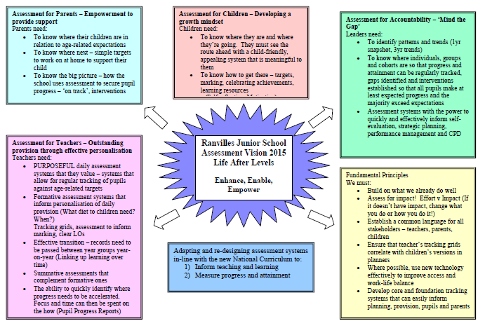
Rationale for Selected Focus
Enhance, Enable, Empower
Rooted in the school’s vision for assessment – A desire to avoid the subjectivity of old levels system and to create:
  A strongly evidenced based system that would allow powerful and accurate formative assessment to drive teaching and learning.
  A transparent system that built on the school’s existing strong practice and allowed all stakeholders to understand the different layers of assessment and how these inter-relate.
  Clear definitions of ‘age-related’, ‘on track’, ‘good progress’ that could be easily updated in the light of new guidance from the DfE
  A shared understanding that this was more than just a new tracking system or a re-creation of levels in a new guise, but a change in expectations and pace for all – deepening learning to develop mastery, not sacrificing depth for pace

Slide 3
How can we ensure that the new system is transparent for all and that assessments are accurate and evidence-based?
Developing transparency to allow for rigorous
support and challenge

Slide 4
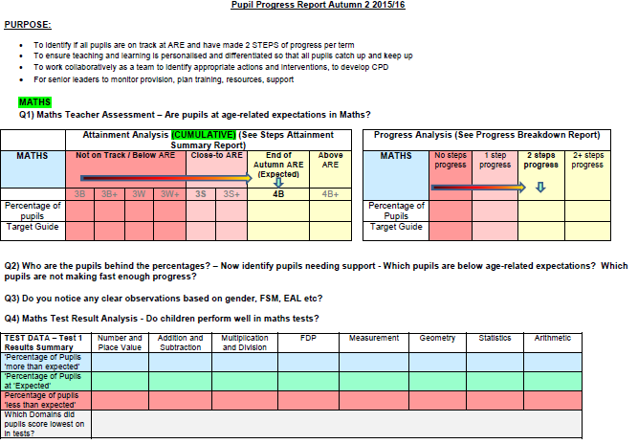
Written Pupil Progress Reports – identifying the actions and impact behind the data
Support and challenge - Demonstrating how summative and formative assessment drives personalised provision

Slide 5
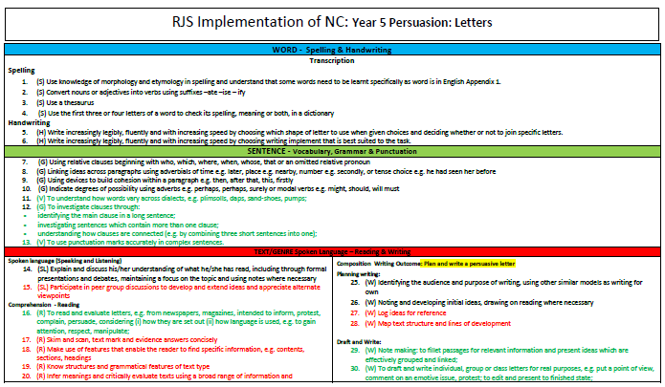
Adapting Phases of Learning
Addressing the broad nature of English NC Statements
Adapting Maths phasing to align to 4 teaching phases but 3 assessment windows whilst maintaining pace

Slide 6
How can we re-assure stakeholders that pupils of all abilities will be adequately challenged?
Securing the basics, weaving domains and working towards mastery for all
A.C.E
Activity - practise the key skill
Challenge – apply the key skill / use alongside other skills or domains
Extension –demonstrate mastery of the skill by independently applying in a range of contexts

Slide 7
Impact and Next Steps
Extensive research has allowed the adaptation of external ‘assessment models’ and ‘data tracking packages’ (Target Tracker, the Hampshire phased model and DfE guidance on ‘mastery’) to create a bespoke and personalised system in-line with the school’s vision, context and needs
Governors understand the process behind the data - Rigorous transparent systems allow clear identification of cohort / groups who are on-track and indicate ‘how on track’ they are in relation to both progress and attainment.
Clear systems show how top-level summative data is a product of rigorous formative assessments that bias and shape medium / short-term planning and daily personalised provision in lessons.
Key Learning – The importance of visual representations and clear systems to explain processes and the need for underlying evidence to support otherwise subjective judgements
Next Steps - Further governor training on the ‘mastery’ philosophy to further emphasise that good / outstanding progress is no longer acceleration through the curriculum.
Contacts for further conversations :
Angela Williams (HT) a.williams@ranvilles-jun.hants.sch.uk
Clare Slowther (DHT) c.slowther@ranvilles-jun.hants.sch.uk

