Slide 1

Sharing the New Information with Parents
Working with parents: With the reforms to the curriculum and assessment framework, we were keen to present the changes to parents prior to the first parents evening. The changes had rightly challenged our thinking as a school and had led us to question the way in which we assess and teach our children. What resulted from our discussions and shared CPD was both challenging and exciting. Communicating our new approaches with parents and helping them to understand their child’s journey through primary school became an important next step for us.

Slide 2
Ideas, Questions and Starting Points
How will we report end of year outcomes bridging from levels to ARE?
How will parents interpret this information?
In what ways will this information challenge the views of parents of children on the SEN register, children who would have previously been viewed as more able/ gifted and talented, children who had not met ARE but were not SEN?
How can we support parents in understanding what the report means as their child moves into the next year group
How can we make the information succinct whilst addressing the questions parents may have?

Slide 3
Timeline….
Summer Term 2015
Presentation to governors to present the phase model
Staff INSET on assessment – two parent governors in attendance
Shared a report against the KPI’s which stated whether their child had met or was below the standard
Met with a parent governor to share the proposed parent presentation
Autumn 2015
Parent meeting after October half term
Early report which gave indicators for effort, behaviour, home learning and attendance with targets for each area taken from phase 1 assessments
Spring 2016
Report will provide information as to whether children are on track to meet ARE, targets for phase 3, support/ intervention and indicators for effort, behaviour, home learning and attendance

Slide 4
Parent Meeting – held at the end of phase 1
Autumn 2015
  Presentation to explain the phases and the important shift in thinking
  Discussed the challenges that we embraced as a school and the impact it had on curriculum opportunities
  Tables set out for each cohort which included examples of maths tasks/ investigations and resources for addition – these were run by team leaders, parents had time to see the progression through on thread (addition) and discuss any questions in more detail
  All parents who attended were asked to complete a feedback questionnaire to help us plan further information evenings

Slide 5
Impact and Feedback
At the first meeting, we had 20 families represented and all parent governors in attendance.
The feedback was positive with many keen to have additional meetings that were subject specific
All parents wanted to have the opportunity to attend Year 2 and Year 6 information evenings
Having the opportunity to see what tasks the children were being asked to do, including enrichment tasks, was very useful and informative

Slide 6
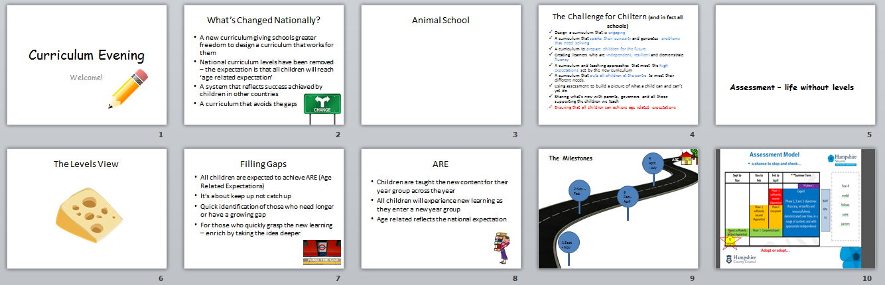
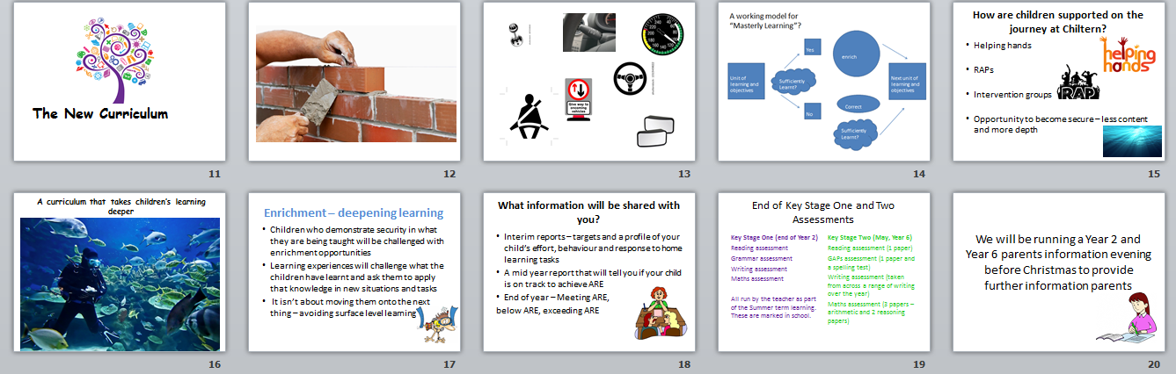

Slide 7
Next Steps
To create our end of term 2 report and our final end of year report
Alongside the SENCo, plan an appropriate reporting format for children who are on the SEN register and are working outside of there are – support parents of children with SEN in knowing how we as a school are responding to the changes in assessment and the new curriculum for their child
Repeat the parents information evening
Plan curriculum subject evenings
Evaluate the impact at the End of year parents evening

