Slide 1
Assessment Update
Where are we, what’s coming, what do I need to prepare, when’s the deadlines????

Slide 2

Why Change??
What are the advantages of levelling?
What are the disadvantages of levelling?

Slide 3


I’m stuck
Didn’t get that or that
Didn’t get that!

Slide 4
School Reform Minister Nick Gibb said:
Ensuring pupil assessment provides an accurate picture of a pupil’s attainment and progress without placing a bureaucratic burden on teachers is a key part of the government’s plan for education.
Levels have been a distracting, over-generalised label, giving misleading signals about the genuine attainment of pupils.
Crucially, they failed to give parents clarity over how their children were performing and also resulted in a lack of trust between primary and secondary schools - clogging up the education system with undependable data on pupil attainment.
The commission announced today will help schools develop their own, more accurate assessment systems that truly show how a child is performing in the classroom.

Slide 5
As Tim Oates of Cambridge Assessment - and who chaired our curriculum review - points out, any assessment is a claim. A claim that a person can do ‘a’ or ‘b’; that they know and understand ‘x’ and ‘y’. These are claims which have consequences These claims need to be well grounded. If they are not, pupils will be misled about their own progress and we will all be misled about the quality of schools.
But what things does someone with the label ‘level 3’ actually know; what things can they do? In the drive to use levels for school improvement, for measures of national standards, for school inspection, we lost sight of what kind of claim we were making with levels and how reliable they are.

Slide 6
The National Picture of Change…
The new curriculum started from September 2014 for all primary years except Year 2 and Year 6
New tests for Year 2 and Year 6 will be introduced from the next academic year
A grammar test will be introduced in Year 2
Foundation Stage will have an optional baseline assessment
Schools received the message that they can decide what assessment will look like in their school – many schools have started this journey

Slide 7
There will be a need to rethink the way we assess and how we use assessment
The expectations for content has risen significantly – this needs to reflect in the level of challenge
85% at a secure level of attainment against the ARE’s is the new floor standard (Previously 65%)
Keep up not catch up – rethinking intervention
Moderation will be key to its success
Secure subject knowledge will be essential
Establish a clear understanding of mastery
Mastery – Planning great activities for our able children who suffered by the model of progress
For those who never got there – helping children to get there quickly to become secure and not move children on with gaps – planning those buffer zones
Teacher assessments driving what I need to teach
ARE – this is what we are assessing and reporting against

Slide 8

Is levels under a new name
There is a need to rethink how we assess…

Slide 9
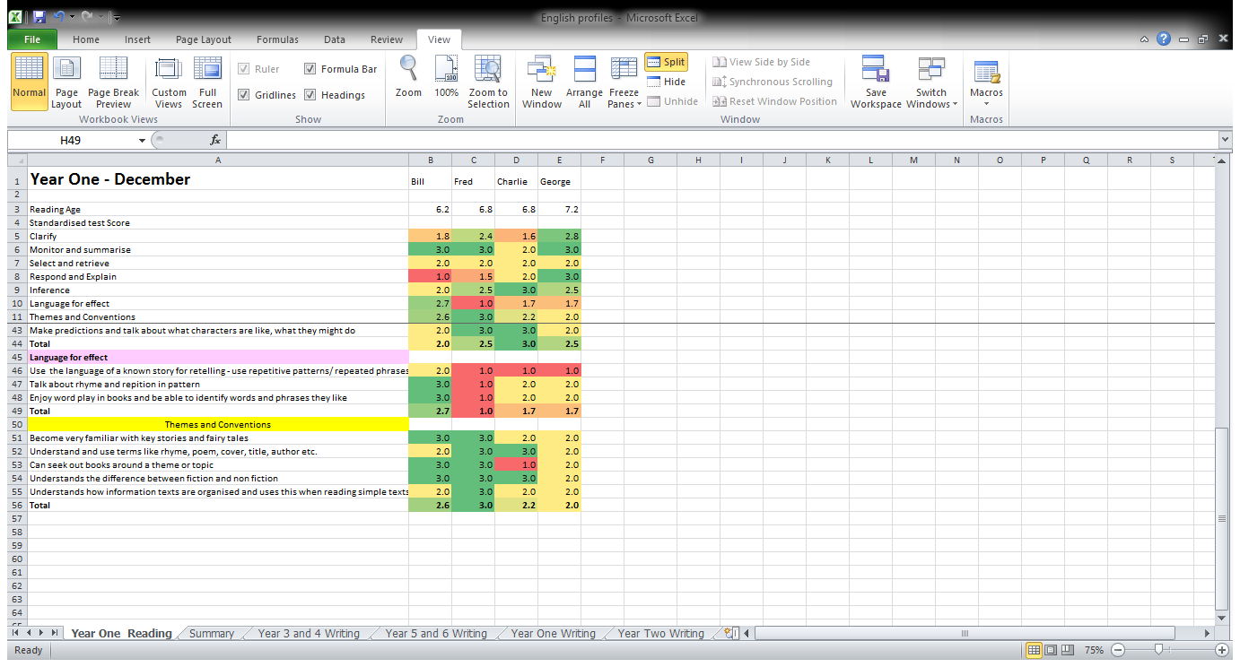
What does a levels replacement look like?

Slide 10

What’s happening in Hampshire?
Conference on the 19th May
English, maths, science and assessment team working together
Phases and milestones
Sept – Nov
Nov – Feb
Feb – April
April – July
Using KPI’s (key performance indicators)
Hampshire progression documents
SIMs to follow

Slide 11

KPI (Using Key Performance Indicators)

Slide 12
Key Performance Indicators
These have come from the NAHT and are progression documents for English and Maths
Hampshire’s document has taken the KPI’s alongside other Hampshire guidance from the maths and English team
The measurement is the % of KPIs at developing, secure and mastered at the end of the year
It provides a way to see the gaps and also know where to enhance and broaden
A KPI will appear once in the year, the school will decide the order of the KPIs
Some KPIs need to be broken down further

Slide 13


Slide 14
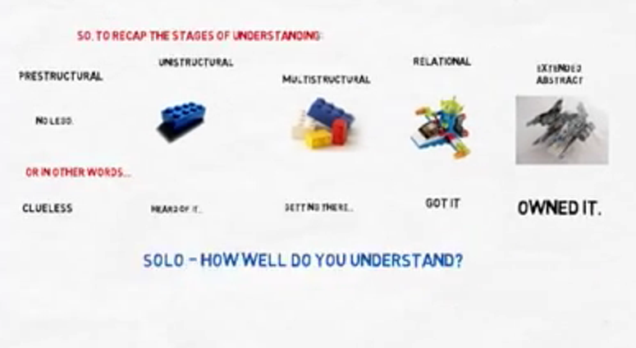
Solo Taxonomy

Slide 15
Why assess – the questions we need to ask of our data?
What do we need our data to do?
Who wants to know?
Where does data live?
What do the children need to know?
What is the story?
What do we do about it?

Slide 16
Data Analysis
Ask a question Select the data Present it Strategic decision
Data is the engine room that drives school improvement

Slide 17
What are we doing at Chiltern?
With other local heads, we will be forming an assessment alliance network group
We have produced a report format to share new assessment information with parents alongside a parent leaflet
Progress meetings will fall in line with the milestone points
We have bought into the EYFS baseline from September 2015
We will purchase a recommended standardised test
We will continue to liaise with SIMs with regards to tracking
Lynne and Caroline will be attended the assessment conference on the 19th May
Lynne and Caroline have signed up as part of the assessment working groups from the Autumn term
We will be fully into the new assessment framework from September 2015

Slide 18
What is the Role of Governors
Support at parents evenings in understanding the changes – why has my child not met ARE?
Understand the language of assessment to be able to question the schools data
Understand how tracking and therefore measures of progress will change
Support the school as critical friends during a period of change
Consider attending the pupil progress meetings held in November
Consider attending the INSET of 3rd July
Look out for governor training linked to assessment
Be aware of what we simply don’t know yet : )

