Slide 1
Hampshire Assessment Model
Project Group
Winchester Group
Marwell Hotel
7th June 2017
Sarah Dunn, Emma Tarrant, Rebecca Reynolds

Slide 2
Aims of the session
Revisit the principles of the HAM
Explore learning tasks that support pupils to reach ‘expert’
Explore how we determine which children are beyond age related expectations.
Consider how the available assessment information can be used to plan effective transitions between year groups

Slide 3
Overview of the session
9.00 Revisit the principles of the HAM
9.30 Task design: supporting pupils to achieve ‘expert’ in English
10.15 Break
10.30 Task Design: supporting pupils to achieve ‘expert’ in Mathematics
11.15 Defining ‘Beyond’
11.45 Using assessment to inform effective transition

Slide 4
Guiding principles of an assessment model
The curriculum expects that children will deepen their grasp of key ideas, over time, rather than move on and leave gaps behind. Progress is neither linear nor skinny
Through being well taught and given well designed curriculum opportunities they will develop and demonstrate their resourcefulness and versatility, (in an age appropriate way)
This does not mean that all pupils achieve the same degree of mastery… but it is at least sufficient (secure), so that they can make successful progress through the fundamental ideas (be securely on track for end of Key Stage). No one left behind.
Notes:
These are to revisit not to spend time on

Slide 5
Guiding principles of an assessment model
Uses assessment to focus teachers on the content which must be secured before moving on
Content is introduced in an order which, once secured, supports achievement of the more challenging expectations of the national curriculum
Promotes a ‘recursive curriculum’ approach, enabling objectives to be returned to thus securing and deepening children’s understanding
Opportunities to develop links across subject domains are built into the content progression
Notes:
These are to revisit not to spend time on
revise

Slide 6
Hampshire Assessment Model
September to November |  | November to February | February to April | Summer Term
 |  |  | Phase 3 sufficiently secured (APPRENTICE) | Phase 3 (COMPETENT/EXPERT)
 |  | Phase 2 sufficiently secured (APPRENTICE) | Phase 2 (COMPETENT/EXPERT) | Evidence of: Fluency? Independence? Resilience?
Phase 1 sufficiently secured (APPRENTICE) |  | Phase 1 (COMPETENT/EXPERT)
Previous Yr Group objectives secured
Notes:
Recap on the journey of the year – there should have been regular opportunities for children to show their expertise throughout the year.

Slide 7
Learners are dependent
Teacher instructs
Learners are responsible
Teacher guides
Level of Support
Learners are resourceful
Teacher facilitates
Learners are creative
Teacher consults
Academic year
Apprentice
Competent
Expert
Apprentice
Competent
Expert
Competent / Expert
Apprentice
Milestone 1 M2 M3 EoY
Notes:
The introduction of the different phase objectives over the year means that the role of the teacher has to change and is multi-layered. The phased objectives are represented by the different coloured triangles and show how by milestone 3 the teacher is assessing children’s skills at three different depths. Explain on track again – multi-layered changing teaching styles.
As the role of the teacher changes so the design of the task is critical, especially as the year progresses and Phase 2 and Phase 3 objectives are overlaid.
Managing challenge in the classroom for higher attainers. ‘Ahead of the wave’.
By Milestone 3 children have been taught the curriculum objectives for their year group
M3 to the EOY is used to:
ensure that some children become secure in their granular domain gap analysis
any areas of relative weakness for the class are secured (especially if they are key to any key progression in that subject e.g. fractions)
Tasks are designed to stretch individual children and class domains that are already competent, giving greater opportunities to show evidence of how they can apply with resilience their knowledge, understanding and skills independently, accurately and fluently

Slide 8
Guiding principles of an assessment model
By Milestone 3 children have been taught the curriculum objectives for their year group
M3 to the EOY is used to:
ensure that some children become secure in their granular domain gap analysis
any areas of relative weakness for the class are secured (especially if they are key to any key progression in that subject e.g. fractions)
Tasks are designed to stretch individual children and class domains that are already competent, giving greater opportunities to show evidence of how they can apply with resilience their knowledge, understanding and skills independently, accurately and fluently
Notes:
M3 – Milestone 3
EOY – End of Year

Slide 9
Learners are dependent
Teacher instructs
Learners are responsible
Teacher guides
Level of Support
Learners are resourceful
Teacher facilitates
Precise learning objectives are used to ensure focus is clear
Learners are creative
Teacher consults
Academic year
‘A MODEL’ – The journey to Mastering EOY expectations
Building independence and resilience, by removing the scaffolding over time
Apprentice
Competent
Expert
Notes:
Where are we at this point, we are concentrating on showing more evidence of being expert in order to secure ARE

Slide 10
Activity
In pairs highlight key words and phrases that indicate aspects of achieving end of year expectations?
Notes:
Discuss the definitions of expert and highlight key words and phrases that will help teachers understand their role in facilitating learning and well as having sufficient evidence in the children's learning.
How are you encouraging tasks to enable these ‘indicators’ of expert?
How well are teachers using prior assessment to ensure sufficient challenge in regard to ‘indicators’ of expert?

Slide 11
EXPERT mathematician (end of year)
Pupils can suggest and draw on a range of appropriate models to represent a mathematical concept, or solution including a missing box number sentence
Able to talk about their reasoning using accurate vocabulary when engaged in ‘intelligent practice’ tasks
Can discuss what is mathematically the same and different about a range of problems because the context is not distracting from the mathematics required.
Pupils respond flexibly and with resilience to non- routine problems
Make decisions confidently about which calculations could be worked out mentally and which calculations need pencil and paper recording.
Pupils able to discuss and illustrate connections between domains of mathematics
Pupils can independently use informal and formal notation to share their solutions with peers
Pupils independently use known facts involving all four operations to both simplify calculations and check reasonableness of answers including in the context of measures
Notes:
Based on the Dreyfus model A Five-Stage Model of the Mental Activities Involved in Directed Skill Acquisition’
If you didn’t know this was ‘expert’ what would you highlight as end of year expectations?

Slide 12
EXPERT READER
Reads age appropriate texts with increased stamina
Approaches familiar texts with confidence: increased fluency aids comprehension and allows them to self-correct
Selects books independently, reads for pleasure and can use information books and materials for reference purposes
Understanding of different literary drivers revealed through discussion and writing
Infers beyond the literal; draws on multiple skills across domains
Makes links between texts, experiences and the wider world
Notes:
Look at this alongside the yellow band on HAM – Do pupils exemplify these behaviours within the rich range of opportunity outlined in the curriculum?

Slide 13
EXPERT WRITER
Uses awareness of intended outcome to drive choices made
Choices made when writing are based on the breadth of experience of model texts to date
Writing is developed effectively to match the purpose
Can select an appropriate form or genre of writing to effectively communicate in a given situation
Draws upon the range of experiences they have had and makes appropriate word, sentence and whole text level choices, especially when writing for familiar purposes, genres or forms
Based on the Dreyfus model A Five-Stage Model of the Mental Activities Involved in Directed Skill Acquisition’
Notes:
Discussion of key words and phrases that make expert – record on post it… What are common themes.

Slide 14
Implications for Teaching

Slide 15
Learners are dependent
Teacher instructs
Learners are responsible
Teacher guides
Level of Support
Learners are resourceful
Teacher facilitates
Precise learning objectives are used to ensure focus is clear
Learners are creative
Teacher consults
Academic year
‘A MODEL’ – The journey to Mastering EOY expectations
Building independence and resilience, by removing the scaffolding over time
Apprentice
Competent
Expert
Notes:
Where are we at this point, we are concentrating on showing more evidence of being expert in order to secure ARE

Slide 16
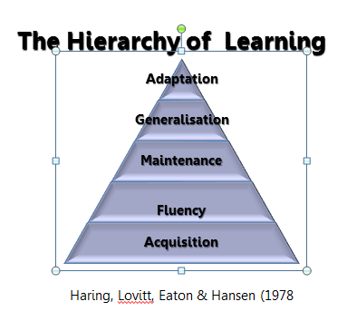
Managing the difference in the role of the teacher – task design for children to show resourcefulness
You may need to return to a model of learning to help your staff have a better understanding of how to design tasks for evidence of expert.
Which model does your school use and how?
Notes:
Quick discussion

Slide 17
Managing the difference in the role of the teacher - facilitator
You may need to return to a model to help your staff have a better understanding of classroom management in the final phase of the year. Which groups of children need instruction? Which need guiding? Which need facilitating?
Notes:
Could use the video clip of ‘Grace’ on the leadership moodle as an example of classroom management.

Slide 18
A return to ‘layered learning’ and cutaway groups
Split inputs
Prior assessment
Teacher Input
Ind. work
Plenary
LSA Guided
Ind. Work
LSA guided
Ind. work
Independent work
Teacher Guided
Ind. work
Notes:
These are a tool not a format

Slide 19
A return to ‘layered learning’ and cutaway groups
Breakaway group(s)
Prior assessment
group input
Practising with support
Independent work
Plenary
Independent Improvement
Independent work
Guided session

Slide 20
Managing the difference in the role of the teacher - facilitator
What evidence do you have that your teachers have been enabling effective group work and classroom management to ensure that some children have been showing expert understanding in phase 1 and 2 objectives?
What are the systems the school has in place to enable all teachers to develop their classroom practice in light of assessment?
Notes:
Delegates to discuss this and share on their table

Slide 21
Assessment supporting the planning process
Milestone 3 data should support the planning process and the creation of a medium term plan for the last 10 weeks of the year.
Some teachers may find it hard to start with a blank page, and this may need to be modelled. As a leader you will need oversight of how assessment has informed the planning to the end of the year.

Slide 22
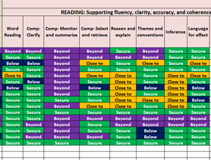
Assessment supporting the planning process
Tasks to encourage
abstract application
in selection and
retrieval, language
for effect and themes
and conventions for
most of the class.
Group teaching for
reasoning and
explanation.
Targeted individual or small group work for themes and conventions and language for effect.

Slide 23
Assessment supporting the planning process
Medium term planning for the final part of the year should be based on M3 assessments.
Tasks design within each unit will also be dependent on M3 assessments.
Look at M3 data for a class, what would you expect to see on the medium term planning?
Notes:
M3 – milestone 3

Slide 24
English – supporting pupils to achieve expert

Slide 25



Managing the difference
Role of the adult
Not yet secure at ARE
Teacher as instructor and guide
Breakaway groups
Returning to gaps in data
Secured ARE
Capable of beyond
Teacher as facilitator and consultant
Provide open ended tasks that allow children to demonstrate independence and resilience

Slide 26
Mastery in English
At any one moment in time, a skill can be said to have been mastered when the child has sufficient knowledge and understanding in order to appropriately use and apply it in contexts – both familiar and unfamiliar – without the need for guidance or scaffolding.
As listening, reading, speaking and writing are all combinatorial processes – they rely on a person’s ability to make decisions, to select from a range of processes, strategies and skills, and to blend these appropriately to produce successful outcomes – mastery in a single or, even, a number of skills is not sufficient to say that a child has ‘mastered’ the content of their year group’s programme of study.
Judging mastery in this instance would require the child to demonstrate that they are versatile: that they are able to select and combine elements from across appropriate domains with sufficient proficiency over time, in a range of known and unknown contexts to successfully comprehend or communicate meaning and intent.
How can the curriculum be designed to enable children to demonstrate mastery?

Slide 27
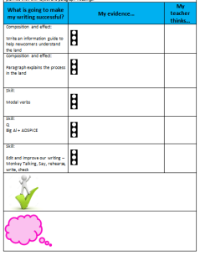
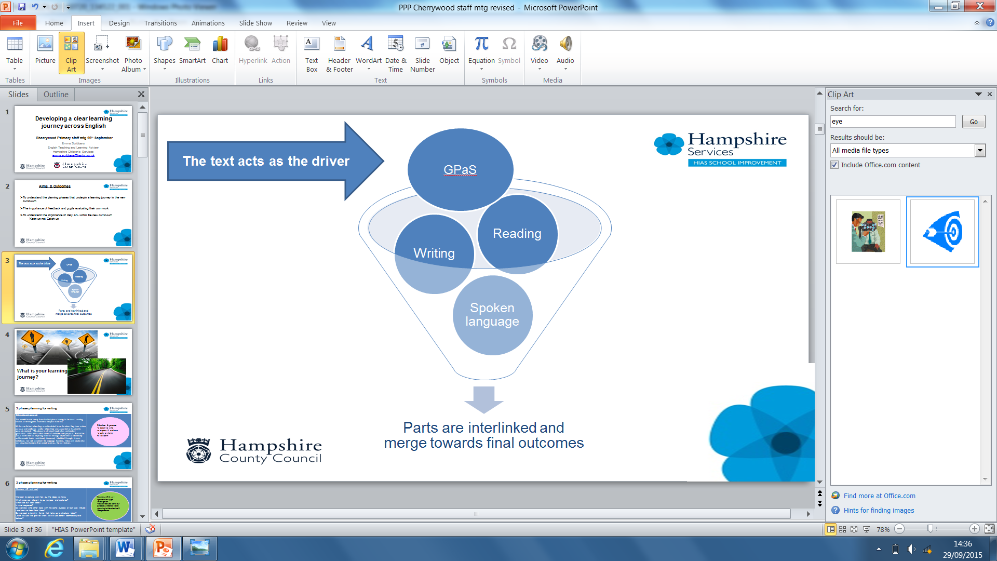
Planning a learning journey to secure gaps and attain ARE
Continue to teach skills and behaviours of a writer
Rich text stimulus
Skills needed for final outcome
Spoken language
Shared reading ‘reading as a writer’
Written outcome
Word level
Planning
Shared reading
‘reading as a reader’
Genre and form
Embedded GPaS
Proof reading and editing
Stimulate and generate
Capture, sift and sort
Create, refine, evaluate
Publish
Apprentice writes
Notes:
HIAS improved model for planning effective learning journeys – this continues for

Slide 28
The interplay between purpose, audience, viewpoint and form
Purpose
persuade/ inform/ entertain/ advise/ compare
Form
letter/ leaflet/ speech/ advert
Viewpoint
bias / jealous/ sympathetic/ disagree
Audience
Book character/ parent/villagers headteacher/a friend/ younger children
Notes:
Have this conversation about any text the children read – they need to unpick in reading in order to achieve in their own writing

Slide 29
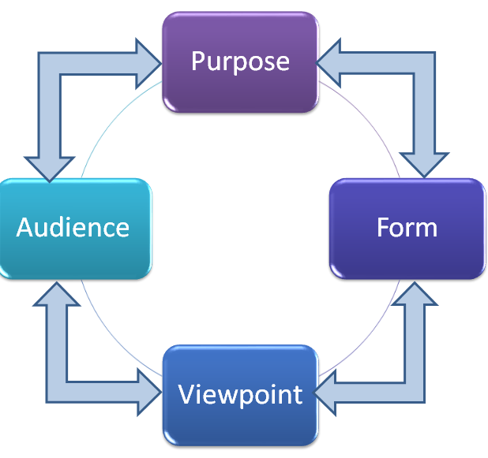
The interplay between decision making as a writer
Starting points
Text inspiration
Prior learning
Pupils needs (AfL)
Pupils interests
NC requirements
Writers’ choices
Tense
1st / 2nd / 3rd person
Formality
Language features
Grammatical devices
Layout
What else …
Notes:
What other choices do writers make?

Slide 30
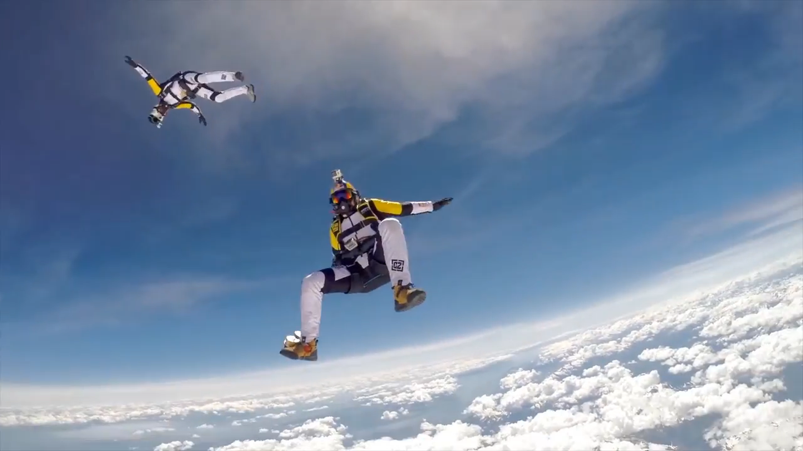
Using a film stimulus as an example
https://www.youtube.com/watch?v=PF0L3gvSVcg
Notes:
Watch 30 seconds of film clip if time and WIFI

Slide 31
A way of reducing the scaffolding is to reduce ‘the givens’.
Level of Support
Academic year
Which will the teacher ‘give’?
Which will the child choose?

Slide 32

Teacher decides:
To inform about extreme sports
Teacher decides:
Teenagers who want to find out about extreme sports
Teacher gives 2 options:
Magazine article
Leaflet
Children brainstorm options in a group – possible outcomes:
Extreme sports put others’ lives at risk and should be banned
Extreme sports push technology advancements and should be encouraged
It should be up to individuals to decide
Extreme athletes are good role models for children
Extreme athletes are bad role models for children

Slide 33
Child decides purpose:
Recount of a day doing extreme sport
Inform people about the benefits / or risks of extreme sport
Entertain – write a narrative where there is an accident / competition won
Entertain – describe the tension/ emotions the moment before starting
Compare the life of a ballet dancer with an extreme athlete
Enter at any point
Enter at any point
Enter at any point
Notes:
Thinking process can start at any point.
Number of givens and number of decisions can vary depending on ability, age and how used to choice children are.
Encourage staff to be brave! Give it a go – outcomes will improve as children feel ownership over their writing choices
Activity: consider the different options / choice you might give pupils at each point?

Slide 34
Planning a learning journey for pupil choice – opportunities to demonstrate beyond
Rich text stimulus
Written outcome
Spoken language
Independent planning
Apprentice writes to trial and reflect with peers
Proof reading and editing
Word level
Opportunities for choice within audience, purpose and form
Possible redraft
Shared reading
‘reading as a reader’
Publish
Immersion in the driver similar for all children
Adults facilitate and consult drafting and editing process
Time and opportunity to publish to high standard
Pupil choice options introduced. Children make writers’ choices and plan in detail. Take responsibility for success criteria.

Slide 35
Purpose
(a reason to write)
Inform
Explain
Describe
Instruct
Advise
Persuade
Entertain
Discuss
Retell
Report
Compare
Speculate
Evaluate
Explore
Agree/disagree
Fiction
Audience
A friend/peer who feels/needs…
A character from a story
Someone important (a teacher, a head teacher, a governor, the police, a local MP, the Queen, the Prime Minister)
Several people (an army, a crowd, neighbours)
Someone who wants to find out…
A local industry (post office, restaurant, shop, travel agency, estate agency)
Non-fiction
Poetry

Slide 36
What about reading?

Slide 37





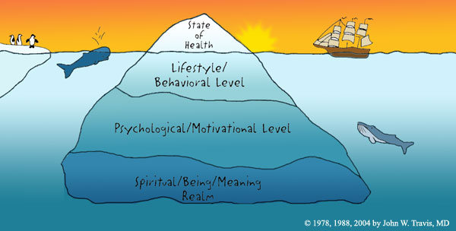

Reading domains:
Hampshire assessment model
Making meaning is the guide and the goal
Higher cognitive demand, but it is possible to train these thinking muscles at all ages
Word reading | Comprehension |  |  |  | Inference | Language for effect | Themes and conventions
Cracking the code: piecing together the cues to make a word make sense in context | Clarify | Monitor and summarise | Select and retrieve | Respond and explain | Empathise Predict See layers of meaning | How part relates to whole: writer’s choices in relation to intention | Categorisation: similarities and differences between like texts/ other texts I have read
 | Noticing the bits that don’t make sense | Developing a mental map of the text | Seeking the specific… | What you think and feel
Notes:
Look at last 3 columns in both HAM– these link to reading at greater depth

Slide 38
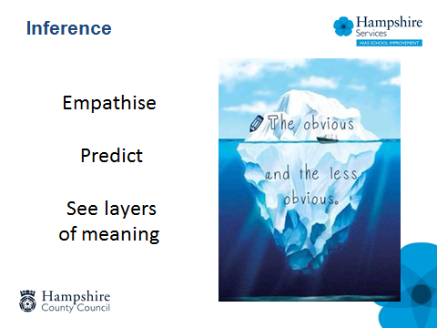
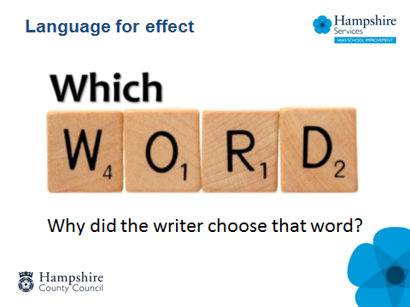
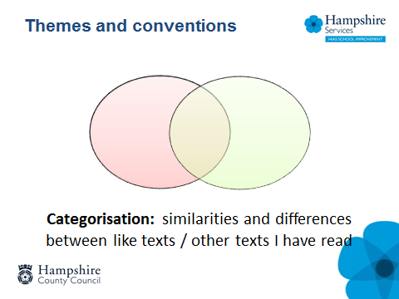
Notes:
These can very easily remain as surface level responses – we need to ensure our task design challenges pupils to draw on their wider understanding.

Slide 39
An Enriched Curriculum offers:
A variety of rich and challenging texts
Opportunities to talk about texts
Nonfiction, image rich texts, poetry, heritage texts, film
Opportunities to trace themes / ideas within and between texts
Opportunities to make links and comparisons between texts
Opportunities to explore deeper levels of meaning
Notes:
Encourage readers to go wider and deeper – not just read more.
Pupils need these experiences at each year using age related texts – look to links and connections – parallel texts

Slide 40
Questioning:
Exposition – literal questioning
(looking questions)
What do these words mean?
What do we know about…?
Can you predict the outcome of…?
Exploration – inference/deduction based on the text.
(clue questions)
How does the phrase/word….make you feel about?
Can you make links between…?
Expansion – evaluative/opinion questions, often linked to experience of the wider world.
(thinking questions)
Do you agree with the writer’s view on?
Notes:
Greater depth pupils need to be challenged to think / evaluate and form an opinion

Slide 41
…could …. | …makes the reader feel ….
…might …. | …represent …
…maybe … | …suggest ….
…seem as if…. | …symbolise …
Notes:
Pupils find this difficult if they haven’t had the necessary models.
The key is to introduce and model vocabulary to support evaluation / speculation / opinion

Slide 42
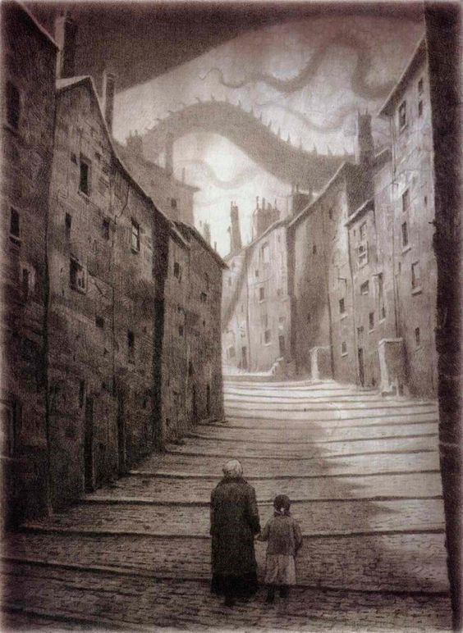
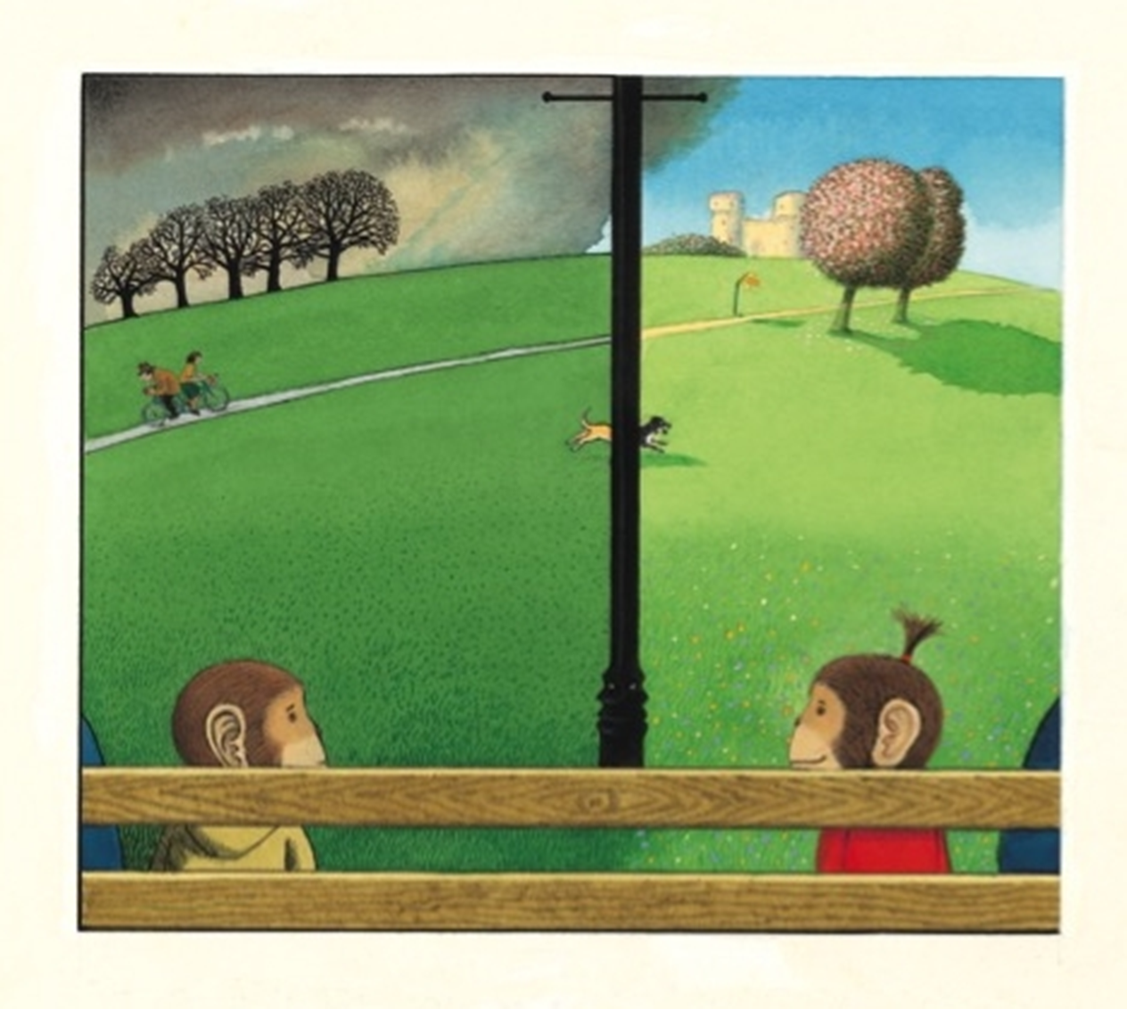
Going Deeper with Image
…could….
…makes the reader feel ….
…might ….
…represent …
…maybe …
…suggest ….
…seem as if….
…symbolise …
Notes:
We need to encourage tentative talk around texts
Talk through the 1st image – model how you frame ideas using language prompt cards.
Activity: in pairs talk around the 2nd image (Voices in the Park)

Slide 43
Exploratory Talk…
…in which partners engage critically but constructively with each other's ideas;
everyone participates;
tentative ideas are treated with respect;
ideas may be challenged;
challenges are justified, reasons are given and alternative ideas or understandings are offered;
opinions are considered before decisions are made and agreement is sought.
reasoning is visible in the talk.
(Mercer & Littleton, 2007; Dawes, Mercer & Wegerif, 2000)
Notes:
43

Slide 44

Taking the talk to the text
…could….
…seem as if….
…might ….
…makes the reader feel ….
…maybe …
…suggest ….
Notes:
Applying to non-fiction

Slide 45
Focus on specific use of words: Language for effect
Notes:
Do as task – use the cards that they already have

Slide 46
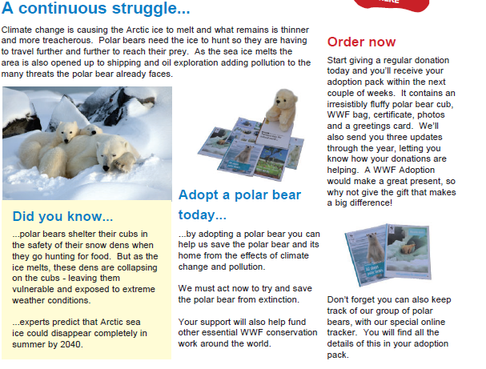
Notes:
Provide the whole text for more confident readers. Or work up in stages.

Slide 47


Themes and conventions
Rhyming texts
Conflict / heroism / courage / tolerance

Slide 48
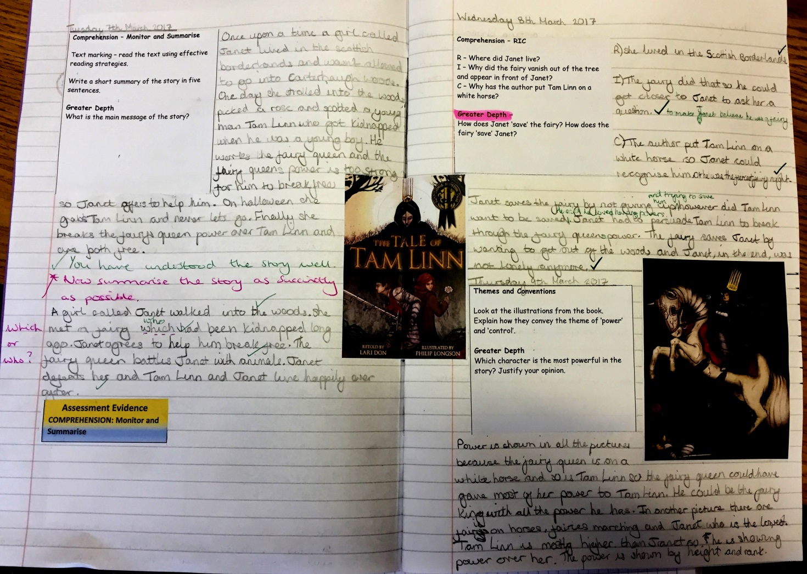
Notes:
Task design is key
Is this really challenging a child to think at greater depth?
We are unclear of the sequence of learning that has led to this point – have themes just been given or arrived at through discussion / expansion through dialogic talk?

Slide 49
Tam Linn is mostly higher than Janet so he is showing power over her. The power is shown by height and rank.
…the fairy queen could have…
He could be…
Notes:
When we look at the pupils response it is in the early stages of development – animations to unpick 3 key elements
With further talk and the use of language / expansion – opinion models – the pupil will get there. This task was given in March – there is time to refine.
Remember written responses are only part of the evidence– talk is still key – and small group reading (such as guided) is still important to model, instruct and
develop thinking.

Slide 50
Creating an enriched curriculum …
What does an enriched / enhanced reading curriculum look like?
Are teachers making connections between texts at a theme level?
Are they enriching key texts with poetry, non fiction etc?
Do the pupils ‘self regulate’ their understanding through strategies such as reciprocal reading?

Slide 51

Break

Slide 52
Mathematics – supporting pupils to achieve expert

Slide 53
Mastery of Mathematics
‘A mathematical concept or skill has been mastered when, through exploration, clarification, practice and application over time, a person can represent it in multiple ways, has the mathematical language to be able to communicate related ideas, and can think mathematically with the concept so that they can independently apply it to a totally new problem in an unfamiliar situation’
Drury, H (2014) Mastering mathematics, Teaching to transform achievement OUP

Slide 54
Teaching Tripod
Tasks that allow children to develop understanding of a concept.
Variation- intelligent practice
Linked examples (procedural variation)
Application to a variety of contexts
Concrete apparatus to develop understanding alongside explaining linking with language
Images to support understanding and support explanations
Inspecting the structure of maths
Why and how things work
Explaining
justifying
TRUST
Mike Askew (2012) Transforming Primary Mathematics, Routledge ISBN 978-0-415-60702-5
Notes:
Mike Askew (2012) Transforming Primary Mathematics, Routledge ISBN 978-0-415-60702-5

Slide 55
Learners are dependent
Teacher instructs
Learners are responsible
Teacher guides
Level of Support
Learners are resourceful
Teacher facilitates
Precise learning objectives are used to ensure focus is clear
Learners are creative
Teacher consults
Academic year
‘A MODEL’ – The journey to Mastering EOY expectations
Building independence and resilience, by removing the scaffolding over time
Apprentice
Competent
Expert
Notes:
Where are we at this point, we are concentrating on showing more evidence of being expert in order to secure ARE

Slide 56
Learning over the year is not linear – think of a curve …
Curriculum content
Time
Apprentice
Competent
Expert
EOY Mastery
Notes:
Schools have greater confidence in their understanding of the model
Eng/ maths

Slide 57
Identify weaknesses and gaps in current year
Current Year
Plan for ‘quick fix’ lessons within a learning journey
Tailored teaching for small groups and individuals
Next Year
Co-construct planning to address areas for consolidation and teaching
Utilise the end of year and transition through carefully constructed tasks
Notes:
Eng/ maths

Slide 58
Managing the difference
Role of the adult
Not yet secure at ARE
Teacher as instructor and guide
Breakaway groups:
Returning to gaps identified by data
Secured ARE
Capable of ‘beyond’ through additional problem solving
Teacher as facilitator and consultant
Provide open ended tasks that allow children to demonstrate independence and resilience
Notes:
Eng/maths

Slide 59
End of year assessment
Children have achieved ‘expert’ against all objectives = secure in all domains and may be beyond in some so met or exceeded ARE
Children have achieved ‘expert’ in most objectives, particularly phase 1 and 2, but are competent in phase 3 = professional judgement but likely to be secure in all domains so met ARE
Children have a mixture of expert, competent and apprentice in a variety of objectives = professional judgment but likely to be below so not met ARE
What if they are ‘close to’? Make a decision and decide if they have met ARE or not.
Notes:
Eng/maths

Slide 60
APPRENTICE mathematician (November)
Relies heavily on the teachers’ modelling to solve calculations and problems tending to repeat exactly what the teacher/ adult has said to describe process used
Uses success criteria as a checklist
Relies upon adult guidance and reminders when ‘stuck’ particularly when remembering meanings of new technical vocabulary or language
Makes choices based heavily on previous year group’s successes
Works ‘mentally’ or with pencil and paper recording as directed by the teacher
Uses concrete resources and models and images as shown by the teacher or adult. May still be building understanding of the connections between concrete modelling and informal/ formal recording
Some solutions are based on counting in 1s rather than making using appropriate use of number bonds (10, 100, 1000, 1) or other known facts
Notes:
Based on the Dreyfus model A Five-Stage Model of the Mental Activities Involved in Directed Skill Acquisition’

Slide 61
Apprentice + COMPETENT mathematician (February)
Can anticipate and independently suggest an appropriate mathematical model which has been used in previous work so far in the year when solving a problem or a calculation.
Can make some suggestions for success criteria to clarify their thinking
Beginning to independently explain their reasoning with peers and adults using some new vocabulary accurately
Developing resilience to ‘being stuck’ by using more than one approach independently before asking for adult help
Can accurately identify and record the number sentence involved when working mentally using a missing box to show the unidentified part.
Able to draw on more than one different representation of the same concept, skill or solution to a routine problem including using concrete resources, models and images and informal recording based on these models
Beginning to notice, talk about, demonstrate and use inverse relationships in calculation
Some use of known facts and related facts made to check reasonableness of answer and or to identify a calculation that could be solved easily mentally
Notes:
Based on the Dreyfus model A Five-Stage Model of the Mental Activities Involved in Directed Skill Acquisition’

Slide 62
EXPERT mathematician (end of year) make links to DfE interim performance descriptors for end of key stage in Y2 and Y6 ‘working at expected’ +
Pupils can suggest and draw on a range of appropriate models to represent a mathematical concept, or solution including a missing box number sentence
Able to talk about their reasoning using accurate vocabulary when engaged in ‘intelligent practice’ tasks
Can discuss what is mathematically the same and different about a range of problems because the context is not distracting from the mathematics required.
Pupils respond flexibly and with resilience to non- routine problems
Make decisions confidently about which calculations could be worked out mentally and which calculations need pencil and paper recording.
Pupils able to discuss and illustrate connections between domains of mathematics
Pupils can independently use informal and formal notation to share their solutions with peers
Pupils independently use known facts involving all four operations to both simplify calculations and check reasonableness of answers including in the context of measures
Notes:
Based on the Dreyfus model A Five-Stage Model of the Mental Activities Involved in Directed Skill Acquisition’

Slide 63
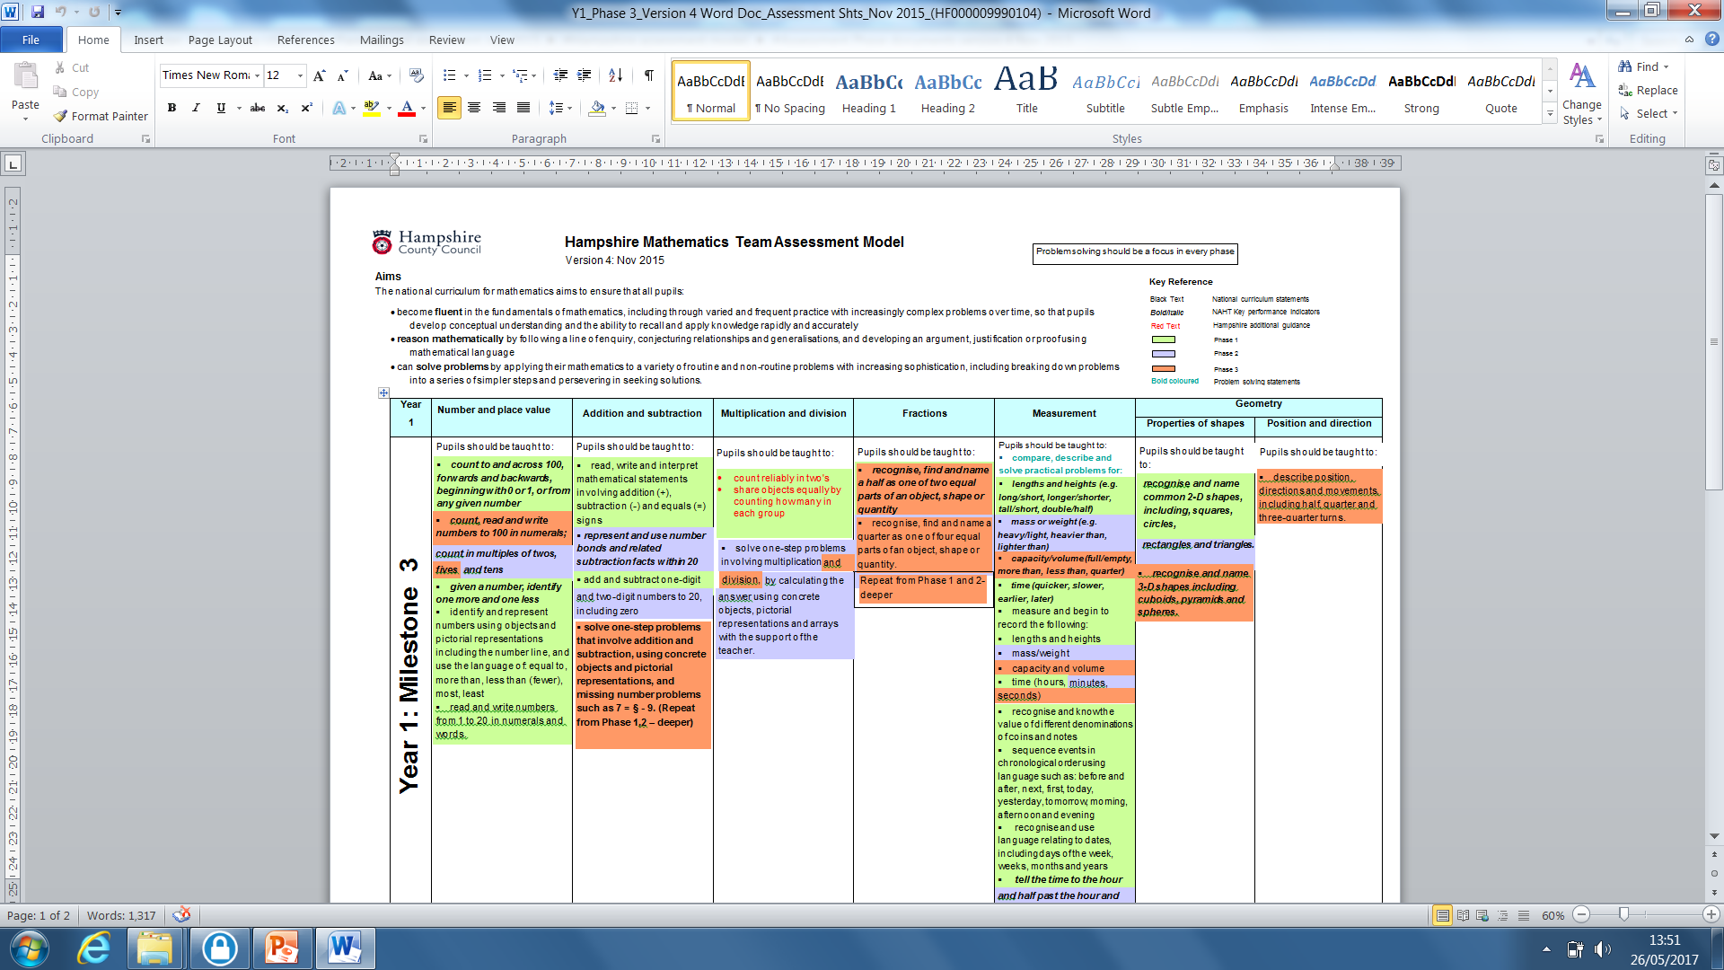
Year 1: Money

Slide 64
Measures - money
Year one objective:
recognise and know the value of different denominations of coins and notes
This is the non-negotiable minimum expectation for all children by the end of year 1.

Slide 65
For some children, achieving this aim will require lots of experience and practise with coins – to understand the concept of a coin or note having a “value”.
This relates to their developing understanding of number (to 100)

Slide 66

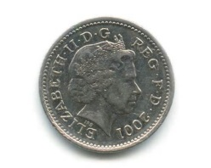

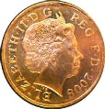
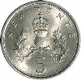

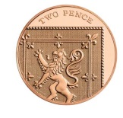
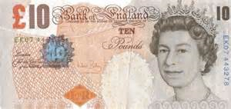

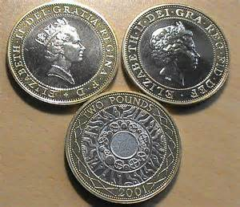
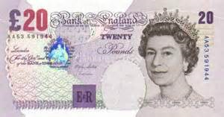

0
2
100
1
5
10p
20
50

Slide 67
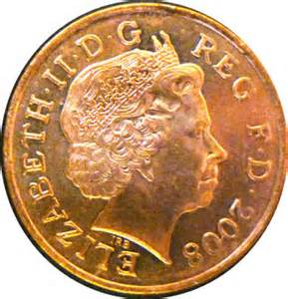

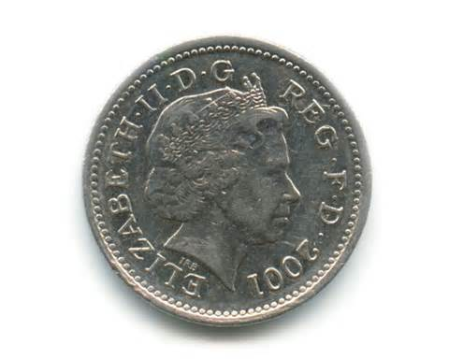
Ideas of equivalence…
has the same value as
Core learning….this coin has a value of
“ten”

Slide 68

Deeper understanding of equivalence…
Extended / deepened
Learning…..
There is a different
combination of coins
that also, together,
have the same value
as a 10p coin.
(This is based on my
secure understanding of
“equivalence”)
has the same value as….
Making links….
This builds on….
My understanding of counting in 2’s
My early developing understanding of
multiplication as repeated addition

Slide 69
Even deeper understanding of coin values….
Is there another way to make 10p?
And another?
Have you found them all?
Prove it to me….
(deeper thinking, applying understanding of coin values and equivalence, reasoning, proof, communication, explanation…PROBLEM SOLVING)

Slide 70
Classic task…
Find a way to you make 30p.
Is there another way?
Do you think there are any more?
Have you found them all?
How do you know?
More thinking…more challenge… developing “staying power” resilience…perseverance… reasoning… DEEPENING UNDERSTANDING

Slide 71
From a simple starting point…
I have 23p in my purse.
There are 7 coins altogether.
What are they?
Then extend…
Is there another way?
Are there any more?
Have you found them all?
How do you know?

Slide 72

Routine or non-routine…?
Version one:
Michael has these three coins in his pocket. How much money does he
Have?
Version two:
Michael has three coins in his pocket. Each coin is worth less than 20p.
How much money might he have?
Is there another solution?
Have you found them all?
Are you sure?
Prove it!

Slide 73
Which version…
Involves more problem-solving?
Makes children think more?
Require more resilience, persistence?
Demands more reasoning?

Slide 74
Deepening a problem…
Version 1 provides practice with recognising coins and adding coin values but it does not develop pupils’ problem-solving skills. If pupils are given a set of questions like this to solve, they don’t have to think about how to interpret each one or decide upon the steps to solve it.
Pupils may also form the false impression that mathematics is repetitive and doesn’t require deep thought.

Slide 75
Deepening a problem…
Version 2 requires the use of deeper problem-solving skills.
They have to draw upon their knowledge of different coins and think of different combinations based on the criteria stated
They then have to add coin values together to establish the amount of money he would have each time.
They are further challenged to prove that they have found all possible combinations.
This demands systematic working with an expectation of reasoning and proof.
What information have I got and how am I going to use it???

Slide 76
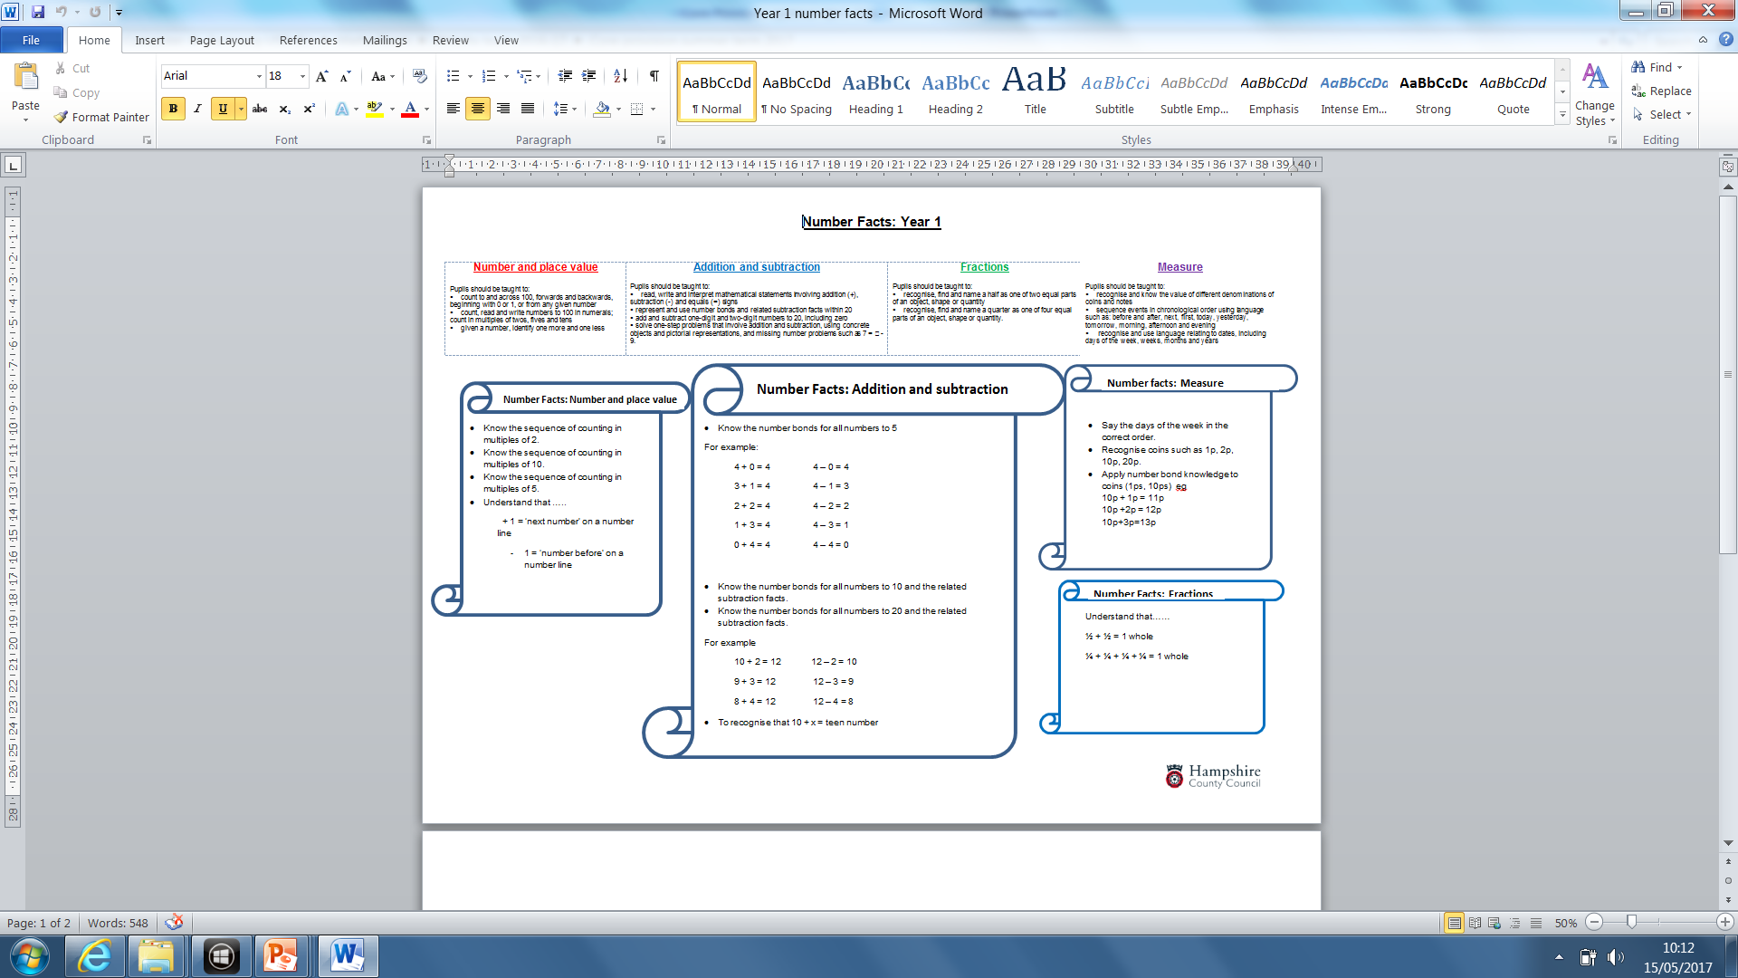

Slide 77
Year 1 number facts
Can pupils can solve problems using number facts (not counting in ones) in the context of money

Slide 78
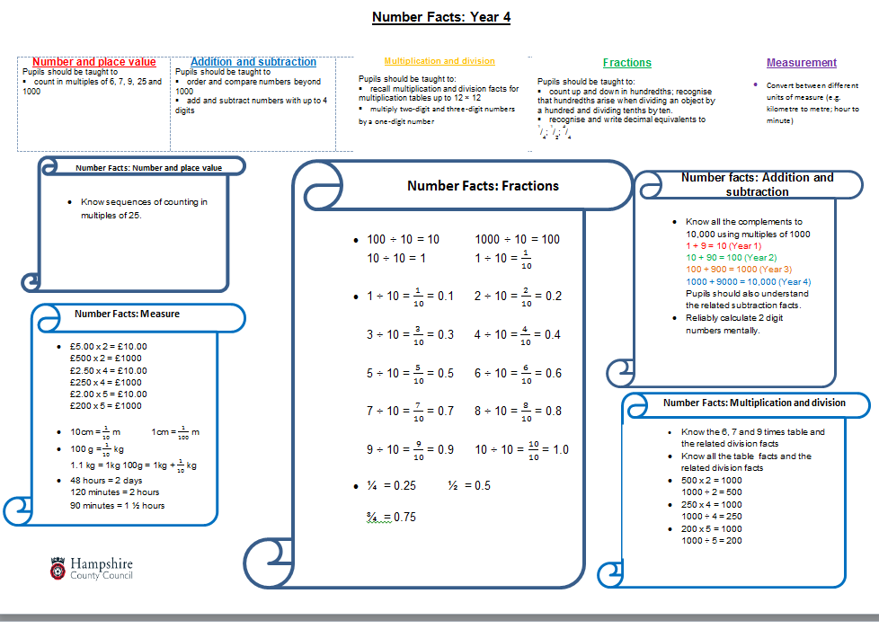

Slide 79
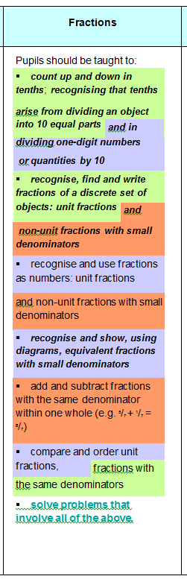
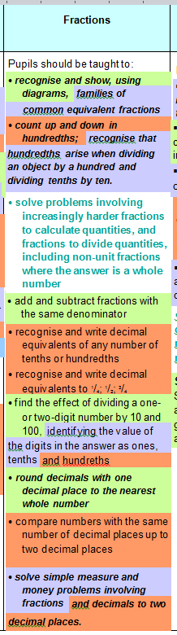
Year 4 Fractions
Year 3
Year 4
Domain Links:
Number and place value
Multiplication and division
Measurement
+
+
Key stage 1

Slide 80
Year 4 Big ideas
Fractions arise from solving problems, where the answer lies between two whole numbers.
Fractions express a relationship between a whole and equal parts of a whole. Children should recognise this and speak in full sentences when answering a question
involving fractions. For example, in response to the question What fraction of the chocolate bar is shaded? the pupil might say Two sevenths of the whole chocolate bar is shaded.
Equivalency in relation to fractions is important. Fractions that look very different in their symbolic notation can mean the same thing.

Slide 81






NCETM Teaching for Mastery
https://www.ncetm.org.uk/resources/46689

Slide 82
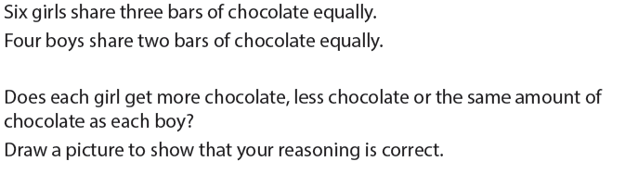
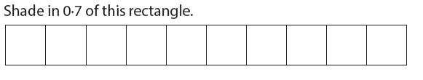
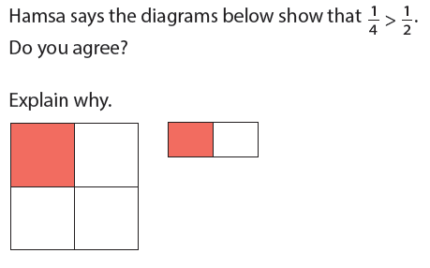
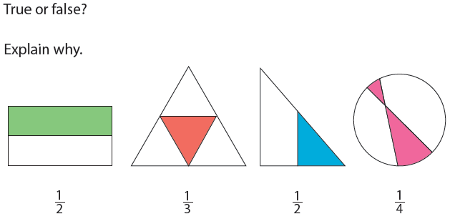
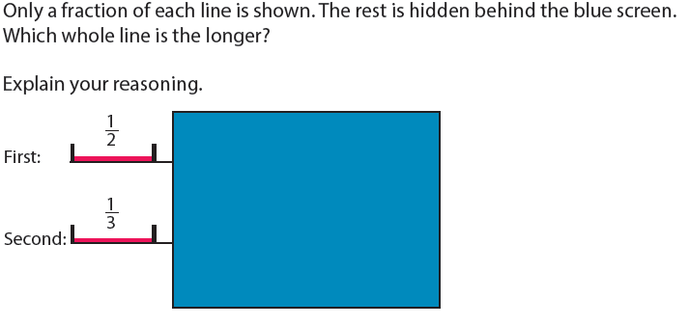
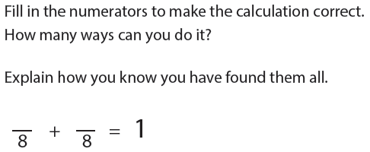
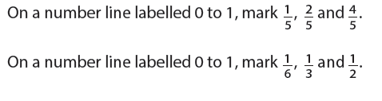
Key NCETM Mastery Tasks from Year 3 booklet

Slide 83

Year 3
What do you expect all Y3/4 pupils need to be able to say, write and draw in response to this?

Slide 84
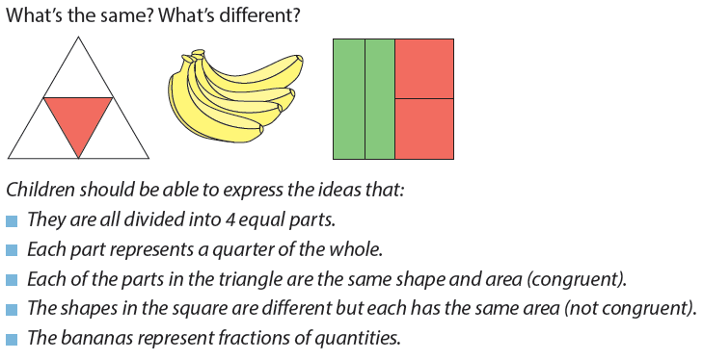
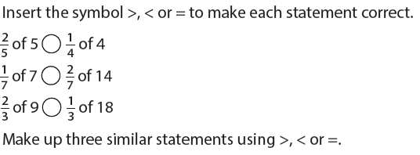
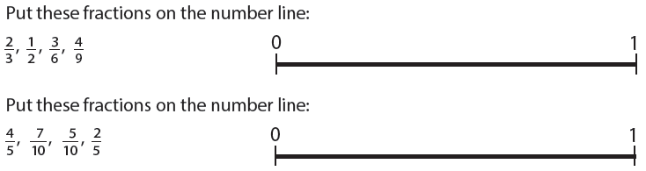
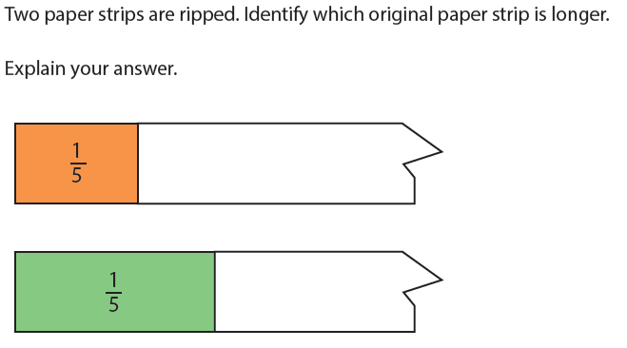
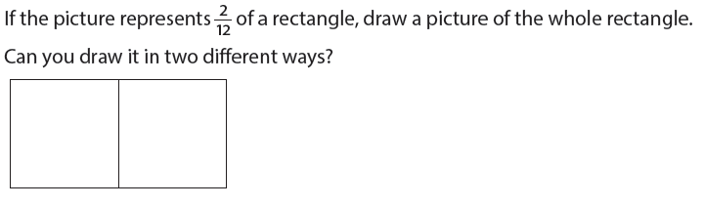
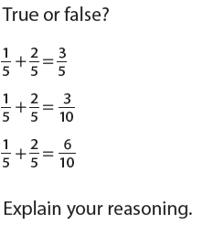
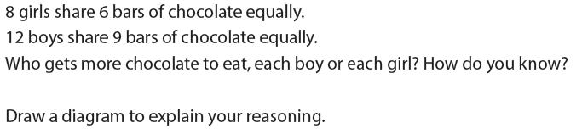
Key NCETM Mastery Tasks from Y4 booklet

Slide 85
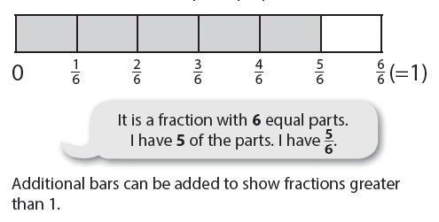
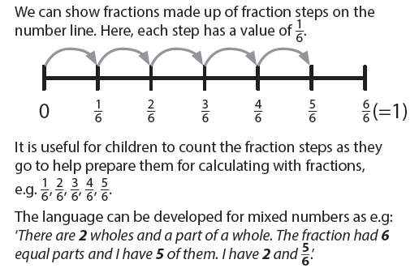
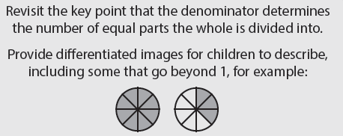
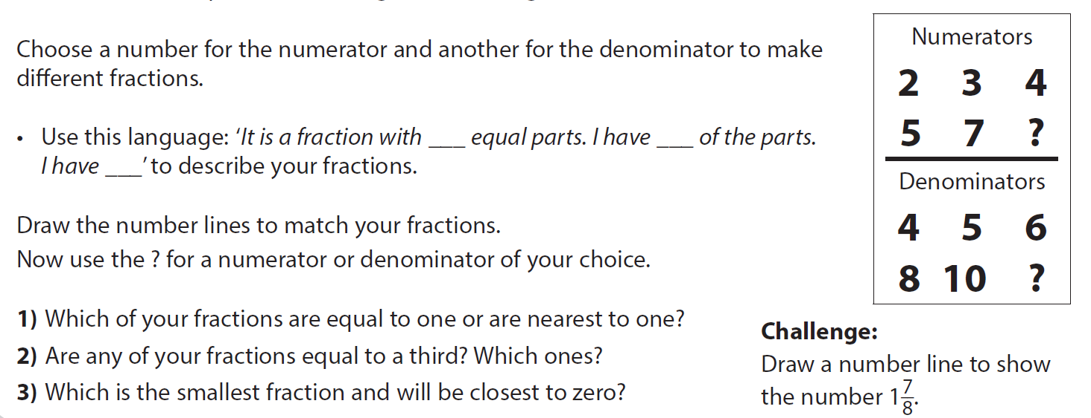
Year 4: counting… fractions as numbers/ fraction strips/ number lines

Slide 86
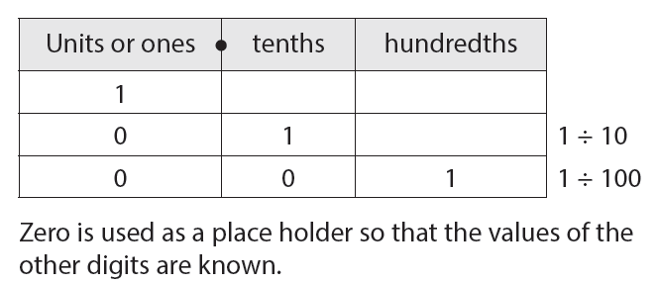

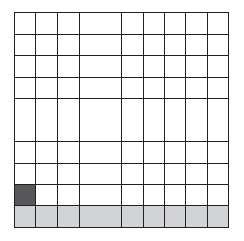
Y4: decimal representations of tenths and hundredths
In year 3 pupils learn that division can be used to create a fraction eg 1÷10 = 1/10. So in the same way a fraction can be converted to a decimal using a place value grid showing decimal place value columns (or a calculator)
Another important image is a blank 100 square or dienes base 10 blocks

Slide 87
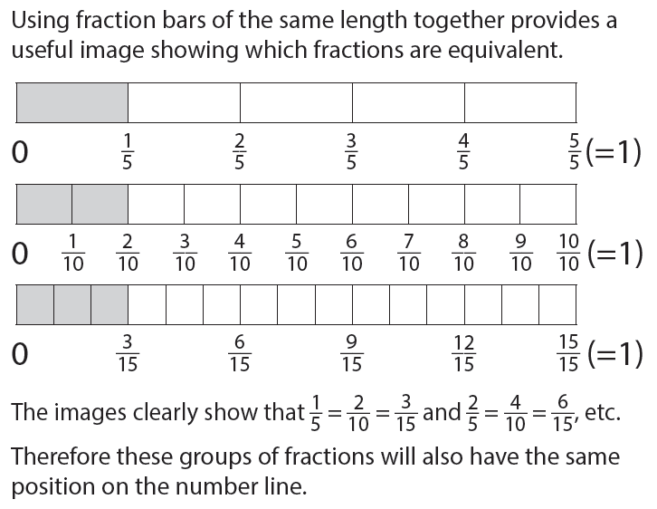
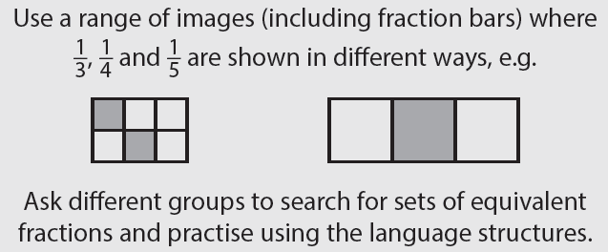

Y4: Developing understanding of equivalence

Slide 88
On a camping holiday, 5 people want sausages for breakfast on the last day. There are 5 (6, 10, 17) sausages left.
How can they be divided equally between the 5 people with the least number of cuts?
How much does each person get?
Children will need repeats of this type of problem to become confident in their solutions, able to use a range of diagrams and start noticing and using links with multiplication and division facts

Slide 89


Pizza Party Problem
Twins Lucy and Josh are having a birthday party with their friends.
Lucy has 11 friends round her table and Josh has 7 friends round his table.
The pizzas were too big for one each so their dad ordered nine pizzas for the girls’ table and six pizzas for the boys’ table. The children on each table shared the pizzas fairly.
On their way home Lucy and Josh discussed how much pizza they each got to eat. Lucy said they eat more because they had more pizzas on their table. Josh though he had more because there were not as many people sitting at his table.
What do you think? Did the girls or the boys have more to eat?
Notes:
6/8 or 9/12, both =3/4 of a pizza each

Slide 90

Using bar models to solve problems involving fractions
From Set 4 Bar Model Activity Cards TTS

Slide 91

Pupils will need to work on this problem until they are confident…what changes could be made?
Expect number sentences as well as bar model diagrams to explain reasoning…

Slide 92
Hampshire Assessment Model: Milestone 3 to ARE
Once Milestone 3 assessment completed there is a ‘gap’ until the end of term. This gap is intended for:
Revisiting the whole curriculum focusing particularly on the domains that pupils need more time on to develop fluency in fundamental ideas (interventions?)
Ensuring that the last, end of year assessment can be based on pupils independently solving a range of routine and non-routine problems within their year group’s curriculum expectations
Supporting pupils to understand and use the links between domains when reasoning and solving problems
Supporting pupils to be able to work mentally appropriately and confidently using known and related facts

Slide 93
End of year attainment
By the end of the year pupils need to be showing their understanding of their curriculum fundamentally through independent problem solving at an appropriate pitch to be at age related expectations. (Aims of the curriculum)
(Y2 and Y6 should use DfE perfomance descriptors)

Slide 94
Reviewing pupil work
By the end of the year pupils need to be showing their understanding of their curriculum fundamentally through independent problem solving at an appropriate pitch to be at age related expectations. (Aims of the curriculum)
(Y2 and Y6 should use DfE perfomance descriptors)
How has pupil work improved from this time last year?
Which areas need further development?
‘Close to’ pupils- what interventions are needed to move as many pupils as possible towards appropriate attainment by the end of the year?

Slide 95
EXPERT mathematician (end of year) make links to DfE interim performance descriptors for end of key stage in Y2 and Y6 ‘working at expected’ +
Pupils can suggest and draw on a range of appropriate models to represent a mathematical concept, or solution including a missing box number sentence
Able to talk about their reasoning using accurate vocabulary when engaged in ‘intelligent practice’ tasks
Can discuss what is mathematically the same and different about a range of problems because the context is not distracting from the mathematics required.
Pupils respond flexibly and with resilience to non- routine problems
Make decisions confidently about which calculations could be worked out mentally and which calculations need pencil and paper recording.
Pupils able to discuss and illustrate connections between domains of mathematics
Pupils can independently use informal and formal notation to share their solutions with peers
Pupils independently use known facts involving all four operations to both simplify calculations and check reasonableness of answers including in the context of measures
Notes:
Based on the Dreyfus model A Five-Stage Model of the Mental Activities Involved in Directed Skill Acquisition’

Slide 96
What does ‘beyond’ mean?

Slide 97
Final session
Beyond
Final assessment
Working together to plan (co-construction) first few weeks in September – time for revision and re visiting. Getting transition right.

Slide 98
Can you be an expert and not be beyond?
Discuss
Notes:
Ensure that you have a written rationale that is clear within your own school (including FGB) for defining ‘on track for Beyond’ and ‘Beyond’.
Refer to transition matrices.

Slide 99
Beyond
Beyond is about extended abstract learning. Prior learning looked at in a new way and used as the basis for prediction, generalisation, reflection or creation of new understanding (Hook and Mills 2011). Children being able to apply their learning in an a new context and creating new meaning or thinking.
Children are making conscious deliberate decisions about their learning. Children can transfer their learning and explain their learning to others. Teachers will need to capture and extend their thinking.

Slide 100
Beyond
Expert

Slide 101
Managing the difference in the role of the teacher - consultant
How will you support teachers in being able to design tasks that require children to adapt, create and think in the abstract? More opportunities to question and extend thinking?
What is the role of the English and mathematics leaders within this?
Notes:
Quick discu

Slide 102
Managing the difference
Role of the adult
Not yet secure at ARE
Teacher as instructor and guide
Breakaway groups
Returning to gaps in data
Secured ARE
Capable of beyond
Teacher as facilitator and consultant
Provide open ended tasks that allow children to demonstrate independence and resilience

Slide 103
End of year assessment
Children have achieved ‘expert’ against all objectives
  secure in all domains and may be beyond in some so met or exceeded ARE
  Secured all of the objectives for the year group
  TRACKER = SECURELY ON TRACK
Children have achieved ‘expert’ in most objectives, particularly phase 1 and 2, but are competent in phase 3
  professional judgement but likely to be secure in all domains so met ARE
  TRACKER = SECURELY ON TRACK
Children have a mixture of ‘expert’, ‘competent’ and ‘apprentice’ in a variety of objectives
  professional judgment but likely to be below so not met ARE~

Slide 104
Transition
What strategies are used to support continuity of learning between summer and autumn terms?
Collaborative cross year team planning for first unit of work in September based on assessment of individuals and groups? Eg YR/ Y1
Visits to classrooms summer term and revisit autumn term? Eg Y2/Y3
Using the same pupil books in autumn term (unless it would be beneficial for some pupils to have a new book)
Notes:
Key issue with transition between any year is pitch and expectation is too low resulting in pupils spending too long in low level tasks building back up to where they might have been in the previous summer term. CTs planning with next year group teacher thinking about – ‘if I planned the next unit (ie autumn term one) what would I expect pupils to be able to do and what would be the challenge?’

Slide 105
Hampshire Assessment Model
September to November |  | November to February | February to April | Summer Term
 |  |  | Phase 3 sufficiently secured (APPRENTICE) | Phase 3 (COMPETENT/EXPERT)
 |  | Phase 2 sufficiently secured (APPRENTICE) | Phase 2 (COMPETENT/EXPERT) | Evidence of: Fluency? Independence? Resilience?
Phase 1 sufficiently secured (APPRENTICE) |  | Phase 1 (COMPETENT/EXPERT)
Previous Yr Group objectives secured
Notes:
Lots of information is available to inform this yellow block – getting after gaps and what will they have forgotten

Slide 106
Analysing individual pupils
What pupil information might be needed?
Red Arrow – why is this pupil below in all domains? SEND? External factors? Prioritise particular domains?
Green Arrow – possible anomalies – could you be below in NPV and beyond in others? Granular objective analysis?
Orange Arrow – what is the plan to accelerate progress in A+S, Fractions and Geometry?
Notes:
Note – no ‘close to’s’ as end of year. Making then point that per pupil analysis should be part of the end of year analysis

Slide 107
Analysing domains
Are some domains more ‘fragile’?
Group teaching for some
Using all available information
Data rich
Co-construction linked to transition
When analysis is complete…..
Targeted intervention or small group

Slide 108
Identify weaknesses and gaps in current year
Current Year
Plan for ‘quick fix’ lessons within a learning journey
Tailored teaching for small groups and individuals
Next Year
Co-construct planning to address areas for consolidation and teaching
Utilise the end of year and transition through rich drivers and tasks
Notes:
End of year and start of next…. Who needs to nail a key thing… repeated daily and who needs
Implication of timing – when do we need to do this to enable co-construction?

Slide 109

Transition –
Collaborative Planning
  Co-construction of the first learning journey to reinforce known weaknesses and teach to close to gap
Notes:
Engaging literacy driver is essential English to talk through slide
Accessible to all – film, image or picture book

Slide 110
To consider…
Have you been developing:
school portfolios of work for each year group to show what evidence of expert/competent at the end of phase 2 and phase 3 looks like?
critical pathway type documents that reflect the school specific curriculum and that are ‘reverse engineered’?

