Slide 1
Hampshire Assessment Model
Spring Term 2017

Slide 2
Programme
9:00 Introductions
9:05 – 10:00 Self-evaluation and action
10:00 Coffee
10:15 Pedagogical responses to securing
Attainment at ARE
Good progress for below ARE
Attainment beyond ARE
Review of action plans throughout

Slide 3
Guided school review of achievement
During the next hour we would like you to undertake a review of achievement and progress
Quick recap:
  What to look for in Writing years 1 and/or 5
  What to look for in maths at this point in years 2 and/or 6

Slide 4
Reviewing
2016
Statutory assessments
Current tracking data
Work in books
Taking ACTION
Suggest
Year 1 and/or
Year 5
English
Suggest
Year 2 and/or
Year 6
Mathematics

Slide 5
Guided review: 2016 statutory assessments
Share the information you have brought with you in your discussion group
What did last year’s end of KS assessments tell you about…
  Attainment and progress?
  Strengths and weaknesses in learning of the entire curriculum?
Did you utilise question level analysis as part of this process (KS2?)
What has been the school’s response and how are you monitoring the impact of those changes?

Slide 6
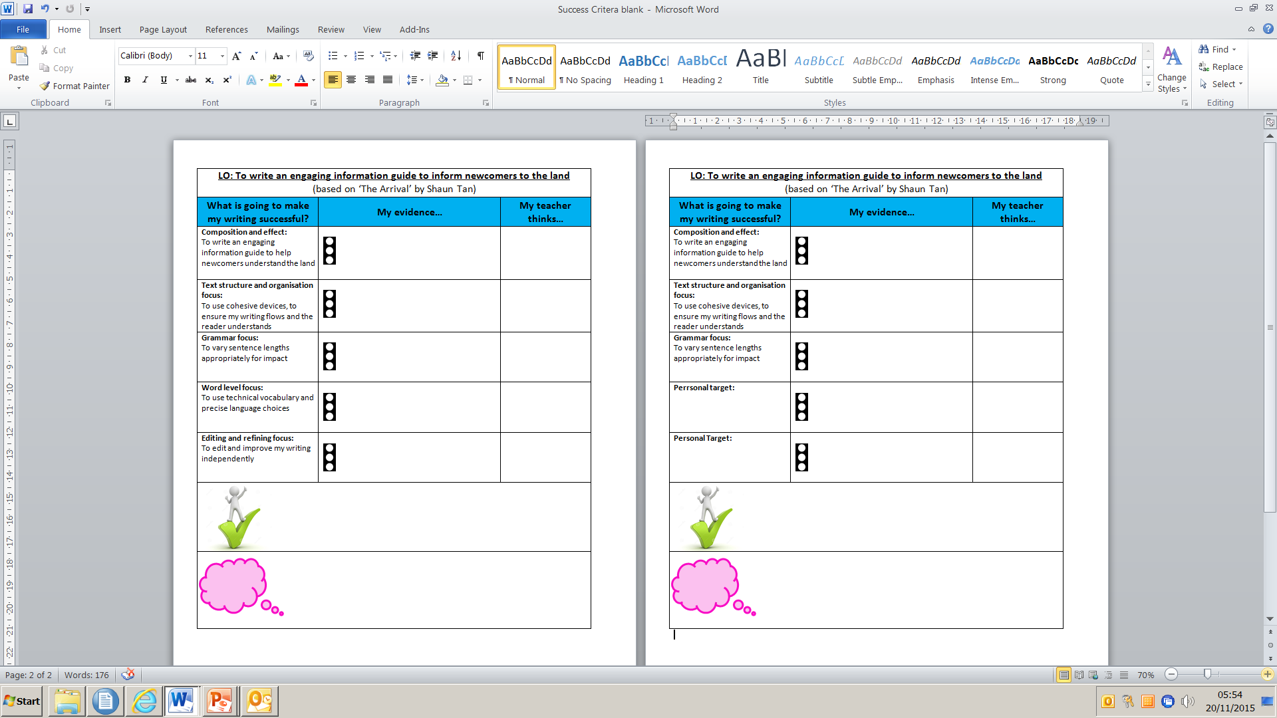
Apprentice
Competent
Success criteria reflects new learning in phase 2
Evidence of competence in phase 1 objectives - pupils apply with greater independence and resilience in new contexts
Objectives not required in success criteria
Notes:
English - Emma

Slide 7
‘What to look for in Year One’
Competent
‘Applying in some independent work with some inconsistency ’
Apprentice
‘Applying with support’

Slide 8
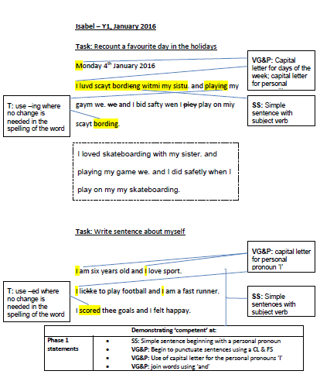
What are the key skills you need to secure now to support end of KS outcomes?
Notes:
Key skills: sentence - simple sentence structure - use of ‘and’ - accurate use of CL and FS…

Slide 9
‘What to look for in Year Five’
Competent
‘Applying in some independent work with some inconsistency ’
Apprentice
‘Applying with support’

Slide 10
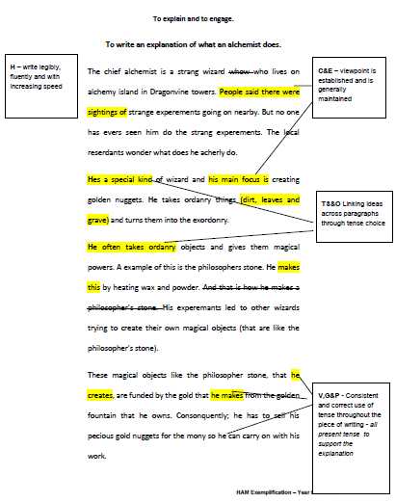
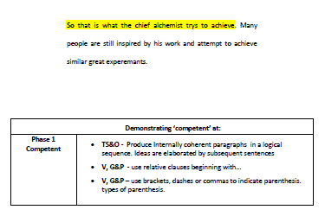
What are the key skills that support end of KS outcomes?
Notes:
Punctuation – punctuation for parenthesis
Sentence – range of sentence length and structure
Grammar – modal verbs…

Slide 11
In mathematics Y2/Y6
KS1 statutory assessment is based on moderation of work
However, the KS1 tests provide a useful illustration of the kinds of capabilities that pupils might be expected to demonstrate
We are not suggesting that, as in KS2, the tests as a whole, are a reliable indicator of KS1 statutory standard
However, in maths, we can use the test questions in KS1 and 2 to get a sense of appropriate pitch and cognitive demand for Y2 and Y6

Slide 12
Year 2 and Year 6
Key messages for statutory assessments
In KS2, Arithmetic test and reasoning (problem solving) papers- both papers need focused teaching time
All pupils should be engaged in ‘reasoning’ (problem solving) with opportunities to really understand a solution to a problem through sufficient practise (variation technique) to develop independence and fluency
For all pupils mental strategies need to be based on:
  concrete experiences using structured resources
  linked to use of pictures and models and images.
  developing conceptual understanding of formal notation and in upper KS2, formal methods.
Mental + range of written strategies needed
Facts and derived facts a key component of calculation in key stage 1 and 2

Slide 13
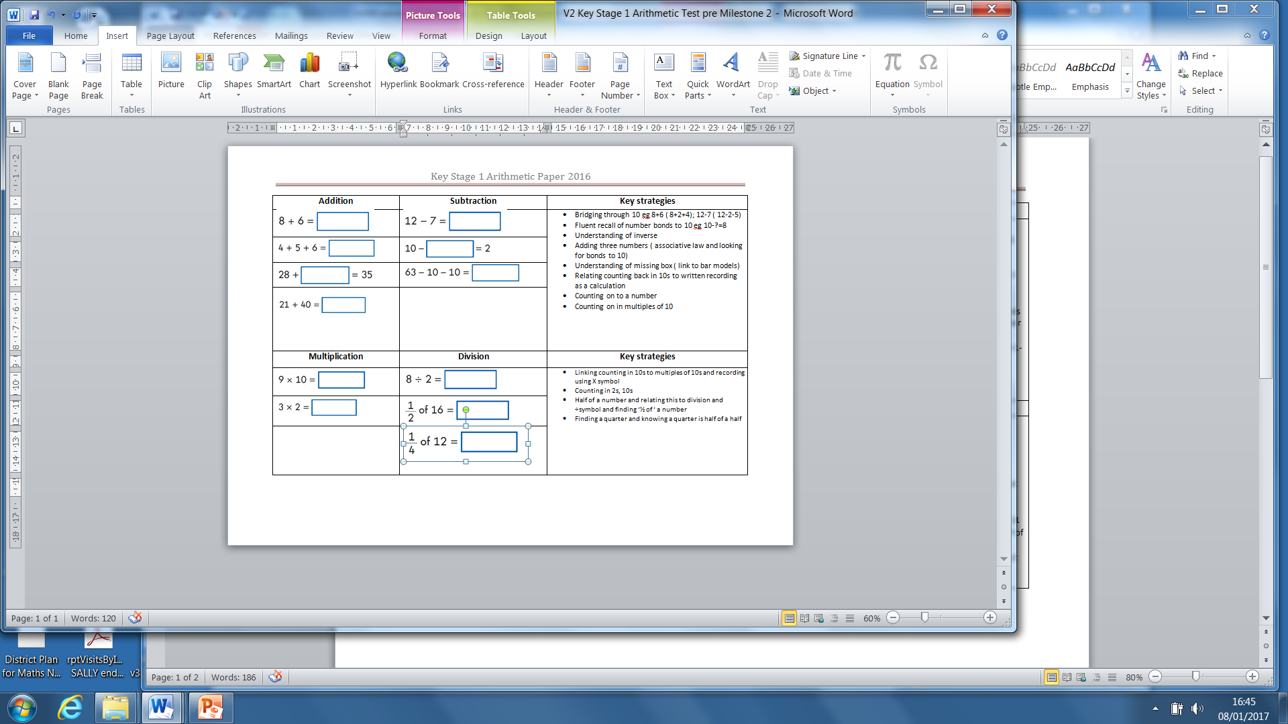
KS1 Arithmetic Paper or similar questions used in classroom work to evidence ARE
e.g. Handout

Slide 14
What are the implications for provision and teaching mathematics in year 2
(and preceding years)?
Review of Y2 moderated classroom work and tests in 2016
Arithmetic test/ questions in typical classroom work
Which questions did pupils select an appropriate strategy (mental/ written) for?
Which questions revealed conceptual errors?
Reasoning Paper/ reasoning problems in typical classroom work
What Kinds of questions did pupils find easy/ harder?
Did pupils have an appropriate recording strategy that helped them to communicate their solutions succinctly?
Which domains need more focus this year?
Were pupils able to draw fluently on key facts? If not what strategies have been put in place to address this?

Slide 15
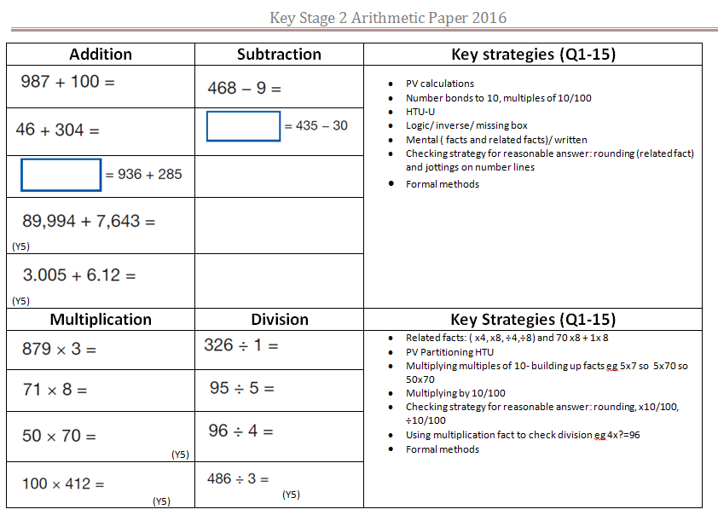
KS2 Arithmetic Paper e.g. Q1-15
e.g. Handout

Slide 16
What are the implications for provision and teaching in Year 6 (and all preceding years)
Review of the 2016 SATs questions.
Arithmetic test:
Which questions did pupils select an appropriate strategy (mental/ written) for?
Which questions revealed conceptual errors?
What strategies were used to prepare pupils for this test? Were they effective? What will you do differently this year?
Reasoning Papers
Which questions did pupils find easy/ harder?
Did pupils have an appropriate recording strategy that helped them to communicate their solutions succinctly?
Which domains need more focus this year?
Were pupils able to draw fluently on key facts? If not what strategies have been put in place to address this?

Slide 17
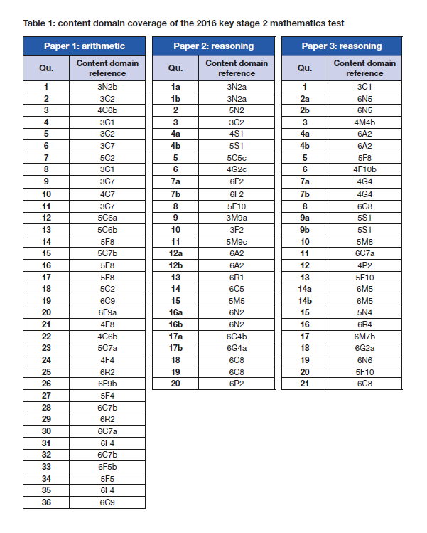
From KS2 mark scheme
Use to support analysis of pupil responses:
Did all pupils answer Y3, Y4 pitched questions etc…
If not – make sure this is secure in Y3, Y4 planning this year
Which domains were successfully answered by all?
Which particular questions did individual / groups of pupils struggle with? Why?
Were mistakes procedural errors or conceptual misconceptions?

Slide 18
Let’s review
2016
Statutory assessments
Current tracking data
Work in books
Taking ACTION
Suggest
Year 1 and/or
Year 5
English
Suggest
Year 2 and/or
Year 6
Mathematics

Slide 19
Guided review:
Current tracking data and 2016 data
What is progress and attainment data telling you about learning in maths in Year 2 and Year 6 and in writing in Years 1 and 5?
Are similar children doing better than last year?
Where, what and for whom are there learning domains requiring acceleration?
Looking in the books
Do the books align with your attainment and progress data?
To what extent are they matching exemplification materials at this point in the year?
Are they better than this time last year?
Are domain strengths being maintained and weaknesses addressed?

Slide 20
Action plan
What are you pleased to see in the books that reflects your analysis from 2016?
What do you feel is not yet securely in place?
What actions might you take to respond to your current analysis? (new or re-inforced)
How will you monitor the impact of these actions

Slide 21

Coffee

Slide 22
Pedagogical Approaches
Moving ‘close to’ – ARE
Ensuring best progress for those working below
Moving ARE – ‘Beyond’ and Greater Depth

Slide 23
Moving ‘Close to’ children to ARE
Senior Leadership Team questions to ask
Notes:
Close to 20 mins reading
20 mins writing
20 mins Maths

Slide 24



Slide 25
Are high level questions used to reveal what children do and don’t understand?
Are children grouped appropriately e.g. according to ‘Simple View of Reading?
Are adults spending enough time modelling before children are expected to complete independently?
Are adults used for ‘pre teaching’?
e.g. vocabulary focus and/or context
‘Close to’ ➔ ARE
READING
SLT questions to ask
Does planning break down NC statements into steps of learning?
Are children aware of the skills and strategies for reading as clearly as in writing?
What are the supporting resources to enable children to be successful?
Notes:
Change red to white text

Slide 26
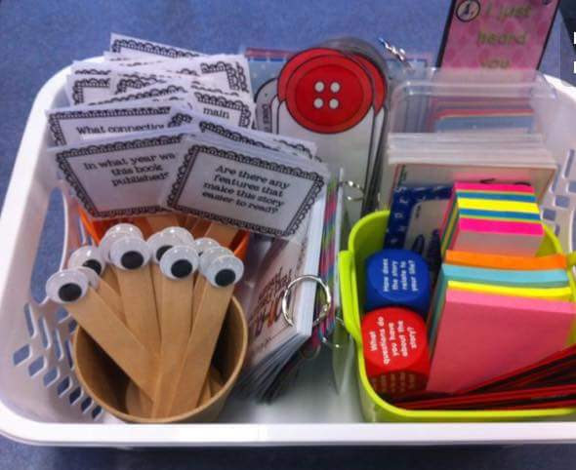

How do you currently support children’s learning in reading?

Slide 27
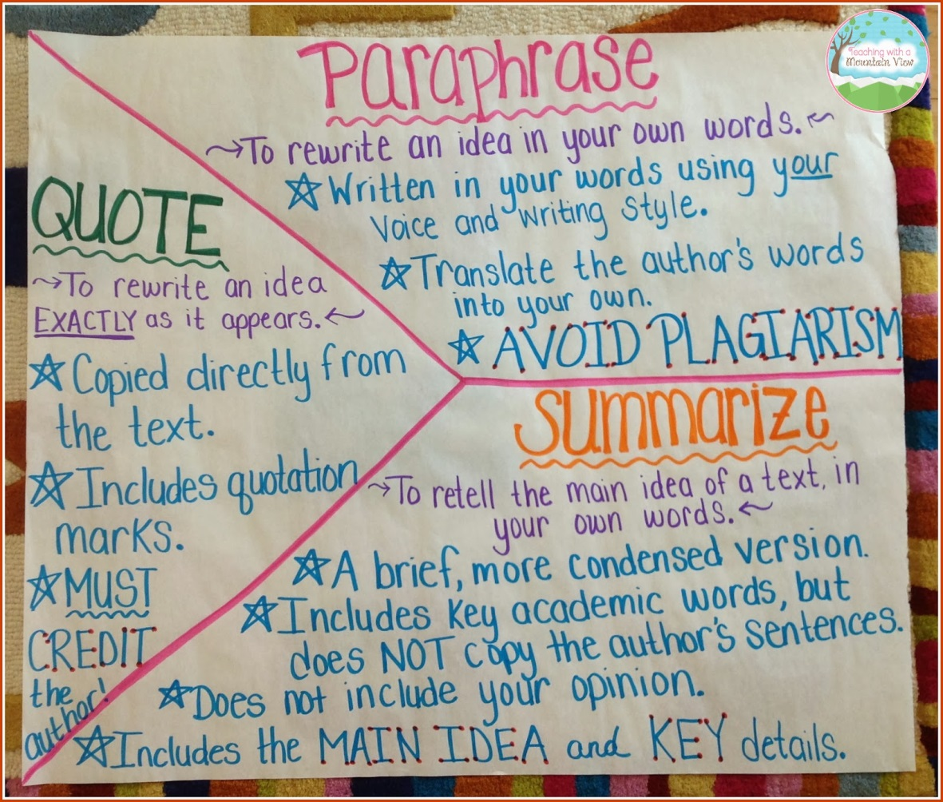
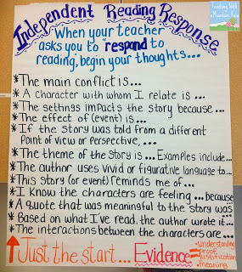
Supporting outcomes in reading …

Slide 28
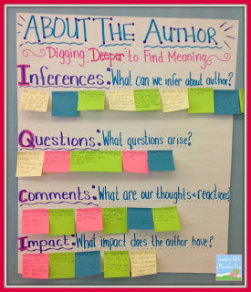
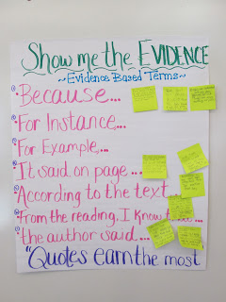
Supporting outcomes in reading …

Slide 29

Unpacking a national curriculum
statement
LANGUAGE
STRUCTURE
Year 3 - 6 reading statement
Identify how language, structure and presentation contribute to meaning.
Identify … contribute to meaning …
PRESENTATION
How many elements are there to this statement?
Unpack …

Slide 30
Year 3-6 reading statement
Identify how language, structure and presentation contribute to meaning.
LANGUAGE
STRUCTURE
PRESENTATION
How is ‘STRUCTURE’ different to ‘PRESENTATION’
How is ‘LANGUAGE’ different for fiction/ non fiction/ poetry etc?
What do children need to know and understand about language, structure and presentation before being able to identify how they ‘contribute to meaning?’
… contribute to meaning …
Other CPD questions?

Slide 31
A few examples to start …
LANGUAGE
STRUCTURE
PRESENTATION
Non fiction
Technical language
Precise vocabulary choices
Passive voice
Formality
Fiction/Poetry/Plays
Alliteration
Metaphor
Play on words
Non fiction
Contents page
Index
Topic sentences
Organisation of ideas on the page
Fiction
Chapters
Flashback
Poetry
Verses
Line length
Forms of poetry
Plays
Specific structure
Non fiction
Captions
Diagrams
Bullet points
Layout e.g. letters
Fiction
Capitalisation
Italics
Images
Poetry
Shape poems

Slide 32
What might a lesson objective be?
Can I identify the key language features of humorous poetry?
Can I explain how the language features of poetry impact the reader?
Can I identify why ‘language’ choices are different in fiction compared to non fiction?
Can I identify how the language features of an explanation text guide the reader?
Can I identify and explain how presentation in non-fiction books contributes to meaning?
What task design would enable these learning objectives to be achieved?
Can staff create a sequence of LOs that make a reading learning journey?

Slide 33
Are techniques such as the slow writing process or paired writing used effectively?
CPD – are teachers shying away from teaching areas due to lack of subject knowledge?
Are adults spending enough time modelling in
shared and guided sessions?
Are ‘non negotiables’ in place and part of classroom ethos to use them?
‘Close to’ ➔ ARE
WRITING
SLT questions to ask
How often do teachers writing conference with children?
When and how is effective oral and written feedback given?
Do learning journeys demonstrate enough time on oral rehearsal, word and sentence level tasks i.e. building blocks for success?

Slide 34
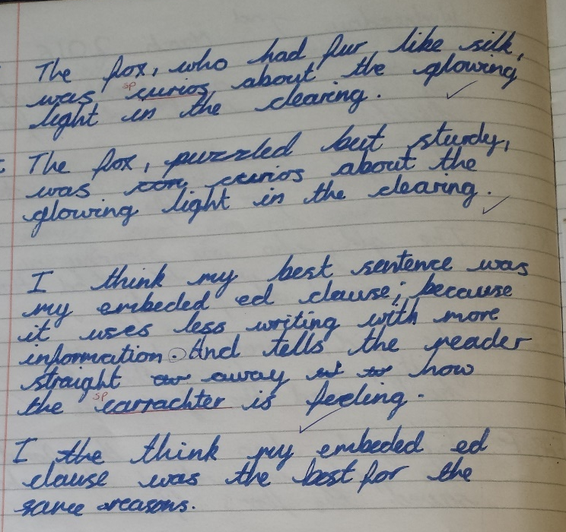
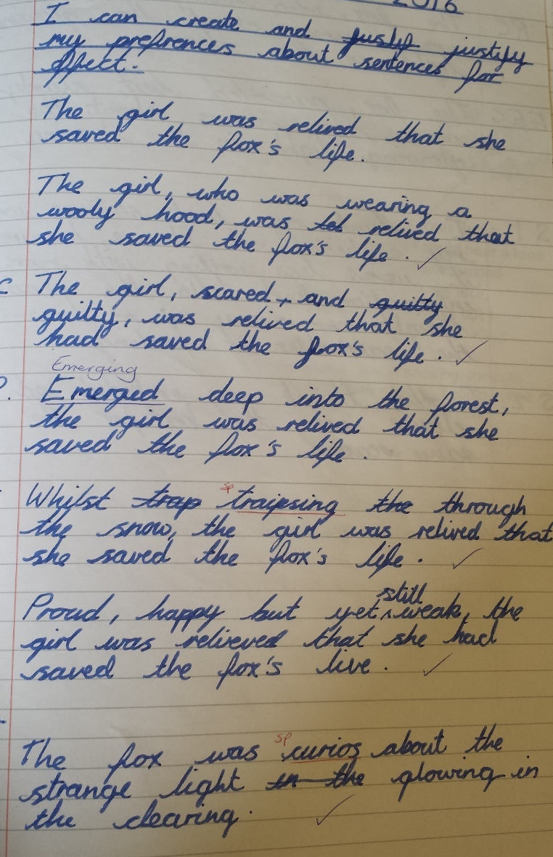
Notes:
Y5 – Kempshott Junior School

Slide 35
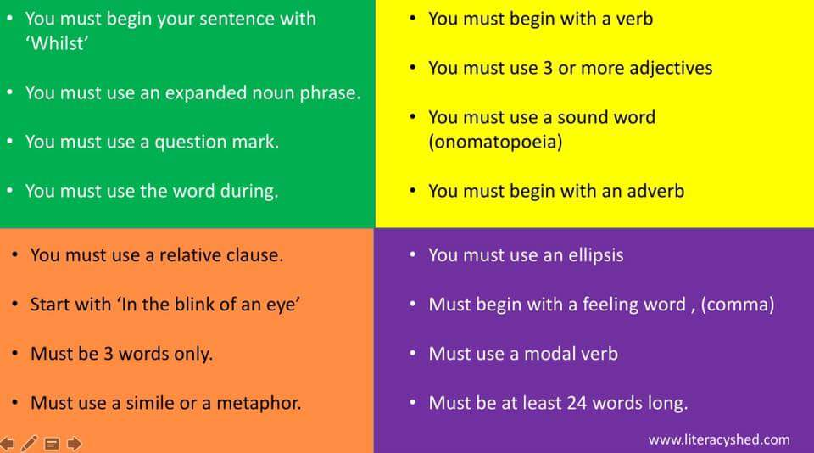
An example of the ‘Slow writing process’

Slide 36
Revisit your action plan
What are you pleased to see in the books that reflects your analysis from 2016?
What do you feel is not yet securely in place?
What actions might you take to respond to your current analysis? (new or re-inforced)
How will you monitor the impact of these actions

Slide 37
Is there a relentless focus on the core concepts e.g. number, place value, calculation?
Are teachers linking work across domains, at the right pitch, as a context for the concept that’s in focus?
Do they have appropriate recording strategies, fluency, reasoning and [problem solving?
Is there an ongoing focus on the core concepts “outside” normal lessons when the focus is different e.g. geometry
‘Close to’ ➔ ARE Maths towards Y2
SLT questions to ask
Encourage children to describe / talk about what they are doing as evidence of their understanding?
Do teachers ensure that concrete apparatus and pictorial representations used all the time?
…and use pictorial representations alongside apparatus
Notes:
Ensuring a relentless focus on these core concepts – children will not move on with their learning until these are secure.
This does not mean children are not working on other domains, but work within other domains should be appropriately pitched and used as a context for their learning in place value, calculation etc.
Ensure concrete apparatus and pictorial representations are encouraged all the time
Encourage the use of pictorial representations alongside apparatus – this will help them tackle test questions without having apparatus available
Encourage them to describe / talk about what they are doing – capture the things they say as evidence of their understanding
They may also need on-going intervention over and above the lesson – e.g. if, during lessons, children are working on geometry, keeping the core learning in number, place value and calculation going is vitally important.

Slide 38
Y2: Key concepts:
(Are they on track to the expected KS1 standard)
Place value
Unitizing – (they have moved on from counting only in ones)
Correctness in writing the numbers in numerals.
Recall and use of number bonds for calculation (including understanding how addition and subtraction relate to each other)
Using understanding of place value for addition and subtraction (adding tens, then ones – no re-grouping)
Secure knowledge and understanding of doubles and halves to 20.

Slide 39
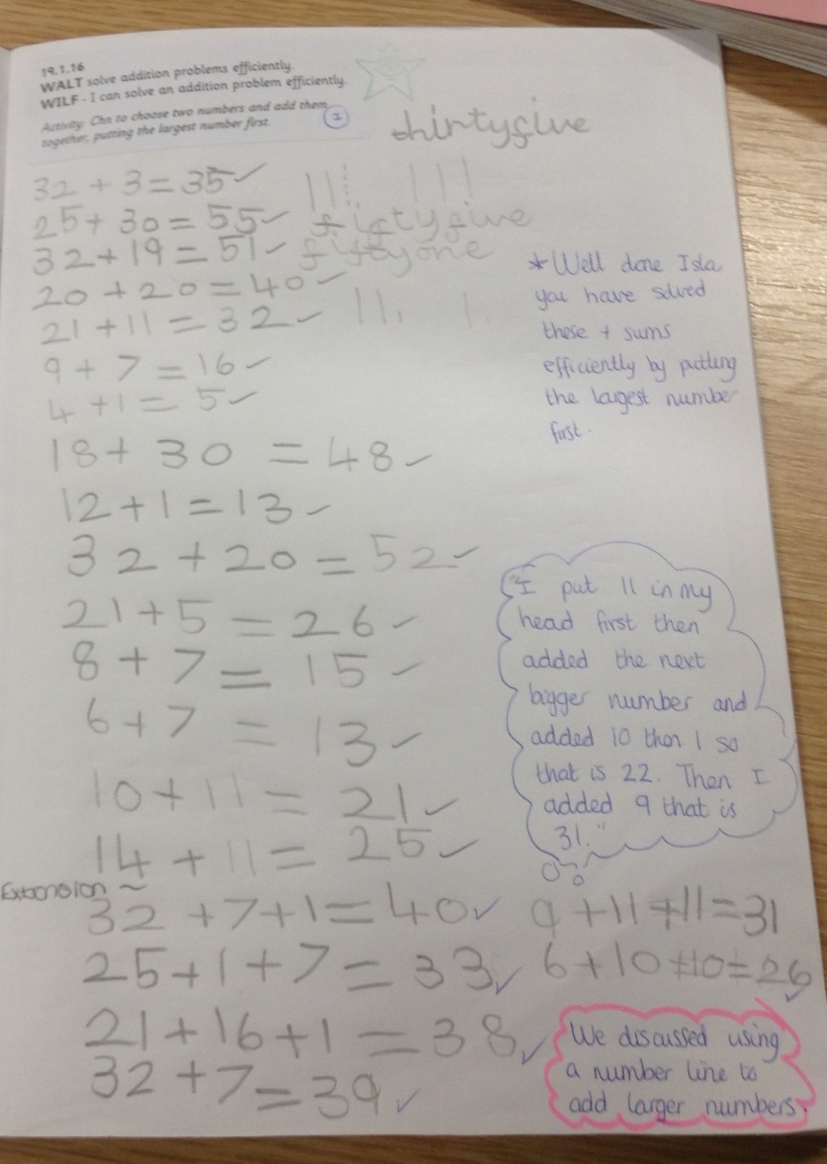
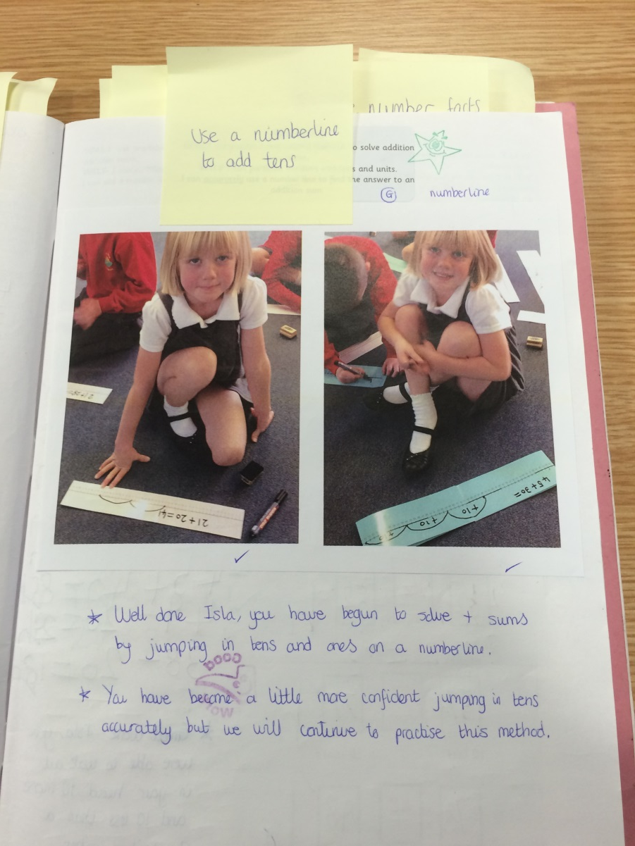
Dialogue / conversation / teacher intervention gives valuable insight into the child’s understanding and strategies used
Notes:
Some examples of where the dialogue / conversation / teacher intervention gives valuable insight into the child’s understanding and strategies used.

Slide 40
Developing reasoning from Milestone 2 to Y2 /Y6 SATs
Use pitched problem solving resources and sort the published examples into ‘easier’ through to ‘harder’.
Give pupils quality time to work on the ‘easier’ examples to ensure they can explain their solutions and have practise at similar problems (variation).
Plan to work on the ‘harder’ examples after Milestone 2
Use the NCETM Mastery booklet after Milestone 2 eg Y1/ Y5 booklets (any task for Year 2/ 6 now) and Y2/Y6 booklets the first column ‘Mastery’ for pupils working ‘securely on track’.

Slide 41
A two step problem?
Or two one-step problems?
Sarah bought an apple for 30p and a banana for 25p. How much did she spend? How much change did she get from £1?
Sarah bought an apple for 30p and a banana for 25p. How much change did she get from £1?
Secure one-step problems leading to milestone 2, two step problems follow on
Pupils likely to attain ‘greater depth’ by end of KS1 need earlier challenge…
What information have I got and how am I going to use it?

Slide 42
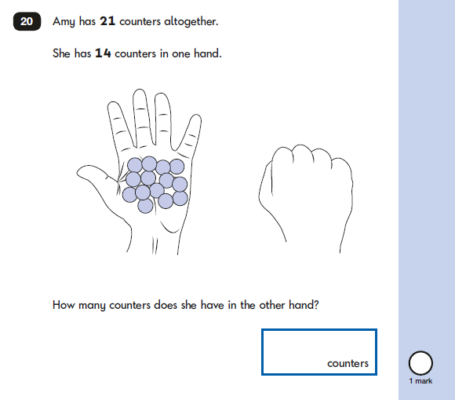
2016 KS1 Paper: Reasoning
Being able to work out the number sentence needed
21= 14+?
14+?=21
Use of a number line to ‘draw’ the calculation
Use of a bar model
Able to use both bar model and number line to support a number sentence- ‘multiple representation’
Discussed at Y2 standardisation

Slide 43
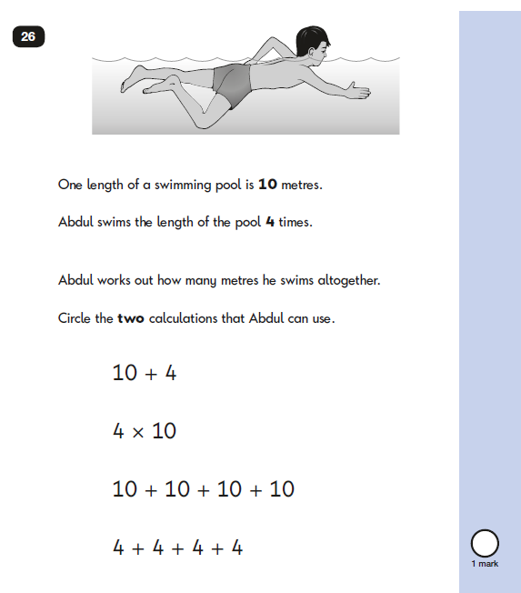
2016 KS1 Paper: Reasoning
Developing awareness of the links between different operations.
Writing the same number sentence in different ways

Slide 44
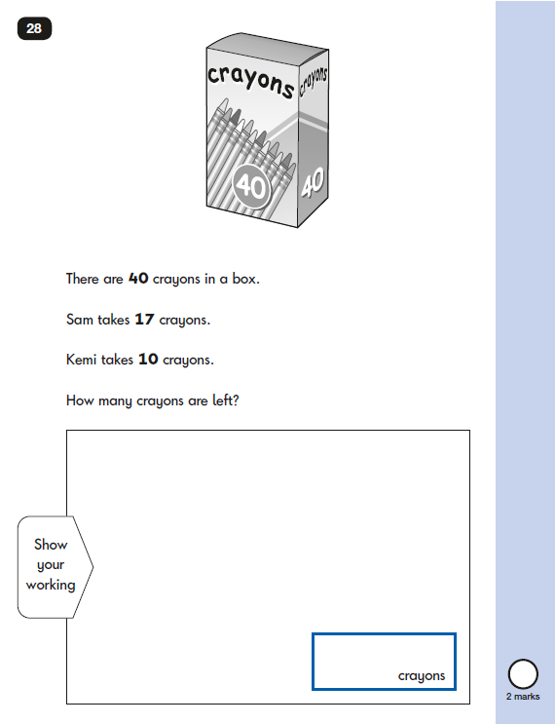
2016 KS1 Paper: Reasoning
Subtracting two quantities…
Can pupils use a number line for this calculation?
Could they write a number sentence?
(Links to arithmetic Q)

Slide 45
Are all pupils expected to develop and demonstrate their reasoning by
talking and writing,
simply and coherently
Are pupils able to answer arithmetic questions fluently? (e.g. more questions than minutes)
Is effective use being made of high quality published resources to ensure right pitch?
Are interventions effectively focused?
‘Close to’ ➔ ARE Maths Y6
SLT questions to ask
Is there an overt development of pupils’ reasoning capabilities using “intelligent practice” (Variation theory?)
Are teachers making effective use of the NCTEM mastery tasks?

Slide 46
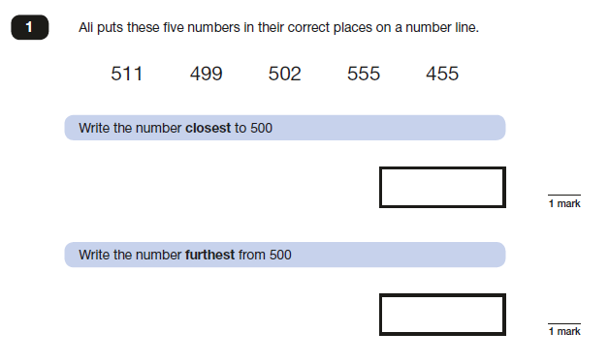
Paper 2 KS2 (year 3/4)

Slide 47
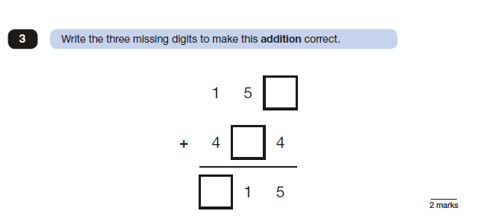
Paper 2 KS2 (Y3/4)
Do pupils understand formal methods conceptually so that they can solve this starting point

Slide 48
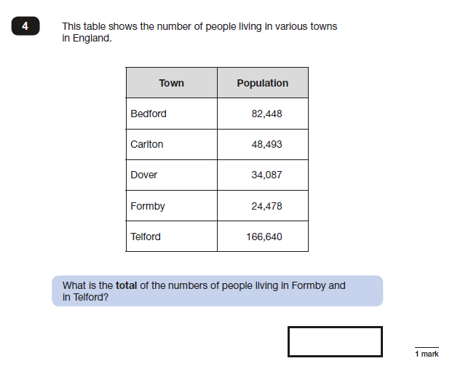
Paper 2 KS2 (Y3/4)
Reading larger numbers
Extra information
Checking reasonableness of answer

Slide 49
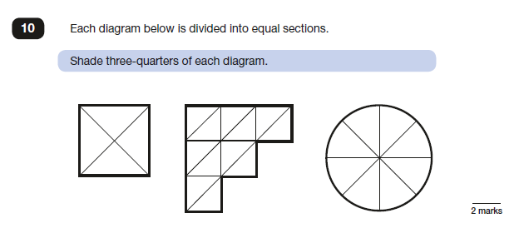
2016 Paper 2: Reasoning Y3/4)
Requires understanding of fractions of shape and number
Need flexible strategies for finding ‘three quarters’
Can ‘see’ three quarters in two images –has to be calculated in one.
Different possible representations for three quarters all images

Slide 50
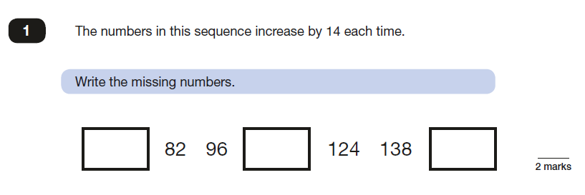
2016 Paper 3 (Y3/4)
Mental or mental with quick number line jottings to check?
Will Y6 pupils use informal jottings to check?
2 marks for all numbers, 1 mark for 2 numbers

Slide 51
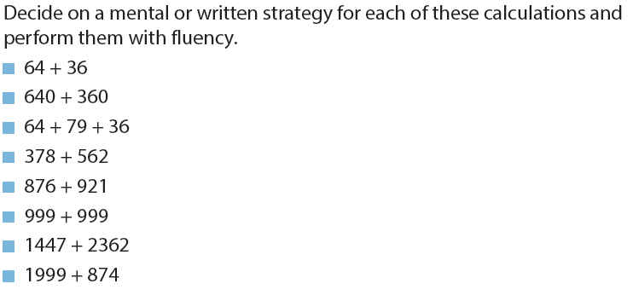
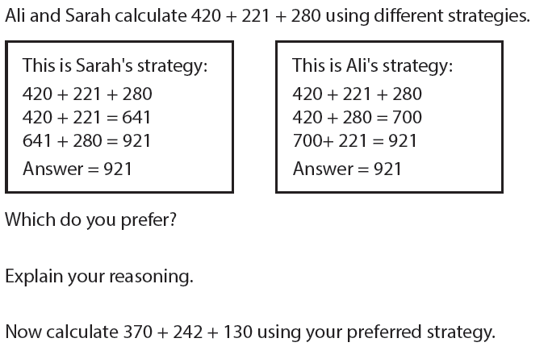

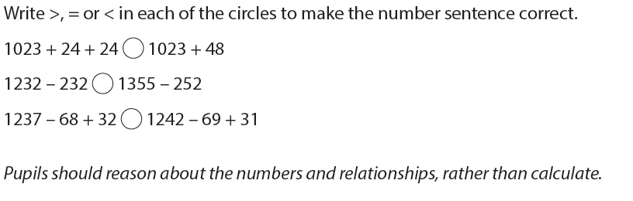
From Year 4 onwards: Addition and subtraction Problem solving
A range of pitched problem solving resources essential…
Pupils should be taught to:
add and subtract numbers with up to 4 digits using the formal written methods of columnar addition and subtraction where appropriate
estimate and use inverse operations to check answers to a calculation
solve addition and subtraction two-step problems in contexts, deciding which operations and methods to use and why.
Notes:
Year 4 NC and NCETM Mastery booklet tasks: addition and subtraction

Slide 52
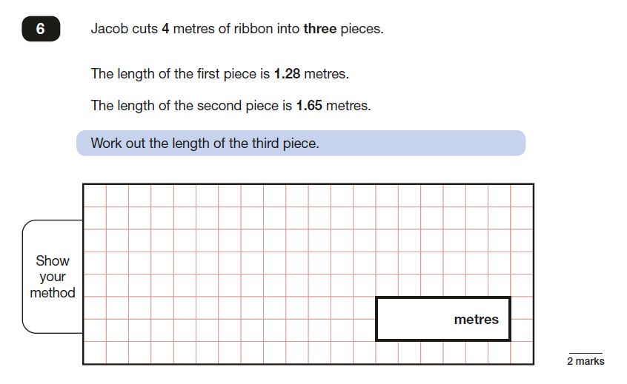
2016 Paper 3 KS2
Bar model diagram really helps here
Calculation worked out as metres then convert
Different strategies
2 marks correct answer, 1 mark correct method
1.28+1.65=2.93
4-2.93
4-1.28= 2.72
2.72-1.65
4-1.65=2.35
2.35-1.28

Slide 53
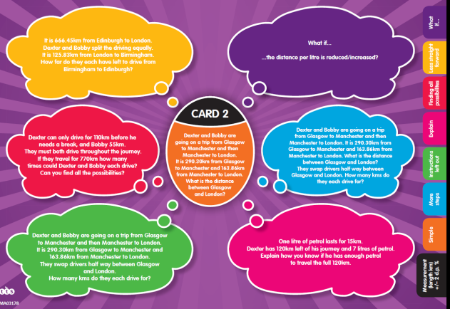
Reasoning: Variation Theory
Careful choice of examples that require thinking not just repetition
The relationship between examples is as important (if not more so) than the examples on their own
The ideas build upon the previous example
You learn more when you identify the differences
Variation depends on looking for what is the same and what is different

Slide 54




Eg: Pouring Jam
I have a 9 litre vat of jam to be poured into jars, each with a capacity of 3 litres
How many jars can I fill ?
9÷3 = 3 3litre jars
I have a 9 litre vat of jam to be poured into jars, each with a capacity of 1 litre
How many jars can I fill ?
9÷1 = 9 1litre jars
I have a 9 litre vat of jam to be poured into jars, each with a capacity of $\frac{1}{2}$ litre
How many jars can I fill ?
9÷ $\frac{1}{2}$= 18 $\frac{1}{2}$litre jars
I have a 9 litre vat of jam to be poured into jars, each with a capacity of $\frac{1}{3}$ litre
How many jars can I fill ?
9÷ $\frac{1}{3}$= 27 $\frac{1}{3}$litre jars
The full answer makes sense of the mathematics ~ there are always 9 litres of jam (same). The jars are different sizes (different)
The order matters

Slide 55
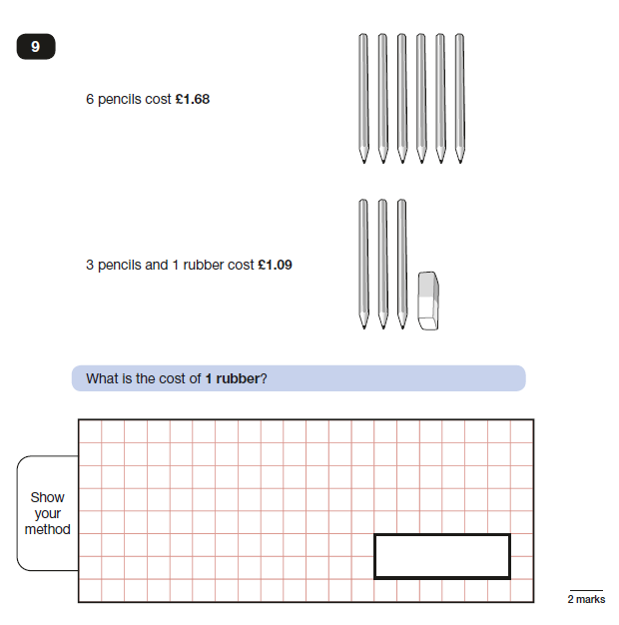
2016 Paper 2: Reasoning (Y3/4)

Slide 56
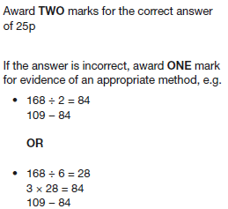
Reasoning: all pupils…talking simply and coherently + writing
Q9 paper 2: two key solutions- knowing and understanding both…
Solutions/ pure calculations
Mental/ jottings/ methods…
3 pencils + 1 rubber = £1.09
Half of 6 pencils + 1 rubber = £1.09
Solution as calculation needed-Y6.
Understanding of solution related to the problem needed by Y4.
£1.68/2 = 84p; ( ½ of £1.68; £1.68÷ 2)
84p + 1 rubber = £1.09
So £1.09 – 84p = 1 rubber
‘I could also find the cost of one pencil by dividing by 6 then multiplying this number by 3 to get the cost of 3 pencils’

Slide 57


Variation
6 pencils cost….£1.20; £1.80; £2.40
3 pencils and a rubber cost….£1; £1.30; £1.70
Oral rehearsal;
talking and writing;
practise at both strategies…
Discussion about recording:
pure calculations and the solution to the problem.
Including units (money/ pencil/ rubber) in the working out supports talking out loud

Slide 58
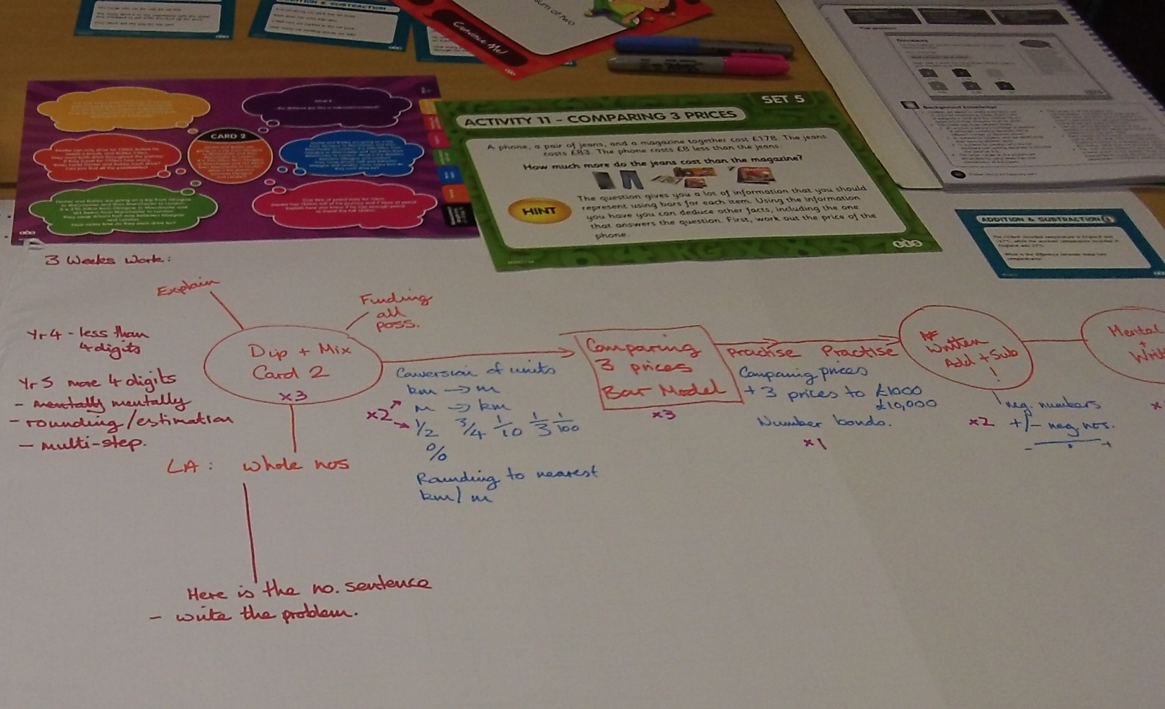
Decide the order of the key tasks and how long pupils might need to really ‘get it’ – think about the practise that will be needed…e.g. converting units, key number facts…
Using published resources, rather than teachers writing their own, ensures appropriate pitch
Different resources give pupils a richer experience of problem solving…
Notes:
Identifying a sequence of problems that relate to the domains in the unit of work:

Slide 59
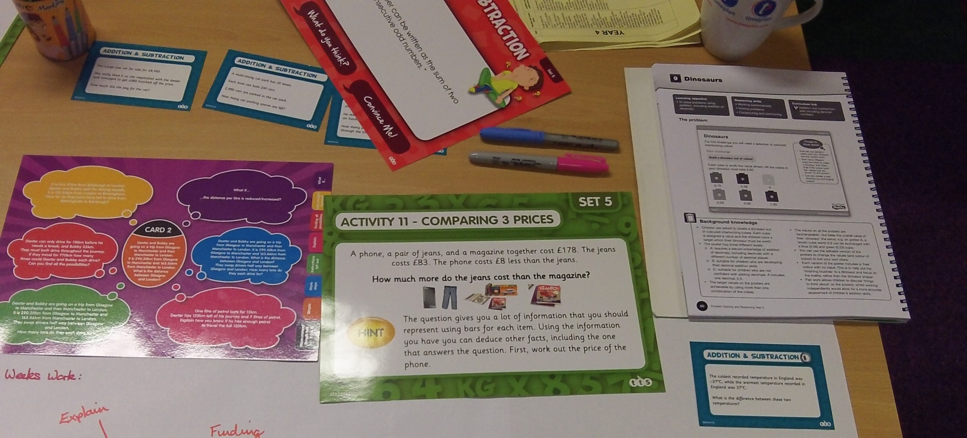
What tasks could be used?
Which ones are most helpful for the class?
Notes:
Y5 Rising Stars: Dinosaurs task

Slide 60


Slide 61
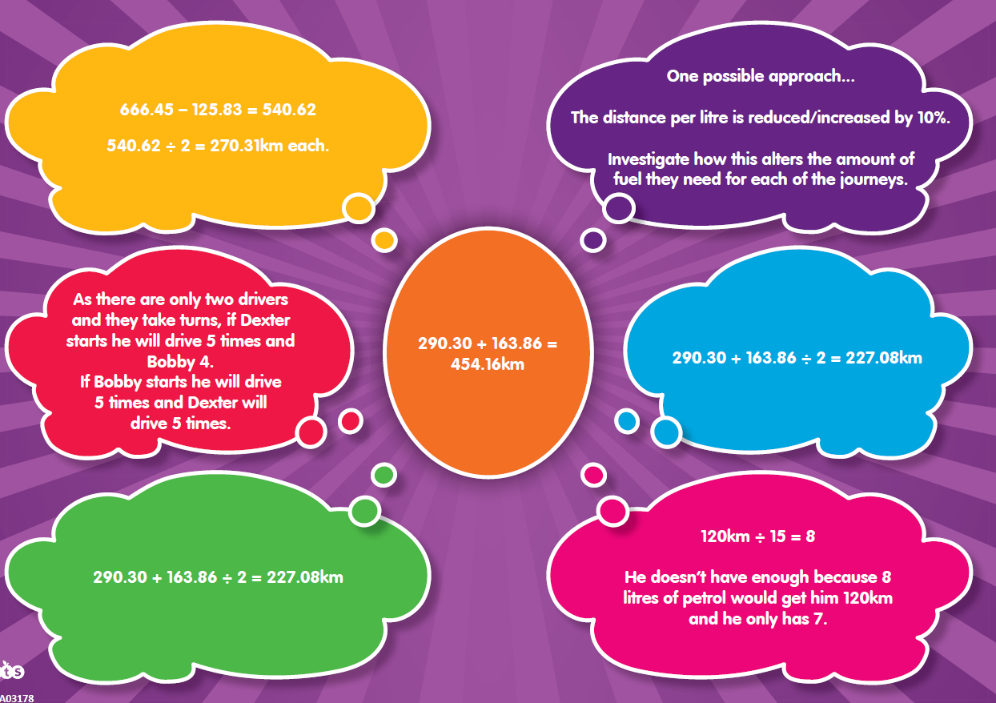
Models and images needed with these solutions

Slide 62






NCETM Teaching for Mastery
Can be used to support:
‘cold’ / ‘hot’ tasks
Diagnostic conferencing (HTLC video clips)
Interventions/ catch up
Pre -teaching
end of year expectations
https://www.ncetm.org.uk/resources/46689

Slide 63
Effective Interventions
Supporting pupils towards ARE for Milestone 2 by focusing on:
Pre teaching
Pupils talking about their reasoning using targeted accurate vocabulary to build confidence
Learning the mathematics in a context and practising any related calculations afterwards to understand the purpose and when to apply.
Having several goes at a problem (not an over focus on ‘right answers’ as the main goal)
Starting with models and images, with concrete resources. related to the domain as they will link with other domains and help with ‘over learning’/ generalising

Slide 64
Effective Interventions
NPV linked to pairs of operations: adding/subtracting multiples of 10/100/1000 and multiplying and dividing by 10/100/1000
Practising spotting needing to use multiplication rather than repeated addition especially for 10x a number
Discussing mental strategies and when to use them
Working hard on using one fact to work out another one
Working hard on finding a simpler fact to start with
Context of measurement easily draws in lots of other mathematics

Slide 65
Revisit your action plan
What are you pleased to see in the books that reflects your analysis from 2016?
What do you feel is not yet securely in place?
What actions might you take to respond to your current analysis? (new or re-inforced)
How will you monitor the impact of these actions

Slide 66
Ensuring best progress for those working below
Notes:
PPI

Slide 67
A mastery approach is…. really effective differentiation
“The excellence of the teacher is to identify the difference in talents of students” and adjust accordingly. Or, in a word, differentiate. Tony Little (former Eton Headmaster)
“(teachers must) consider students’ response to intervention and then make adaptations and changes in light of that. And that’s exactly what the Visible Learning notions are.”(Hattie,J.2016)
Notes:
“(teachers must) consider students’ response to intervention and then make adaptations and changes in light of that. And that’s exactly what the Visible Learning notions are“(teachers must).”(Hattie,J.2016)
When teaching and learning are visible – that is, when it is clear what teachers are teaching and what students are learning, student achievement increases, (Hattie, J. 2012).
Mention that this will be looked at in andy heyes session
Go through John Hattie’s professor of Education work – meta analysis of what works best in learning and its when teachers see learning through the eyes of their students in schools.

Slide 68
Mastery model
(Based on Bloom, 1968,1971)
Instruction (Unit 1)
Formative assessment 1
Mastery –
enrichment activities
Not yet mastered –correctives
Formative assessment 2
Instruction (Unit 2)
Notes:
Introduce this model which underpins the Hampshire approach to a mastery based curriculum.
This diagram illustrates the principles behind Bloom’s mastery learning. The idea here was to reduce the achievement gap between students
Teachers organise skills or concepts into instructional units that are taught over a week or two.
2. Following initial instruction on the unit, teachers administer a brief assessment based on the unit’s learning goals. This is a formative assessment (as termed by Scriven, 1967) and is aimed to be informative rather than judgmental. This does not signify the end of the unit but is designed to give feedback on the learner’s progress.
3. Pupils who have mastered the unit on the first assessment should be provided with enrichment or extension activities such as projects, reports and problem solving tasks.
4. If a student has not yet achieved mastery, they are given corrective activities based on the feedback from the formative assessment, i.e. they are individual and targeted at helping them to master the skills or concepts from the unit.
- Provides a practical way for you (teachers) to differentiate their learning
Corrective activities could include new sources of information, resources, books, computer instruction, group activities, individual activities, etc.
5. Once corrective activities have been carried out for a day or two, they take a second formative assessment. This is a parallel assessment covering the same concepts as the first but with different questions. It informs us of whether the correctives have been successful. It also gives them a second chance of being successful which is a powerful motivator.

Slide 69
So does it work?
Mastery learning programmes have been shown to lead to higher achievement compared to traditional forms of teaching, (Anderson et al, 1986).
Mastery based approaches reduce the gap in student achievement, (Guskey, 2007).
On average mastery approaches lead to additional five months progress over a year, (Education Endowment Foundation, 2013).
Notes:
The evidence suggests that it is particularly effective when pupils work as part of a group. Also when a high level of success is set. It can be used as part of a whole school approach but it is most effective when applied to particular topics. Read the bit about King Soloman Academy here. www.greatmathsteachingideas.com
One of the criticisms of this approach is that higher achieving students are not given as much attention and don’t get sufficient access to extension (generalisation tasks). However, Guskey argues that this issue reduces as the gap in achievement reduces.

Slide 70
The Hierarchy of Learning
Adaptation
Generalisation
Maintenance
Fluency
Acquisition
Haring, Lovitt, Eaton & Hansen (1978
Notes:
Give out the handouts: Introduce the learning heirarchy. Talk through the stages
summary of what we have just talked about. We would like you to briefly look through it and think back to the activity you did earlier, ask the ‘students’ ‘where on the hierarchy do you feel you were during that task?’ Please note that the handout doesn’t include the maintenance stage as this refers to ongoing elements described in the acquisition and fluency stage.
Once completed, introduce the Harings Learning Hierarchy. State that it is another model which helps us understand how mastery learning can work in practice.
Ask them to think about a skill they have and using the chart (which includes exit goals) and get them to identify where they are and what they would need to do to reach an exit goal.
How do we know when to move children on? So we have a goal for each of the stages. I will briefly mention these now as you will receive a handout with these on later for another activity.
A: performs accurately with little support.
F: retain in working memory / combine with other skills / fluent as peers.
G: use it across settings, situations, no confusion with other skills.
Ad: continuous – no exit goal.
SEN/ Hard to teach
An instructional approach, based on the learning hierarchy, would define learning difficulties in relation to accuracy and fluency in skill performance. A pupil who forgets skills is seen as a pupil who has not yet mastered the skill due to insufficient time spent on the acquisition and fluency stages. Attributing the differences to the quality and quantity of instruction, we as adults can influence this process and as a result produce more effective learning.
Where would learning interventions target on the learning hierarchy?
Discussion point: What factors affect children’s ability to progress through the learning heirarchy?
We can see that some children may only reach the acquisition stage. The focus is very much on developing children’s accuracy and fluency. Need to maintain this even after the intervention has finished but also provide opportunities for generalisation of these skills.
Example of juggling – something we might learn for fun but don’t necessarily maintain – lose our fluency!

Slide 71
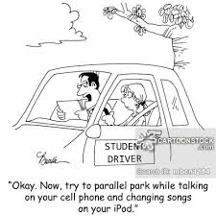
An example
Notes:
Acquisition: our first driving lessons. We learn what the controls are for and where they are – accelerator, brakes, clutch. We probably had to think quite carefully about what to do at each stage of driving but can coordinate them to make the car move.
Fluency: Able to co-ordinate all the necessary actions in order to drive the car. We will have had lots more lessons so can perform the sequence of actions fluently without really thinking. Actions such as mirror, signal, manoeuvre become automatic.
Maintenance: Drive fluently and accurately and will probably have mastered the skill sufficiently well in order to pass our driving test.
Generalisation: motorway driving, different models of cars.
Adaptation: driving in a different country, joy stick to control computer games, driving different vehicles, an automatic car etc.
CAN ANYONE THINK OF ANY OTHER EXAMPLES?

Slide 72
If you wish to find out more…..
The preceding slides form part of training offered by Hampshire and Isle of Wight Psychology Service called,
“Helping Harry Learn”
For more information about this training please contact lucy.manger@hants.gov.uk or kate.jenkins@hants.gov.uk

Slide 73
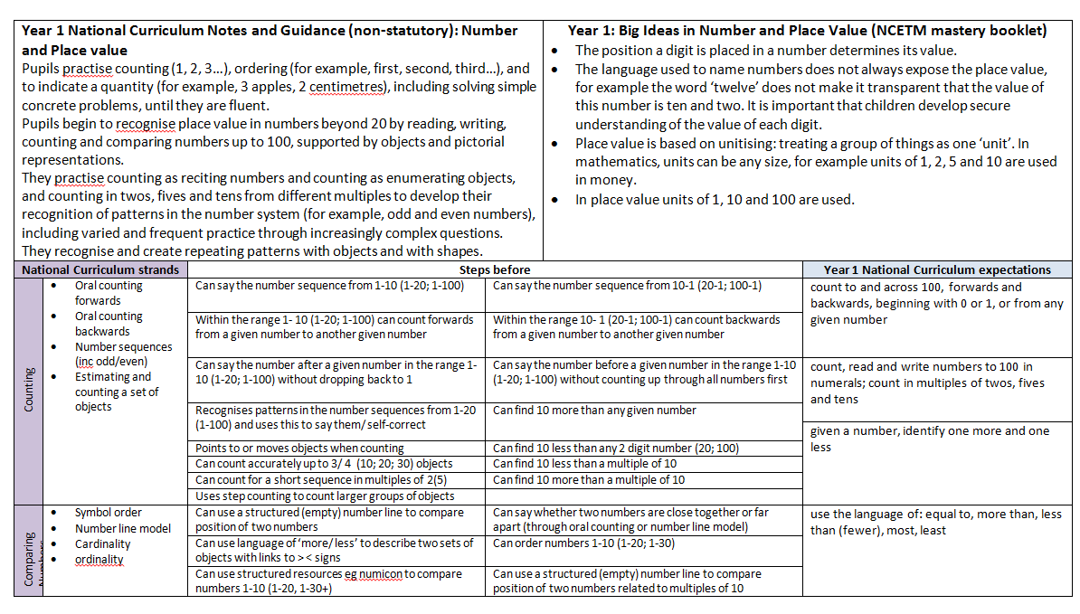
DRAFT
Small Steps Curriculum Y1-Y3
Non-Statutory Guidance for Domain
NCETM Mastery Booklet –Big Ideas
National Curriculum
Links to NCETM Progression document
Small steps leading to national curriculum expectation
Domains: NPV; Add/sub; Multiplication/ Div; Fractions

Slide 74
Pupils where ARE is not obtainable
Small step curriculum
Clarity around learning
Lessen the cognitive load
Slow down – teach less but teach it well
This means that what “Below” pupils do achieve they achieve more deeply by working through the learning hierarchy, over an appropriate time scale
They may not learn everything but what they do learn they learn well

Slide 75
Revisit your action plan
What are you pleased to see in the books that reflects your analysis from 2016?
What do you feel is not yet securely in place?
What actions might you take to respond to your current analysis? (new or re-inforced)
How will you monitor the impact of these actions

Slide 76
Moving ARE children to
‘beyond’ / ‘greater depth’
Senior Leadership Team questions to ask

Slide 77
Are teachers reducing scaffolding over time?
Does planning ensure questioning / task design that requires higher cognitive thinking to challenge e.g. Themes and Conventions
Does task design require and enable children to show deeper understanding
ARE ➔ greater depth
READING
Does task design lead towards a high level outcome over several lessons?
Are children supported to become metacognitive readers?

Slide 78
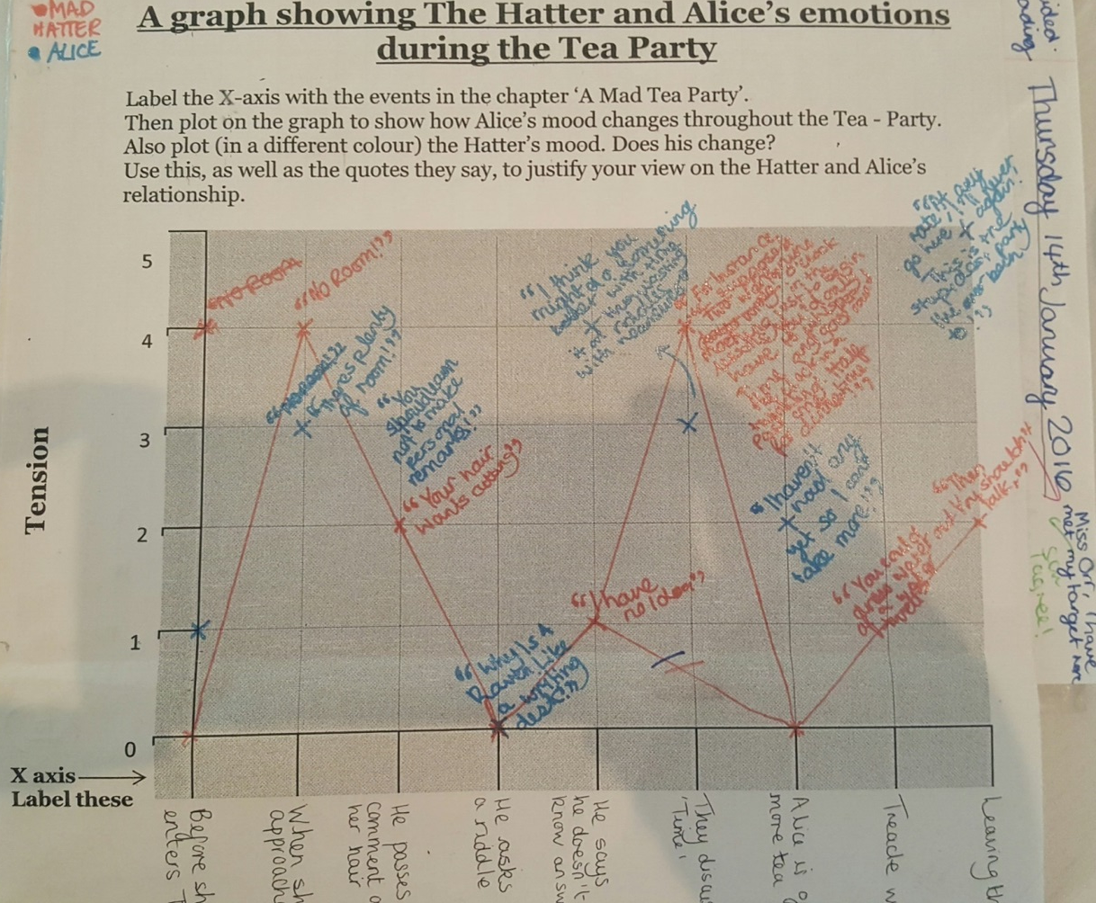
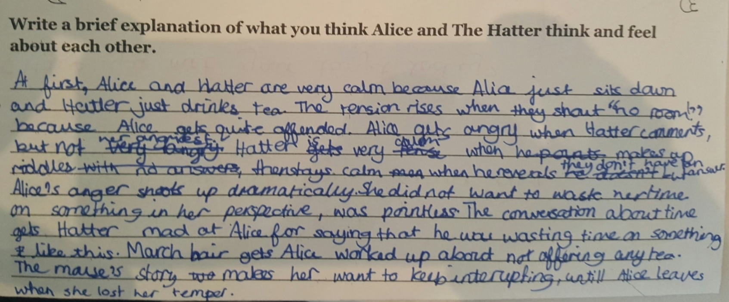
Effective task design:
High expectations for level of detail
Prep work towards an outcome
Task lasts more than one session
Same task could be applied to other texts

Slide 79
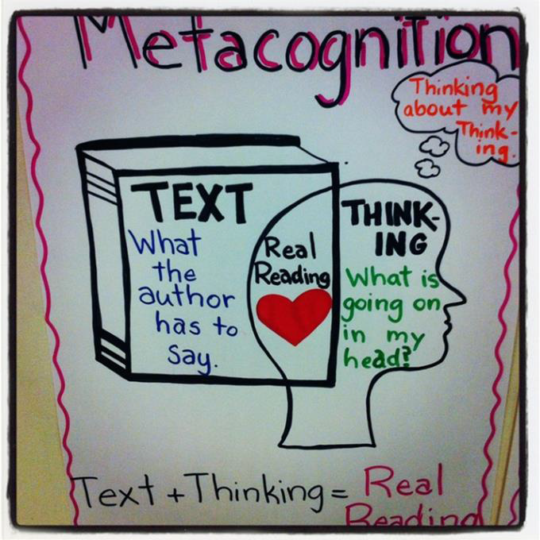
Metacognitive thinking

Slide 80
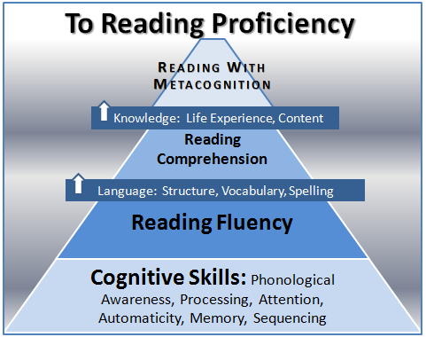

Slide 81
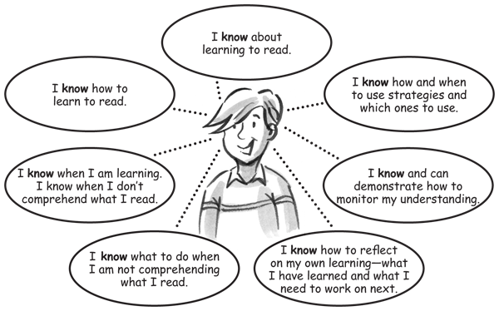
Reading with metacognition

Slide 82
Are children challenged with the author’s voice they write in?
Are children being given choice in their writing outcomes?
e.g. audience / purpose / form?
ARE ➔ greater depth
WRITING
SLT questions to ask
Are children given time and opportunity to apply and demonstrate their writing skills across the curriculum with quality tasks?
Does task design require higher attaining children to ‘struggle’ ?

Slide 83

Task design that requires ‘struggle’

Slide 84

Author’s voice
Repeat the task – change the author’s voice
Child makes decision based on the audience, purpose and chosen form
Formal
Informal
1st person
3rd person
How will I change my vocabulary choices?
What information would I mention/ withhold?
Does my layout and presentation change?
How would a different character think and feel?
Respond to a situation?
Past tense
Present tense
Should my tense be consistent, or be manipulated for effect?

Slide 85
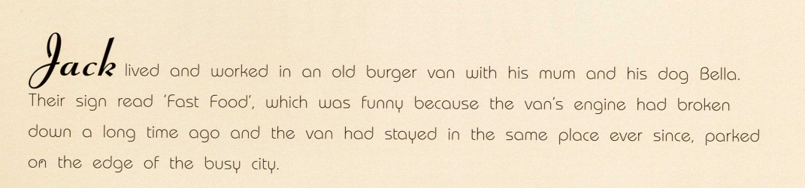
Author’s voice
How would the opening to the same plot ‘sound’ different if it was written as a fairy tale? Science fiction? Fantasy? Heritage?
Change the genre

Slide 86
Enhance by providing challenge NOT time fillers e.g. LIPOGRAMS
A lipogram is a piece of writing that omits a specific letter of the alphabet.
e.g. rewrite the last ten lines / last paragraph as a lipogram.
This activity helps to widen the pupil's vocabulary and gives a real reason for using both a Dictionary and Thesaurus.
n.b. vowels are harder than consonants!

Slide 87

Independence
Fluency
Resilience

Slide 88
“Beyond” pupils in Maths
SLT questions might ask
Are there enough opportunities to work with other higher attaining pupils to practise reasoning with accurate vocabulary(not just left to work independently and individually)?
Are pupils presented with sufficient multi -step problems with a combination of domains
Is multiplicative reasoning more demanding and do problems require decisions about the use of all four operations
Are there more opportunities to use reasoning in domains where there is less experience e.g. geometry
Do teachers ensure pupils can record the mathematics they can do in their head as a number sentence (at the least) but also all steps in a solution
Can pupils effectively make decisions about whether to work mentally or use a formal method
Can pupils come up with an alternative solution when appropriate

Slide 89
Revisit your action plan
What are you pleased to see in the books that reflects your analysis from 2016?
What do you feel is not yet securely in place?
What actions might you take to respond to your current analysis? (new or re-inforced)
How will you monitor the impact of these actions

