Slide 1
Core Provision
January 2017

Slide 2











End of KS1: SATs Arithmetic Paper 2016
Q: 1,2,3,4,5, 6, 7, 8,9,10,11

Slide 3






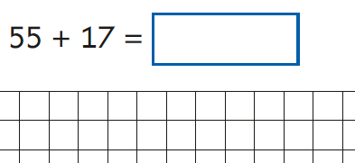

End of KS1: SATs Arithmetic Paper 2016
Q12, 13, 14,15,16,17,18,19

Slide 4


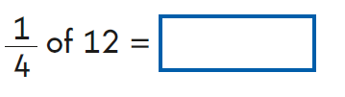
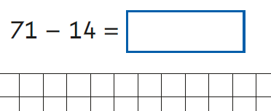


End of KS1: SATs Arithmetic Paper 2016
Q 20,21,22,23,24,25

Slide 5
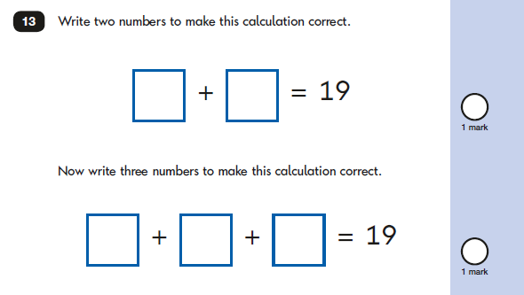
2016 KS1 Paper 1: Reasoning

Slide 6
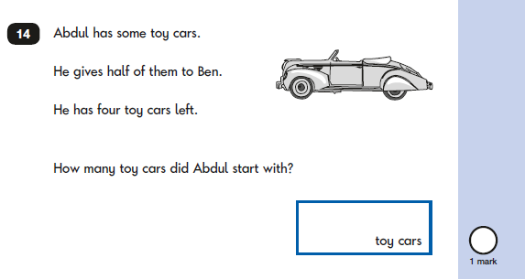
2016 KS1 Paper: Reasoning

Slide 7
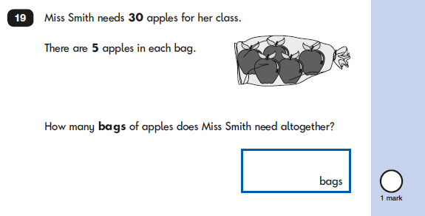
2016 KS1 Paper: Reasoning

Slide 8
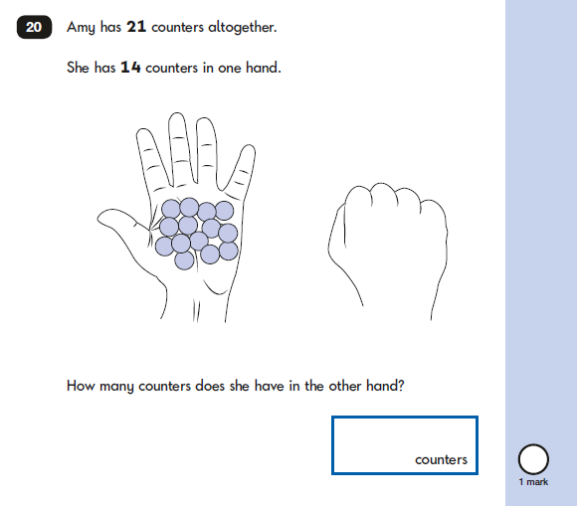
2016 KS1 Paper: Reasoning

Slide 9
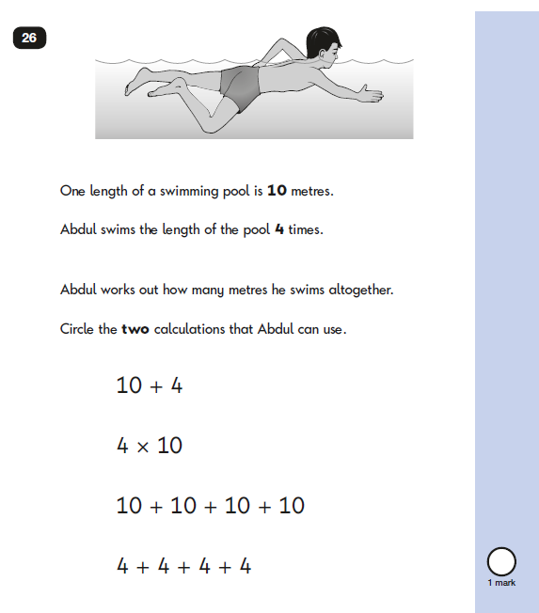
2016 KS1 Paper: Reasoning

Slide 10
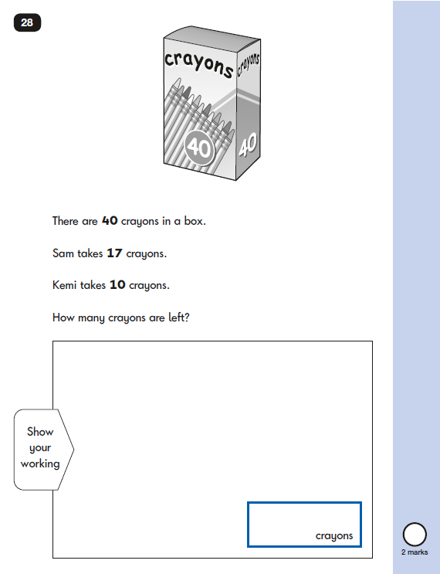
2016 KS1 Paper: Reasoning

Slide 11















KS2 Arithmetic paper 2016:
Q:1, 2,3,4,5,6,7,8,9,10,11,12,13,14,15
More questions than minutes…
Notes:
Pink: Y3
Green: Y4
Blue: Y5

Slide 12





















KS2 Arithmetic Paper 2016
Q:16, 17,18,19,20,21,22,23,24,25,26,27,28,29,31,32,33,34
More questions than minutes…
Notes:
Green: Y4
Blue: Y5
Mauve: Y6

Slide 13
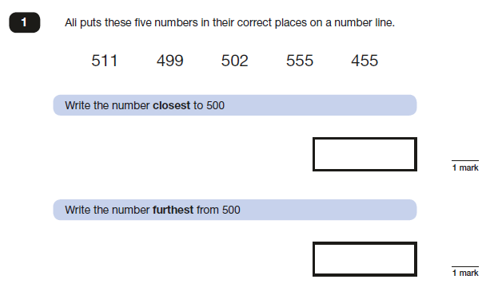
Paper 2 KS2 (year 3/4)

Slide 14
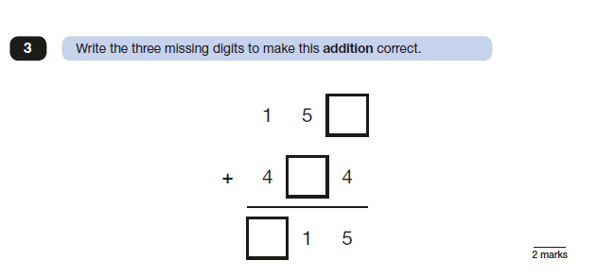
Paper 2 KS2 (Y3/4)

Slide 15
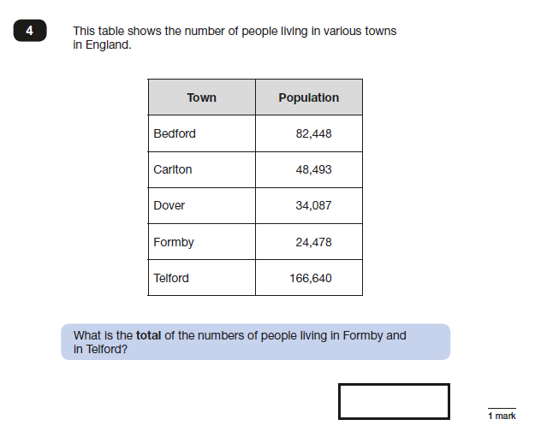
Paper 2 KS2 (Y3/4)

Slide 16
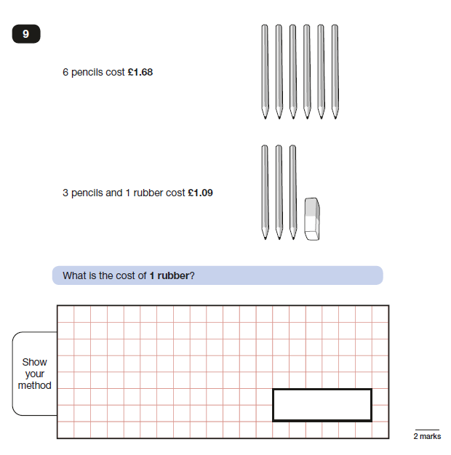
2016 Paper 2: Reasoning (Y3/4)

Slide 17
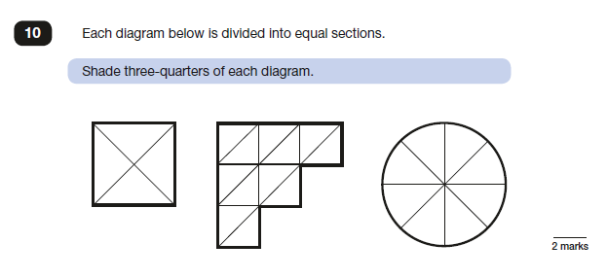
2016 Paper 2: Reasoning Y3/4)

Slide 18
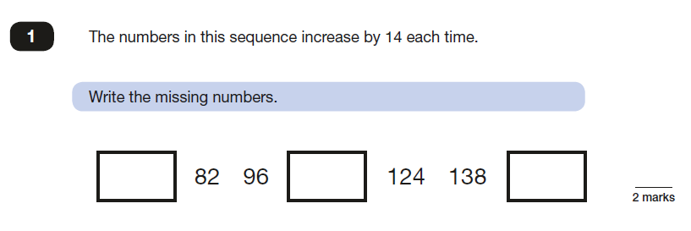
2016 Paper 3 (Y3/4)

Slide 19
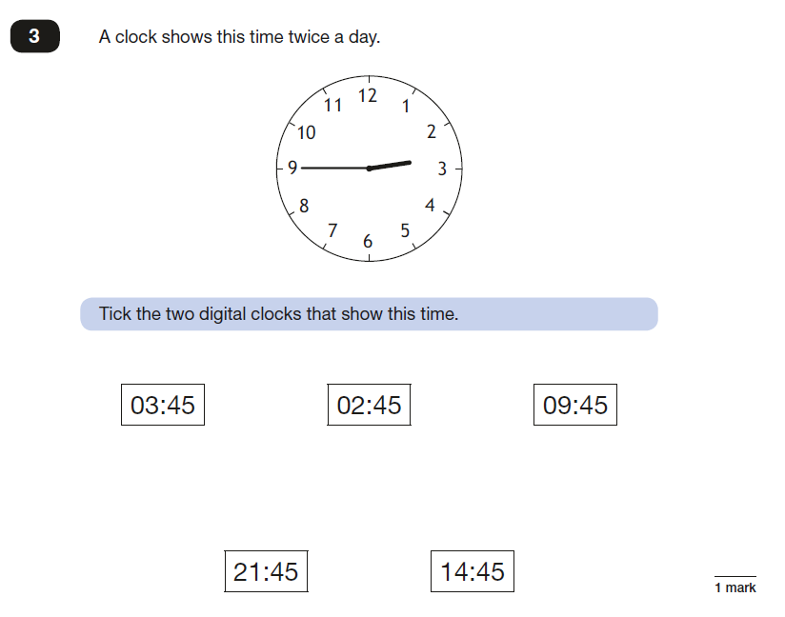
2016 Paper 3 (Y3/4)

Slide 20
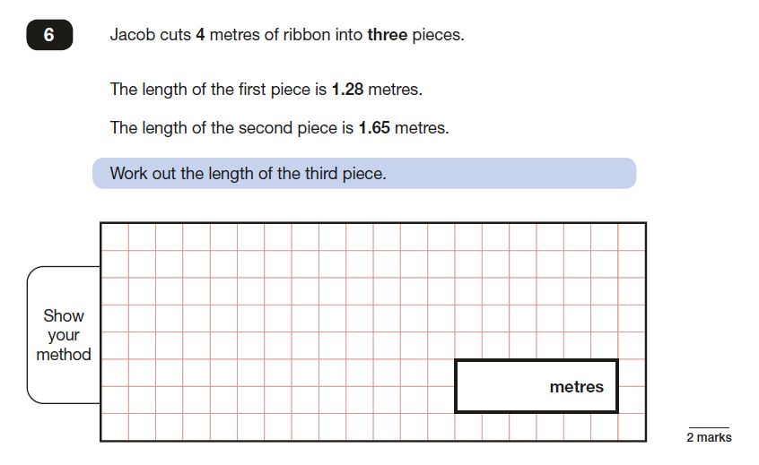
2016 Paper 3 KS2

