Slide 1
MATHS exemplification
Year 1, 3, 4, 5

Slide 3
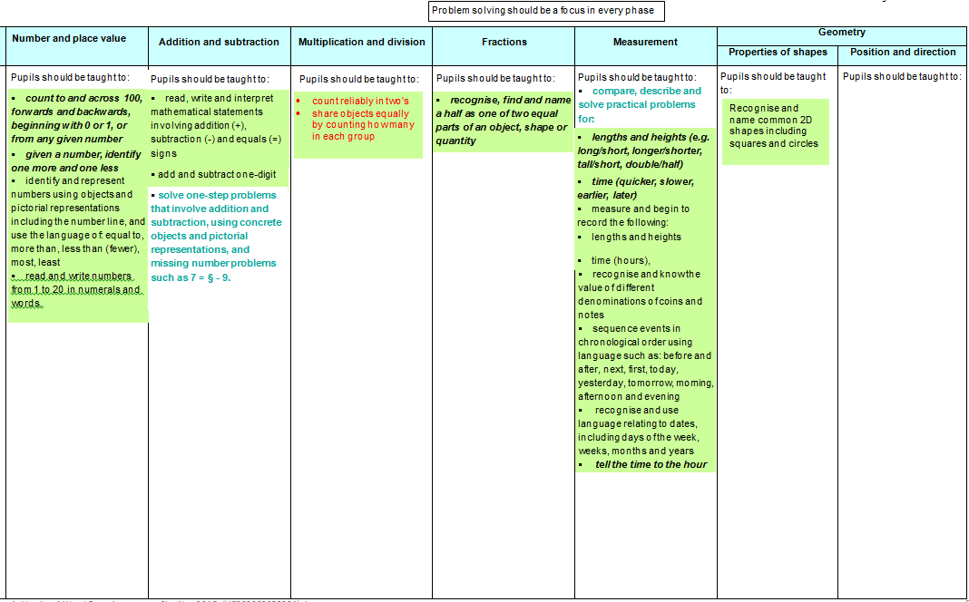
Year 1 Phase 1
YR transition information needs shared discussion relating to year 1 curriculum
Fluency: counting to 20+
Fluency: Count reliably with numbers from one to 20, place them in order and say which number is one more or one less than a given number. ( familiarity with concrete structured resources?)
Fluency: Using quantities and objects, they add and subtract two single-digit numbers and count on or back to find the answer.
Fluency: They solve problems, including doubling, halving and sharing.

Slide 4
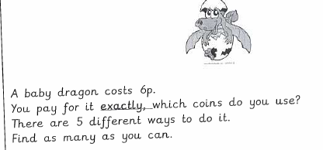
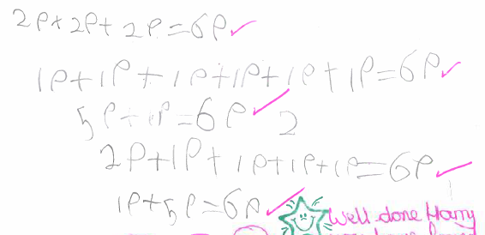
Year 1
Read, write and interpret mathematical statements involving addition (+), subtraction (-) and equals (=) signs
Recognise and know the value of different denominations of coins and notes
Notes:
Making links across the topics/domains

Slide 5
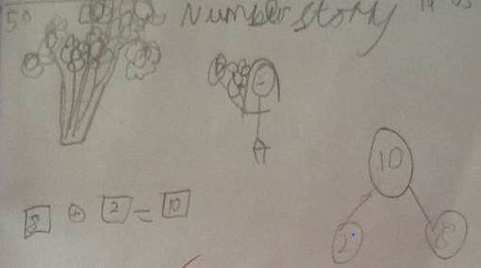
read, write and interpret mathematical statements involving addition (+), subtraction (-) and equals (=) signs
add and subtract one digit
Notes:
Range of recording to show partition of 10 as 8 and 2

Slide 6
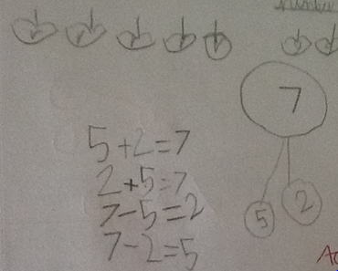
read, write and interpret mathematical statements involving addition (+), subtraction (-) and equals (=) signs
add and subtract one digit
Notes:
Facts and related facts

Slide 7
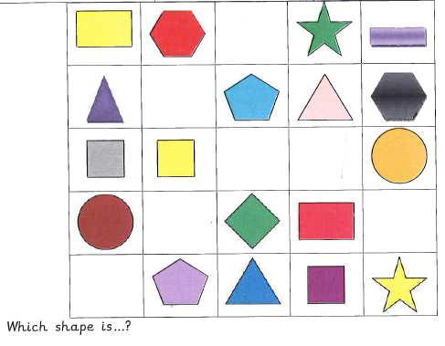
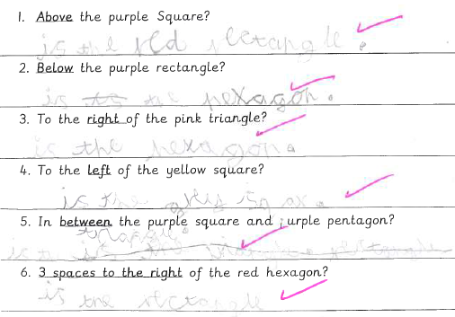
Recognise and name common 2-D shapes including squares and circles
Language of position:
from non-statutory
notes and guidance
Notes:
Note - the non-statutory notes and guidance in the National Curriculum can be useful unpack what is being asked of the pupils

Slide 8
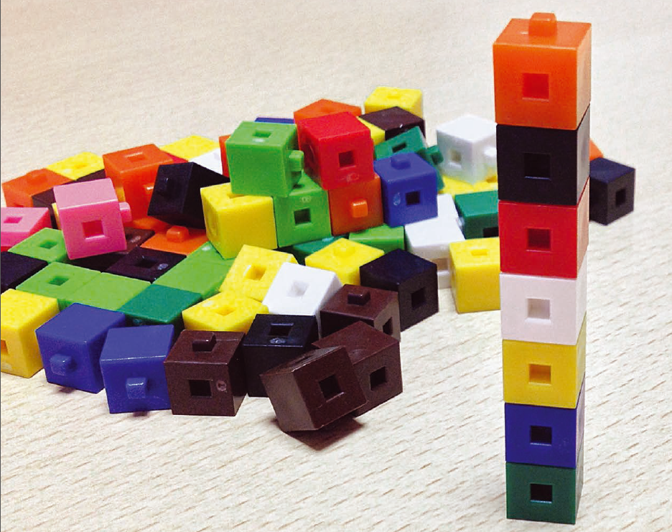
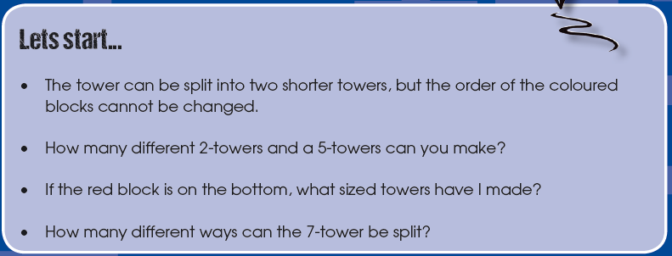
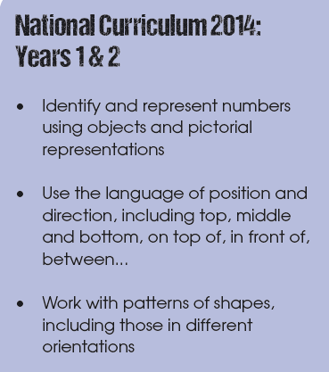
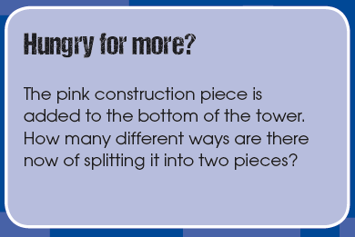
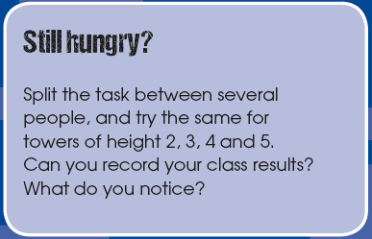
By end of phase 2
Real World Maths TTS

Slide 9
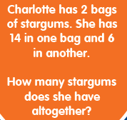

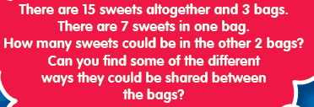
By end of phase 2
Dip and Pick Problem Solving Year 1, TTS

Slide 10











End of KS1: SATs Arithmetic Paper 2016
Q: 1,2,3,4,5, 6, 7, 8,9,10,11,13, 15,16,19,23

Slide 11
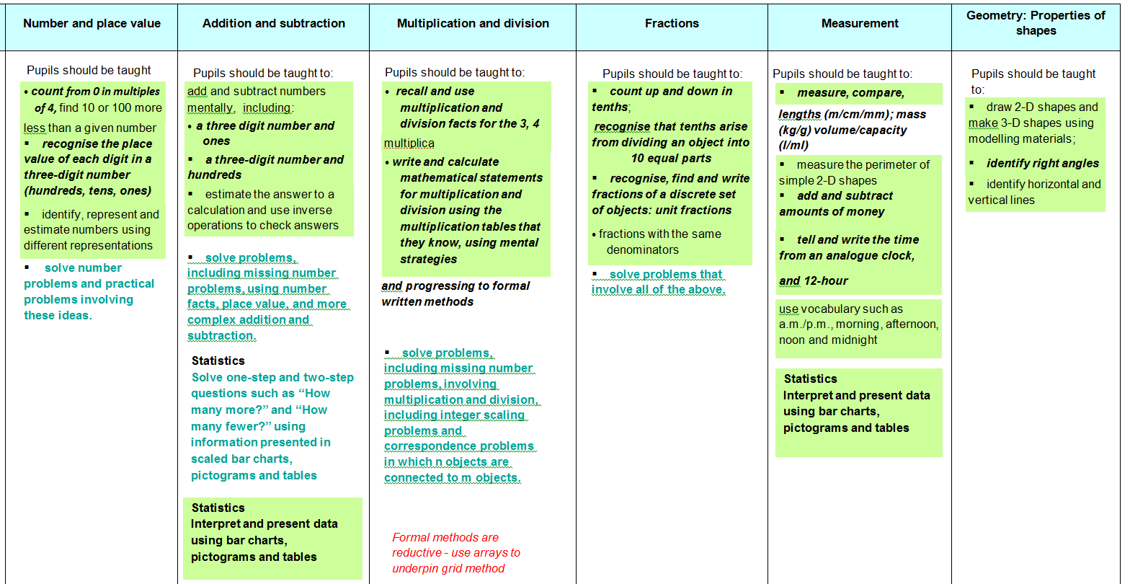
Year 3: Phase 1
Securing transition from end of key stage 1 (0-100) and beginning work on 0-1000
Fluency: Representing two digit numbers with a range of resources, showing & explaining +/- 10(s) from two digit numbers
Fluency: Number bonds to all numbers to 10 and 20
Fluency: Add/subtract 2 digits (mentally and recording), using inverse and commutativity in calculation (money and measures)
Fluency: multiples of 2,5,10 to also support division
Fluency: Half, quarter and three quarters of numbers and shapes
Fluency: in use of models such as number lines, arrays and bar models as tools for thinking

Slide 12
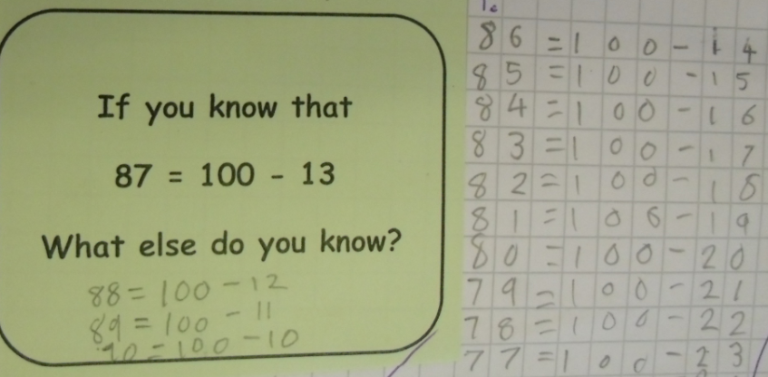
Year 3
solve problems, including missing number problems, using number facts, place value, and more complex addition and subtraction

Slide 13
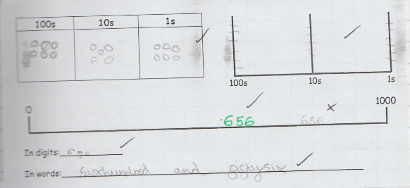
recognise the place value of each digit in a three-digit number (hundreds, tens, ones)
identify, represent and estimate numbers using different representations

Slide 14
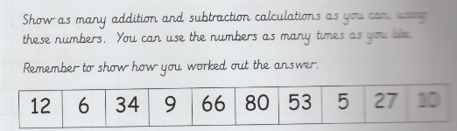
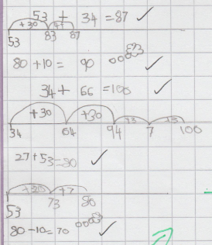
add and subtract numbers mentally
Notes:
Number lines support mental calculations
Although not seen in some of the new text books, number lines are important as part of a multi representational approach and as a conceptual route into PV and calculation, ordering and rounding.

Slide 15
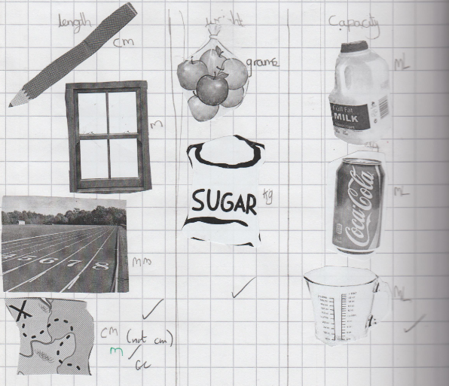
measure, compare, add and subtract: lengths (m/cm/mm); mass (kg/g); volume/capacity (l/ ml)
Notes:
Really getting a chance to be hands on with measures is important – children need concrete examples to ‘hang’ things on. Give a few egs.

Slide 16
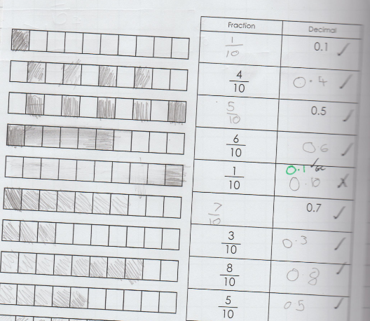
count up and down in tenths; recognise that tenths arise from dividing an object into 10 equal parts

Slide 17
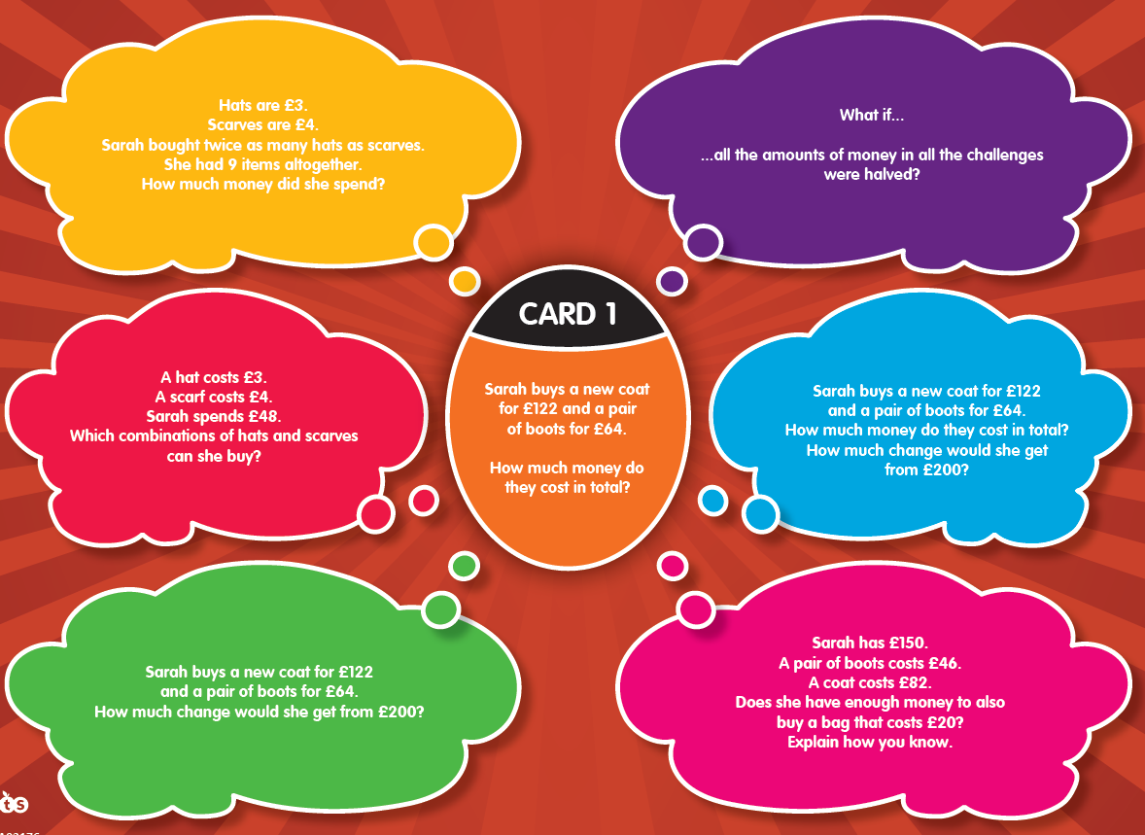
By end of phase 2
Dip and Pick problem solving TTS

Slide 18
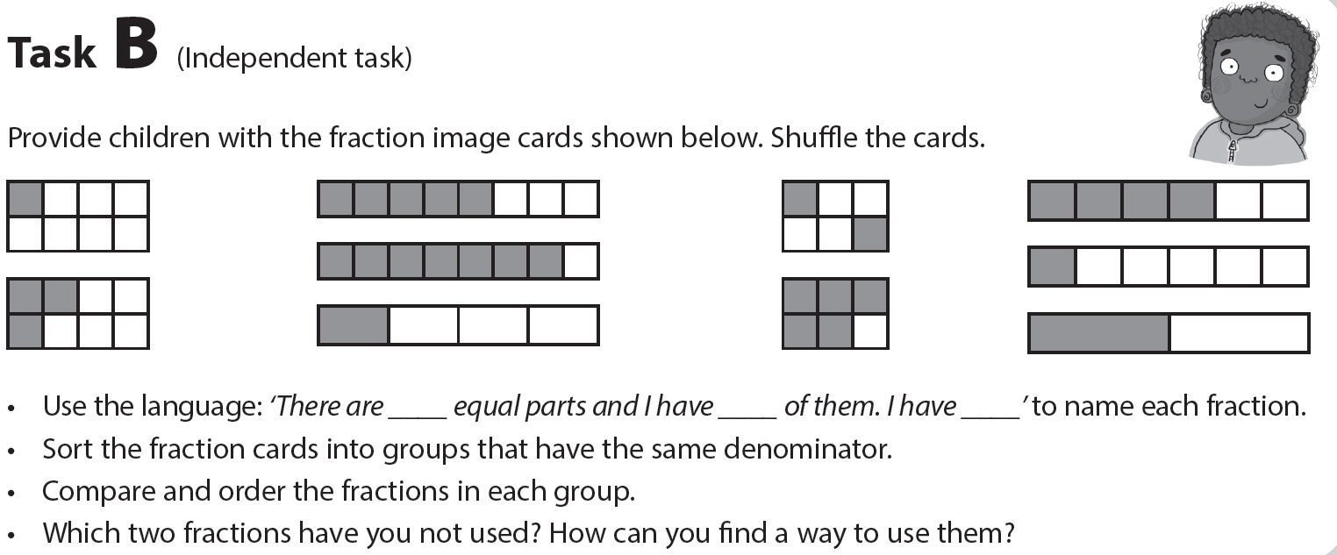
By end of phase 2

Slide 19
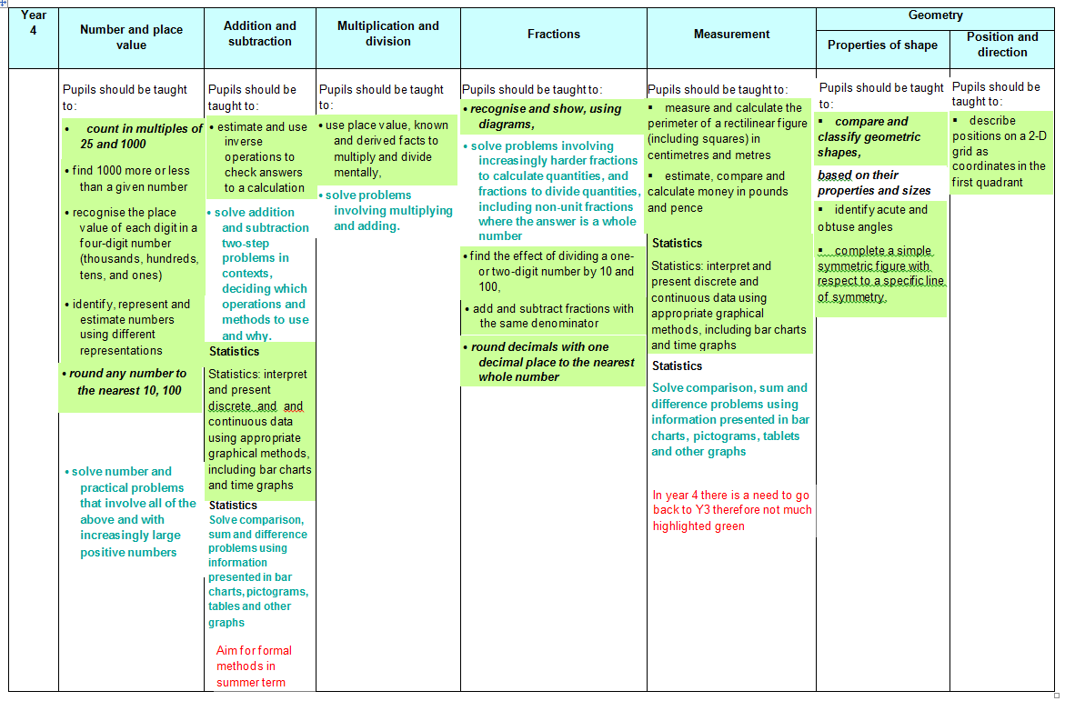
Year 4 phase 1
Y3 Fluency: Representing three digit numbers with a range of resources, showing & explaining +/- 1000/ 500/50(s) from three digit numbers
Y3 Fluency: Use of key facts like 640+360= 1000 , using inverse and commutativity in calculation (money and measures)
Y3 Fluency: multiples of 2,5,10,3,4,8 to also support division. Knowing how/ why multiples relate to each other eg x4 with x8
Y3 Fluency: Knowing all unit fractions when working with numbers and shapes, inc tenths as decimals (measures)
Y3 Fluency: in use of models such as infinite number lines, arrays ( towards grid method) and bar models (calculation/ problem solving as tools for thinking

Slide 20
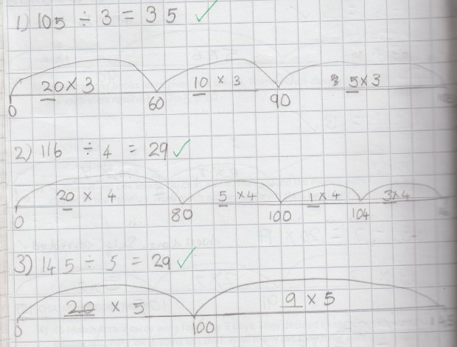
Year 4
use place value, known and derived facts to multiply and divide mentally
Notes:
Again use of number lines to support mental strategies.
Phase 1 assessment focuses on mental calculations. That’s not to say there wouldn’t be written calculations in the books too.

Slide 21
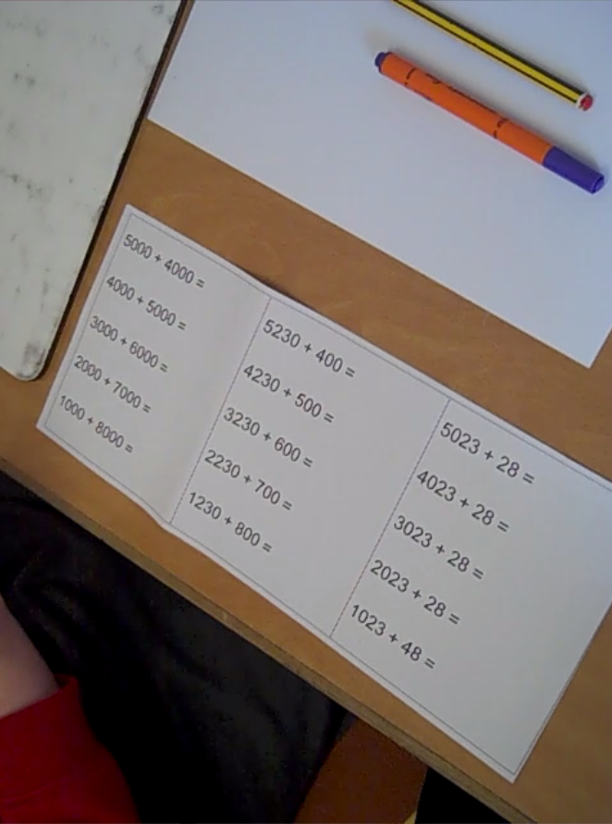
HTLC Leadership Moodle:
Assessment video clips Y1-Y6 phase 1
Y4 pupil conferencing to support teacher assessment…

Slide 22
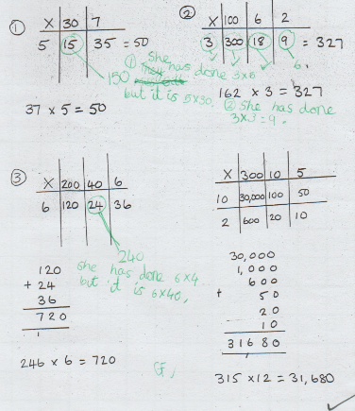
Use of error spotting for multiplication

Slide 23
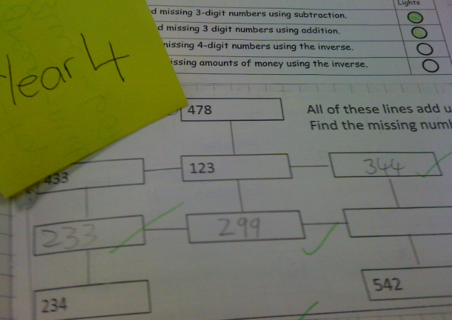
solve addition and subtraction two-step problems in contexts, deciding which operations and methods to use and why

Slide 24
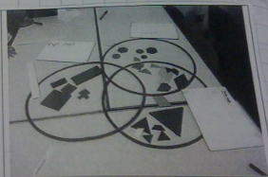
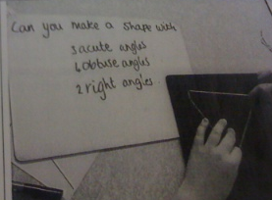
compare and classify geometric shapes, based on their properties and sizes identify acute and obtuse angles

Slide 25
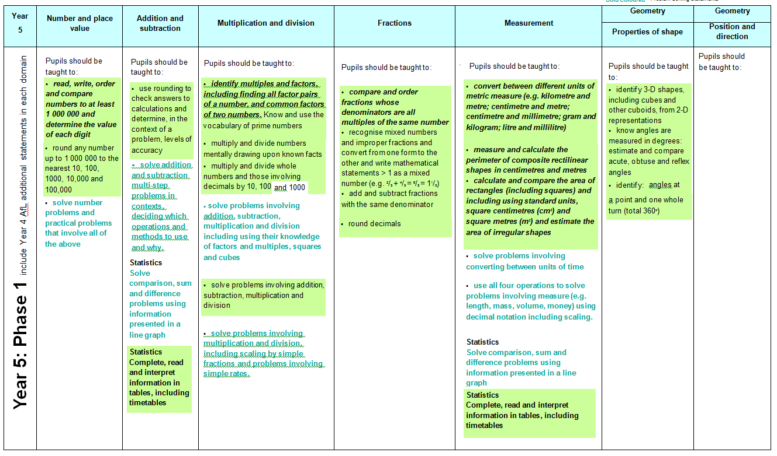
Year 5 phase 1

Slide 26
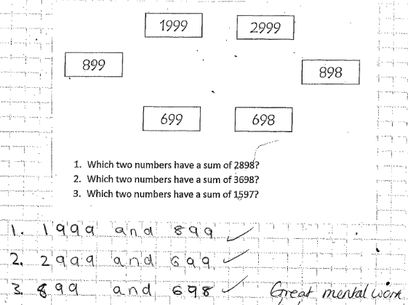
Year 5
use rounding to check answers to calculations
Notes:
Also non-statutory guidance: pupils identify the place value in large whole numbers

Slide 27
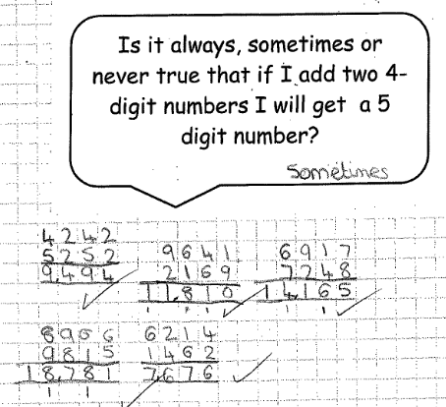
Notes:
Again the phase 1 assessment is mental strategies and language but we would expect to see written calculations too.
This is an investigation which brings in reasoning (how do we articulate reasoning?)

Slide 28
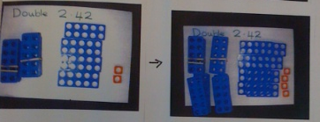
solve problems involving number up to three decimal places
Notes:
Resources are important in year 5 too.

Slide 29
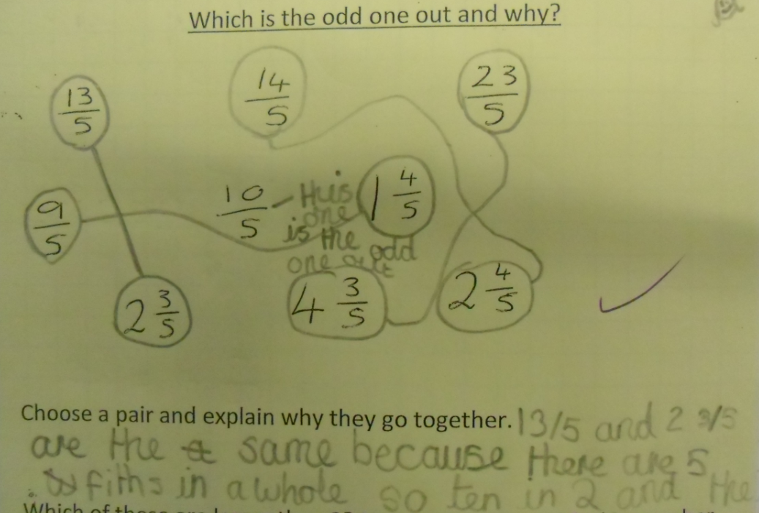
compare and order fractions whose denominators are all multiples
of the same number
recognise mixed numbers and improper fractions and convert from one
form to the other

Slide 30
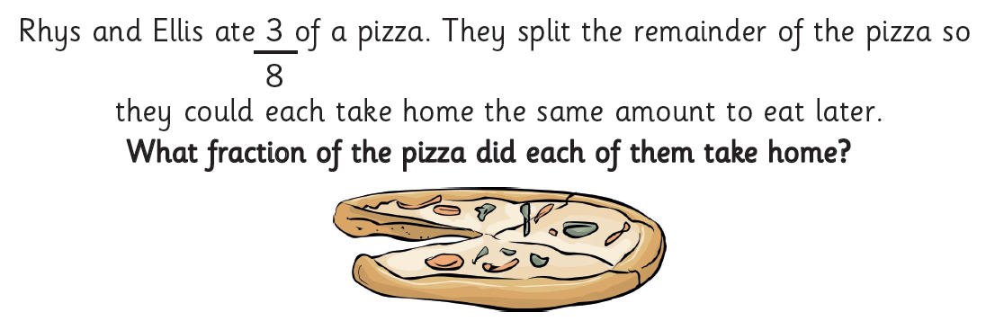
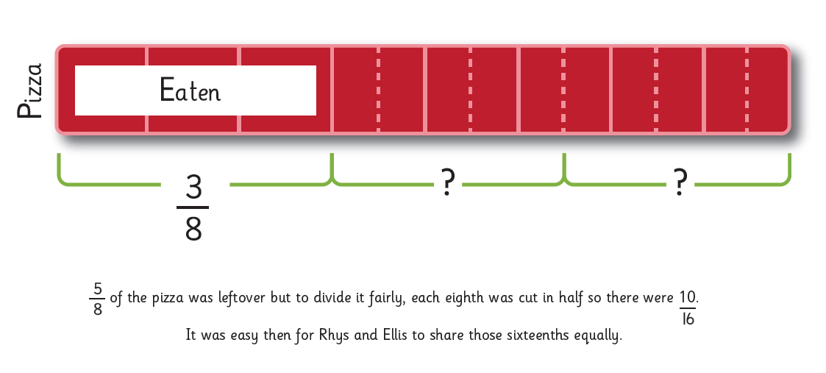
Y5 by the end of phase 2

Slide 31
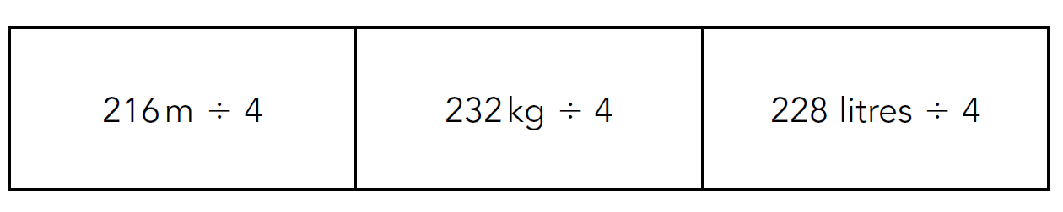
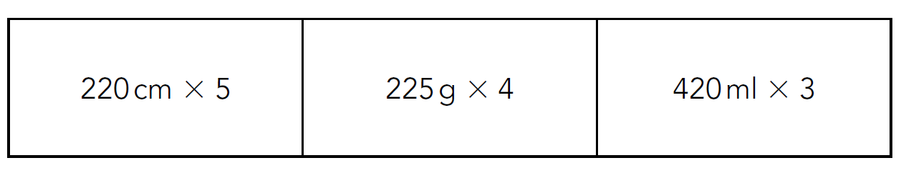
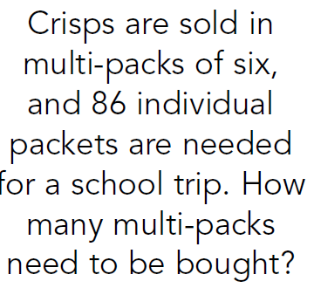
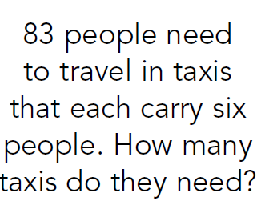
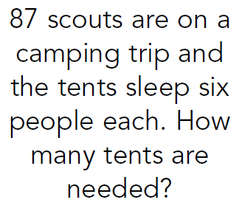
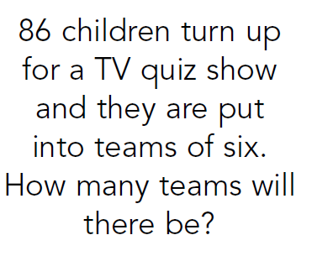
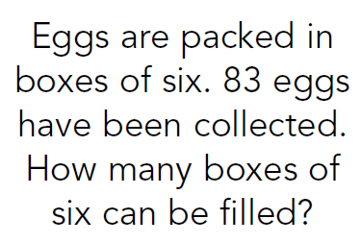
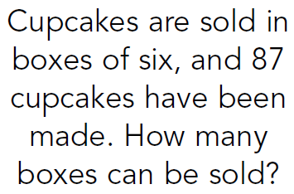
Y5 by end of phase 2
Suggest and record different calculation strategies including conversion of units, know related facts, suggest and write problems for these calculations
Notice links and connections between the same calculations. Explain why the solution may be different depending on the context

Slide 32















KS2 Arithmetic paper 2016:
Q:1, 2,3,4,5,6,7,8,9,10,11,12,13,14,15
More questions than minutes…
Notes:
Pink: Y3
Green: Y4
Blue: Y5

