Slide 1
Hampshire Assessment Model
SIMS Resources

Slide 2

At each milestone the teacher can record whether the child is on track to meet age related expectations by the end of the year as follows:
This should take into account the Curriculum Objectives for the relevant phases for that Milestone. Snapshots are taken at 4 points (Milestones 1, 2, 3; and End of Year).

Slide 3
Hampshire Assessment Model Resource
Marksheet Templates for recording and analysis:
Domain Bricks for Maths, Reading and Writing (summative judgements for years 1 to 6)
Curriculum Objectives for Maths, Reading and Writing (formative judgements for years 1 to 6)
On Track Overall
Marksheet Templates for internal use and to assist in reporting to parents:
Interventions
Class teacher comments
Head teacher comments
Tracking Grids

Slide 4
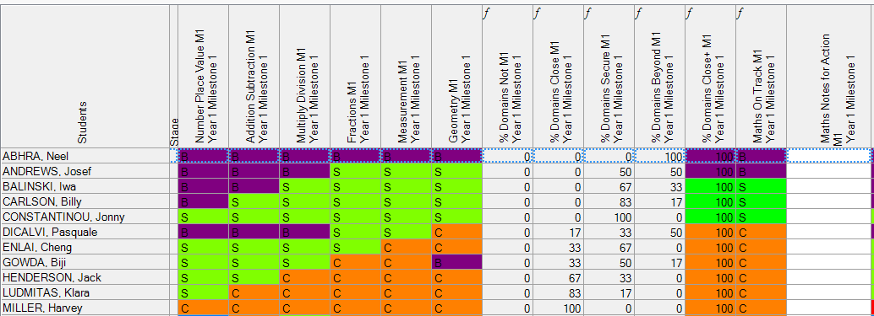
Domain Brick Marksheet
Recording an S (Secure) means that the pupil is securely on track to meet the end of year standard.

Slide 5
Formulae
At each milestone the percentage of domain bricks that have been marked as N, C, S and B is calculated and the percentage at C+.
the subject overall On track judgement is generated (based on the assumption that an entry has been made for each domain brick):
  in a Domain if a pupil has one or more N bricks, the subject overall will be N
  if there are no N bricks and the pupil has one or more C bricks, the subject overall will be C

Slide 6
Hampshire Assessment Model Resource
Internal use Individual Report for years 1 to 6 (all current academic year’s data entered in SIMS HAM templates for an individual child)
Report for parents – customisable by schools
SIMS.net reports for SLT analysis:
Domain Analysis
Cohort Tracking (whole school, vulnerable groups)
High Level Analysis
SIMS Discover Graphs

Slide 7
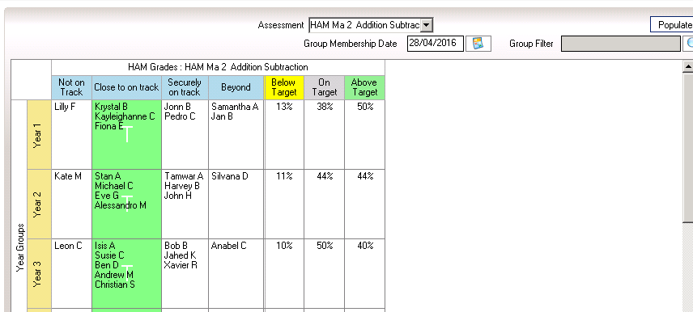
Example Output from HAM Group Tracking Grid
Information can be viewed at individual domain brick level or at overall domain level

Slide 8
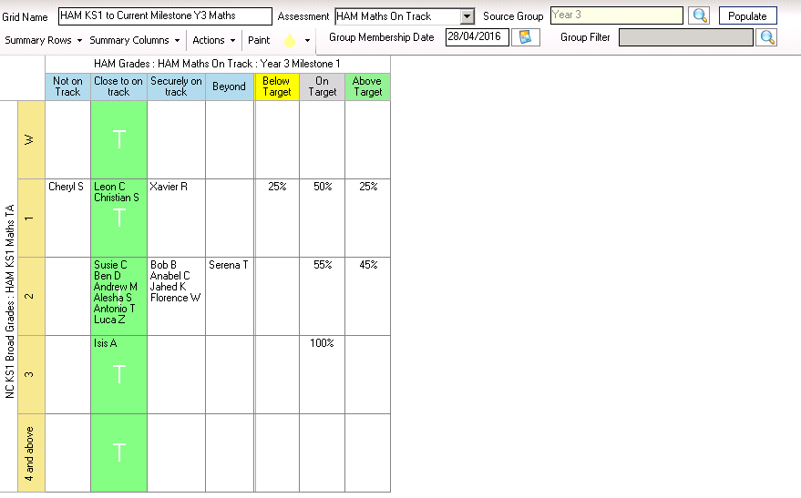
Example output from HAM KS1 to Current Milestone Tracking Grid

Slide 9
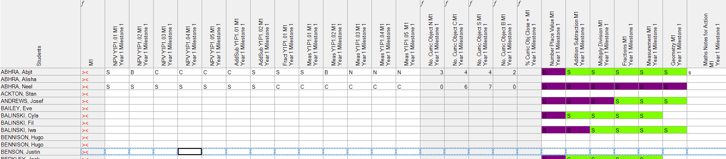
Curriculum Objective Marksheet

Slide 10
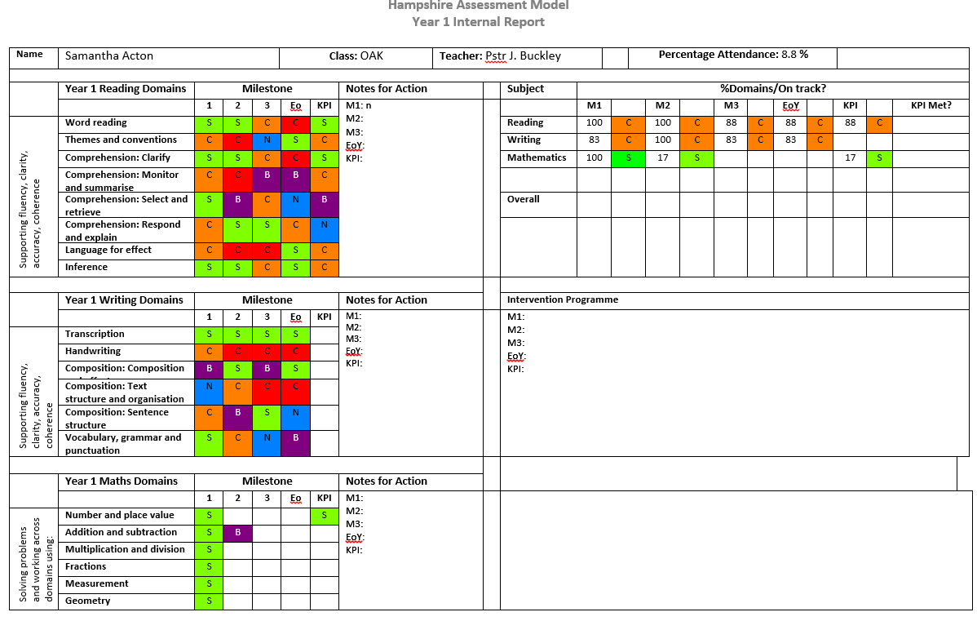
Internal Report

Slide 11
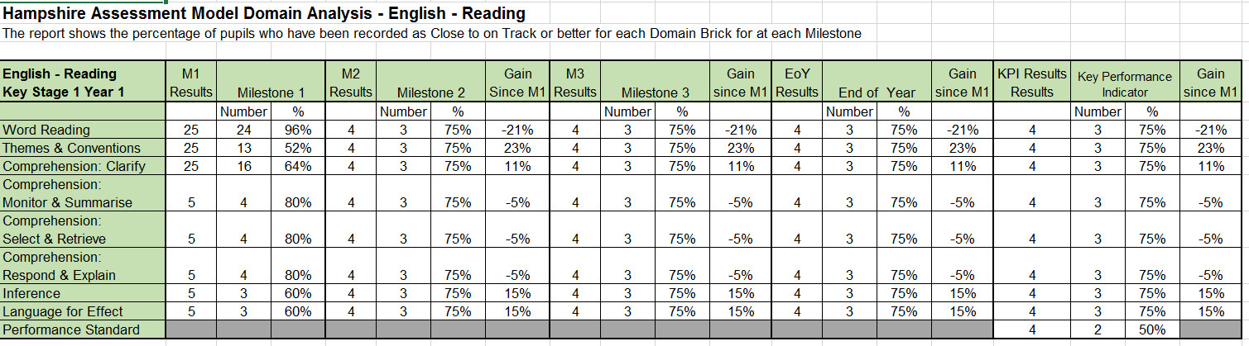
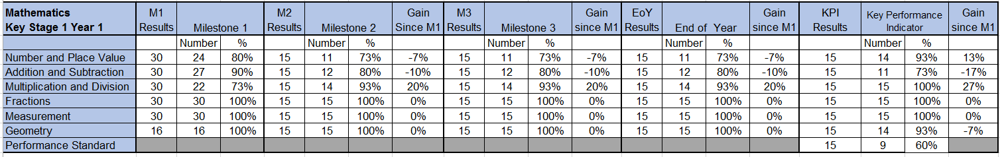
Domain Analysis

Slide 12
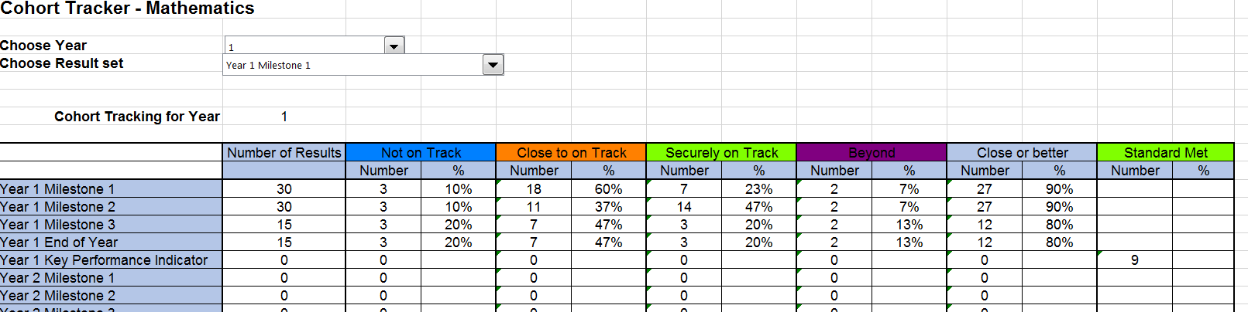
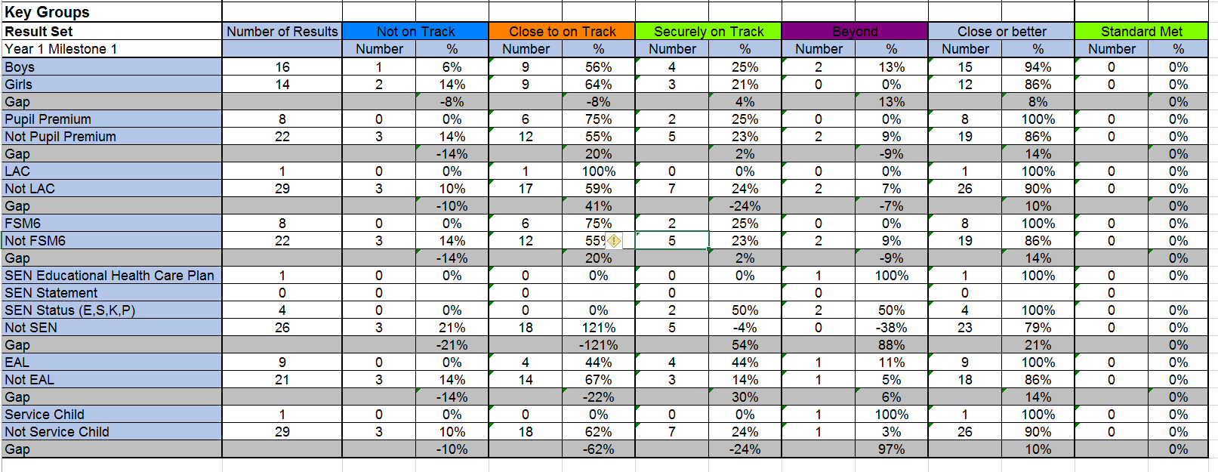
Cohort Tracker
Notes:
Not all key groups are depicted here – the report includes more – see guidance notes

Slide 13
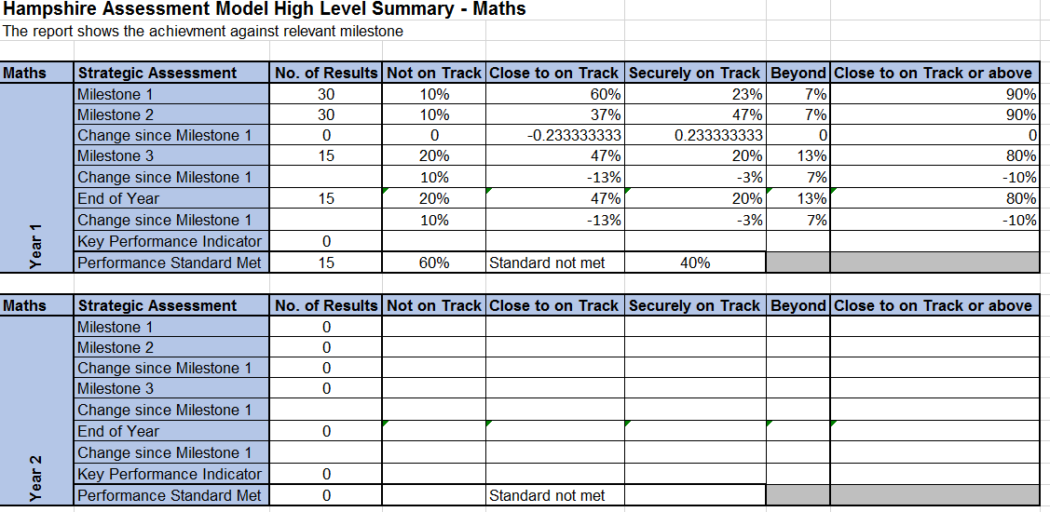
High Level Analysis – by subject

Slide 14
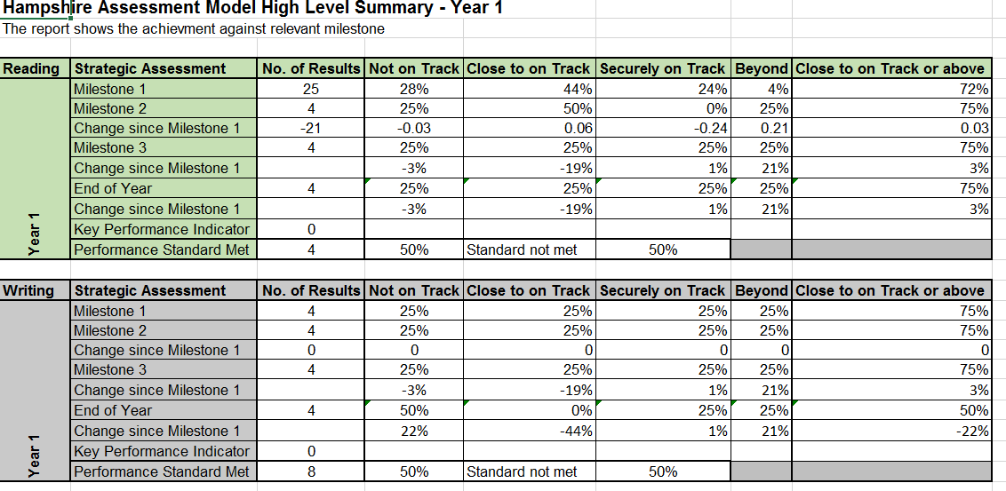
High Level Analysis – by year

Slide 15
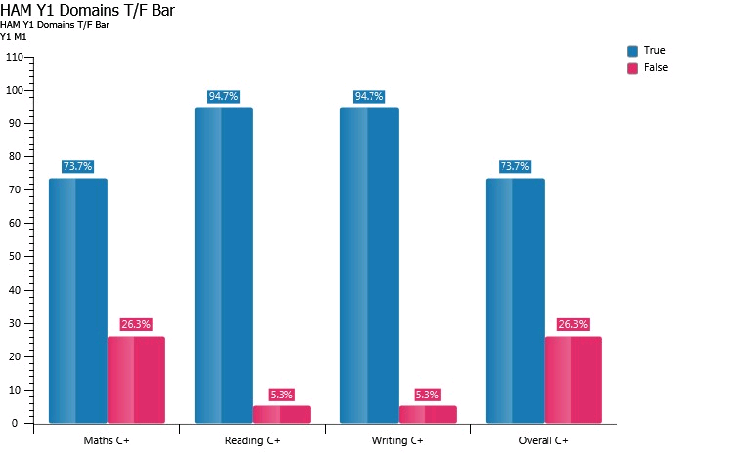
HAM Domains T/F Bar
The true bar represents the number or % with a Close+ result, the false bar represents the N

Slide 16
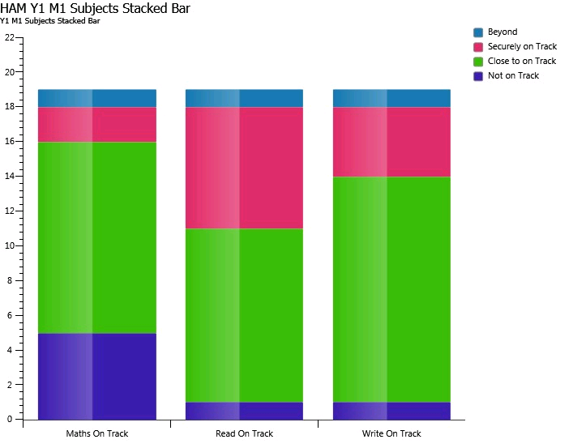
HAM Subjects Stacked Bar
One graph for each milestone showing the spread of grades for each subject.

