Slide 1
HAM in action: Reading and Writing

Slide 2
What might these ideas mean in the context of learning?
Apprentice- Fundamental ideas that build on previous year’s work
Competent- builds on ideas initially developed at the Apprentice stage
Expert- builds on Competence and achieves sufficient mastery for next year’s work
Fluency over time?
Independence?
Resilience to deal with complexity and new contexts?

Slide 3
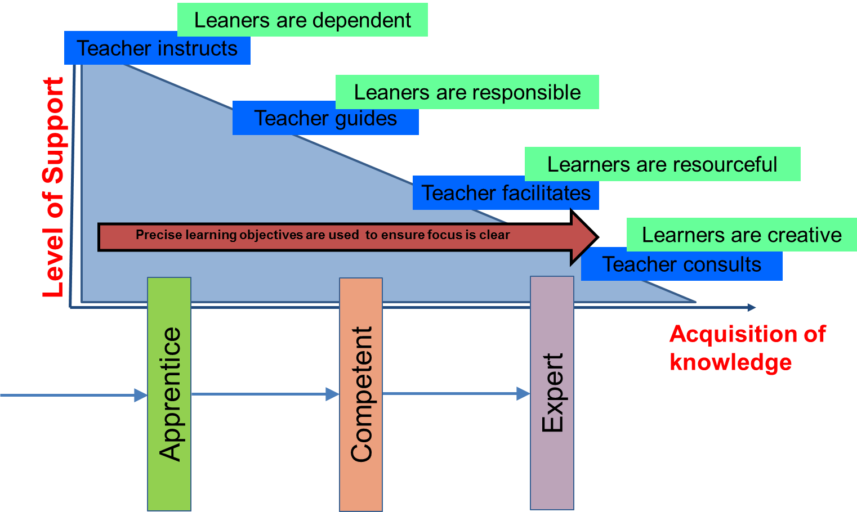
Planning for fluency, independence and resilience for all learners
Year
Milestone
Unit
Lesson

Slide 4
Planning for fluency, independence and resilience for all learners
Year
Writing Outcomes Purpose, Audience, Form | Narrative – Class version of dual narrative using different viewpoints (linked to pond) Instructions – What to do when you find a ‘lost’ animal for Mark the site manager Information – Animal Diary for the author Steve Parker | Poetry – night sky and shooting stars Diary – to describe the ‘star fishing’ Information – What is Diwali? | Recount – postcards / diary from Samson’s Journey Report – news report on the events | Narrative – own version : focus on problem Information – advisory poster or a leaflet on how to have a healthy diet Explanation – the food chain | Narrative – own version: focus on resolution Information text – Q&A model using ‘Could a penguin’ | Poetry – using Quentin Blake texts as stimulus Explanation – modified transport Information text – Fact file on Quentin Blake
Sentence grammar and punctuation skills | Proof read to check for errors – make additions, revisions and correction to their writing
 | Sentence punctuation Coordination conjunctions Exclamatory sentence Command sentences Statements Expanded noun phrases | Subordinating conjunctions Questions / Statements / Exclamations Expanded noun phrases Past tense Present tense | Contractions Range of conjunctions Adverbials to link sentences and ideas -er and –est adjectives Past tense Expanded noun phrases | Commas in a list 4 types of sentence Range of conjunctions Past tense | Apostrophe for possession Suffixes – ful and - less 4 types of sentence Commas in a list | Suffixes –ment and – ness Apostrophe for possession Commas in a list

Slide 5

Planning for fluency, independence and resilience for all learners
Milestone
DATA
Parallel texts
Planning for Mastery -experiencing the same thing in different ways
Data gap means a curriculum gap

Slide 6
Suggestions for a journey to fluency, accuracy, clarity and coherence - READING
Level of Support
ARE
Time
FOCUS ON TEACHER LED LEARNING WITH SPECIFIC OUTCOMES
Specific tasks focusing on one or more of the domains
Building a skills base
FOCUS ON FACILITATING OPPORTUNITIES FOR APPLYING TAUGHT SKILLS INDEPENDENTLY
A focus on higher order skills
Deep questioning
Tasks that require answers using skills from across the domains
Range of stimulus e.g. ‘read a painting’ focus on the comprehension skills
Reduce the scaffolding over time

Slide 7







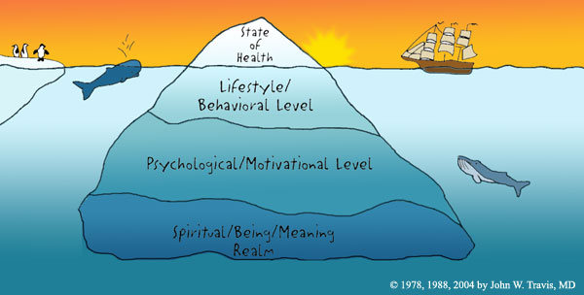

Reading domains: HAM
Developing independence and resilience in reading
Higher cognitive demand, but it is possible to train these thinking muscles at all ages
Making meaning is the guide and the goal
Word reading | Comprehension (knowledge and experience of the world brought to bear alongside strategies) |  |  |  | Inference | Language for effect | Themes and conventions
Cracking the code: piecing together the cues to make a word make sense in context | Clarify | Monitor and summarise | Select and retrieve | Respond and explain | Empathise Predict See layers of meaning | How part relates to whole: writer’s choices in relation to intention | Categorisation: similarities and differences between like texts/ other texts I have read
 | Noticing the bits that don’t make sense | Developing a mental map of the text | Seeking the specific… | What you think and feel

Slide 8
Planning reading using a layered approach and precision teaching….
Precision in defining what pupils need to learn.
Precision in defining what must be taught.
LO: Children to have an understanding of inference and apply this to the text.
Teachers focus group - children who had good word recognition and needed to further develop comprehension skills.

Slide 9

Choosing the text…
The text was chosen due to the range and scope of inference within both the text and illustrations
Jemmy Button
By Jennifer Uman and
Valerio Vidali

Slide 10
Teaching model
Whole class reading
Independent work
Review and further planning
Prior assessment
Guided group
LSA Input
Independent work

Slide 11
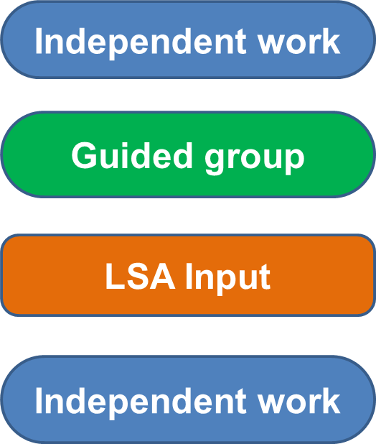
Independent
Read the text on the selected pages, study the pictures carefully and consider…
Why did Jeremy’s mother let him go?
What was she feeling when he left?
Why is the hand in the illustration so big and covering Jeremy’s face?
Write a diary entry from the mother’s perspective
Focus Group - Direct teaching
How does the author tell us about Jeremy’s viewpoint?
Why has the author chosen to compare bricks to stones, what other comparisons are there?
What does the phrase ‘almost but not quite’ mean?
How does he feel at these points in the book?
What are the links between the illustrations and the text and what are they inferring?
Independent
Use the illustrations to infer what Jeremy is feeling and thinking at key points in the book.
Create though bubbles to show what Jeremy might be thinking, feeling or deciding at these points in the text.
How has he changed?
LSA
Read aloud, think aloud
How do illustrations support the text?
What can we infer from the faces, colours, scale?
Explore thoughts, inferences and questions, record these on post-it notes on the page.

Slide 12
Planning for fluency, independence and resilience for all learners
Milestone
DATA
Parallel texts
Planning for Mastery -experiencing the same thing in different ways
Data gap means a curriculum gap

Slide 13
Reading Review
Is there a recursive curriculum?
  Do pupils revisit skills over time (fluency and accuracy)
  Are pupils challenges to apply prior knowledge and skills?
Is there precision in teaching?
  Precise focus on what pupils need
  Layered learning to meet different needs
Is planning / teaching responsive to needs?
  In the moment
  Across the lesson
  Within a unit

Slide 14

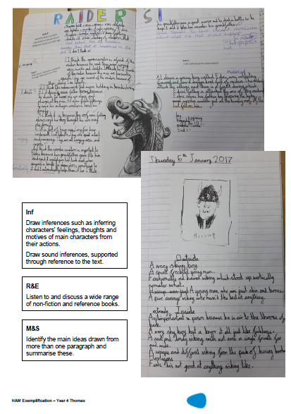
HAM Reading Exemplification

Slide 15
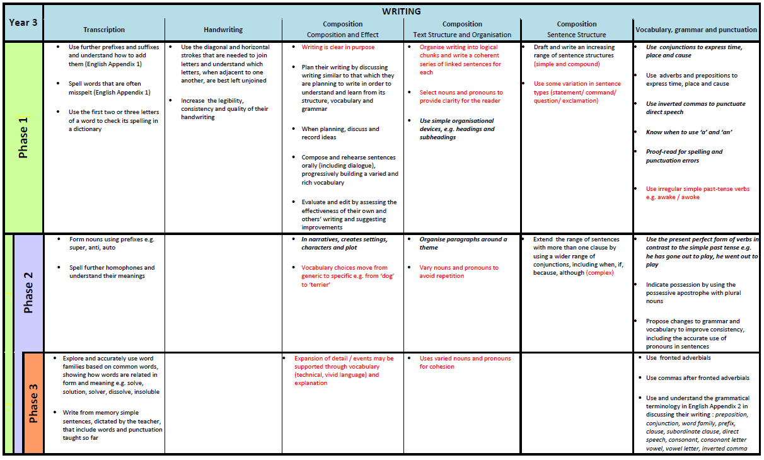
HAM for Writing
Notes:
Handout Yr 3 writing page – 1 per school.

Slide 16
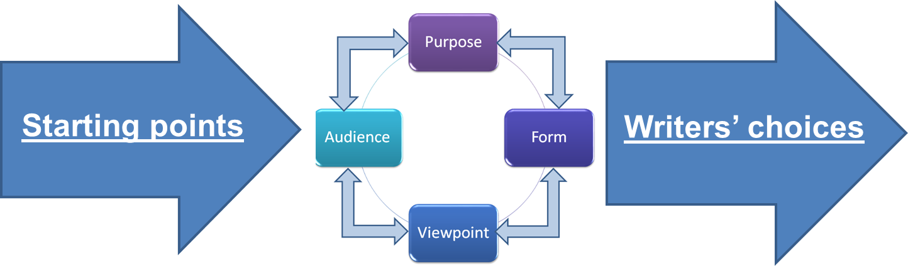
Planning for fluency, independence and resilience for all learners
Unit
Unit planning written to address gaps in data

Slide 17
Suggestions for a journey to fluency, accuracy, clarity and coherence - WRITING
Level of Support
ARE
Time
FOCUS ON TEACHER LED LEARNING WITH SPECIFIC OUTCOMES
Word banks
Apprentice writes
Teacher demonstrating
Genre features explicitly taught
Structured learning journey to site of instruction writing
Teacher agreed success criteria
Guided editing/ redrafting
FOCUS ON FACILITATING OPPORTUNITIES FOR APPLYING TAUGHT SKILLS INDEPENDENTLY
Pupil choice in writing outcomes – consider audience/ purpose/ author’s voice
Meaningful ‘site of application’ writes
Challenge pupils to generate own success criteria
Empowering pupil choices
Independent editing and redrafting
Reduce the scaffolding over time

Slide 18
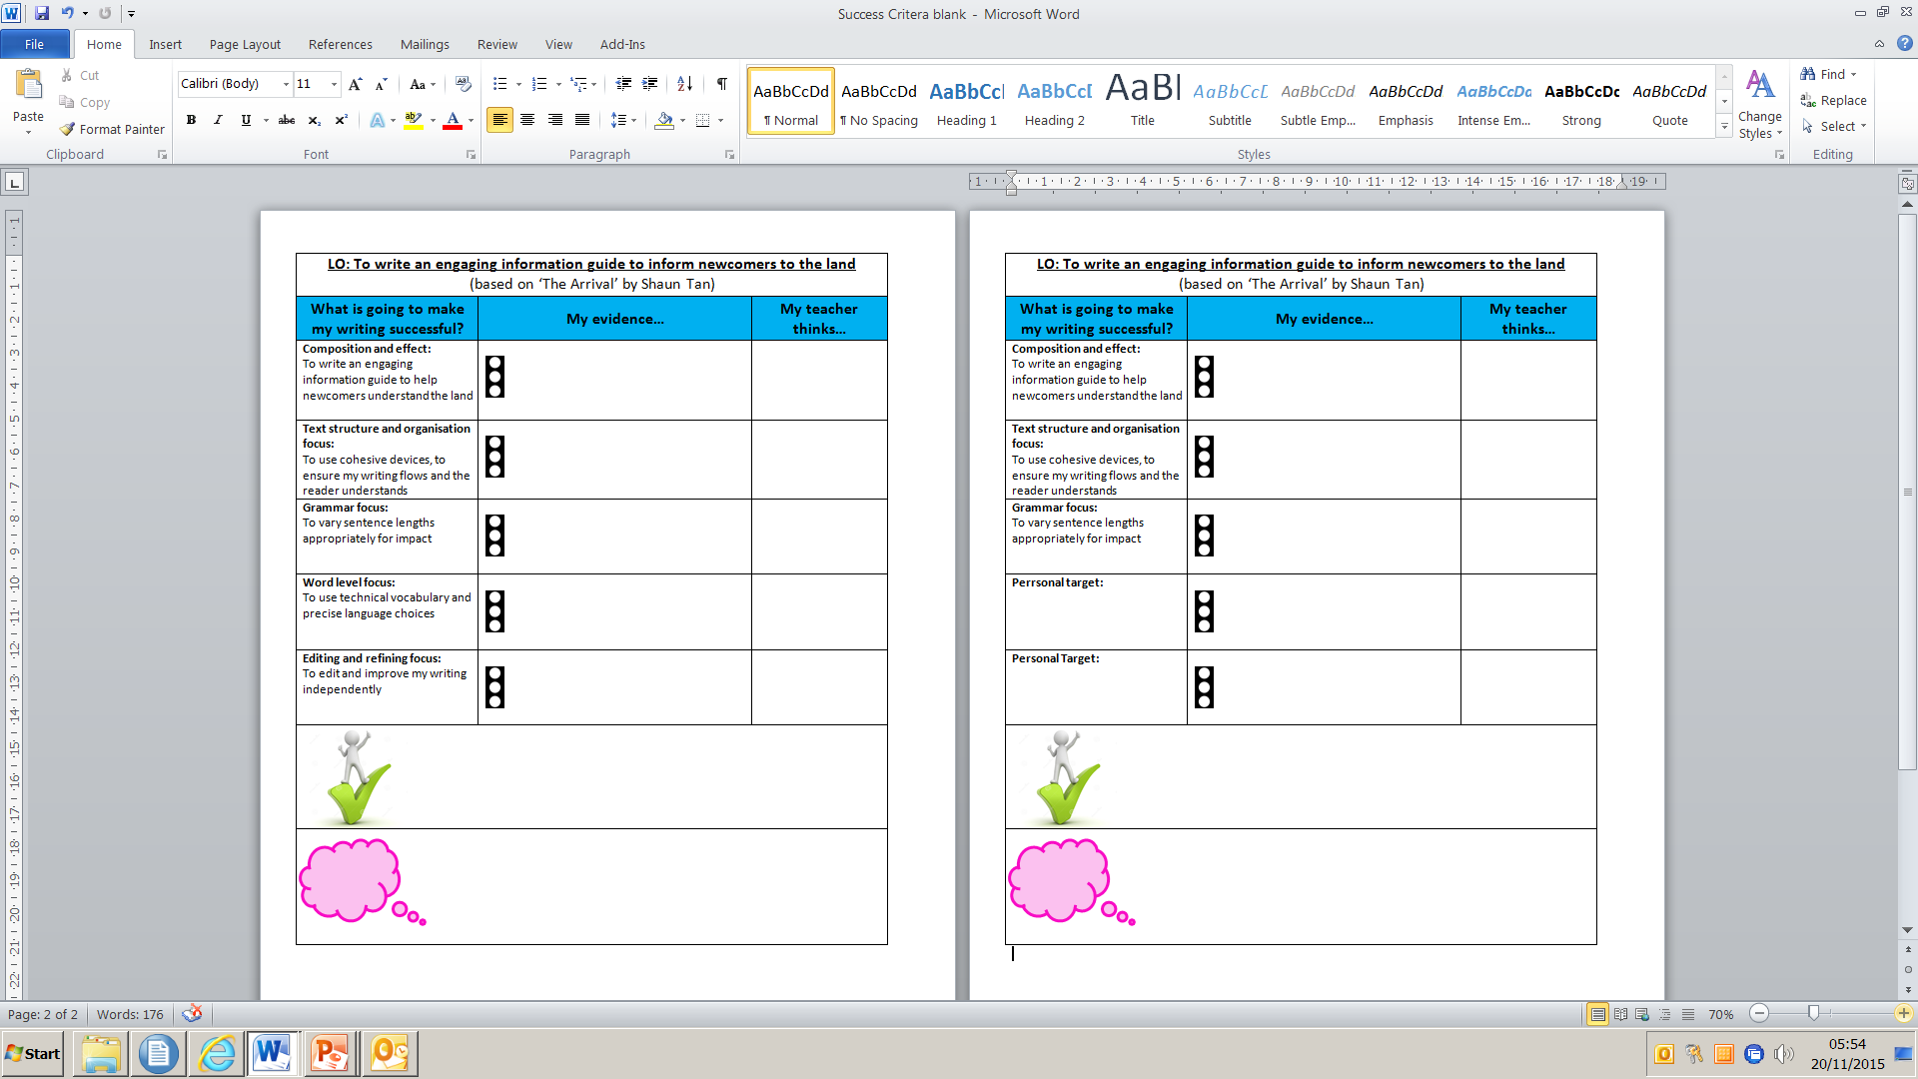
Apprentice
Competent
Success criteria reflects new learning in phase 2
Phase 1 objectives not yet ‘sufficiently’ secured become individual targets, identified in feedback
Objectives not required in success criteria
Evidence of competence in phase 1 objectives - pupils apply with greater independence and resilience in new contexts
Notes:
Success criteria used for sustained writes
Success criteria generated with children
Statements reflect the learning journey of focused teaching from phase 1.
Not a tick list of genre features

Slide 19
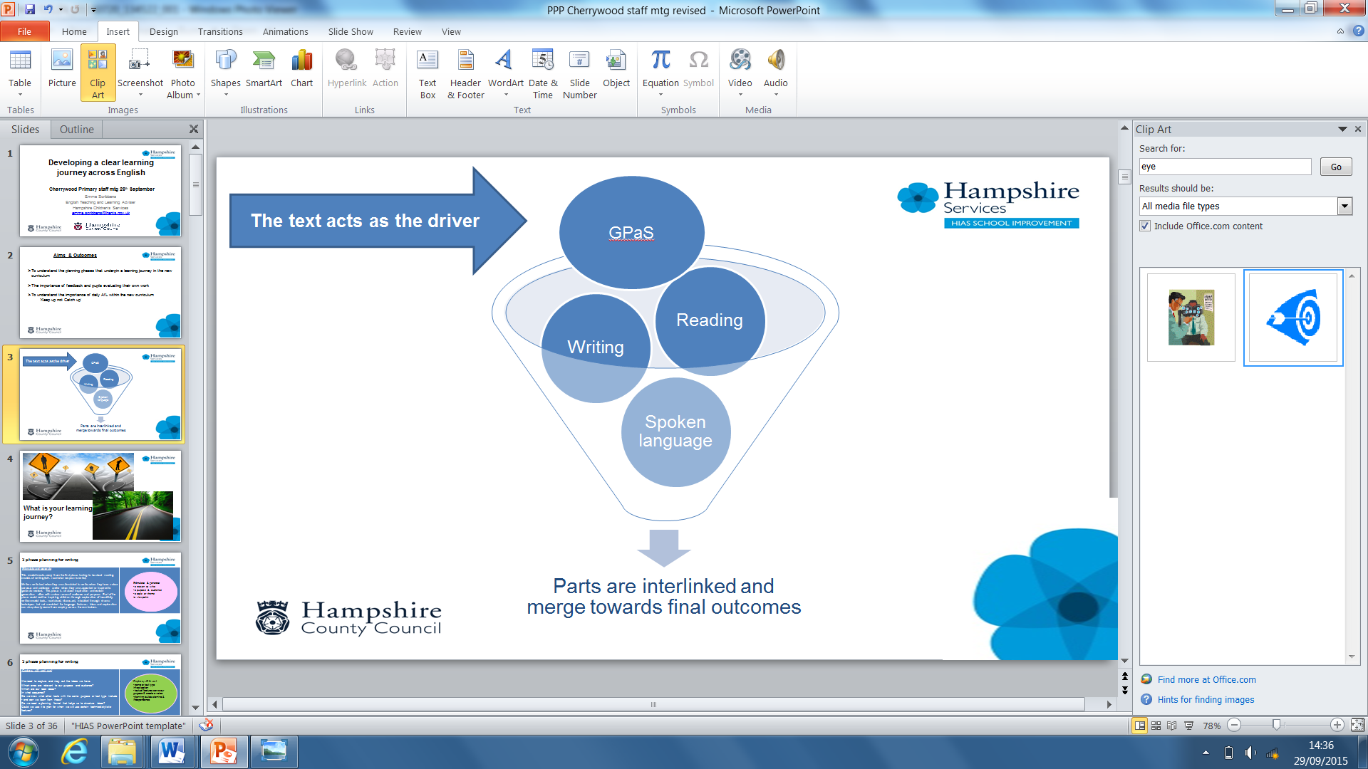
Year 3 assessment of learning
Phase 2 writing (VGP)
Use adverbs and prepositions to express time, place and cause
Phase 2 writing (VGP)
Expansion of detail / events may be supported through vocabulary (technical, vivid language)
Phase 1 writing
(Composition and Effect) Events or ideas are developed using some appropriate vocabulary
Phase 1 writing
(Composition and Effect)
Draft and write by composing and rehearsing sentences orally, progressively building a varied and rich vocabulary
Phase 1 reading (Respond and Explain)– Yr 3
Discuss words and phrases that capture the reader’s interest and imagination
Phase 2 reading (Respond and Explain) Yr 3
Begin to use vocabulary from the text to support responses and explanations
Phase 2 reading (Language for Effect)
Discuss the effect specific language has on the reader
Spoken Language
Developing a broader, deeper and richer vocabulary

Slide 20
Assessing ‘competence’ of phase 1 content and ‘apprentice’ of phase 2 content
STIMULUS: Dreaming The Unicorn by Tony Mitton
Outcome:
Write own poem about a mystical beast:
Ideas are developed using technical, vivid language Ph2
Adverbs and prepositions to express time, place and cause
Ph2
Begin to use vocabulary from the text to support responses and explanations (Ph2)
Share ‘The Unicorn’ with the children, discuss images the poem creates in their heads.
Children refer to specific word choices made by the poet and support answers with explanation of impact
Share purpose and audience of unit:
Poems to engage and entertain through language choice.
Publish on poetry website.
Ideas are developed using some appropriate vocabulary (Ph1)
Pupils create their own noun phrases using words collected from original (Ph1)
(technical, vivid language)
Share phrases and discuss effect on the reader.
Develop a broader, deeper and richer vocabulary
Discuss words and phrases that capture the reader’s interest and imagination
Introduce Wordle of the unicorn poem – do not reveal what the subject / poem is.
Pupils identify words that engage and capture imagination. Discuss impact on the reader.
Use adverbs and prepositions to express time, place and cause (Ph2)
Share an image of a mystical setting / creature.
Develop adverbial / prepositional phrases to support description.
Remind pupils to use technical, vivid language.
Draft and write by composing and rehearsing sentences orally, progressively building a varied and rich vocabulary (Ph1)
Pupils construct poetic sentences that ‘paint a picture’ stimulated by their own selected image.
Teacher assesses for ability to apply vocabulary choices that are appropriate and have an impact on the reader

Slide 21
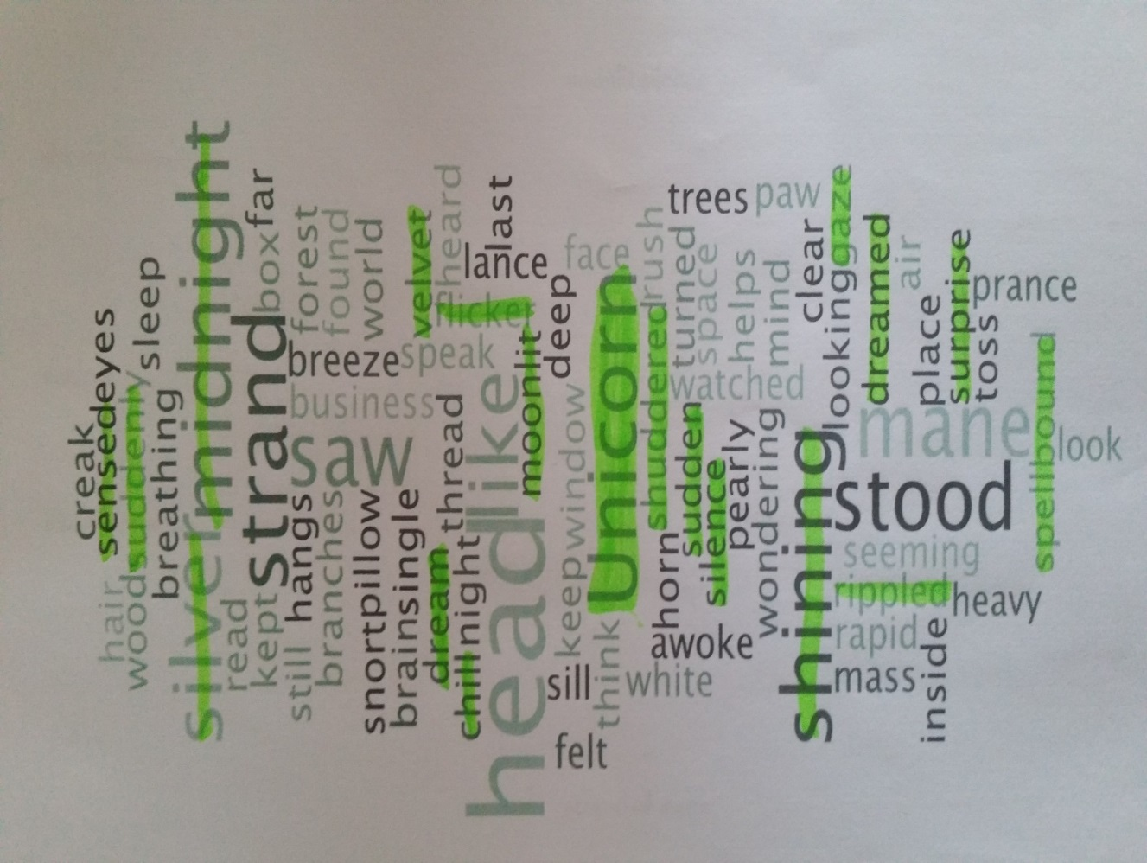
Develop a broader, deeper and richer vocabulary
Discuss words and phrases that capture the reader’s interest and imagination
spellbound
T: “So amazed, you are caught in the ‘spell’ of the thing - you can’t look away or move.”
C: “Is it the same as being astonished?”
shuddered
T: “Can you show me how you might shudder?”
sensed
T: “It means knowing but not seeing”
velvet
T: “It’s a material that’s really soft and smooth when you touch it.”
C: “I can feel it when I say it”
rippled
C: “I think of waves silently moving up and down on a lake”
moonlit
C: “When the moon is shining down on something and you can see it”
gaze
T: “Which word is better ‘look’ or ‘gaze’?”
C: “Gaze - because it shows you how”

Slide 22
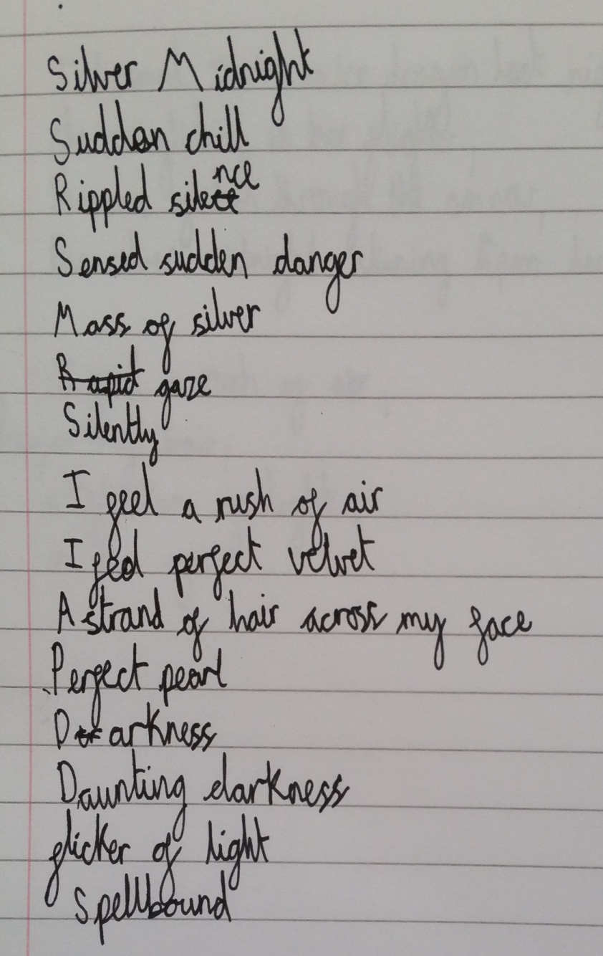
Ideas are developed using some appropriate vocabulary
Teacher comment / observations:
Initially child only paired up highlighted words e.g. silver midnight were words near each other on the Wordle
After mini plenary to encourage children to adapt into their own ideas, child took greater ‘risks’ e.g. ‘sensed sudden danger’
Child not yet confident to apply some new vocabulary into their own noun phrase e.g. ‘spellbound’ only listed
Child has used good level of rich vocabulary and deepened knowledge of word choices during the task
Child now needs to apply in context to embed understanding

Slide 23
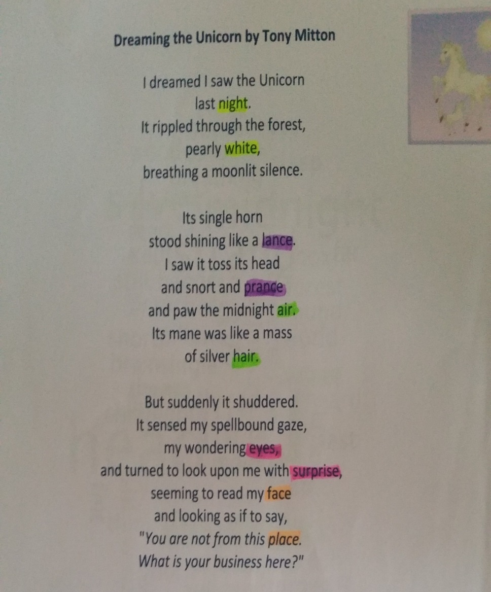
Begin to use vocabulary from the text to support responses and explanations
I saw these words in the Wordle yesterday!
‘Suddenly’ is a good word because it shows how quickly something happened
It shows how the unicorn moves like a horse, because horses ‘prance’ around
I understand ‘spellbound’ now it is in the poem – the person is looking at the unicorn for a long time, they are curious about it. It says they are ‘wondering’
I have highlighted the rhyming words in different colours.
The hardest to find were ‘eyes’ and ‘surprise’ because they are not spelt like each other

Slide 24
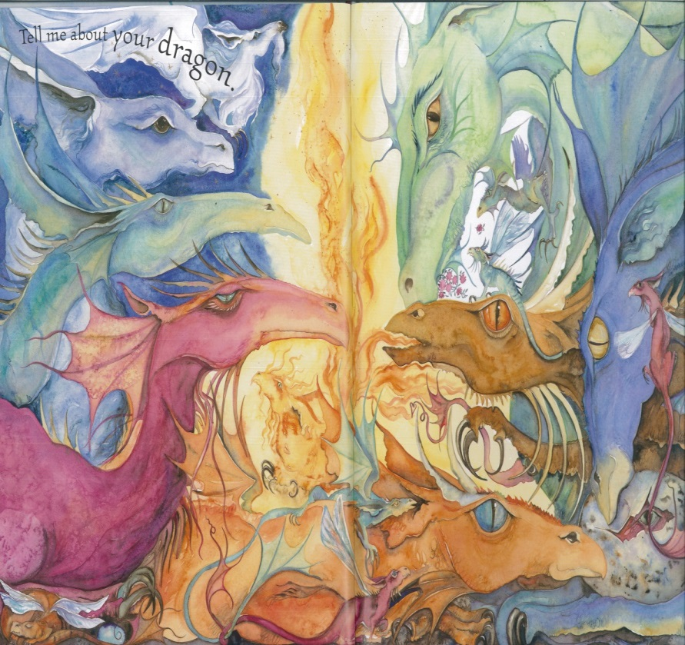
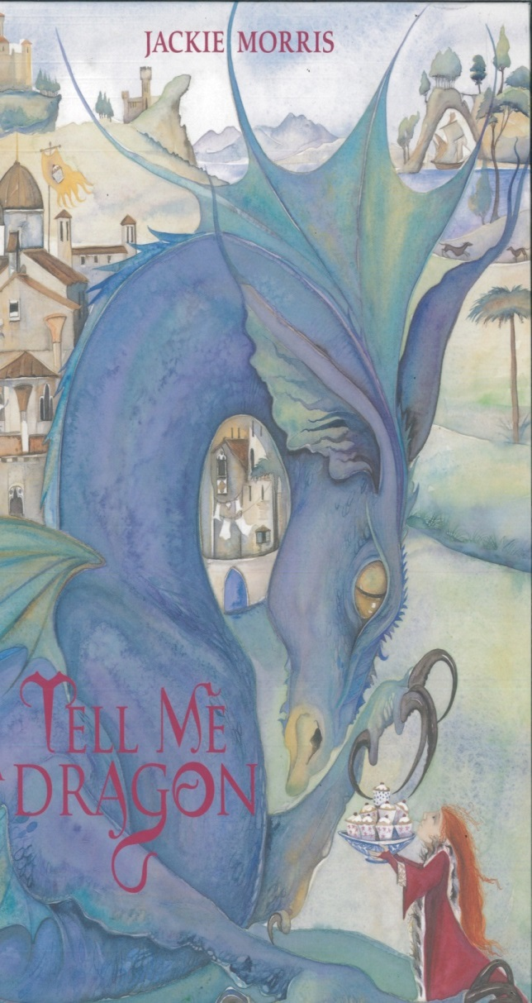
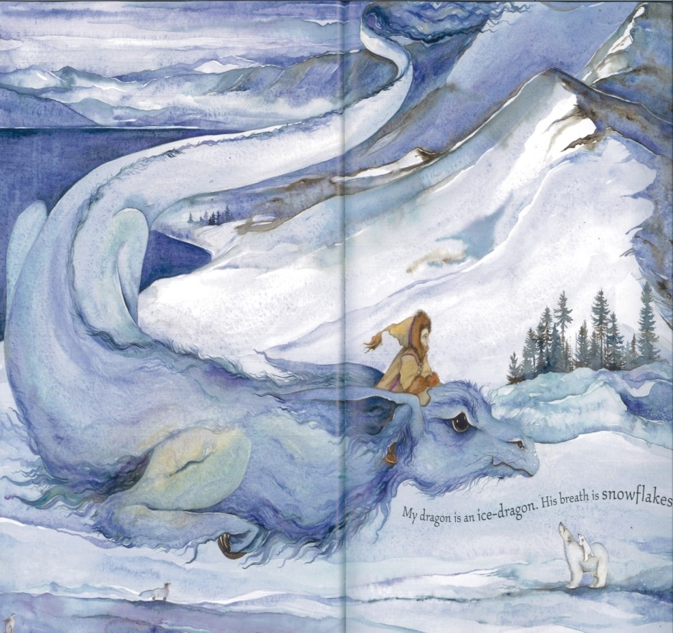
Images of mystical creatures/ dragons used to stimulate poetry writing
Tell Me Dragon by
Jackie Morris

Slide 25
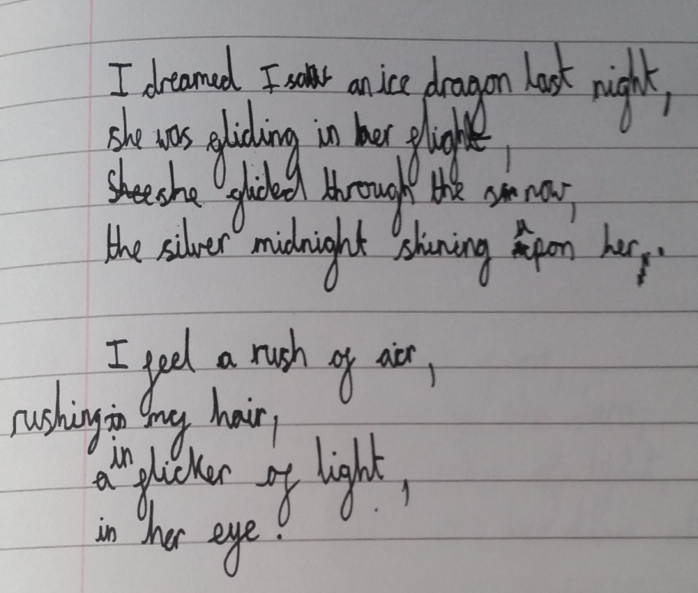
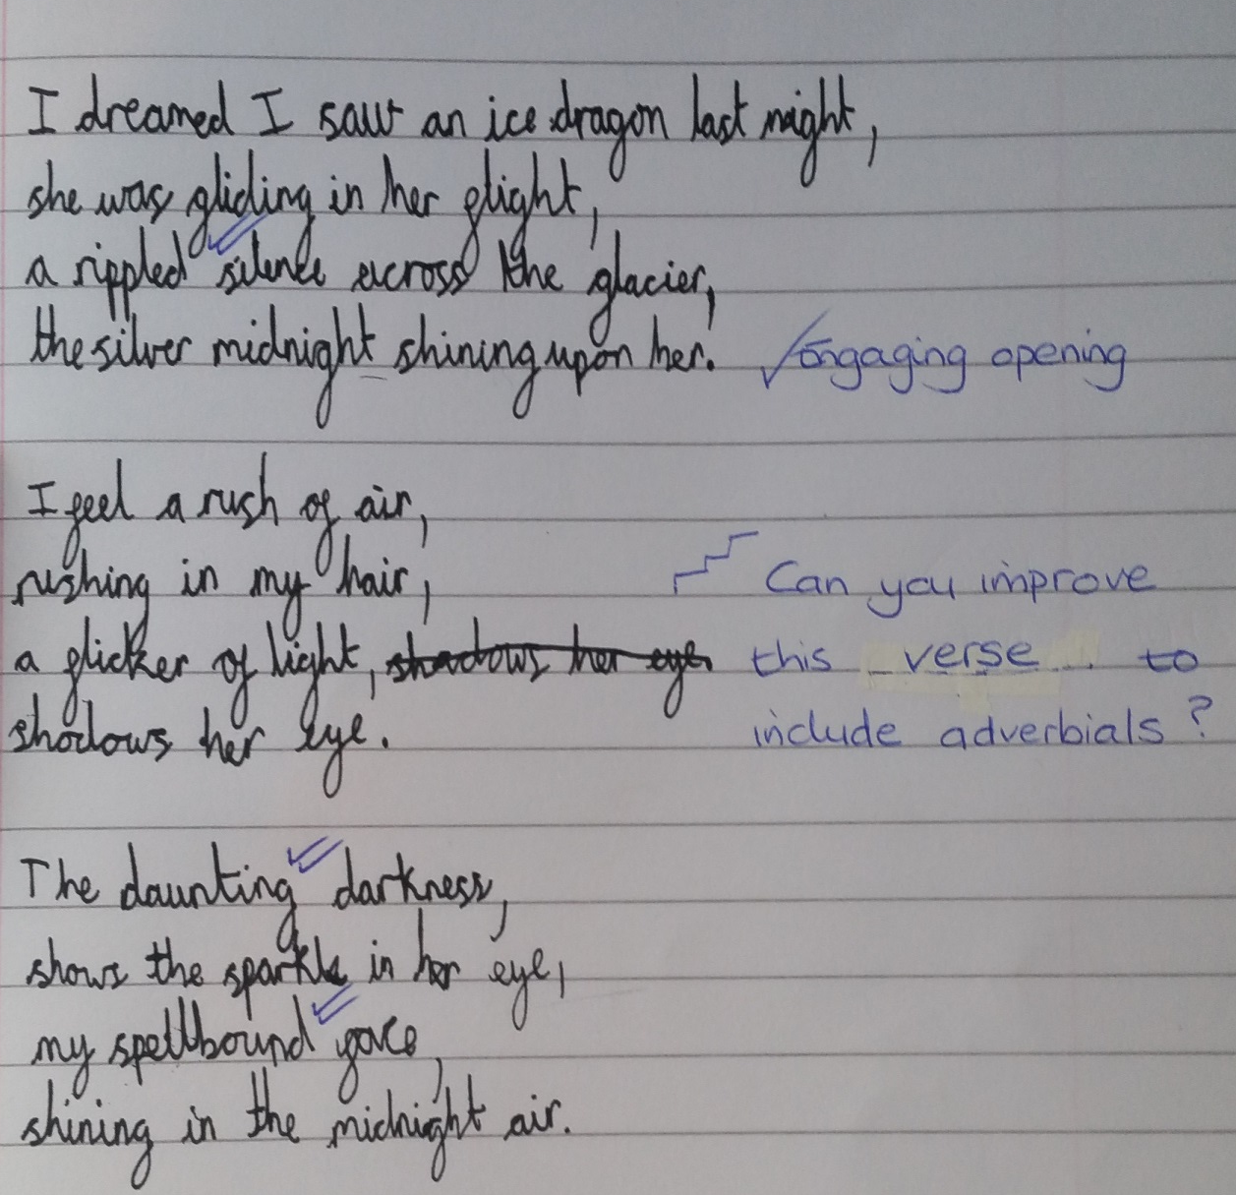
Draft and write by composing and rehearsing sentences orally, progressively building a varied and rich vocabulary

Slide 26
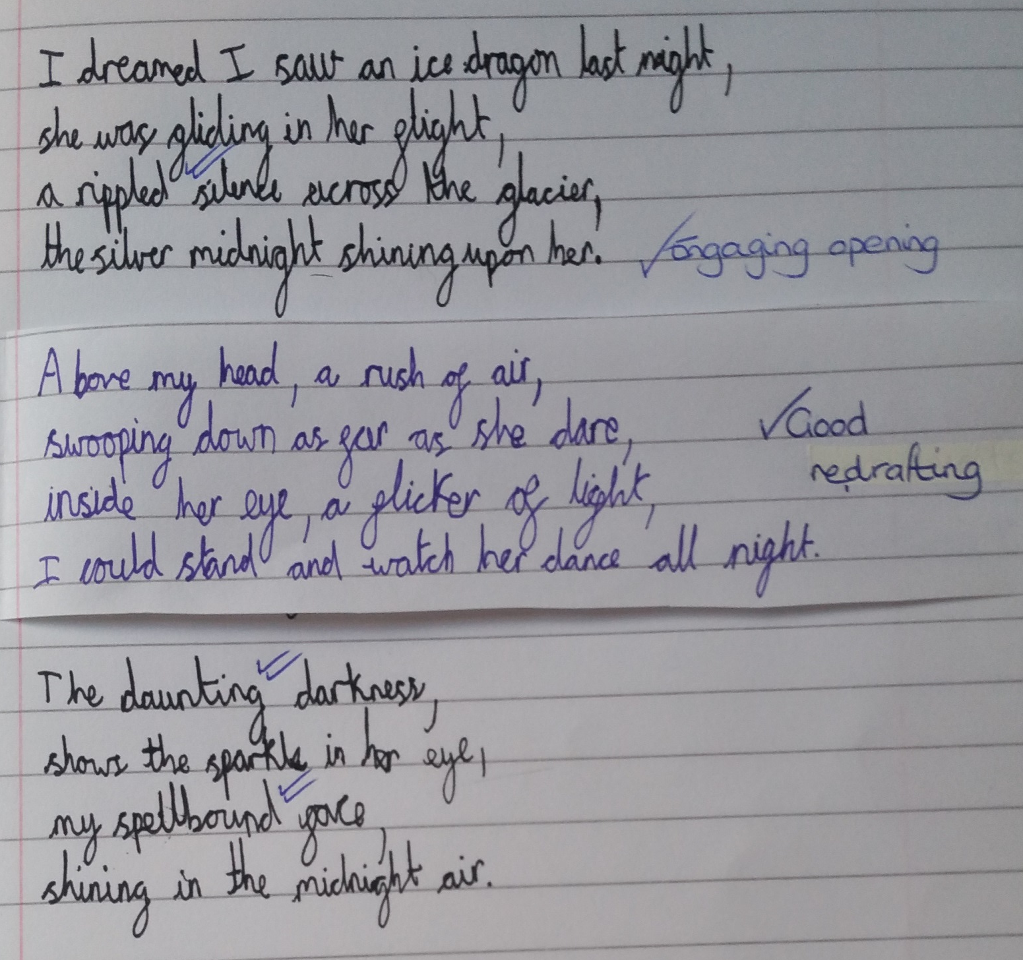
Use adverbs and prepositions to express time, place and cause

Slide 27
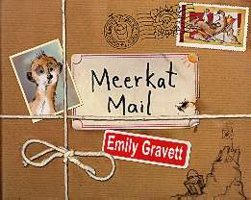

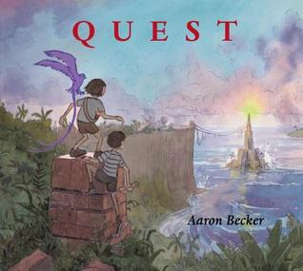

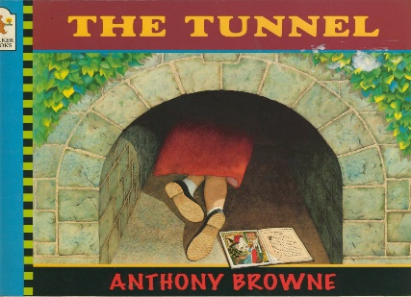
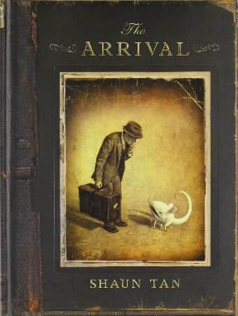

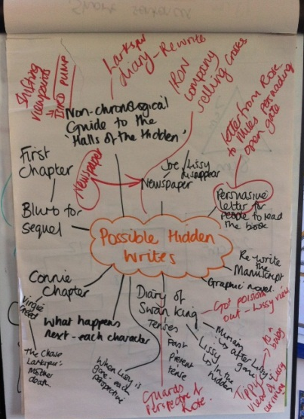
Developing independence and resilience in writing
Choose a stimulus with multiple writing outcomes:
Quality picture books – including for older readers
Wordless picture books
Purpose
Form
Audience
Current local/ national/ world event or issue
Real school event:
School production
Summer fayre
Residential/ day visit
3 ways to tell the same fairy tale
Think genres … think beyond the traditional genres
Writing narrative from a different viewpoint
Email to another character / blog the event
Formal letter & informal diary – same character, same event
– change the style

Slide 28
Writing Review
Is there a recursive curriculum?
  Do pupils revisit skills over time (fluency and accuracy)
  Are pupils challenges to apply prior knowledge and skills?
Is there precision in teaching?
  Precise focus on what pupils need
  Layered learning to meet different needs
Is planning / teaching responsive to needs?
  In the moment
  Across the lesson
  Within a unit

Slide 29
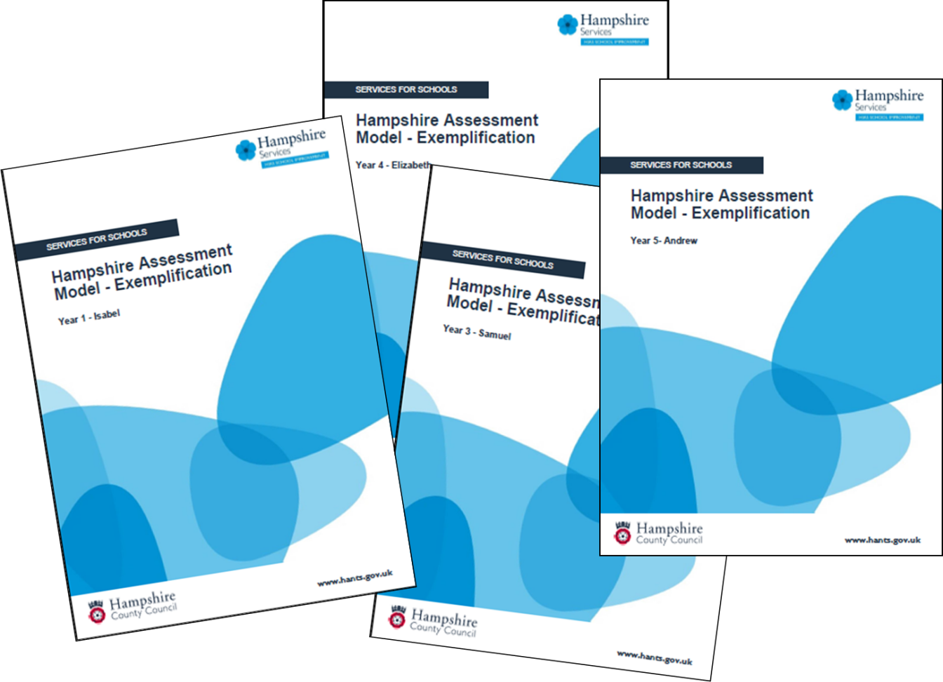
HAM Writing Exemplification

