Slide 1
HAM in action: mathematics

Slide 2
Curriculum Aims
Should be evident through individual lessons, units of work, work across the year…

Slide 3
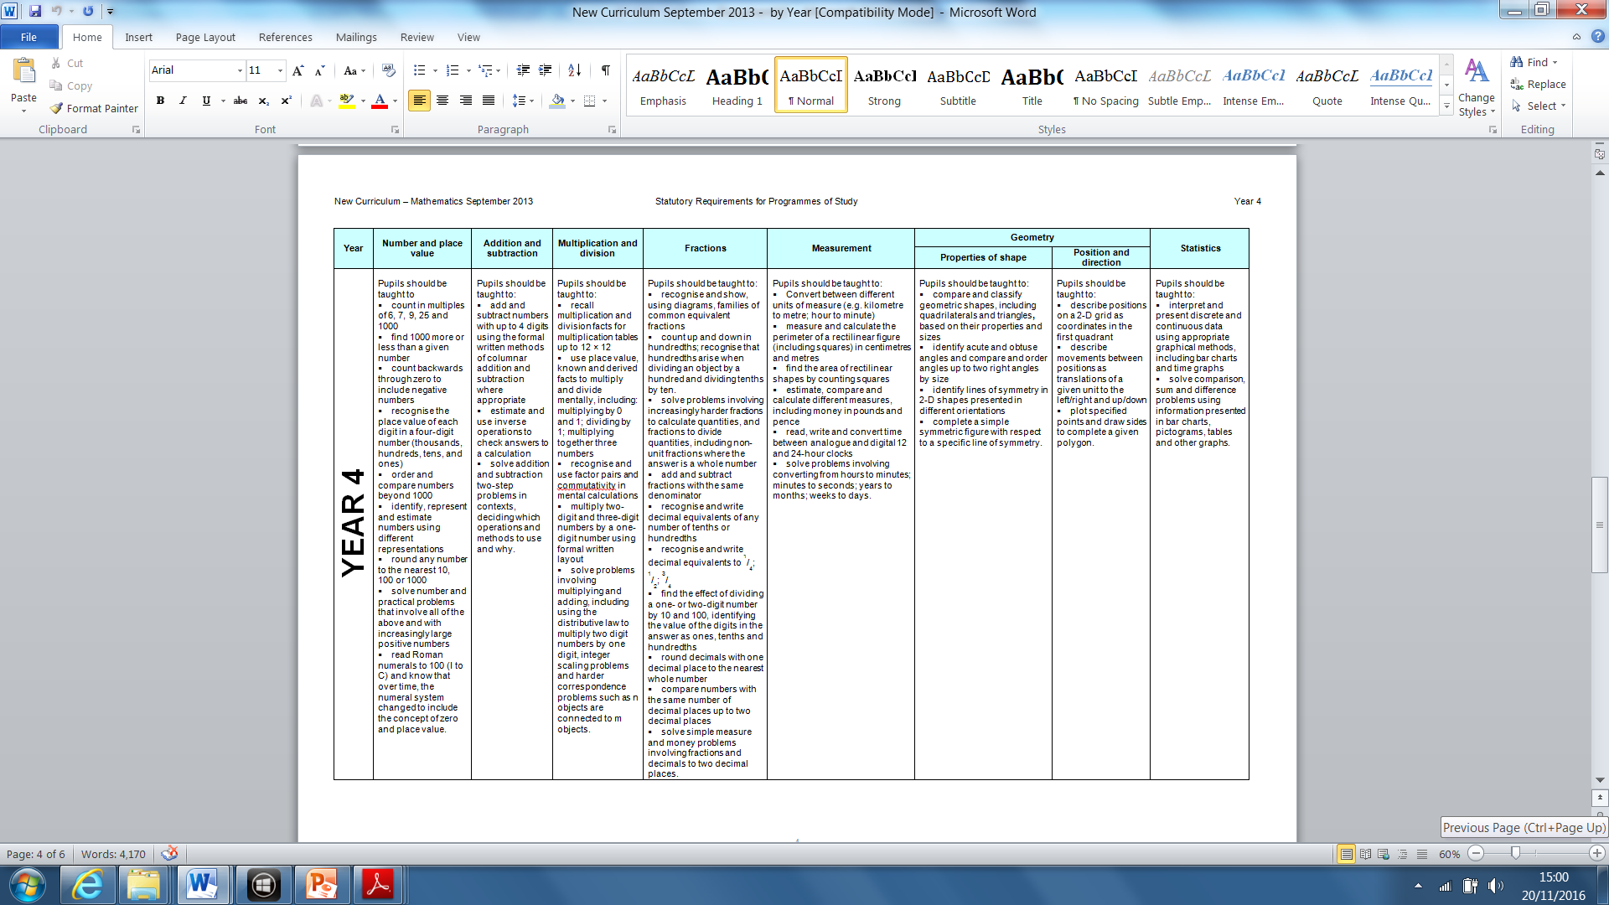
Links within and between domains…
‘Mathematics is an interconnected subject in which pupils need to be able to move fluently between representations of mathematical ideas. The programmes of study are, by necessity, organised into apparently distinct domains, but pupils should make rich connections across mathematical ideas to develop fluency, mathematical reasoning and competence in solving increasingly sophisticated problems.’ NC 2014

Slide 4
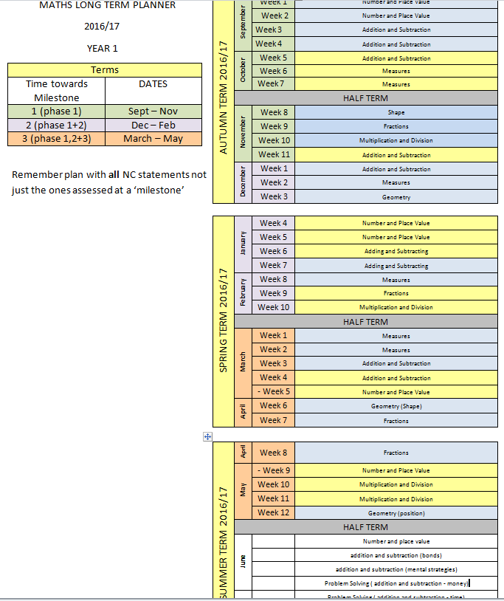
Long term curriculum maps…
Journey between Milestones, working on all domains to varying depths…
Revisiting each domain in different orders to combine in ‘units of work’ in different ways

Slide 5
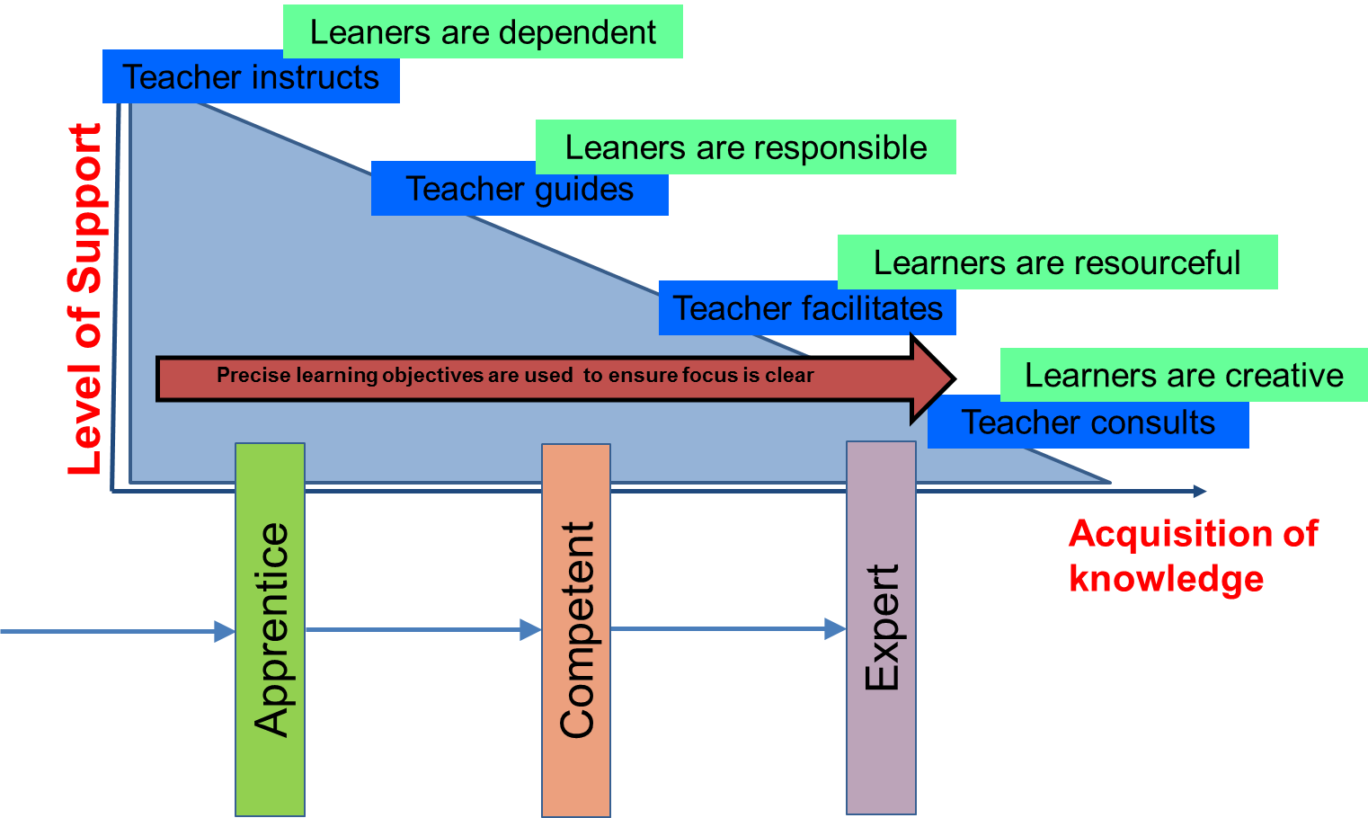
Planning for fluency, independence and resilience for all learners
Year
Milestone
Unit
Lesson

Slide 6
Planning a Year 5 unit Autumn term: check back to year 4
The ‘on track’ pupils should be able to use year 4 curriculum to solve problems from beginning of year 5…may need some small reminders…
Some pupils still need to secure Y4 curriculum…
Task design is key to enable a ‘revision’ whilst not going back further than is necessary…
Questioning/ pupil talk
Use of models and images
Use of concrete resources

Slide 7
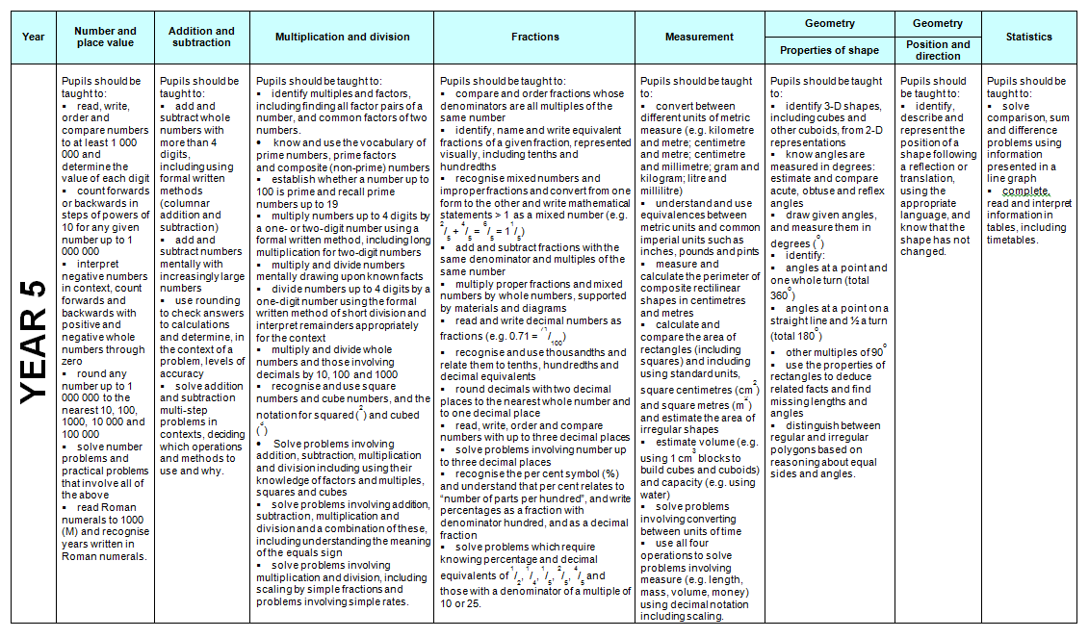
Small step towards end of year 5 expectations…
Working with year 5 statements implies that pupils are secure with understanding in that domain from year 1 to year 4…
They have all year to conceptually and procedurally to understand year 5 statements

Slide 8
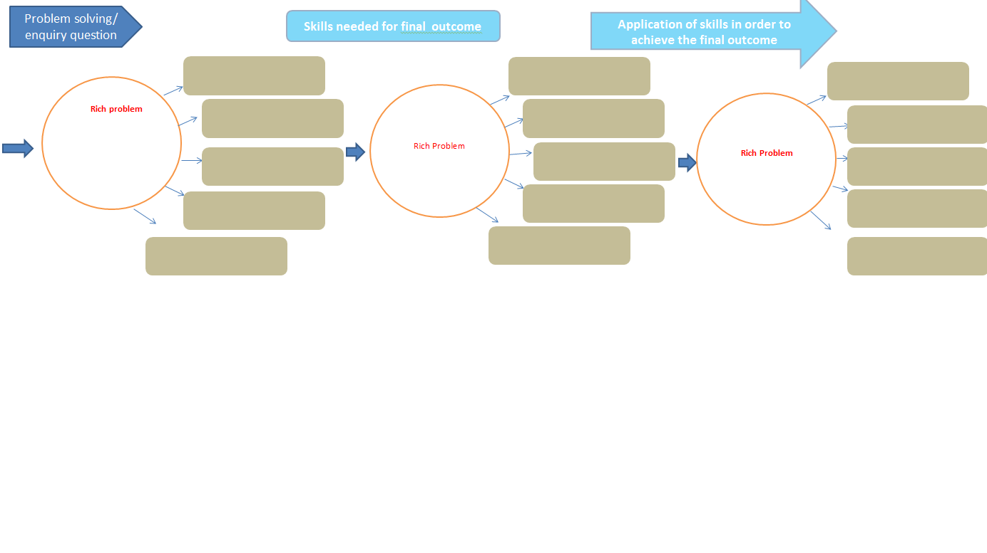
Planning a unit of work

Slide 9

Teaching for Mastery (in Shanghai)
The key principles are
PROCEDURAL VARIATION provides a process for formation of concepts stage by stage, in which pupils' experience in solving problems is manifested by the richness of varying problems and the variety of transferring.
CONCEPTUAL VARIATION provides pupils with multiple perspectives and experiences of mathematical concepts.
INTELLIGENT PRACTICE: when designing exercises, the teacher is advised to avoid mechanical repetition and to create an appropriate path for practising the thinking process with increasing creativity.
c.f. Gu, Huang & Marton, 2004 and Lo, Chik & Pang, 2006
Gu, 1981

Slide 10
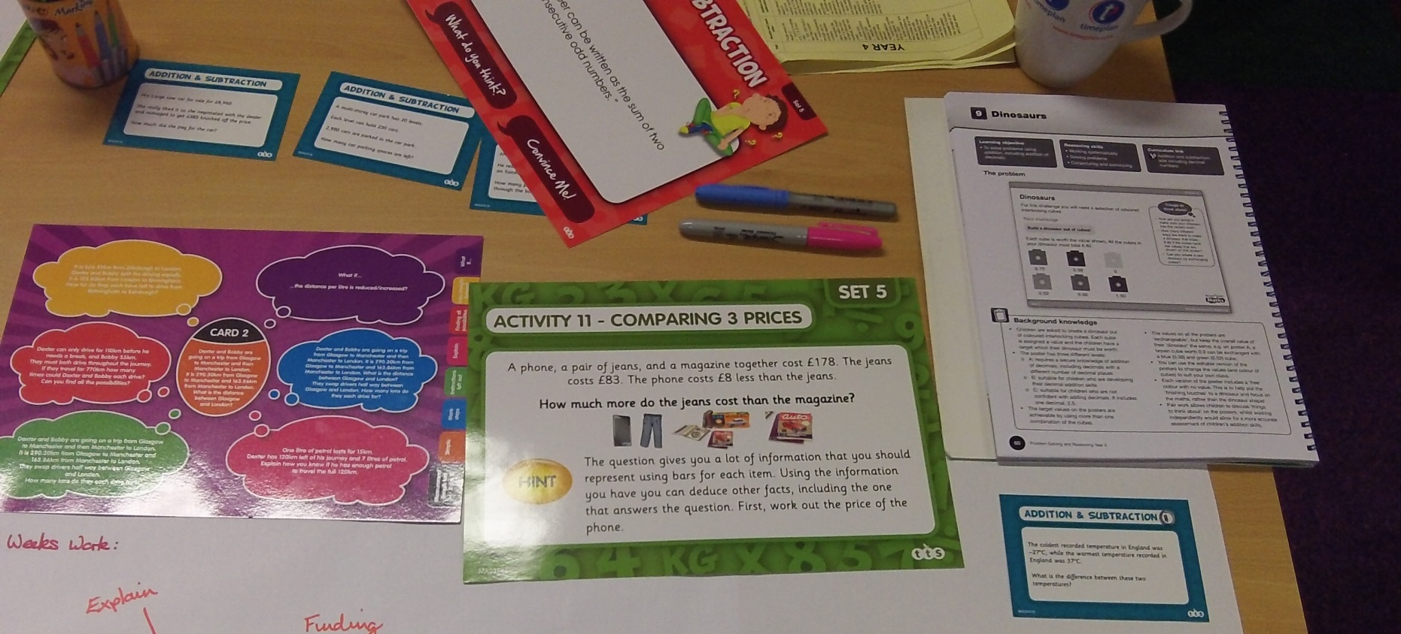
What tasks could be used?
Which ones are most helpful for the class?
Notes:
Y5 Rising Stars: Dinosaurs task

Slide 11
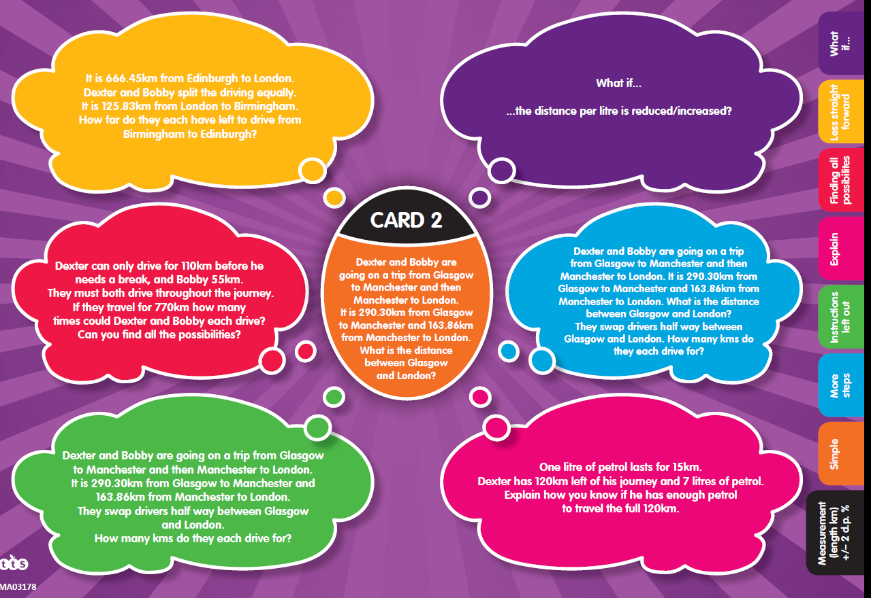
Selecting a key task to use as a starting point…
This problem involves decimals, measurement, addition.

Slide 12
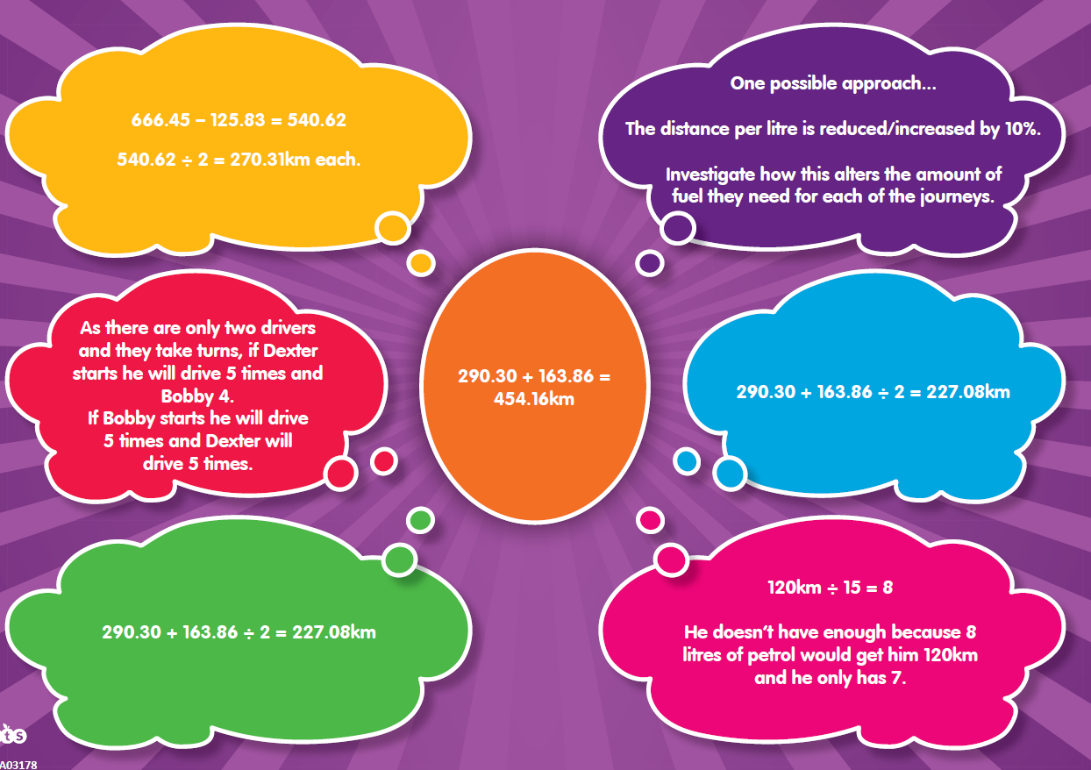
Models and images needed with these solutions

Slide 13
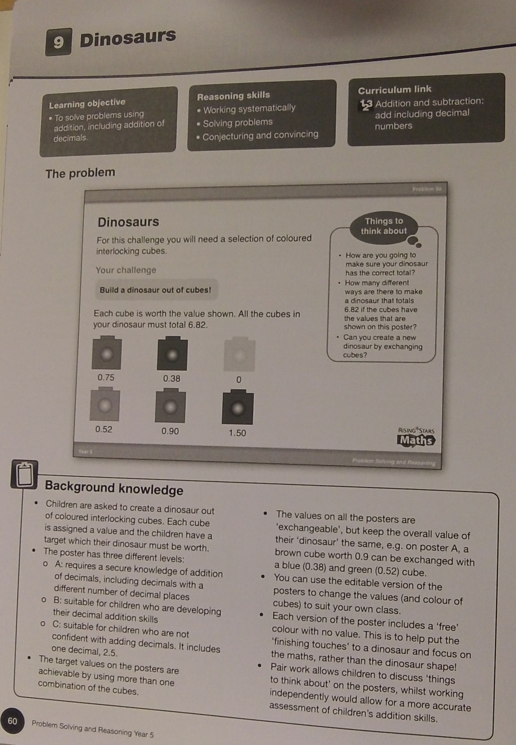
Addition and subtraction using decimal numbers to make ‘dinosaurs’
Task design: what sort of recording strategies could pupils use to support conceptual understanding as well as ‘right answers’…
Notes:
Y5 Rising Stars Problem Solving and Reasoning: Dinosaurs

Slide 14
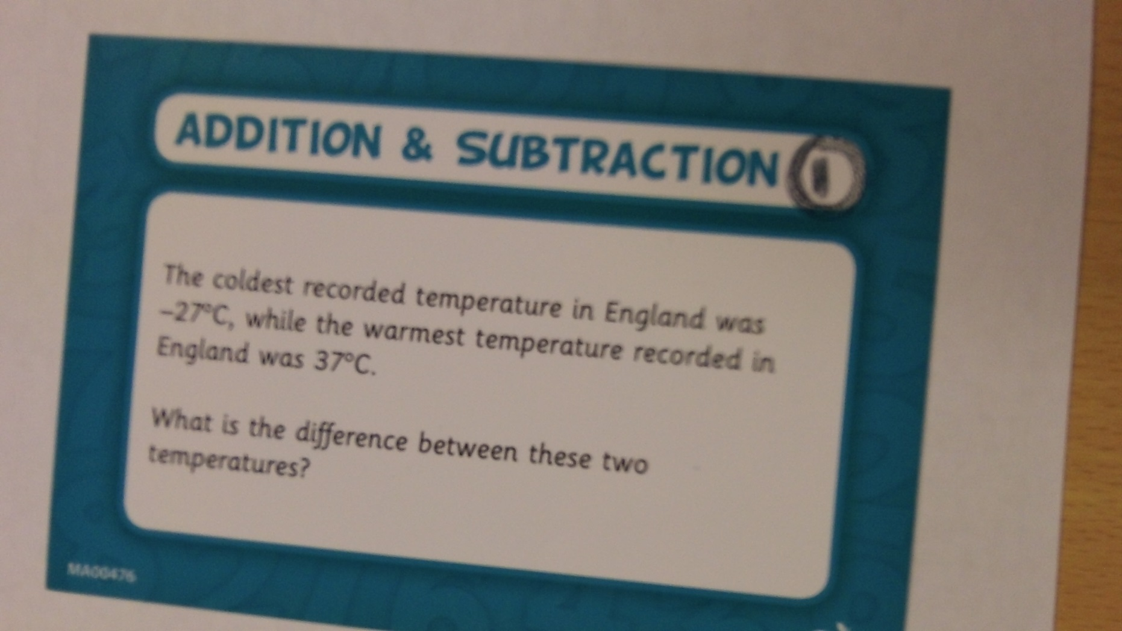
Using negative numbers
Notes:
TTS Graded Problem solving cards Y5

Slide 15
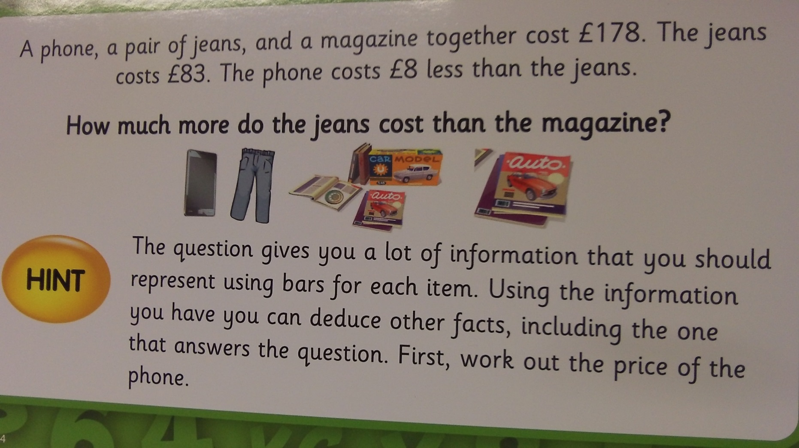
Problem example using a Bar Model to support problem solving
The numbers are not challenging - the interpretation of the text /structure of the problem and reasoning is the focus.
Notes:
TTS Bar Model cards Y5

Slide 16
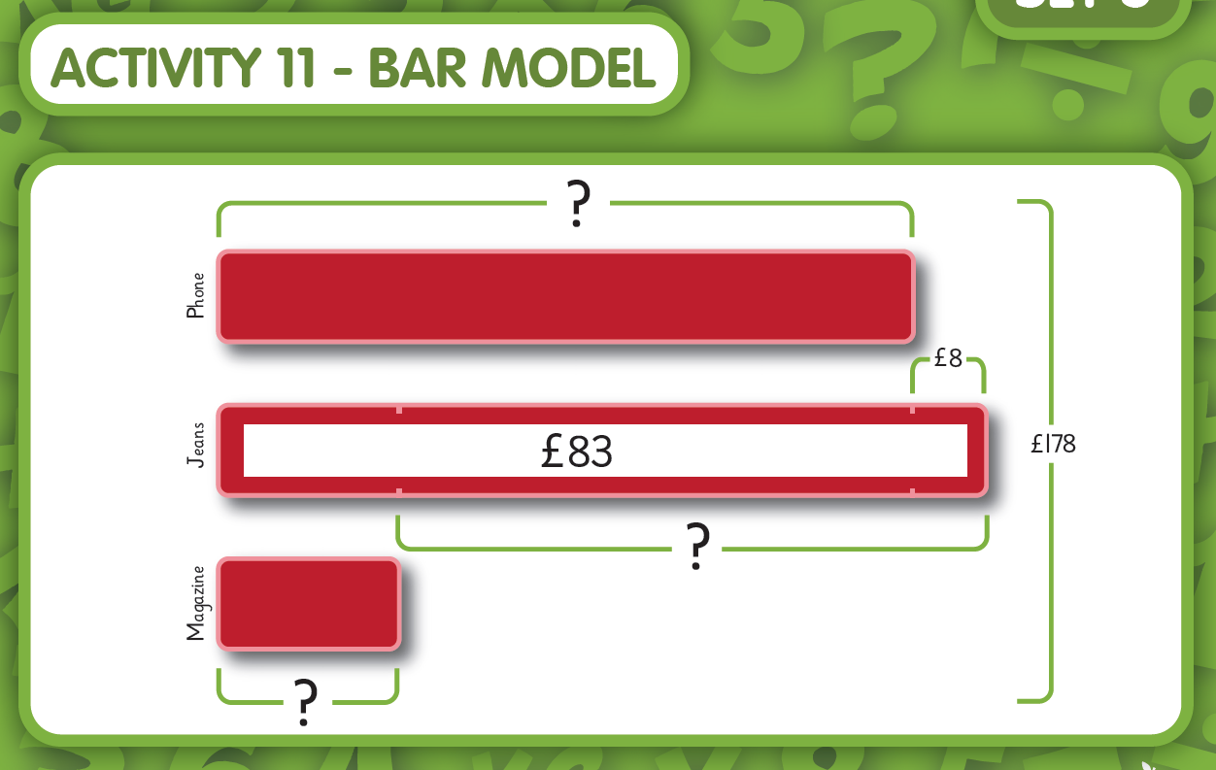

Slide 17
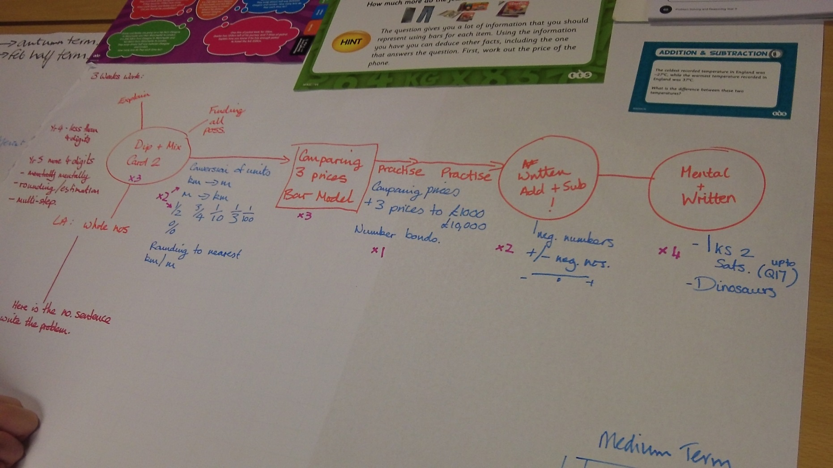
Build in practise with decisions about when to use mental strategies, more formal recording…

Slide 18
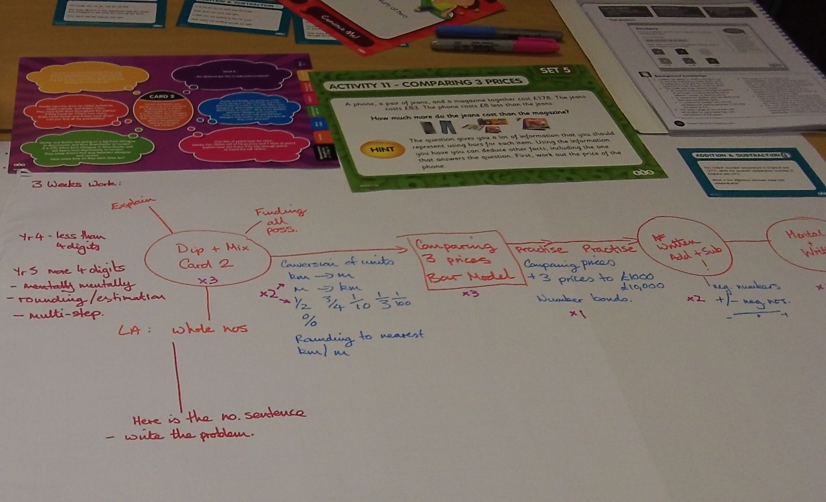
Decide the order of the key tasks and how long pupils might need to really ‘get it’ – think about the practise that will be needed…eg converting units, key number facts…
Using published resources, rather than teachers writing their own, ensures appropriate pitch
Different resources give pupils a richer experience of problem solving…
Notes:
Identifying a sequence of problems that relate to the domains in the unit of work:

Slide 19
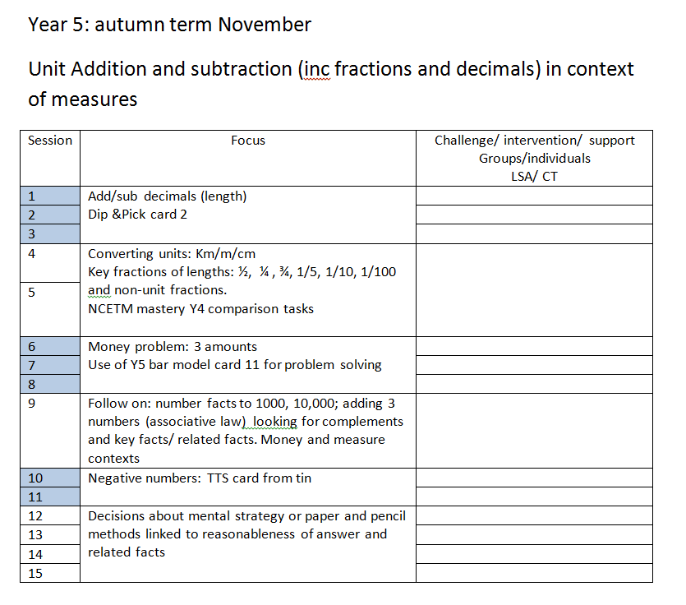
Medium term plan
Useful for mathematics managers to link data with provision:
Work scrutiny: sequences of lessons
Domain coverage
Useful for class teachers
Easy reference to previous work
Can be used again
Developed collaboratively in PPA for next 2/3weeks
Short term planning individual

Slide 20
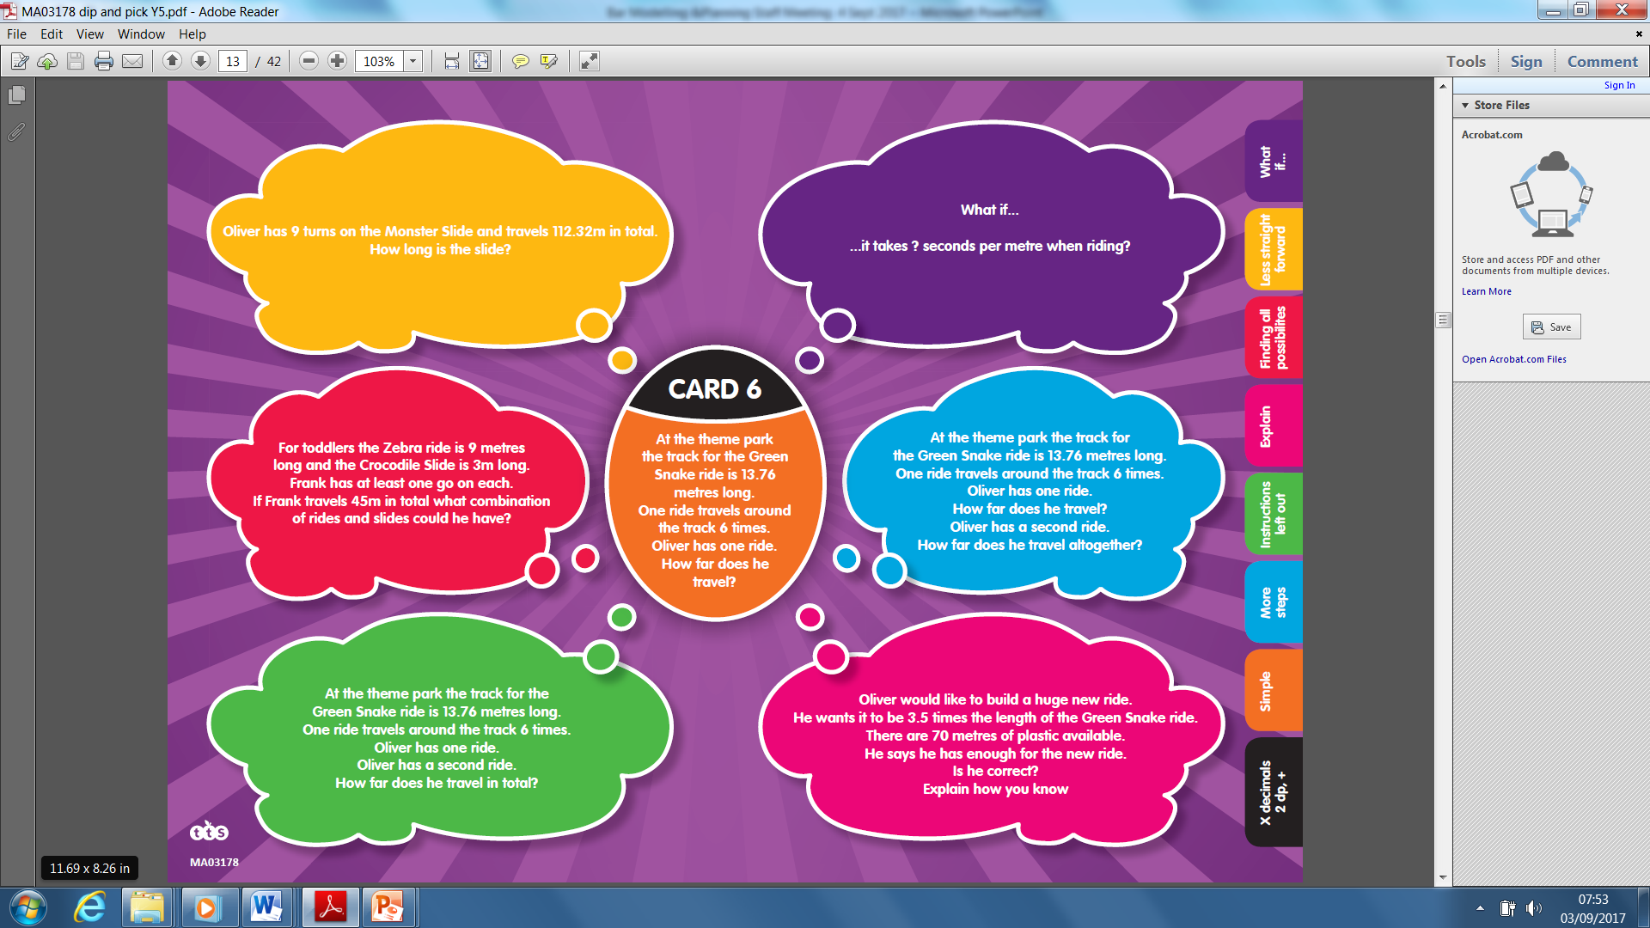
A possible ‘year 5’ problem (could be adapted?)
What mathematics is needed to solve this problem?
Which aspects would a year 5 pupil typically manage?
Which aspects are possible areas of difficulty for pupils?
TTS Dip and Pick Y5

Slide 21
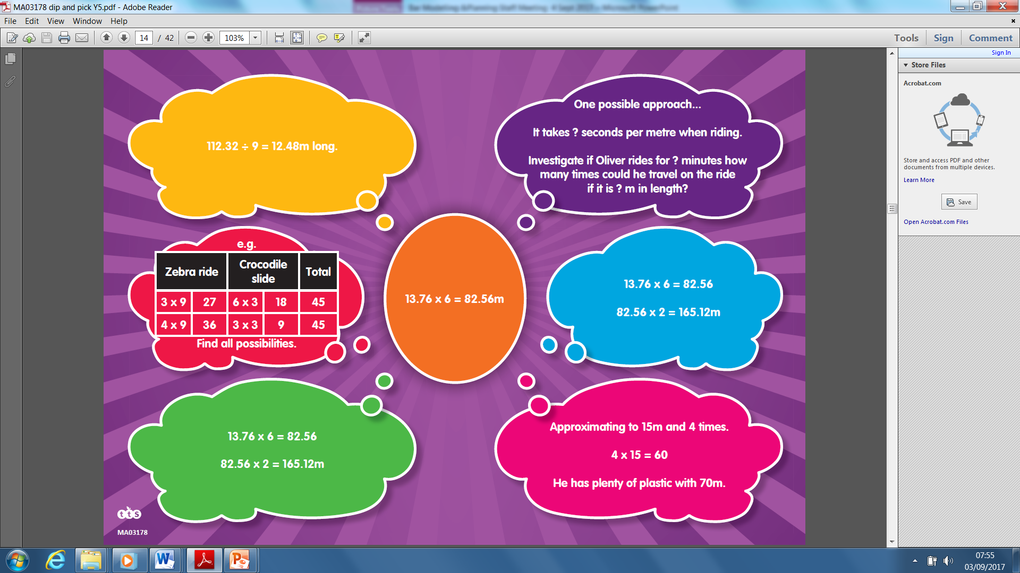
CPA approach
Procedural Variation
Conceptual Variation
‘Intelligent’ practice
Pictorial (supports concepts & mental)
Could pupils draw a picture/ diagram of the problem that this calculation solves?
Could pupils construct number lines to model the position of this decimal number?
Could pupils use a bar model and number line to show this calculation?
PRACTISE of any of this as needed
Multiplication/ division
Deep understanding/
mastery
Concrete
(Supports concepts & mental)
Do pupils know how long this is? Could they estimate it and show? Compare it to another length? Eg classroom width?
Do pupils know where 13.76 is on a number line?
Do pupils know how far away this number is to the next whole number?
Could pupils model this decimal number with dienes or 100 square model?
PRACTISE of any of this as needed
Abstract
(decide mental /formal)
Multiply the decimal number by 100 then divide the product by 100 (PRACTISE)
Solve the calculation using a formal method (PRACTISE)
Ignore the measurement unit until found the product
Use this calculation as the starting point for other related facts using PV/ decimal numbers (PRACTISE)
Understand this calculation is a ‘model’ for all solutions to similar problems and other numbers can be substituted
Understanding the linked division calculations to any multiplication calculation (PRACTISE)

Slide 22
Prior experience of the first problem, deeply understood
Concrete
(concepts & mental)
Deep understanding/
mastery
Pictorial
(concepts & mental)
Abstract
( decide mental /formal)

Slide 23

Prior experience of the first and second related problems, deeply understood
Choose problem option focusing on division to make the links between multiplication and division
Concrete
(concepts & mental)
Deep understanding/
mastery
What could you start to expect pupils to know/ use from previous experiences?
Pictorial
(concepts & mental)
Abstract
(decide mental/ formal)

Slide 24
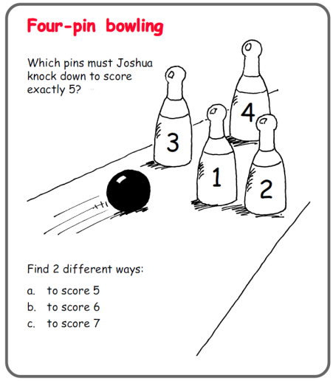
CPA approach
Procedural Variation
Conceptual Variation
‘Intelligent’ practice
Pictorial (supports concepts & mental)
Could pupils draw a picture of the problem for their solutions?
Could pupils use a bar model and number line to show their calculation?
PRACTISE of any of this as needed
Addition/ subtraction
Deep understanding/
mastery
Concrete
(Supports concepts & mental)
Have pupils played a game of skittles?
Can pupils count out objects to match each of the numbers?
Can pupils use concrete objects to model each calculation/solution?
Can they use a bead string, numicon to show the calculation as well as single counting objects?
PRACTISE of any of this as needed
Abstract
(decide mental /formal)
Record solutions using a number sentence (PRACTISE)

Slide 25


Slide 26
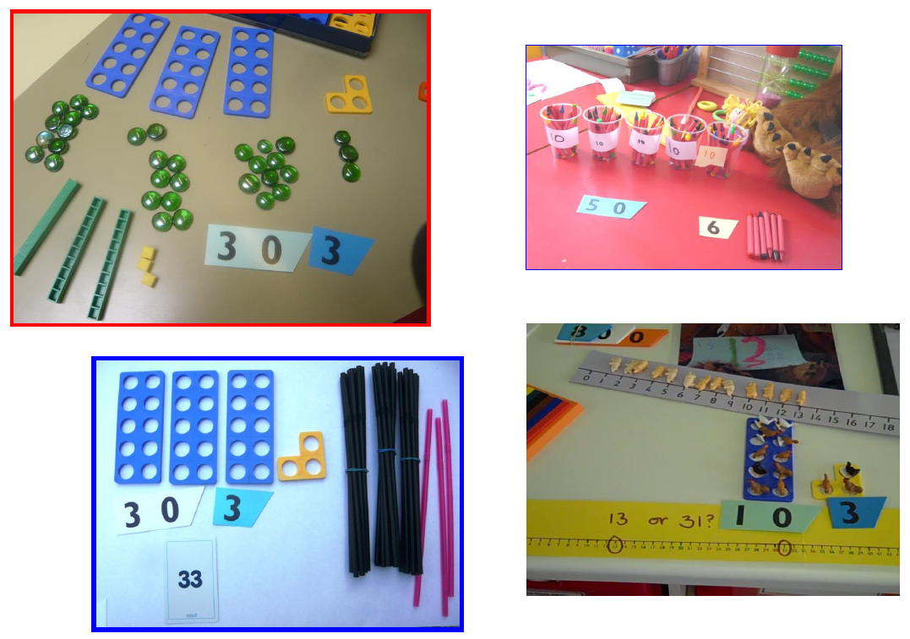
Essential Concrete resources in Key Stage 1

Slide 27
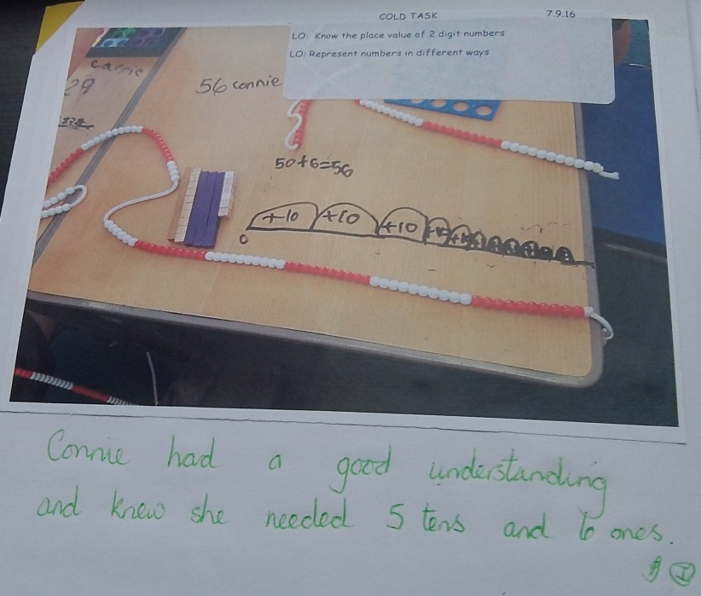
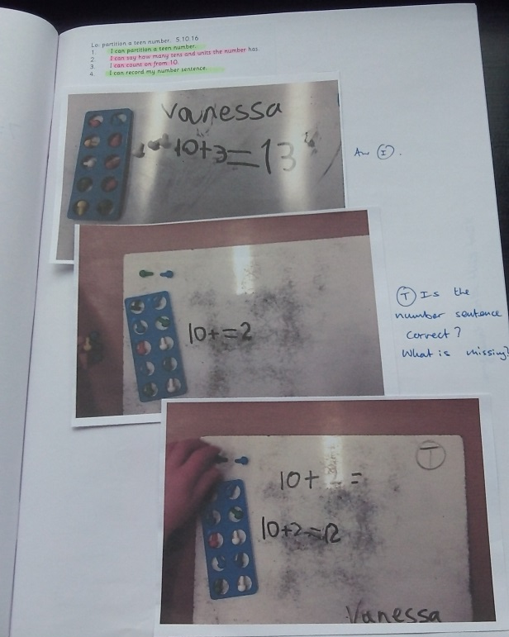
Concrete resources linked to recording
Alongside problem solving to support manipulation of ‘number’ as part of calculation in KS1 and KS2

Slide 28
Intelligent practice
In designing tasks/ exercises for practice the teacher
‘is advised to avoid mechanical repetition and to create an appropriate path for practising the thinking process with increasing creativity’
Gu 1991

Slide 29
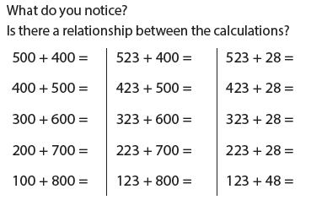
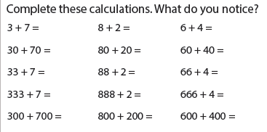


Intelligent practice

Slide 30






NCETM Teaching for Mastery
https://www.ncetm.org.uk/resources/46689

Slide 31
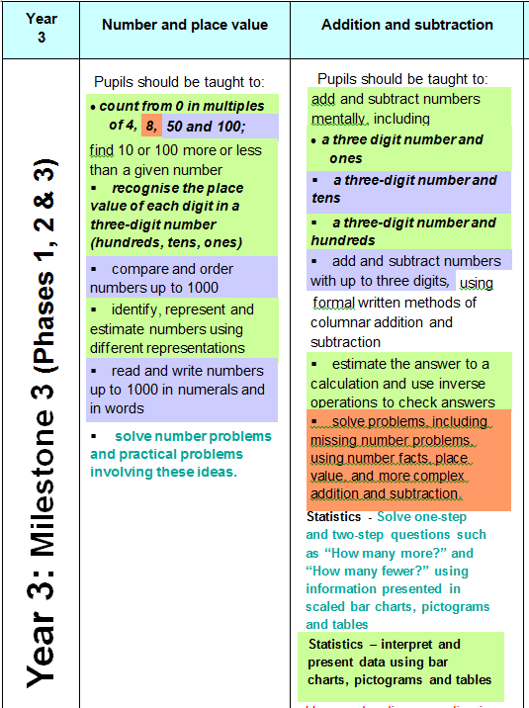
Plan to teach ‘addition and subtraction’ with number and place value….
Rather than using the assessment document as the teaching schedule.

Slide 32
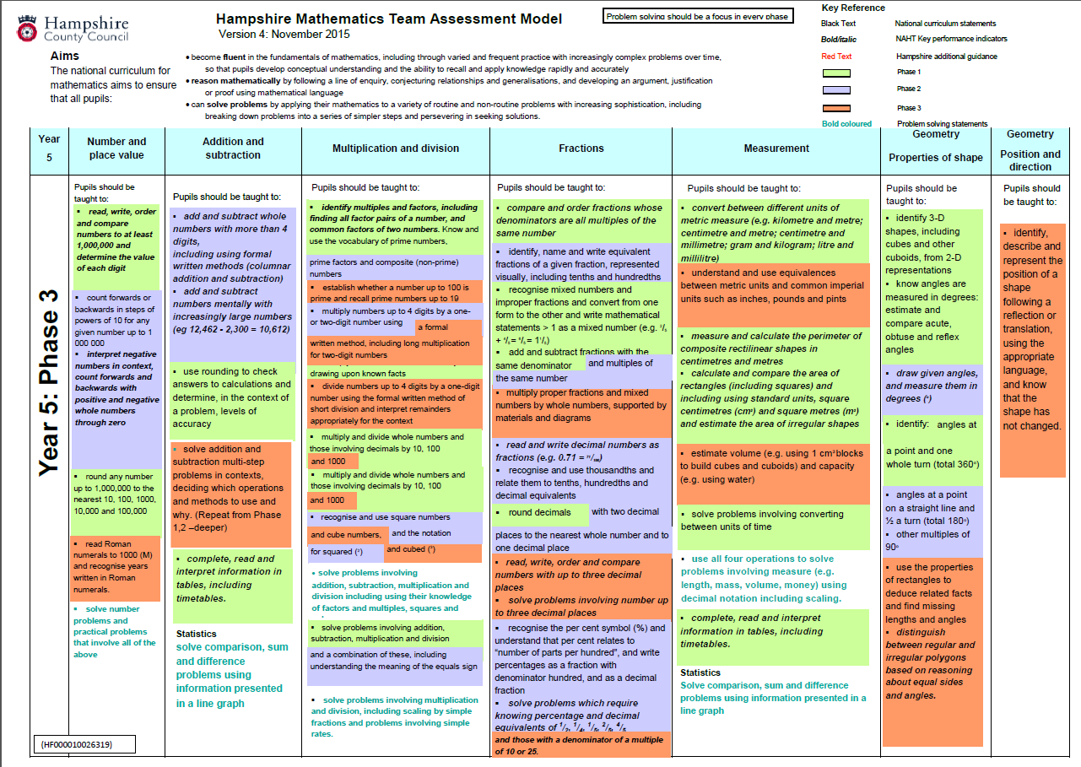
Notes:
Teacher assessments at end of phases should take into account how well pupils apply mathematics, particularly to ‘routine’ problems….
Phase 1 is about which pupils ‘apprentice’ year 5 mathematicians which implies they have ‘moved on’ from year 4 curriculum attainment but still need scaffolding for year 5 pitch- have all year to become a year 5 mathematician so all parts of the curriculum need developing all year.

Slide 33
Provision
Fluency, reasoning, problem solving…
Develop units of work from whole curriculum/domain: check secure attainment from previous year group(s). Visit all domains between Milestones.
Deepen learning work at ARE
Assessment: checking progress towards ARE…
End of year
ARE
Milestone 1
Milestone 2
Milestone 3
Y3
Year 4
Y5
Year 4
Whole curriculum
Stop and Look from M1: National curriculum Domains
National curriculum Domains
Stop and look from M2
Stop and look from M3

Slide 34
Myth
You have to teach all phase 1 and the pupils have to know all this by November, phase 2 by February etc…
Use/ select from all the curriculum statements in a domain through the year. The assessment documents are not the teaching schedule. The pupils have all year to develop secure understanding of the curriculum at that point

Slide 35
Myth
You must only use the year group’s curriculum all year.
Pupils need to build on from secure foundations towards expected attainment. Tracking back through previous year group curriculum is essential

Slide 36
Myth
NC statements can be acquired and understood within a lesson or two.
All NC statements describe end of year expectation. These need to be worked on across the year, coming back to them many times, making links within and across domains

Slide 37
Myth
Pupils should only be using formal written methods in key stage 2
Pupils need to acquire all the knowledge, skills and concepts in Y3, Y4, Y5 and Y6 by the end of key stage 2. Formal methods need to be part of the repertoire all pupils have for calculation where it is appropriate. Models and images, jottings based on mathematical models support the high standards expected with mental strategies by the end of key stage 2. Pupils are expected to decide which is the most appropriate strategy when calculating and to have a sense of a reasonable answer. Relates to ‘fluency’ and ‘reasoning’.

Slide 38
Remember
When planning If you select a learning objective from eg year 4 you are by default implying that previous curriculum knowledge is secure. The curriculum document is accumulative.
Task design, assessment tasks, teacher annotations, pupil recording with multiple representations can all illustrate that pupil has secured and retained previous expectations.

Slide 39
‘Securely on track to meet end of year expectations’
Is there sufficient work in all domains? (This doesn’t mean same amount of time in all domains)
Has the pupil shown sufficient independence in their reasoning for this point in the year – this might be following some scaffolded/ supported/ guided work.
Is there sufficient problem solving? What is the quality of this – appropriate pitch/ complexity?
Is the pupil showing conceptual and procedural understanding? (models and images linked to concrete resources)
Does this pupil seem to have secured previous year group curriculum through the level of tasks they are currently engaging in?

