Slide 1
Agenda
Overview of principles
Break
HAM in action:
mathematics
Lunch
HAM in action: English
What we learned: Case study
Break
On tracking
Plenary

Slide 2
Excellence and Equity
Hampshire Assessment Model
Overview
eric.halton@hants.gov.uk

Slide 3
Some ideas to help us think (differently)
Implications of Life without Levels are philosophical, cultural and practical
Re-modelling of National curriculum predicated on “mastery” for all pupils (not all the same but all gain secure learning)
“Extension” (more things on the same topic) not “acceleration” (rapidly moving on to new content)
Secure (Total) fit not best fit
ONE model but hard thinking required to interpret in school and classroom context: variation inevitable
The intention of the national curriculum is to secure the aims of each subject…..

Slide 4
Mathematics NC Aims
The national curriculum for mathematics aims to ensure that all pupils:
become fluent in the fundamentals of mathematics, including through varied and frequent practice with increasingly complex problems over time, so that pupils develop conceptual understanding and the ability to recall and apply knowledge rapidly and accurately.
reason mathematically by following a line of enquiry, conjecturing relationships and generalisations, and developing an argument, justification or proof using mathematical language
can solve problems by applying their mathematics to a variety of routine and non-routine problems with increasing sophistication, including breaking down problems into a series of simpler steps and persevering in seeking solutions.

Slide 5
English NC Aims
fluency – clarity – accuracy - coherence
The national curriculum for English aims to ensure that all pupils:
read easily, fluently and with good understanding
develop the habit of reading widely and often, for both pleasure and information
acquire a wide vocabulary, an understanding of grammar and knowledge of linguistic conventions for reading, writing and spoken language
appreciate our rich and varied literary heritage
write clearly, accurately and coherently, adapting their language and style in and for a range of contexts, purposes and audiences
use discussion in order to learn; they should be able to elaborate and explain clearly their understanding and ideas
are competent in the arts of speaking and listening, making formal presentations, demonstrating to others and participating in debate.

Slide 6
The purpose of assessment data
The fundamental question for teachers and school leaders to consider in evaluating systems for collecting and reporting assessment data is what purposes the data is intended to support.
Final report of the Commission on Assessment without levels 2015
Formative assessment
In-school summative assessment
….. is intended to inform teaching and learning. There is no intrinsic value in recording formative assessment; what matters is that it is acted on.
..to evaluate pupils’ learning and progress at the end of a period of teaching. (so..)
  what uses the assessments are intended to support,
  what the quality of the assessment information will be,
  how much time it would take teachers to record the information, and
  how frequently it is appropriate to collect and report it.

Slide 7
Ten Hampshire Assessment Model principles
Equity & Enrichment
Mastery Matters
A.C.T. Together
Formative First
Responsive Teaching
Secure Learning Pathways
Agile Feedback
Summative Tracking
Pace not Race
Moderated Expectations
Notes:
7 mins
Mastery learning’ is a specific approach in which learning is broken down into discrete units and presented in logical order.
After undertaking these corrective activities (or alternative enrichment or extension activities for those who have already achieved mastery), pupils retake a parallel assessment.
The new national Curriculum is premised on this idea of mastery..
Deep, secure learning for all
Extension of “able” students (more things on the same topic) rather than acceleration (rapidly moving on to new content)

Slide 8
“Mastery” for “all” means….?
This will be evident in students’ capacity to apply their knowledge, skills and understanding with (sufficient):
  Fluency over time
  Independence
  Resilience to deal with complexity and new contexts
What might this
mean in different subjects?
Mastery Matters
Notes:
2 min

Slide 9
Final report of the Commission on Assessment without Levels (Sept ’15)
‘Mastery learning’ is a specific approach in which learning is broken down into discrete units and presented in logical order.
Pupils are required to:
  demonstrate mastery of the learning from each unit before being allowed to move on to the next,
  with the assumption that all pupils will achieve this level of mastery if they are appropriately supported.
  Some may take longer and need more help, but all will get there in the end.
Assessment is built into this process.
  Following high-quality instruction,
  pupils undertake formative assessment that shows what they have learned well and what they still need to work on,
  and identifies specific ‘corrective’ activities to help them do this.
Mastery Matters

Slide 10
Mastery learning
The Hampshire model expects that children will deepen their grasp of key ideas, over time, rather than move on and leave gaps behind. Progress is neither linear nor skinny
Through being well taught and given curriculum opportunities they will develop and demonstrate their resourcefulness and versatility, (in an age appropriate way)
This does not mean that all pupils achieve the same degree of mastery… but it is at least sufficient, so that they can make successful progress through the fundamental ideas. No one left behind
Agile Feedback

Slide 11
Mastery and the link to statutory tests and assessments
What stops a pupil from achieving ARE in a test or moderated teacher assessment?
  Not sufficiently fluent?
  Not sufficiently independent?
  Not sufficiently resourceful and resilient?
  ….in all the subject curriculum as experienced by each child
Task design is key – children that were capable of demonstrating the skill required, had not been able to because the classroom tasks they had been undertaking did not require them to.
Implication about changes to the role of a teacher as the year progresses
  Instructor
  Coach
  Facilitator?
Secure Learning Pathways

Slide 12
Re-imagining Differentiation
Differentiates, not by a teacher’s notion of “ability”, but through the teacher’s insights into the way each learner is “seeing” the learning intention of the task.
This derives from more assessment alongside pupils, not just of them, and draws on deep subject knowledge, including knowing where to anticipate and how to provoke, misconceptions
Finding the right, “different”, ways to get them all to a sufficiently secure point.
Formative First

Slide 13
Redefining Learning Objectives?
Differentiating for variation, not ability means:
  Barriers to learning are most likely in areas that teachers find it difficult to appreciate may be problems: learners who don’t have problems seeing it like the teacher are seen as able and those who do are seen as less able... rather than having a less complete picture
  In lesson planning, less attention to the overall learning objective (an outcome) and more forensic focus on what the child/group need to know, do, understand in order to build their success, overcome a barrier/gap towards the long term objective.
  Thorough consideration in planning the object of learning is the most important focus e.g. where to start is fundamental.. The point of departure and a firm grasp of the whole area
Formative First

Slide 14


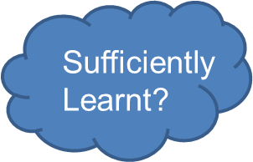
A working model for
“Masterly Learning”?
Yes
enrich
Unit of learning and objectives
Next unit of learning and objectives
Sufficiently Learnt?
No
No
Correct
Responsive Teaching
Adapted from Bloom, 1971
Correct
Notes:
The expectation is that the majority of pupils will move through the programmes of study at broadly the same pace. However, decisions about when to progress should always be based on the security of pupils’ understanding and their readiness to progress to the next stage. Pupils who grasp concepts rapidly should be challenged through being offered rich and sophisticated problems before any acceleration through new content. Those who are not sufficiently fluent with earlier material should consolidate their understanding, including through additional practice, before moving on.
Bloom, B. S. (1971a). Mastery learning. In J. H. Block (Ed.), Mastery learning: Theory and practice (pp.
4 7–63). New York: Holt, Rinehart & Winston.
Bloom, B. S. (1971b). Individual differences in school achievement: A vanishing point? Bloomington, IN:
Phi Delta Kappan International.
Bloom, B. S. (1974 ). An introduction to mastery learning theory. In J. H. Block (Ed.), Schools, society and
mastery learning (pp. 3–14 ). New York: Holt, Rinehart & Winston.

Slide 15
Precise learning model
Precision in defining what pupils need to learn.
Precision in defining what must be taught.
Identifying key moments in lessons where this precise knowledge should be understood.
Checking that all understand.
Dealing with the spread.
Creating regular opportunities for pupils to apply the understood knowledge; to use meaningfully
A.C.T. Together
Notes:
This is a model of planning and teaching that has developed over the last three years amongst secondary science teachers, it has equal relevance to primary.
It is designed to help the teacher become crystal clear about what pupils need to understand and more importantly what the teacher has to teach them all.
In reality in science we often do this the other way round…we do often start with the interesting scientific problem…Blooms helps teachers visualise this

Slide 16
Enrichment not acceleration
The expectation is that the majority of pupils will move through the programmes of study at broadly the same pace. However, decisions about when to progress should always be based on the security of pupils’ understanding and their readiness to progress to the next stage.
Pupils who grasp concepts rapidly should be challenged through being offered rich and sophisticated problems before any acceleration through new content.
Those who are not sufficiently fluent with earlier material should consolidate their understanding, including through additional practice, before moving on.
Pace not Race

Slide 17
A word or two about higher attaining pupils
We should be aiming to show that our higher attaining pupils are making good progress (from their starting points) through:
Tasks with challenge their thinking and skills, expecting more Fluency, Independence and Resourcefulness in less familiar contexts
These expectations should be reflected in the task design and the specific success criteria even if the class are working from a common overall curriculum statement
Their books should demonstrate that they are being given tasks and feedback that stretches their application of knowledge, skills and their understanding
Overtime, all those pupils who started the key stage “Beyond” their peer group, should be showing secure evidence of achievement that is “deeper within” e.g. still beyond. The % beyond should remain % beyond.
However, individual higher attaining pupils who demonstrate gaps in their understanding should have these addressed before they move on with the challenges planned for their peers
Equity & Enrichment

Slide 18
Pupils where ARE is highly unlikely to be achieved (SEND)
Clarity around learning intentions
Lessen the cognitive load to focus on the object of learning
Slow down – teach less but teach it well
This means that what “Below” pupils do achieve they achieve more deeply by working through the learning hierarchy, over an appropriate time scale
They may not learn everything but what they do learn they learn well
SEND tracking and curriculum planning tools available
Pace not Race

Slide 19
Skills Acquisition in the Dreyfus Model
The layers of proficiency over time:
‘Concrete experience is necessary and sufficient for proficiency’
Apprentice – Has a working understanding, tends to see actions as a series of steps, can complete simpler tasks without supervision
‘Applying with support’
Competent – Has a good working and background understanding, sees actions at least partly in context, able to complete work independently to a standard that is acceptable though it may lack refinement
‘Applying in independent work with some inconsistency in familiar contexts’
Expert – Has an authoritative, deep and holistic understanding, can achieve to a high standard routinely and deals with matters intuitively
‘Give reasons and make conscious and consistent decisions about the choices made in unfamiliar contexts’
ARE - Children need to be ‘secure’ at ‘Expert’ in order to achieve ARE
Secure Learning Pathways
Acknowledgements: Dreyfus, S.E.Dreyfus, H.L. (February 1980). ‘A five-Stage Model of the Mental Activities Involved in Directed Skill Acquisition’
Notes:
This is what you’d expect learning behaviours to look like
Strap lines
Apprentice – ‘Beginning to do it with the master’ ‘I’m learning to do it’
Competent - Trialling and testing the things they’ve learnt in a context with varying degrees of success
Expert – Can apply in unfamiliar context
Beyond - Versatility and creativity – can apply in unfamiliar territory the sky is the limit

Slide 20
The mastery learning journey
Learners are dependent
Teacher instructs
Secure Learning Pathways
Learners are responsible
Teacher guides
Level of Support
Learners are resourceful
Teacher facilitates
Precise learning objectives are used to ensure focus is clear
Learners are creative
Teacher consults
Academic year
‘A MODEL’ – The journey to Mastering EOY expectations
Building independence and resilience, by removing the scaffolding over time
Apprentice
Competent
Expert

Slide 21
Four practical strategies
Construct a mastery learning journey through every unit
Use assessment continuously (formative), stop and check (summative) periodically
In each teaching session, be precise about what is essential that the children learn (sufficiently) and organise/differentiate for that
Stretch pupils’ thinking by “going deeper” not further on
Agile Feedback

Slide 22
Ten Hampshire Assessment Model principles to challenge & refine practice
Equity & Enrichment
Mastery Matters
A.C.T. Together
Formative First
Responsive Teaching
Secure Learning Pathways
Agile Feedback
Summative Tracking
Pace not Race
Moderated Expectations
Notes:
7 mins
Mastery learning’ is a specific approach in which learning is broken down into discrete units and presented in logical order.
After undertaking these corrective activities (or alternative enrichment or extension activities for those who have already achieved mastery), pupils retake a parallel assessment.
The new national Curriculum is premised on this idea of mastery..
Deep, secure learning for all
Extension of “able” students (more things on the same topic) rather than acceleration (rapidly moving on to new content)

Slide 23
Are they on track?
Summative assessment
Summative Tracking
Moderated Expectations

Slide 24
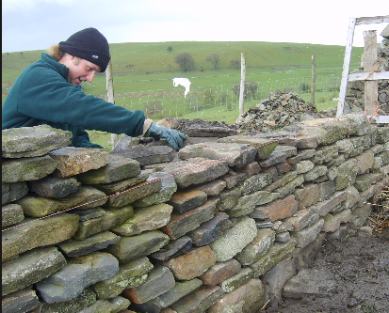
Based on the idea of a wall…
..to evaluate pupils’ learning and progress at the end of a period of teaching.
what uses are the assessments intended to support?
what will the quality of the assessment information will be?
how much time it will it take teachers to record the information? And
how frequently it is appropriate to collect and report it?

Slide 25
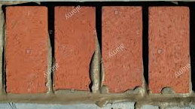
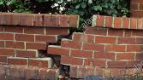
Building towards
End of Year attainment
In education, we often assess someone who achieves 80% in a test as successful
If you were building a wall, would you build the second layer if 80% of the mortar
in the first layer was set and secure ? Or 80% of the bricks were in place?
Would you view that as a sustainable success?
What happens later?

Slide 26



End of year assessment
Secure in all domains and maybe beyond in some.
Needs to explore things in greater depth
MET or EXCEEDED ARE
Secure in most domains.
Some links and relationships and a secure structure is in place
Gaps are small .
Needs to explore and fill gaps
MET ARE
Use your professional judgement
Secure in some domains.
Most links and relationships yet to be made
Gaps are too wide for stability.
Needs to see things differently to cement the ideas together
CLOSE TO ARE (but not yet met)

Slide 27


End of year assessment
Secure in some domains but weak structurally.
Gaps are systemic and performance is inconsistent.
Early pre-teaching interventions needed at start of year
Needs a different approach
NOT MET ARE
Use your professional judgement
Has attended your lessons and experienced each bit
Little comprehension and unable to apply
Needs a different approach
WELL BELOW ARE

Slide 28
Domain Bricks: Building the wall
Maths | Reading | Writing
Number and place value | Word Reading | Transcription
Addition and subtraction | Themes and Conventions | Handwriting
Multiplication and division | Comprehension- Clarify | Composition: Composition and Effect
Fractions (including decimals) | Comprehension- Monitor and Summarise | Composition: Text Structure and Organisation
Measurement | Comprehension- Select and Retrieve | Composition: Sentence Structure
Geometry: properties of shape, position & direction | Comprehension- Respond and Explain | Vocabulary, grammar, & punct.
 | Inference
 | Language for Effect
Used for summative assessment and secure fit

Slide 29
Recursive and interconnected curriculum
The English ‘Melting Pot’
Maths interconnections
Texts act as the drivers
Problem solving at the heart of every lesson
Writing
Parts are interlinked and merge towards final outcomes
Spoken language
Reading
Sense of number
Measurement
Concrete models
Visual images and jottings
Problem solving heuristics
Parts are interlinked and merge towards final outcomes
Geometry
GPaS
Formal notation

Slide 30
Hampshire Assessment Model- a recursive approach to summative assessment
September to November |  | November to February | February to April | Summer Term
 |  |  | Phase 3 sufficiently secured (APPRENTICE) | Phase 3 (COMPETENT/EXPERT)
 |  | Phase 2 sufficiently secured (APPRENTICE) | Phase 2 (COMPETENT/EXPERT) | Evidence of: Fluency? Independence? Resilience?
Phase 1 sufficiently secured (APPRENTICE) |  | Phase 1 (COMPETENT/EXPERT)
Previous Yr Group objectives secured
Notes:
Recap on the journey of the year – there should have been regular opportunities for children to show their expertise throughout the year.

Slide 31
Learners are dependent
Teacher instructs
Learners are responsible
Teacher guides
Level of Support
Learners are resourceful
Teacher facilitates
Learners are creative
Teacher consults
Academic year
Apprentice
Competent
Expert
28. Secure Learning Pathways
Apprentice
Competent
Expert
Competent / Expert
Apprentice
Milestone 1 M2 M3 EOY
Notes:
The introduction of the different phase objectives over the year means that the role of the teacher has to change and is multi-layered. The phased objectives are represented by the different coloured triangles and show how by milestone 3 the teacher is assessing children’s skills at three different depths.
As the role of the teacher changes so the design of the task is critical, especially as the year progresses and Phase 2 and Phase 3 objectives are overlaid.

Slide 32
Hampshire Model: Manageable Phases
It is not a curriculum model: a common misinterpretation

Slide 33
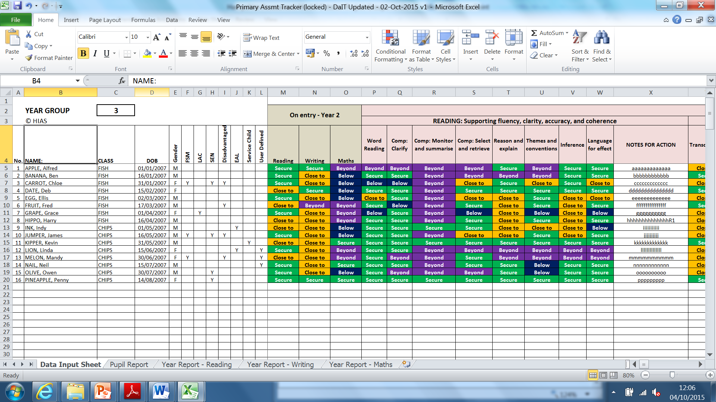
Simple HIAS tracker

Slide 34

Close to?
If pupils are getting there, but not quite there yet…
In the Hampshire Model this means:
  As a result on QFT and planned interventions this pupil will both catch up what’s missing and keep up with progress made by the pupils who were secure at the same time
  This will happen before the next milestone assessment
  100m + 100m = 200m
  80m + 120m = 200m

Slide 35
Finally,
Excellence and Equity is about…
Insightful understanding of the pupil
“Mastery” expectations that all secure ARE (e.g. to do what it takes)
Secure knowledge of the subject “standards”
Progress

